Slide 1
Power BI Project – Sales Data Analysis
Name : Gowthaman.s
Branch : March 2025
Date : 11.06.2025

Slide 2
What is this Project?
This project uses Power BI to understand and analyze sales data.
We clean the data, calculate key values, and create a dashboard to see trends and insights.

Slide 3
About the Data
Dataset: Sales Dataset – Online Shop
Source: Kaggle
Details:
- Online sales from a UK store
- Includes products, prices, dates, and customer info

Slide 4
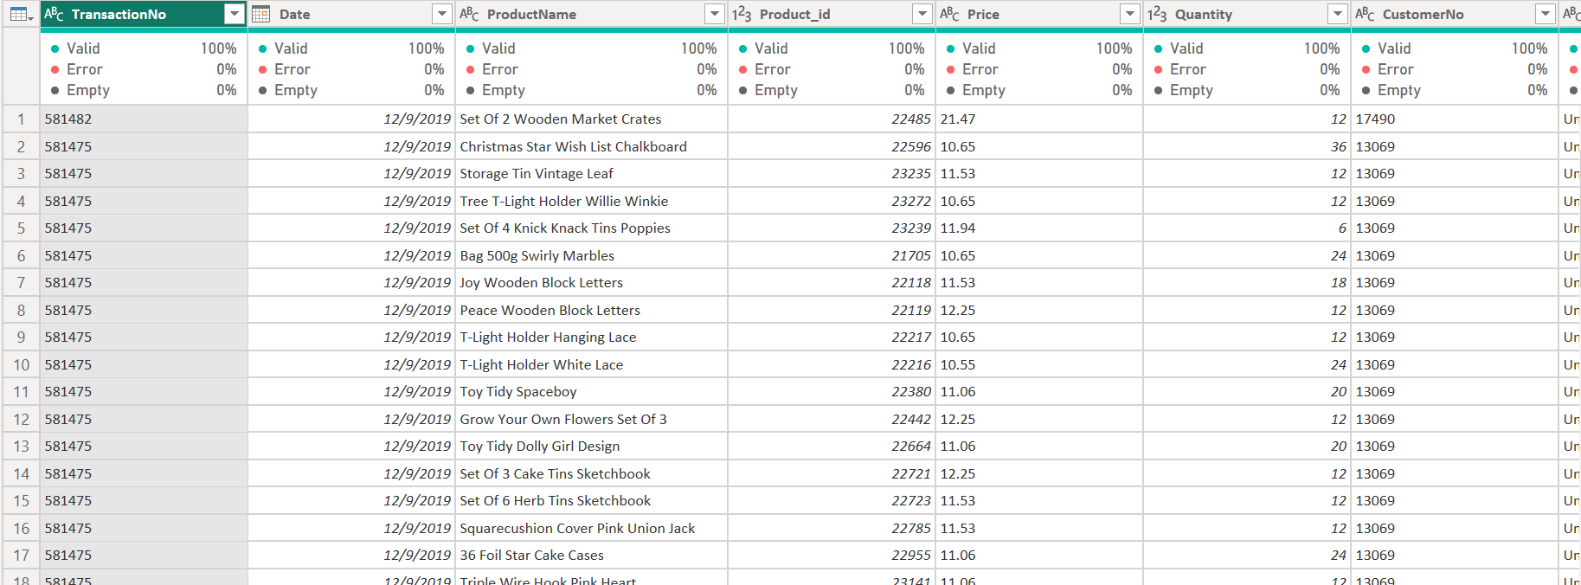
Cleaning the Data
- Removed duplicate rows
- Handled missing values
- Fixed data types (e.g., numbers, dates)
- Split and merged columns when needed

Slide 5
DAX Formulas Used
- Total Sales = SUM(Sales Amount)
- Unique Customers = DISTINCTCOUNT(Customer No)
- UK Sales = CALCULATE(Total Sales, Country = "UK")
- Sales Last Month = CALCULATE(Total Sales, DATEADD(Date, -1, MONTH))
- Sales % of Total = DIVIDE(Total Sales, All Sales)
- Quantity Segment = IF(Quantity > 10, "High", "Low")
- Unique Products = DISTINCTCOUNT(ProductName)

Slide 6
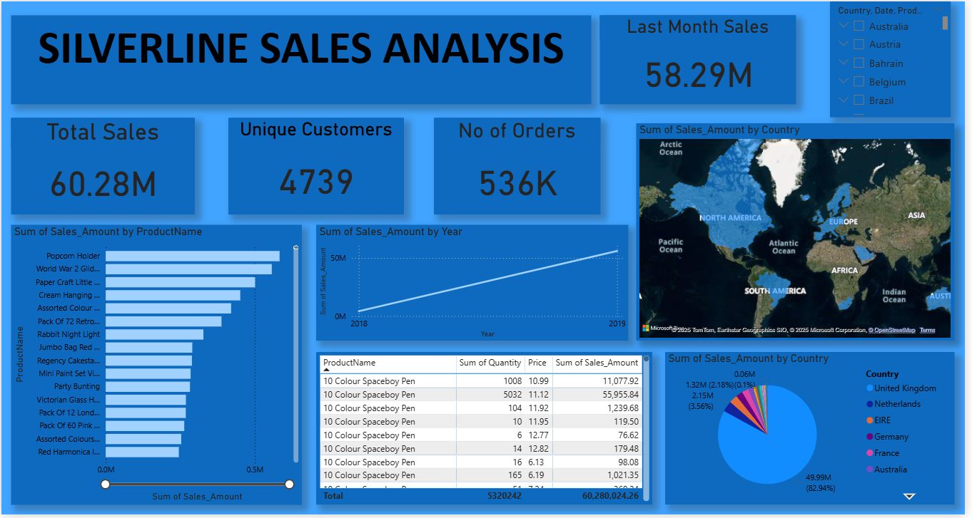
Dashboard Overview:

Slide 7
Key Insights:
1.Total Sales:
₹60,280,024.26 worth of sales recorded.
2.Transaction Volume:
23,204 unique transactions.
3.Top 5 Countries by Sales Volume:
🇬🇧 United Kingdom: 485,095 transactions
🇩🇪 Germany: 10,675
🇫🇷 France: 10,526
🇮🇪 Ireland (EIRE): 8,048
🇧🇪 Belgium: 2,539
4.Sales Trend (Monthly):
Sales were steady with spikes in March and December:
Dec 2018: ₹4.23M
Mar 2019: ₹4.35M
Consistent growth till April 2019

Slide 8
Conclusions:
- United Kingdom dominates sales activity, both in volume and revenue.
Seasonal spikes in December and March suggest promotional or festive shopping trends.
A few niche gift products (like Popcorn Holders and Birdie Crafts) drive a significant portion of total revenue.
Strong sales potential exists in other European countries, especially Germany and France—consider targeted marketing.

