Slide 1
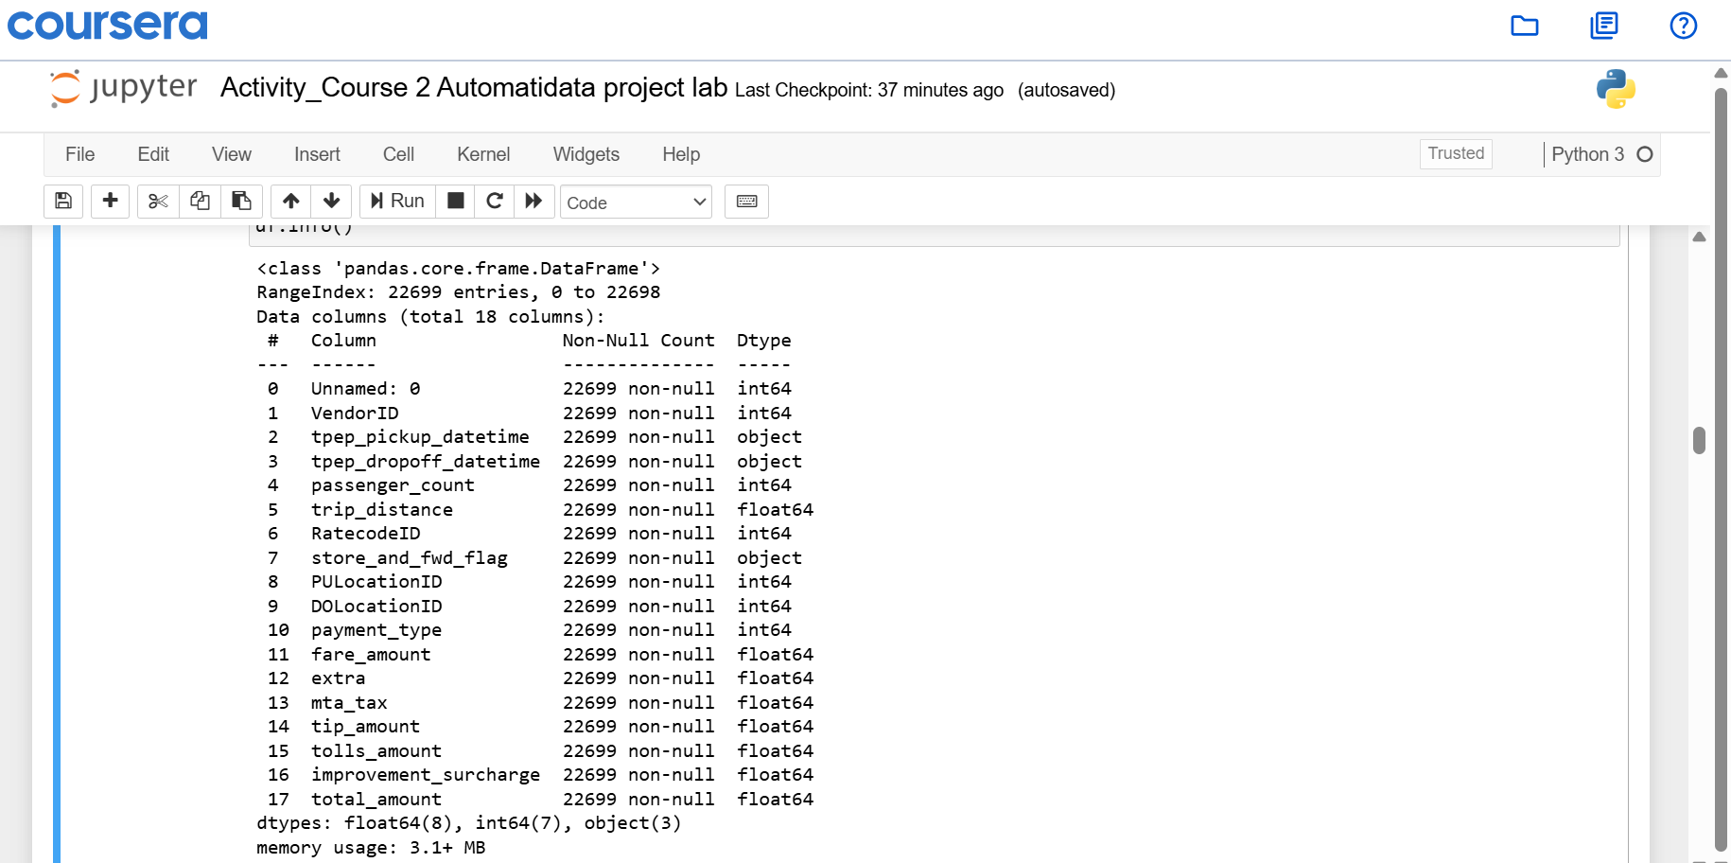
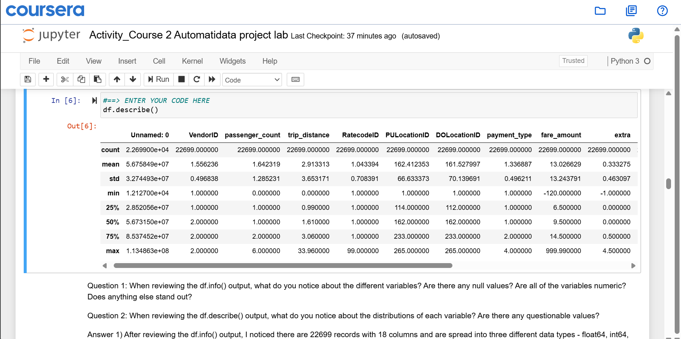
New York City Taxi Fare Prediction Project | Data Discovery
Executive Summary prepared for Automatidata Team
New York City Taxi and Limousine Commission (TLC) is the agency responsible for licensing and regulating New York City’s taxi cabs and for-hire vehicles. A Machine Learning Regression Model will predict the fare amount before any ride is booked.
Since 1971, TLC has been regulating and overseeing the licensing of New York City’s taxi cabs, for hire-vehicles, commuter vans, and paratransit vehicle. It is TLC responsibility to make the fare fair of all the riders
So to build a high precision Regression Model, first the data discovery is very important. Understanding the Dtypes, null value counts, and descriptive statistics will give a clear picture behind the data. Which can further be used for EDA.
The Dataset contains 22699 records and 18 variables. There are 3 three dtypes in the data – float with 8 records, int with 7 records, objects with 3 records. There are no null values in all the columns.
After looking at the Descriptive Statistics I found many unsual values like having negative values, and standard values are unusual.
I would say trip_distance and total_amount columns are the main labels that can be used in for training the regression model.
Image Alt-Text Here
Once the data team is free from the other project, we can deep dive into the data for EDA.
After having clean data, a regression model can be start trained on the data and iterate until it reaches max efficiency.

