Slide 1

UNIVERSITY OF NORTH TEXAS
Information Science PhD Research
UNT Bibliometrics
Research Project
Building an evidence-based bibliometric pipeline — from raw publication data to actionable institutional insights
Prepared by: Gowtham Venkat Eathamokkala — Information Science PhD Student, UNT
SQL Pipeline · Python Extraction · Power BI Dashboards

Slide 2




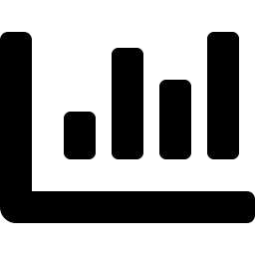

AGENDA
What we'll walk through today
1. Project overview & motivation
2. Three-phase architecture
Why this research matters
Collection, cleansing, and insight generation
3. Phase 1 — Data collection
4. Phase 2 — Cleansing & audit
Python pipelines: OpenAlex API + UNT Faculty Directory
Data quality findings and how they were resolved
5. Phase 3 — Power BI dashboards
6. Limitations & next steps
Four interactive dashboards built from the cleaned data
Honest methodology notes and what comes next
UNT Bibliometrics Research
2

Slide 3

SECTION 01
Why this project?
I focused on UNT-specific research trends because UNT acts as a major hub for open-access publishing and digital scholarship. I have extracted the raw data from Open Alex. This project was built to Quantify Impact and emerging trends in diverse domains
Project snapshot
52,039
Research works collected
359,947
The research questions
Author affiliation records
How much does UNT publish, and how is that changing over time?
What share of UNT's output is openly accessible?
Which research domains and departments lead in output and impact?
How does UNT collaborate with external institutions?
141,611
Topic classification rows
1,889
UNT faculty profiles
UNT Bibliometrics Research
3

Slide 4

SECTION 02
Three-phase project architecture
Each phase produces a clean deliverable that feeds directly into the next
PHASE 1
PHASE 2
PHASE 3
Data Collection
Cleansing & EDA
Insights & Dashboards
>
>
Python pipelines extract raw publication and faculty data into SQL Server staging tables
T-SQL transforms raw data into trustworthy, analysis-ready records with full audit trail
Power BI dashboards surface findings for UNT Collections Assessment stakeholders
4 staging tables
10 analytical views
4 dashboards
555,000+ rows
Audit complete
6 metric families
UNT Bibliometrics Research
4

Slide 5
PHASE 1A
OpenAlex publication data extractor
Python · OpenAlex REST API · Microsoft SQL Server
OpenAlex is a free, open catalog of 200M+ research publications worldwide. Python Script connects via API, filters to UNT's institution ID (I123534392) and publication year ≥ 2000, then loads structured records into SQL Server.
1
2
3
4
5
Authenticate
>
Filter
>
Paginate
>
Parse
>
Insert
Free API key, sent with every request
institutions.id = UNT AND year ≥ 2000
Cursor-based, 200 records/page
Flatten venue, authors, topics, OA status
Idempotent batch insert into MSSQL
Three staging tables created
stg_openalex_works
52,039 rows
One row per publication
stg_openalex_authors
359,947 rows
One row per author-institution pair
stg_openalex_topics
141,611 rows
Domain → field → subfield → topic
UNT Bibliometrics Research
Phase 1A
5

Slide 6




PHASE 1A
Engineering decisions that matter
Exponential backoff retry
Cursor-based pagination
On server errors, wait 2s → 4s → 8s → 16s → 32s before giving up — prevents crashes from temporary outages
Uses OpenAlex's next_cursor bookmark rather than offset pagination — reliable across 50,000+ records
Idempotent inserts
Selective field fetching
IF NOT EXISTS on work_id means the script can be safely re-run without creating duplicates
The select= parameter limits responses to 14 needed fields — faster extraction, lower API credit usage
Packages used: requests · pyodbc · json · time · logging · datetime
UNT Bibliometrics Research
Phase 1A
6

Slide 7

PHASE 1B
UNT Faculty Information System scraper
Python · BeautifulSoup · facultyinfo.unt.edu
UNT's Faculty Information System is a public compliance database (Texas Education Code §51.974). Since it has no single browsable list, scraper searches by department, collects profile links, then visits each profile individually.
1
2
3
4
5
Dept search
>
Collect links
>
Dedup check
>
Visit profile
>
Upsert
Search by ~40 UNT departments
BeautifulSoup finds profile URLs
Skip already-seen profile IDs
Extract name, title, dept, college
Update existing, insert new
Why UPSERT instead of insert-only?
Unlike publications — which are permanent once published — a faculty member's title or department can change. UPSERT logic keeps the table current on every re-run instead of silently leaving stale data in place.
stg_unt_faculty — 1,889 rows: profile_id, name, title, department, college, email
UNT Bibliometrics Research
Phase 1B
7

Slide 8

PHASE 1B
Why combine two data sources?
OpenAlex tells us what was published — the faculty directory tells us who they are at UNT
Question
OpenAlex alone
With faculty directory
Who published this paper?
Was this author at UNT?
Which department are they in?
Current faculty?
Department-level publication stats?
UNT Bibliometrics Research
Phase 1B
8

Slide 9
PHASE 2 — STAGE 0
Data audit
Before cleansing, I measured every table to know exactly where to focus effort
stg_openalex_works
stg_openalex_authors
52,039
359,947
8 exact dupes · 28 DOI dupes · 1,388 title dupes
14,425 null IDs · 27,147 null institutions · 31 missed UNT works
stg_openalex_topics
stg_unt_faculty
141,611
1,889
Clean — zero NULLs found anywhere
Clean — zero duplicate profiles
UNT Bibliometrics Research
Phase 2
9

Slide 10
PHASE 2 — CLEANSING
From findings to root causes
Each anomaly was investigated, not just counted
31 works with no UNT author
OpenAlex truncates authorship lists at 100 positions. These papers had 500+ authors — the UNT author was simply beyond our extraction window.
Resolved: confirmed genuinely UNT-affiliated
8 exact DOI + title duplicates
Same work appearing twice — 6 were preprint/published-version pairs, plus isolated OA-status and date differences.
Resolved: kept earlier publication record
28 DOI-only duplicates
Newline characters embedded in titles, truncated titles, and differing work_type across the same paper.
Resolved: normalized and deduplicated
1,388 title duplicates
A mix of legitimate same-titled works and true duplicates across preprints, articles, and book-chapters.
Resolved: pragmatic dedup, earlier date kept
UNT Bibliometrics Research
Phase 2
10

Slide 11
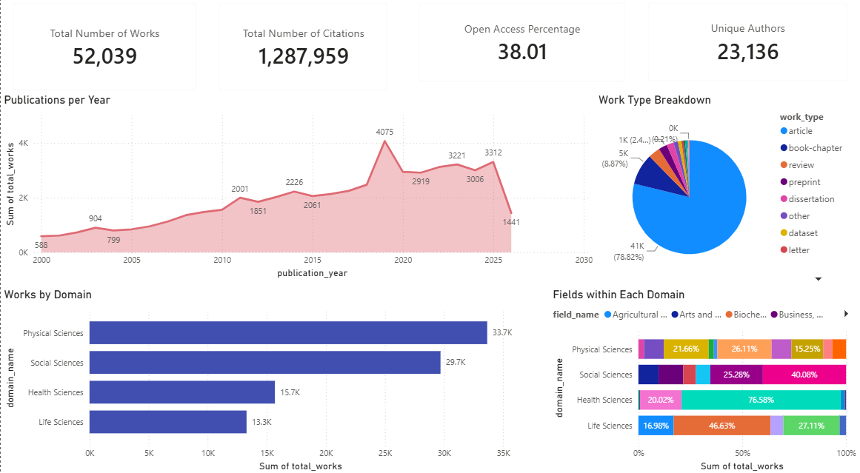
PHASE 3 — DASHBOARD 1 OF 4
Research overview
UNT Bibliometrics Research
Power BI Dashboard
11

Slide 12
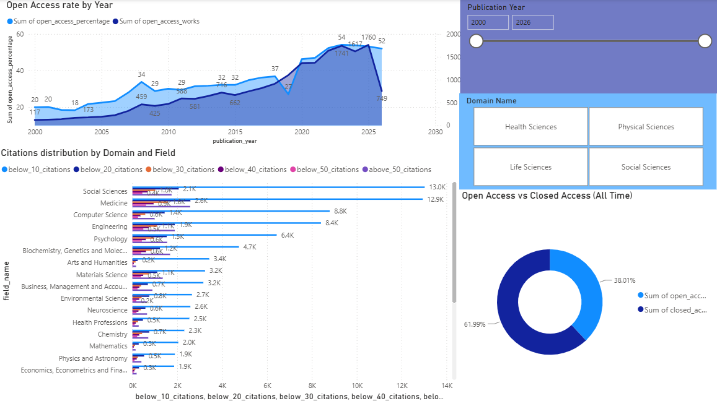
PHASE 3 — DASHBOARD 2 OF 4
Open access and citation impact
UNT Bibliometrics Research
Power BI Dashboard
12

Slide 13
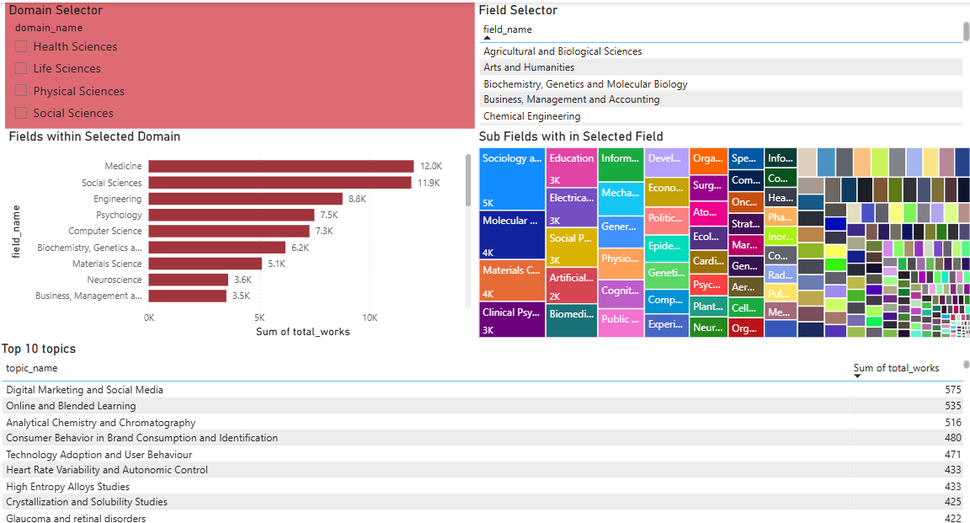
PHASE 3 — DASHBOARD 3 OF 4
Research topics deep dive
UNT Bibliometrics Research
Power BI Dashboard
13

Slide 14
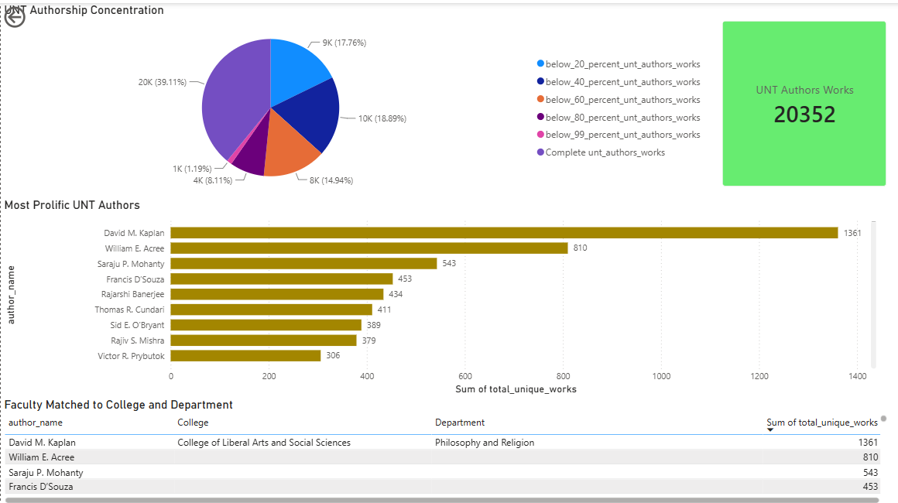
PHASE 3 — DASHBOARD 4 OF 4
Authors, faculty & collaboration
UNT Bibliometrics Research
Power BI Dashboard
14

Slide 15
METHODOLOGY
Known limitations — stated upfront
Transparency about data limitations is standard practice in rigorous bibliometric research
Alumni misattribution
Missing ORCIDs (34%)
OpenAlex may carry forward a researcher's past UNT affiliation onto papers published after they've moved on
Limits author disambiguation accuracy; topic and name-based matching fills part of the gap
Author position cap
Faculty directory coverage
OpenAlex truncates very large author lists — addressed for the 31 known cases, may recur elsewhere
1,889 of ~3,327 reported UNT faculty captured; department list can be expanded in a future pass
UNT Bibliometrics Research
15

Slide 16
Where the project go from here
Expand faculty directory coverage
Add departments to reach closer to the full ~3,327 faculty roster
Author ↔ faculty disambiguation
Build the bridge table using ORCID, topic overlap, and name matching
Quarterly refresh cadence
Re-run both pipelines on a schedule to keep dashboards current
Thank you
Gowtham Venkat Eathamokkala · Information Science PhD Student, University of North Texas

