Slide 1
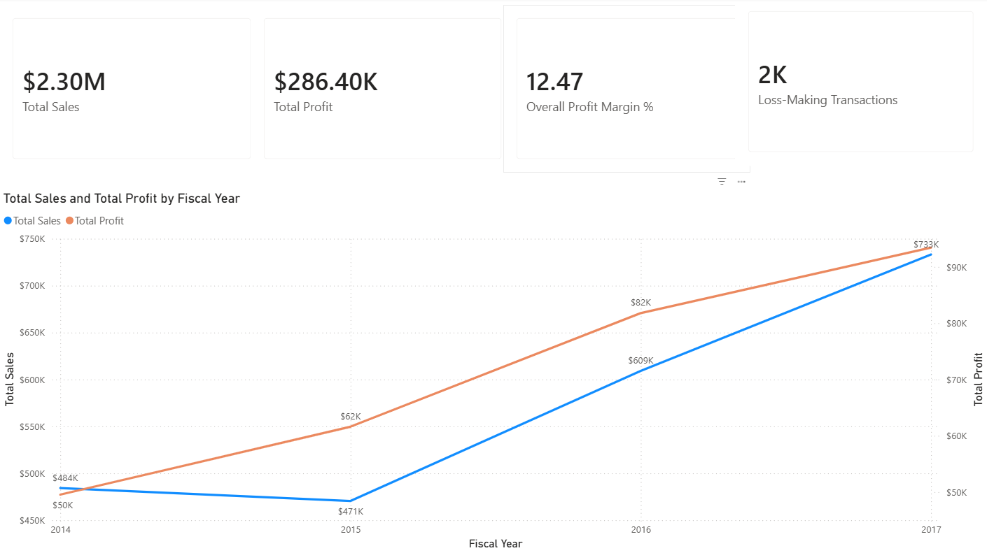
Revenue Growth Masks Profitability Crisis
FY2017 Analysis: Where Are We Losing Money?
Executive Summary:
• Revenue Growth 2014-2017: ($484K → $733K)
• Profit Growth 2014-2017: ($50K → $93K)
• Profit Margin: 12.47% (industry target: 18-20%)
• Loss-Making Transactions: 1,871 (18.7% of all sales)
The Problem:
Revenue is growing, but efficiency is declining. We're growing the wrong things.
We need to identify WHERE we're losing money and WHY.
Next: Let's look at the data...

Slide 2
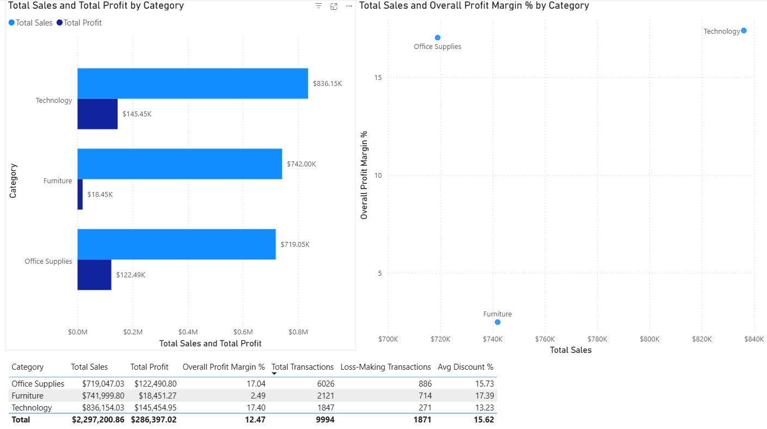
Which Product Categories Are Dragging Us Down?
Category Performance Breakdown:
Office Supplies (Growth Driver):
• Revenue: $719.05K
• Profit: $122.49K
• Margin: 17.04%
• Status: Stable but could improve
Technology (Our Strong Performer):
• Revenue: $836.15K
• Profit: $145.45K
• Margin: 17.40%
• Status: Strong performer, growing well
Furniture (THE PROBLEM):
• Revenue: $742K
• Profit: $18.45K
• Margin: 2.49%
• Status: We're barely breaking even on Furniture
• Loss Transactions: High percentage
• Root Cause: Heavy discounting on this category
Key Finding:
Furniture represents ~32% of revenue but only ~6% of
profit. Total Margin share is 2-3%.
It's dragging down overall margin.
Recommendation:
Either improve Furniture margins OR reduce volume in this category.

Slide 3
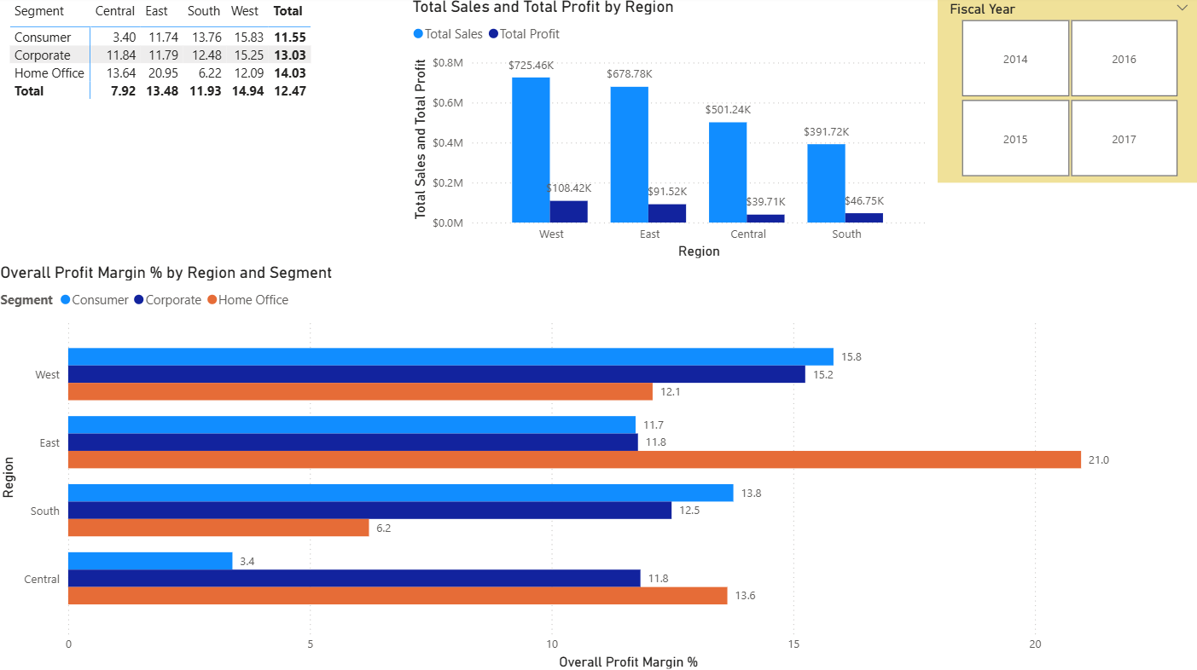
Geographic Performance
Regional Performance:
East Region (Strong):
• Margin: 13.48%
• Status: Solid, good margins
West Region:
• Margin: 14.94%
• Status: Best Performer, Fantastic margin
South Region:
• Margin: 11.93%
• Status: Good average
Central Region (PROBLEM):
• Margin: 7.92%
• Status: Underperforming
• Issue: High discounting, possibly
poor sales execution
Key Finding:
Central region pulls down
overall company margin by 2-3%.
Recommendation:
Investigate Central region: pricing strategy, sales incentives,
competitive dynamics. Benchmark against West region practices.

Slide 4
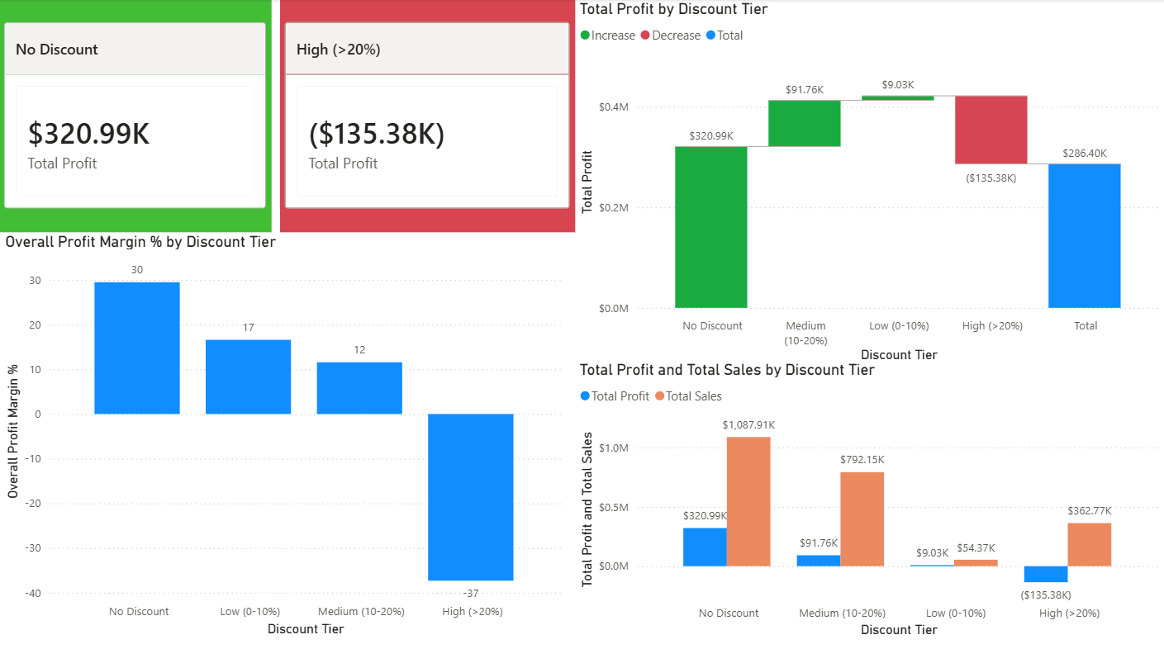
The Discount-Profitability Relationship:
No Discount Sales:
• Volume: ~4,800 transactions
• Revenue: $1,087K
• Profit: $320K
• Margin: 30%
• Status: Most profitable sales
Low Discount (0-10%):
• Volume: ~100 transactions
• Revenue: $54K
• Profit: $9K
• Margin: 17%
• Status: Still profitable
Medium Discount (10-20%):
• Volume: ~3,700 transactions
• Revenue: $792K
• Profit: $91K
• Margin: 12% (marginal)
• Status: Barely profitable
High Discount (>20%):
• Volume: ~1,400 transactions
• Revenue: $362K
• Profit: -$135K NEGATIVE
• Margin: -37% NEGATIVE
• Status: This segment is destroying shareholder value
DISCOUNT IMPACT
Every Discount >20% Destroys Profit
The Critical Finding:
We are LOSING $135,376 on high-discount sales.
These 1,400 transactions are profit killers.
The Opportunity:
If we shifted high-discount sales to a sustainable no discount 30% margin:
PROFIT OPPORTUNITY: +$242K
Why This Matters:
• Every discount deepens the margin cut
• High discounts destroy more profit than they generate in volume
• We're using discounts as a crutch, not a strategy

Slide 5
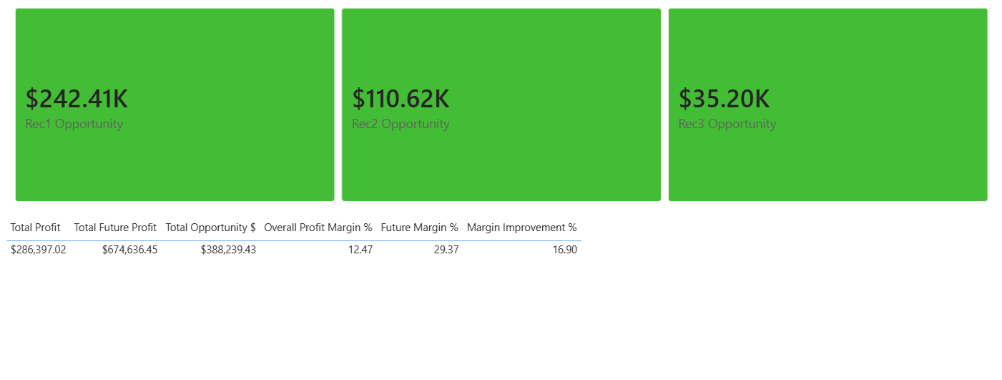
FY2018 Strategy: Restore Profitability
CURRENT STATE (FY2017):
├─ Total Revenue: $2.3M
├─ Total Profit: $286.4K
├─ Profit Margin: 12.47%
└─ Loss Transactions: 1,871
THREE SPECIFIC ACTIONS FOR FY2018:
ACTION 1: Limit High Discounts (>20%)
─────────────────────────────────────
Problem: $362.7K in high-discount sales are losing $135.3K
Target: Shift to sustainable 30% margin - no discount margin
Impact: +$242K PROFIT IMPROVEMENT
Implementation:
• Policy: No discounts above 15% (exceptions require VP approval)
• Sales Training: Teach value-based selling, not discount-based
• Incentives: Bonus for margin, not just volume
• Timeline: Immediate (Q1 FY2018)
Risk: May lose some price-sensitive customers (acceptable trade-off for profitability)
ACTION 2: Fix Furniture Category Margins
────────────────────────────────────────
Problem: Furniture = 32% of revenue, only 6% of profit (2-3% margin)
Target: Achieve Office Supplies margin (10%+)
Impact: +$110K PROFIT IMPROVEMENT
Implementation:
• Cost Review: Audit supplier contracts for Furniture
• SKU Rationalization: Eliminate low-margin SKUs
• Pricing Strategy: Less discounting, premium positioning for quality lines
• Category Mix: Shift toward higher-margin furniture styles
• Timeline: Q1-Q2 FY2018 (supplier negotiations)
ACTION 3: Improve Central Region Performance
─────────────────────────────────────────────
Problem: Central = 7.92% margin (vs West = 14.94%)
Target: Match West region best practices
Impact: +$35K PROFIT IMPROVEMENT
Implementation:
• Knowledge Transfer: Share West region practices with Central
• Sales Coaching: Improve negotiation skills to reduce discounting
• Territory Review: Realign accounts if needed
• Timeline: Q1-Q2 FY2018

Slide 6
Total Impact:
PROJECTED FY2018 RESULTS (If all 3 actions implemented):
├─ Total Revenue: $2.30M (Assuming unchanged - same customers, same volume)
├─ Total Profit: $674K(improvement: +$388K)
├─ Profit Margin: 29.37% (improvement: +16.90 percentage points)
THE BOTTOM LINE:
"We don't need to grow bigger. We need to get smarter about HOW we grow.
By eliminating unprofitable discounting, fixing Furniture margins, and learning
from our best regions, we can turn a 12% margin business into an 29% margin business.
That’s $388K additional profit with around ~$50K (training, consulting, systems)."

