Slide 1
Monitoring and spying software

Slide 2
CONTENTS Abstract EXISTING SYSTEM DRAWBACKS OF EXISTING SYSTEM PROPOSED SYSTEM ADVANTAGES OF THE PROPOSED SYSTEM MODULE DESCRIPTION DATABASE DESIGN SCREEN LAYOUT CONCLUSION `

Slide 3
Abstract
Our software offers the most monitoring controls and features of any monitoring software.
This computer monitoring software is simple to install and easy to use.
It lets you efficiently keep tabs on internet, email, chat, word processing and all activities that take place on monitored computers.
It offers comprehensive logs and reports for nearly every mouse click and keystroke typed on your monitored computer.
the frequency of screenshots, logging storage options, scheduled monitoring, computer lockdown, content filtering and blocking, keyword alerts and more.

Slide 4
Abstract cont..
Our software has two modes of operation.
In visible mode, an icon appears in the task bar of the computer so that users know the computer is being monitored.
In addition to that, our software also has a monitoring camera feature.
You can easily install this camera to monitor your office, to keep an eye on the pets at home .

Slide 5
EXISTING SYSTEM
The existing system uses manual listening through watching at the place where systems are located.
DRAWBACKS OF EXISTING SYSTEM:
Manual verification of all nodes for processes running.
Manual screen verification of all nodes for unwanted activities.
The process accessed could not be referred in future.
Time consumption is more in verification.

Slide 6
PROPOSED SYSTEM
The proposed system uses systematic listening through watching programmatically in systems by installing the application in all nodes.
ADVANTAGES OF THE PROPOSED SYSTEM:
Systematic verification of all nodes for processes running.
Systematic screen verification of all nodes for unwanted activities.
The process accessed could be referred in future.
Time consumption is less in verification.

Slide 7
MODULE DESCRIPTION
There are three types of modules using in monitoring and spying software
CLIENT APPLICATION
MONITORING APPLICATION
WEB APPLICATION

Slide 8
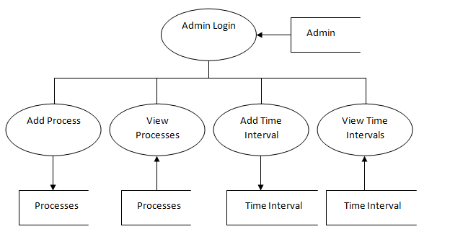
CLIENT APPLICATION
In this module, the process list is added in to ‘Process’ table which is going to be monitored.
In addition, the time interval setting is given in seconds that is saved in to ‘Time Interval’ .
The screen shot will be taken based on this interval.
DATA FLOW DIAGRAM

Slide 9
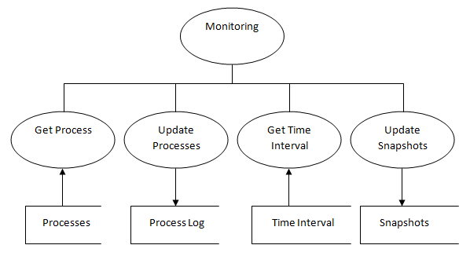
MONITORING APPLICATION
In this module, the process list is fetched from ‘Process’ table so that they are monitored and the processes if found to be run, then they are saved in to ‘Process Log’ table.
In addition, the time interval setting in seconds is fetched and snapshot is taken which is saved in to ‘Snapshots’ table.
DATA FLOW DIAGRAM

Slide 10
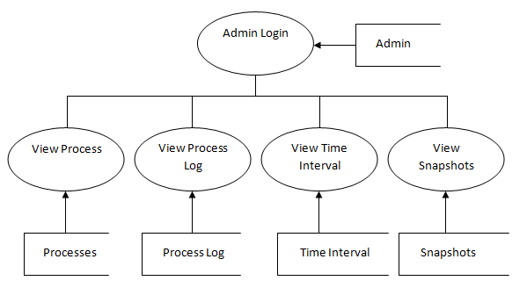
WEB APPLICATION
In this module, the administrator view the ‘Process’ and ‘Time Interval’ table records are viewed using grid view controls.
Likewise, the ‘Process Log’ and ‘Snapshot’ table records are viewed using grid view controls from web browser itself.
DATA FLOW DIAGRAM

Slide 11
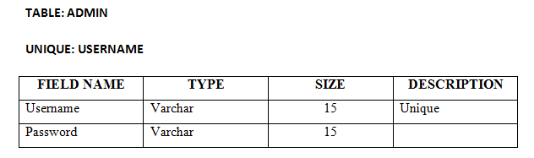
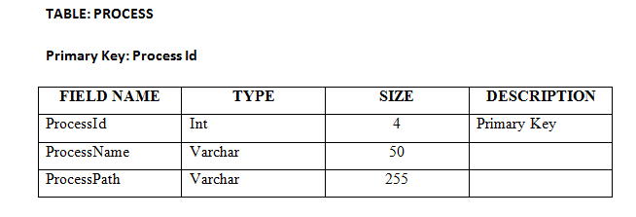
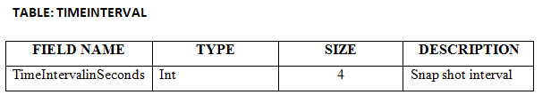
Database Design

Slide 12
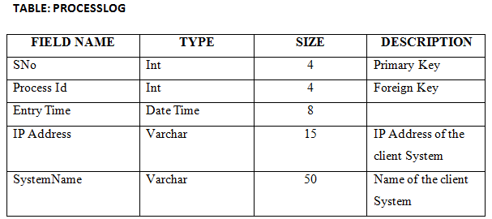
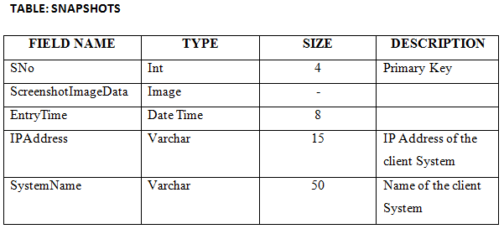

Slide 13
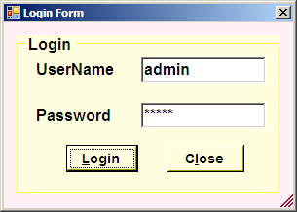
SCREEN LAYOUT
LOGIN FORM

Slide 14
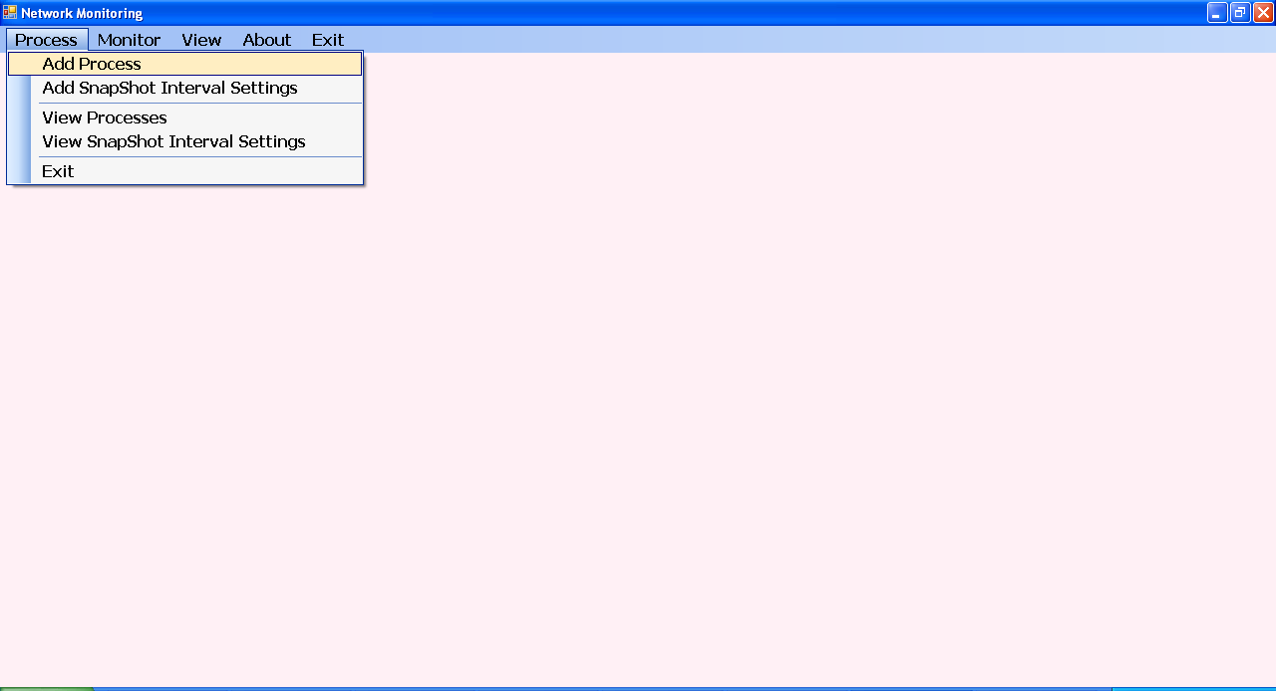
PROCESS FORM

Slide 15
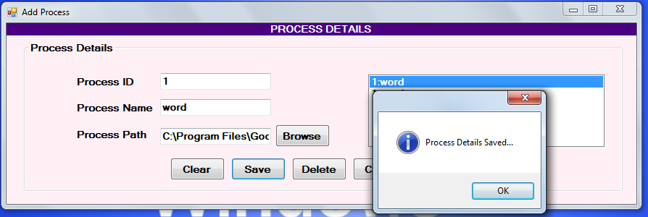
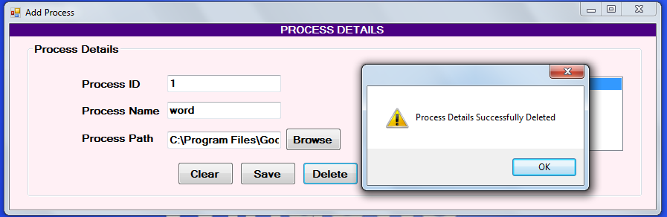

Slide 16
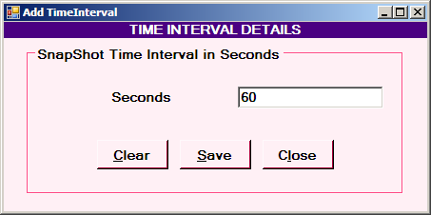

Slide 17
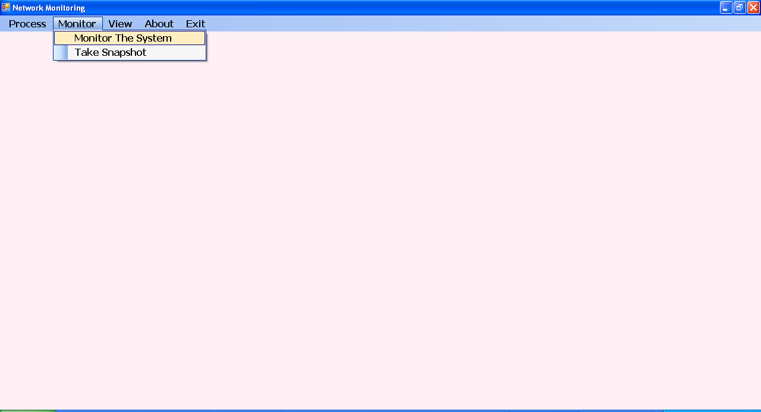

Slide 18
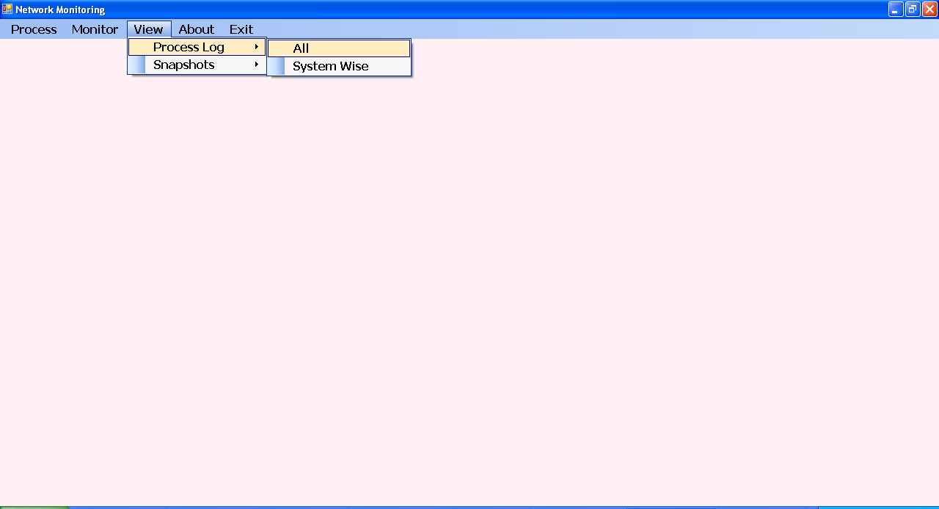

Slide 19
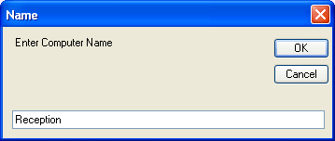
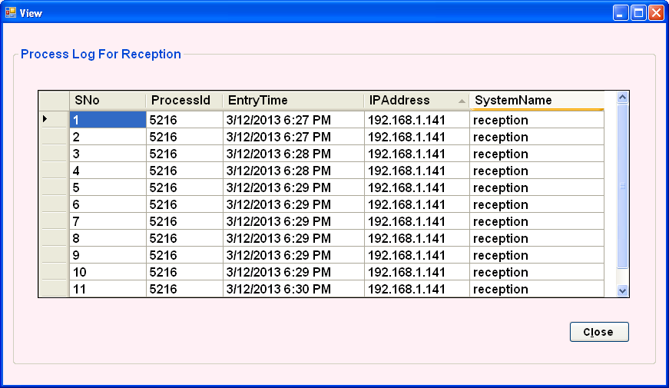

Slide 20
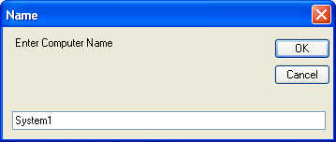
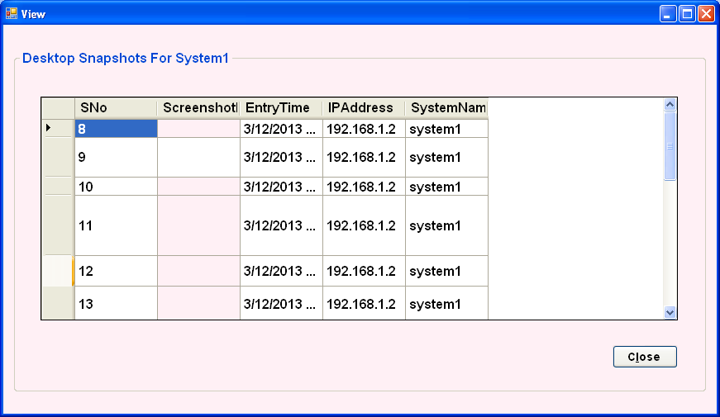

Slide 21
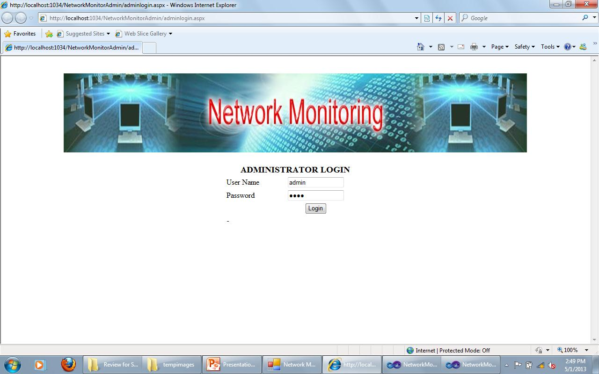

Slide 22
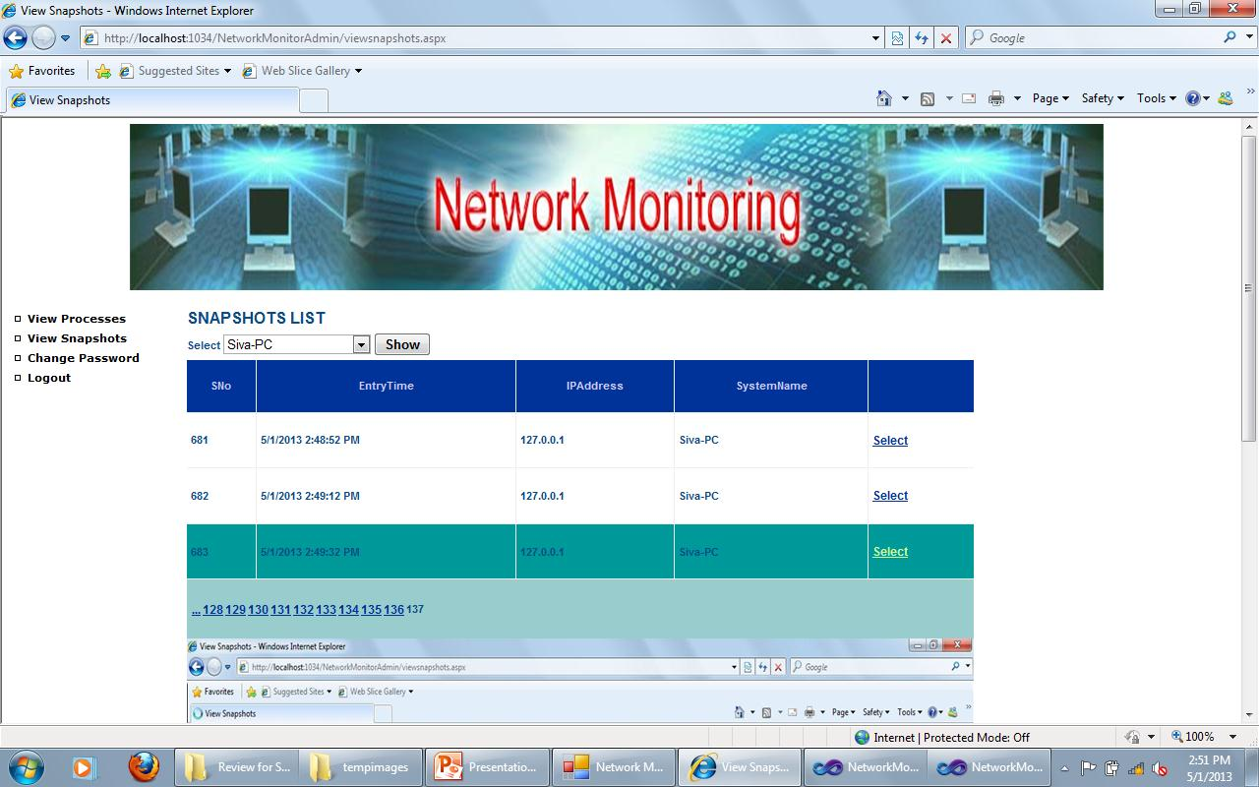

Slide 23
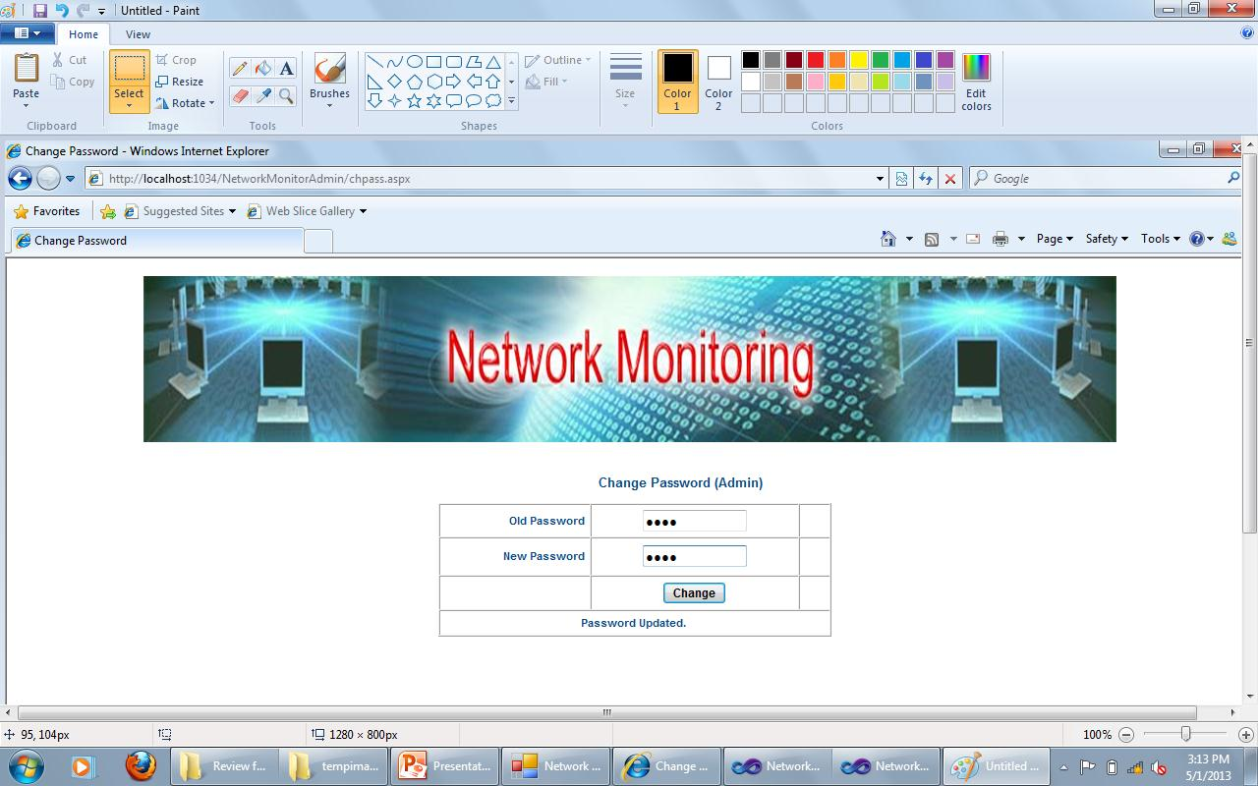

Slide 24
CONCLUSION
The project is very effective to network administrators.
This project is quite simple and easy to understand for the end users.
The user’s Login feature provides some security features. Only authorized users can access the Information.
Thus we may conclude that, this package is found useful as it reduces the time consumption and advanced feature of monitoring even taking snapshots of nodes and update to administrator’s web site.

Slide 25
Thank you

