Slide 1
Mutual Fund Performance Analysis
A Data-Driven Overview of Mutual Fund Returns and Ratings

Slide 2
Key Performance Indicators
• Total Funds Analyzed: 1651
• Average 1-Year Return: 3.61%
• Average 3-Year Return: 19.55%
• Average 5-Year Return: 10.23%

Slide 3
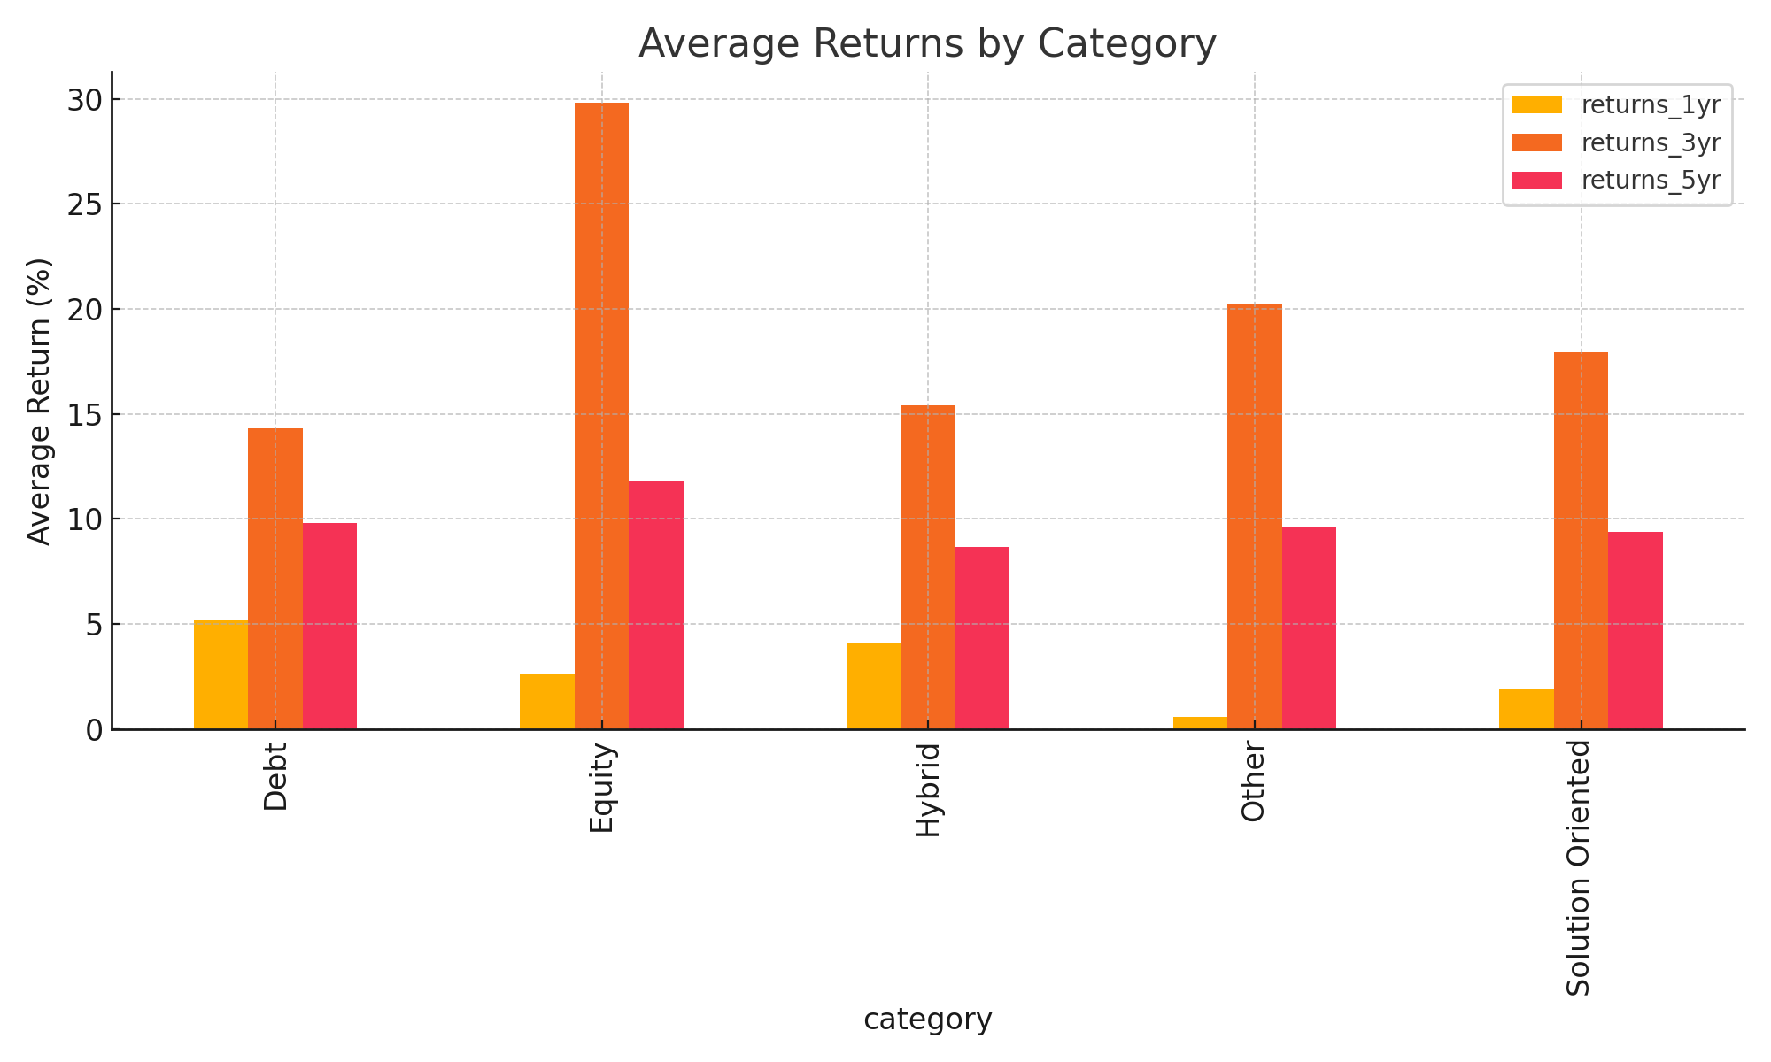
Average Returns by Category
This chart shows average 1Y, 3Y, and 5Y returns across fund categories.

Slide 4
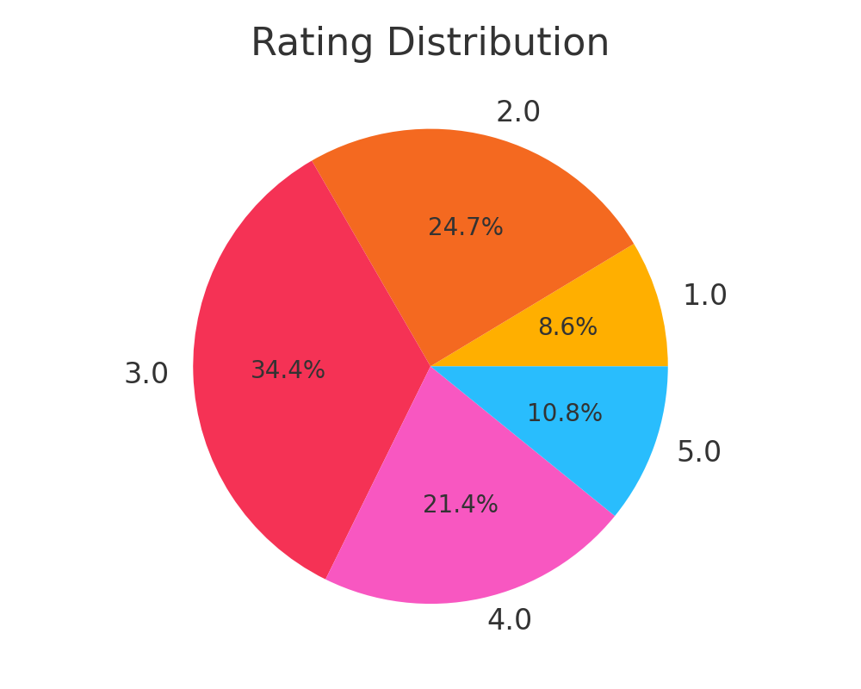
Fund Rating Distribution
Distribution of mutual fund ratings based on overall performance metrics.

Slide 5
Top 10 Funds by 3-Year Return
Fund Name | Category | 3-Year Return (%) | Rating
Quant Small Cap Fund | Equity | 71.4% | 5
Quant Infrastructure Fund | Equity | 61.5% | 5
ICICI Pru Commodities Fund | Equity | 57.1% | N/A
Quant Tax Plan- Direct Growth | Equity | 54.9% | 5
Canara Robeco Small Cap Fund | Equity | 51.8% | 5
Sundaram LT Tax Advantage Fund | Equity | 48.0% | N/A
Bank of India Small Cap Fund | Equity | 47.7% | 4
Quant Flexi Cap Fund | Equity | 47.7% | 5
Nippon India Small Cap Fund | Equity | 47.6% | 4
Sundaram LT Tax Advantage Fund | Equity | 46.9% | N/A

Slide 6
Key Insights & Conclusion
• Equity funds show higher long-term returns but with greater variability.
• Debt and Hybrid funds offer moderate, stable performance.
• 4-star and 5-star rated funds dominate top return segments.
• Insights can help investors and analysts focus on well-rated, high-return schemes.

