Slide 1

Machine Maintenance Prediction
ID:2004
Batch 42
Gowtham Karepalli

Slide 2

Problem statement
A locomotive manufacturing company observes failures in the engines of several locomotives of their fleet.
The data captured through sensors and inspection of previous fleet is given.
Scheduled and unexpected services done for each machine component.
Unexpected services include error, repair, replacement etc and related data is provided with time stamps.
Building model to predict actionpoints for each MachineID like
ComponentRepair (major)
ComponentReplacement
NoIssue (Minor error or normal status)

Slide 3
Data Availability
The data relevant to machines collected in 7 different data files
MachineDetails
Machine models and service period interval for each machine.
ComplaintsLog
Minor errors that took place with each machine at various time period are captured.
ComponentServiceLog
Timestamp, MachineID, ServiceType, ComponentAttended
ComponentReplacementLog
MachineID and which component got replaced with time stamp

Slide 4
Data Availability
OperatingConditionsData
Timestamp, MachineID, readings of different sensors at each point of time
TrainData
MachineID with Actionpoints
TestData
MachineID only and Actionpoints has to be predicted.

Slide 5

Data Exploration
As the datasets are provided in the different files. The files should be combined together in order to make train and test data.
The data is combined using column MachineID as it is common and acts as a primary key in all files.
As the data sets have similarity to tables and some files are big in data: SparkSQL and python are used to data preprocessing

Slide 6

Data Exploration/Feature Extraction
Category columns like Model , ErrorID , ComponentAttended, ServiceType columns are dummified.
OperatingConditionsdata is separated into two datasets namely OperatingConditionstime, OperatingConditionsDay by taking max of sensor value and group by Machine ID , Time & day

Slide 7
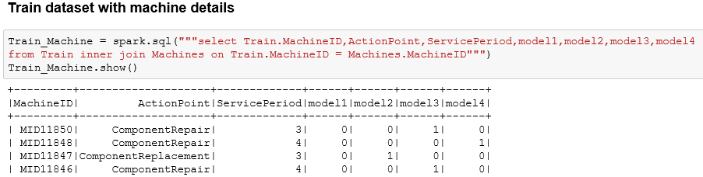
Data Exploration
Join 1 :
Machinedetails dataset with Traindata
In same manner Machinedetails joined with Testdata

Slide 8
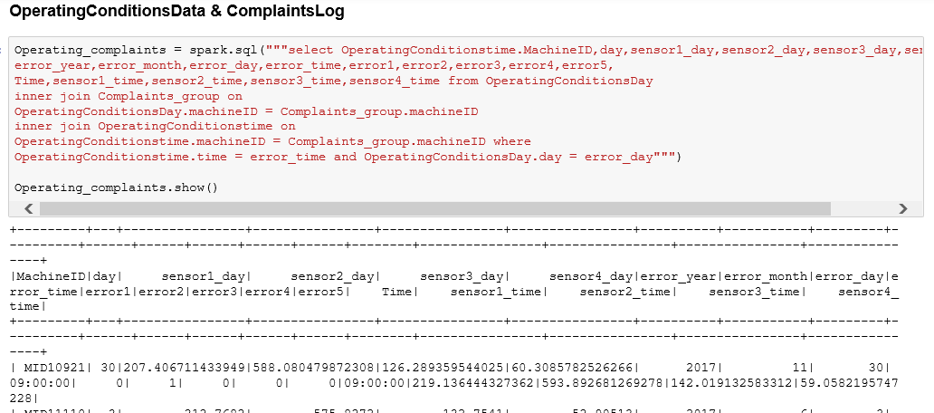
Data Exploration
Join 2
OperatingConditionsData & ComplaintsLog with conditions with error time and error day same as Operating data captured
This is to extract the sensor values during the error occurred time

Slide 9
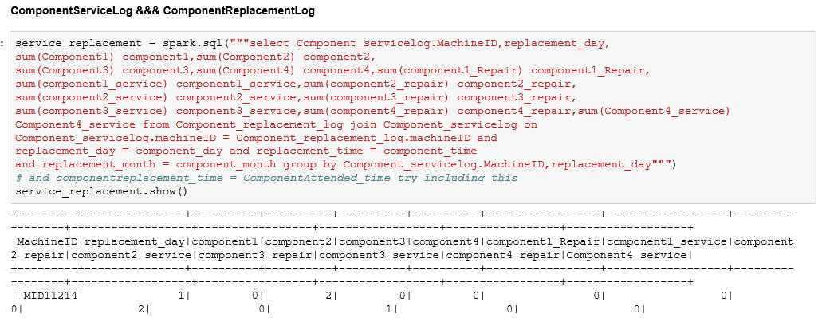
Data Exploration
Join 3
ComponentServiceLog and ComponentReplacementLog with condition component replaced date same as component service log
The sum of components are taken to capture number of components replaced for the machine

Slide 10
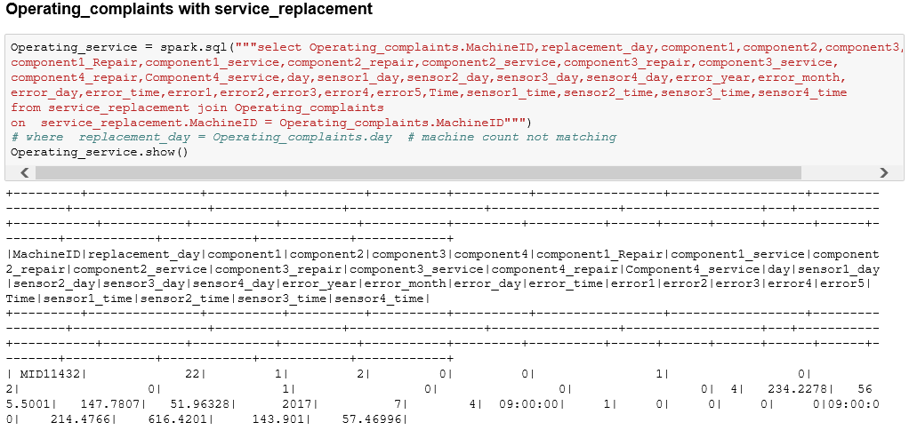
Data Exploration
Join 4
Operating_complaints is Join 2
service_replacement is Join 3
Now this two data sets are joined together

Slide 11
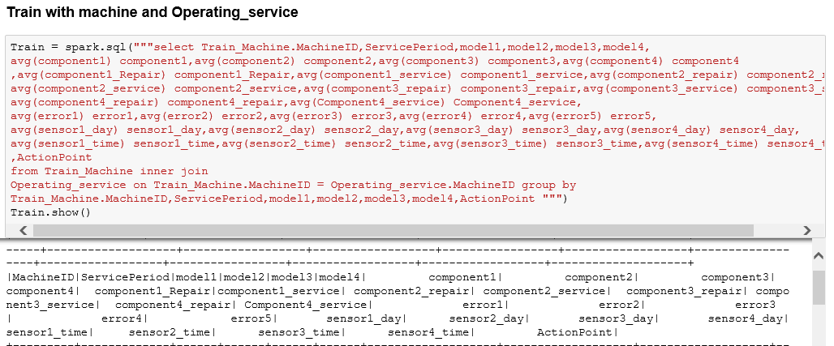
Data Exploration
Join 5
Now Join 1 Train with Machine details
Join 4 are joined together to make the final train data. In same manner test data also created
The Averages of errors, sensors and components are captured here

Slide 12
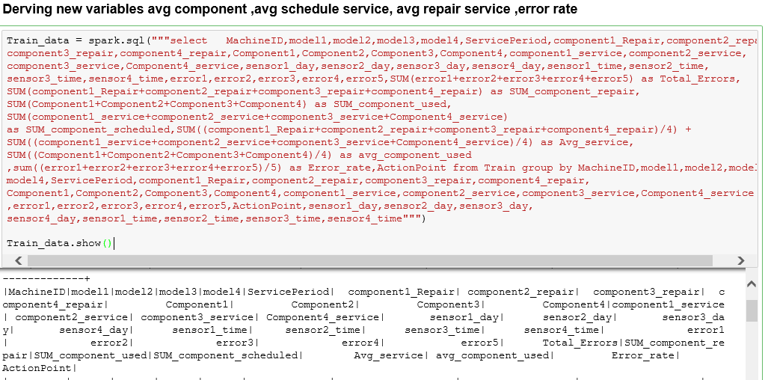
Feature creation
Newly created features:
Avg component
Avg schedule service
Avg repair service
Error rate

Slide 13
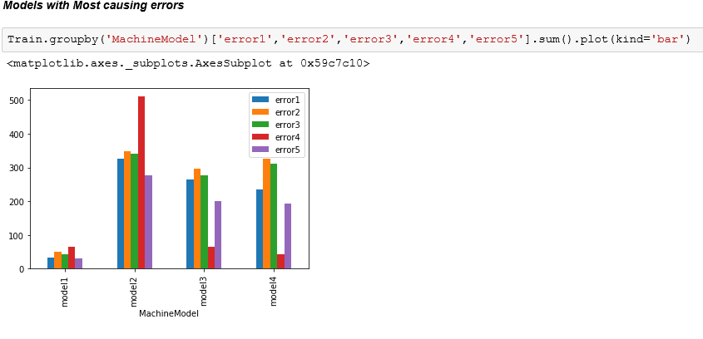
Insights on Traindata
The Most Error causing Machines are of Model 2
The less Errors are occurred in Model1

Slide 14
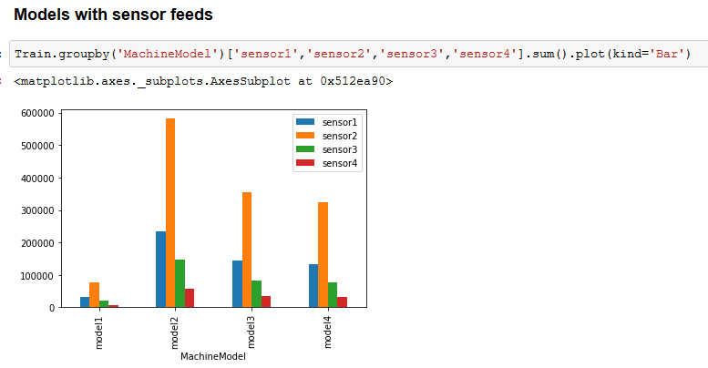

Slide 15
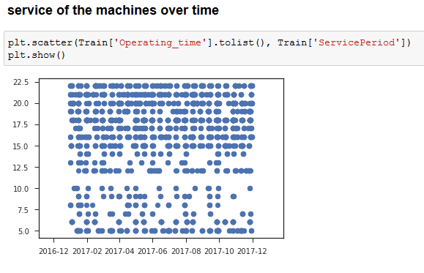

Slide 16
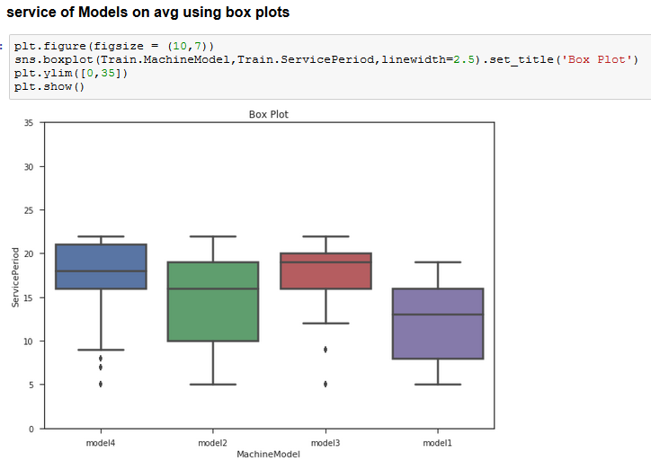

Slide 17
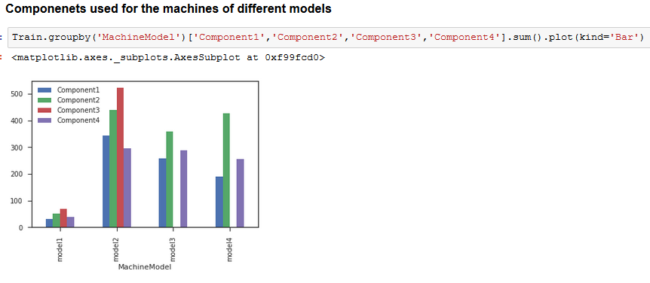

Slide 18
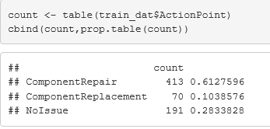
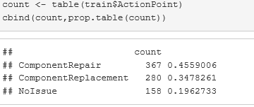
Model Building
The created train data contain class imbalance problem
Smote technique is used and generated extra data for component Replacement class
Models Built
Random Forest
Multinomial logistic Regression
Naive Bayes
C5tree
SVM
Ensemble: Stacking

Slide 19
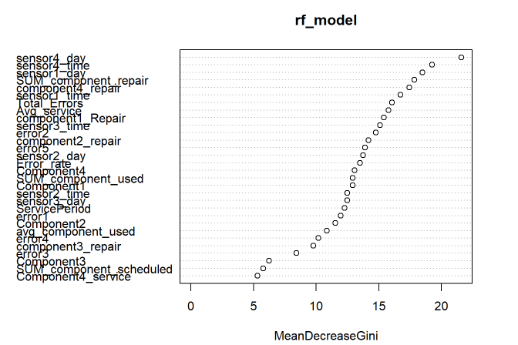
Model Building- Random Forest
rf_model = randomForest(ActionPoint~., data=train_data, keep.forest=TRUE, ntree=16, mtry=2)

Slide 20
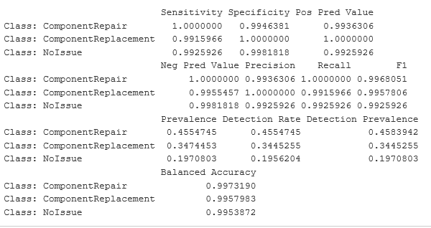
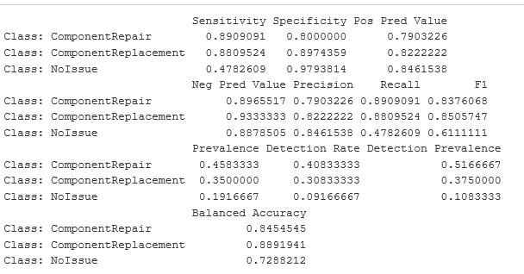
Random Forest
Train Performance Val Performance

Slide 21
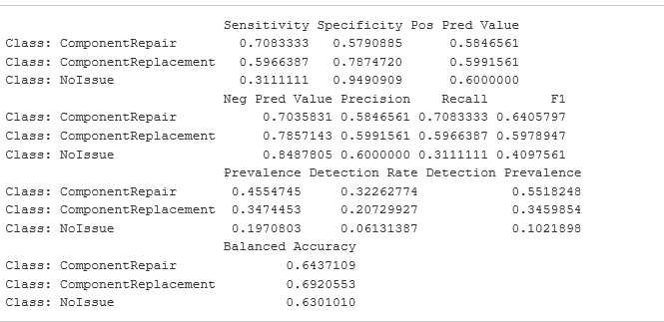
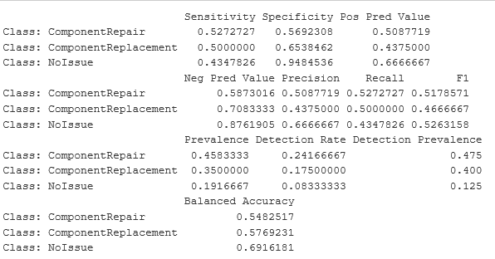
Multinomial logistic Regression model
Train Performance Val Performance

Slide 22
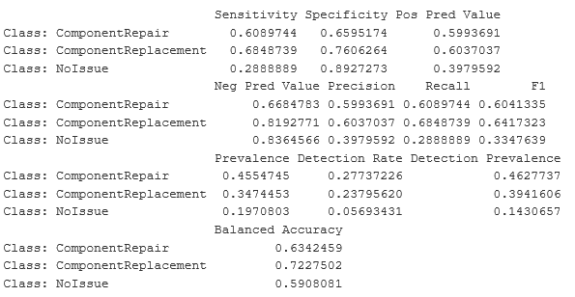
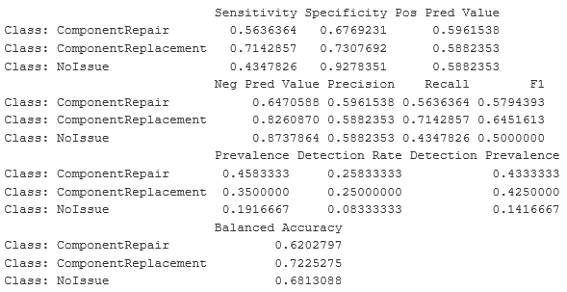
Naive Bayes model
Train Performance Val Performance

Slide 23
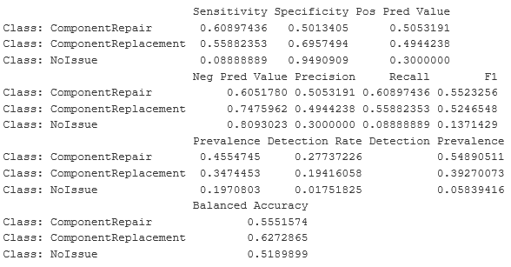
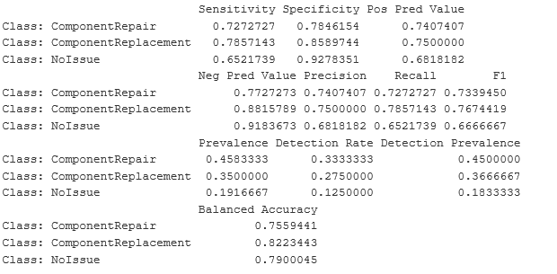
SVM Model
Train Performance Val Performance

Slide 24
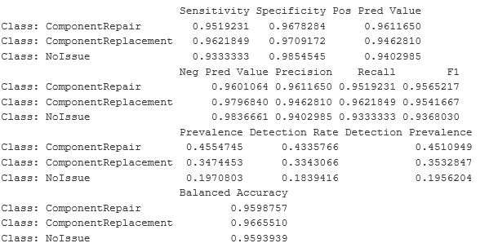
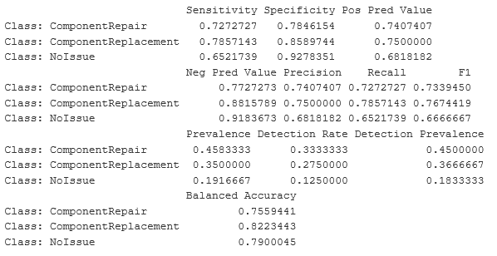
C5tree
Train Performance Val Performance

Slide 25
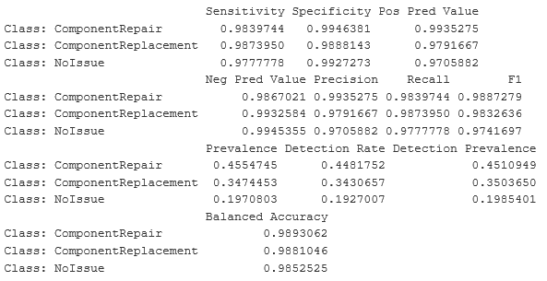
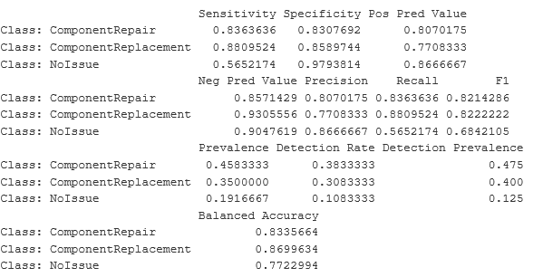
Ensemble:Stacking
Train Performance Val Performance

Slide 26
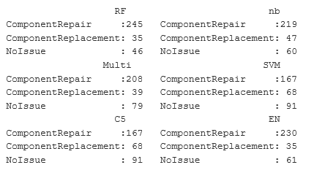
Predictions/Score on test
Models | Grader F1 score
Random Forest | 15%
Multinomial | 12%
Naïve Bayes | 16%
C5tree | 12%
SVM | 20%
Stacking | 15%

Slide 27


Thank you..!

