Slide 1

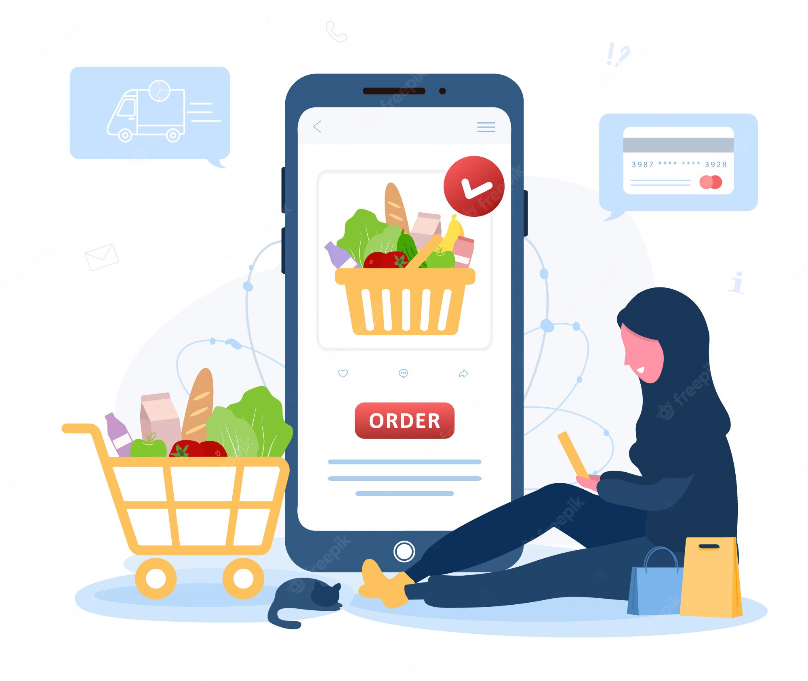
CAPSTONE PROJECT SHOP FOR HOME
GROUP NO. :- 1
GROUP MEMBERS:
Pushpendra Patel
Swathi S
Puja Goyal
Naredla Josna
Akshaya G

Slide 2
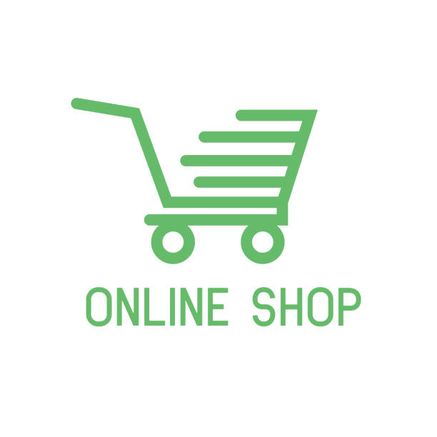
CONTENTS :-
Introduction
Project Description And Goals
Technologies and Tools Used
Modules
Flowchart
Use case diagram
Data Flow Diagram For Admin
Data Flow Diagram for User Login
System Tools
Project Photos
Conclusion
Future Scope

Slide 3
INTRODUCTION :-
Online shopping is a form of electronic commerce which allows consumers to directly buy goods or services from a seller over the Internet using a web browser or a mobile app.
Online shops give us the opportunity to shop 24/7, and also reward us with a ‘no pollution’ shopping experience.
Online shopping can save time for both the buyer and retailer, reducing phone calls about availability, specifications, hours of operation or other information easily found on company and product pages.
The application design contains two modules one is for the customers who wish to buy the articles. And another is for the store owners who maintain and updates the information regarding the articles and about the customers.

Slide 4
PROJECT DESCRIPTION :-
Shop For Home is e-commerce web application, which provides various electronic and lifestyle products.
User can login to website by providing their email id and password.
New user can register first by providing basic details like Name, Email Id, Password and then login to website.
Users can search for various products in search bar and view the products in different categories.
They can add products into shopping cart in multiple quantities when required and also remove it in future.

Slide 5

TECHNOLOGY STACK :
Backend
Java 8
Spring Boot
Spring Security
JWT Authentication
Spring Data JPA
Hibernate
H2 Database
Maven
Lombok
Frontend
Angular 7
Angular CLI
Bootstrap

Slide 6
GOALS:-
Shopping has long been considered a recreational activity by many. Shopping online is no exception. The goal of this application is to develop a web based interface for online retailers. The system would be easy to use and hence make the shopping experience pleasant for the users. The goal of this application is
To develop an easy to use web based interface where users can search for products, view a complete description of the products and order the products.
A search engine that provides an easy and convenient way to search for products specific to their needs. The search engine would list a set of products based on the search term and the user can further filter the list based on various parameters.
Drag and Drop feature which would allow the users to add a product to or remove a product from the shopping cart by dragging the product in to the shopping cart or out of the shopping cart.
A user can view the complete specification of the product along with various images and also view the customer reviews of the product. They can also write their own reviews
The Server process the customers and the items are shipped to the address submitted by them. The application was designed into two modules first is for the customers who wish to buy the articles.

Slide 7
Features Available :-
Admin
Adding products
Updating products
Deleting products
Manage Orders
Getting Stocks
Customers
Registering into System
Login into Website
Logout from Website
See the Product in different categories
Sort the product
Adding product to Shopping Cart and increase or decrease the quantity added in the cart
Add n number of product to Cart
Adding product to the Wishlist option
Get different discount coupons

Slide 8
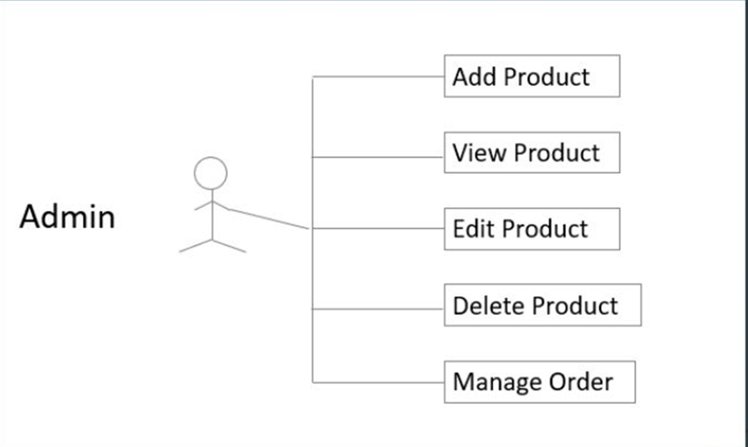
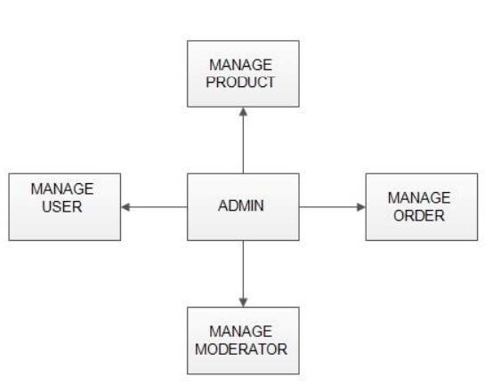
fig: Admin module fig: Use case diagram

Slide 9
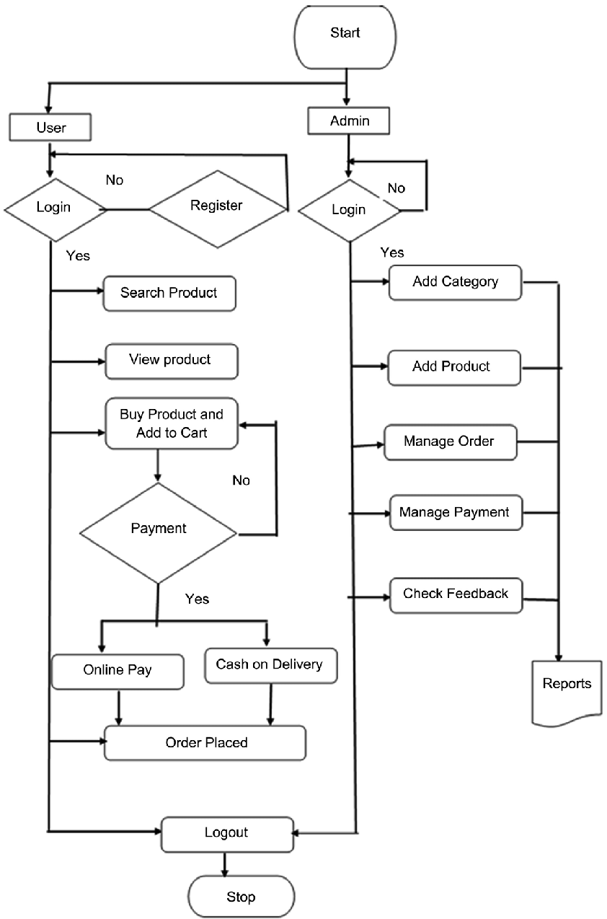
FLOW CHART

Slide 10
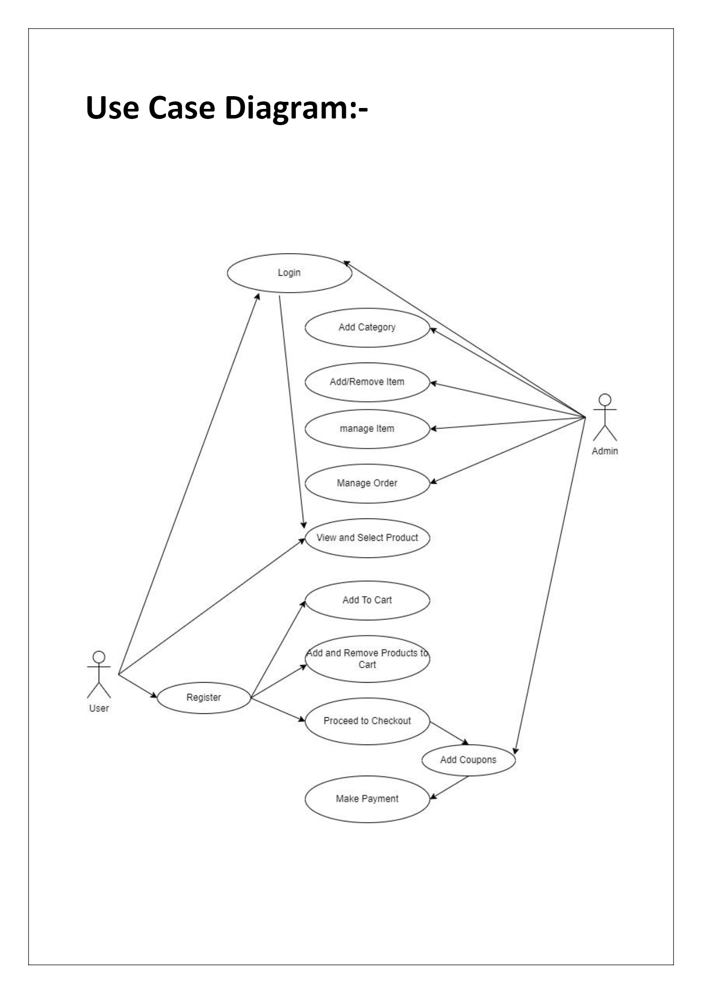
USE CASE DIAGRAM :-

Slide 11
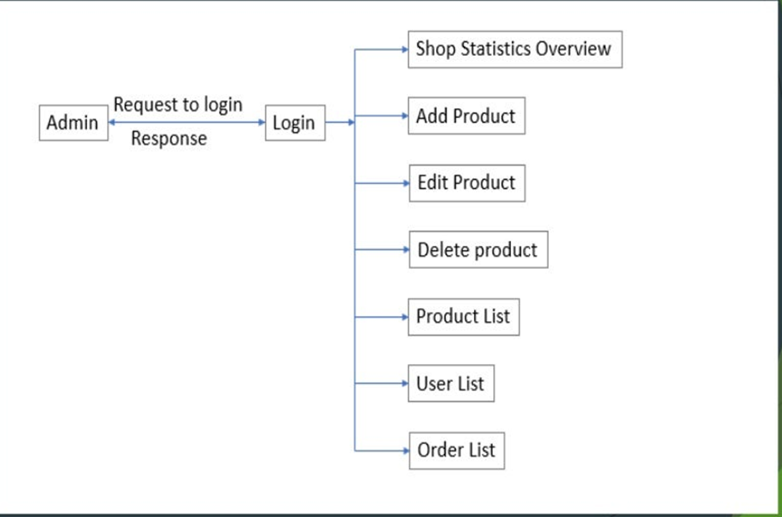
DATA FLOW DIAGRAM FOR ADMIN :-

Slide 12
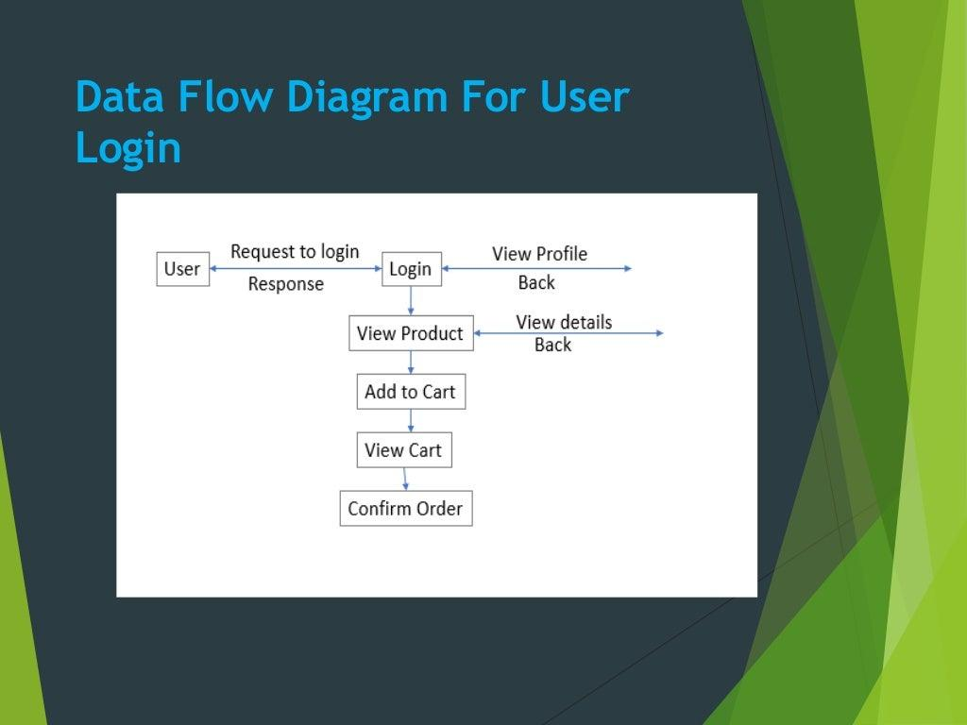
DATA FLOW DIAGRAM FOR USER LOGIN :-

Slide 13
SYSTEM TOOLS :-
FRONT END : JSP, HTML, CSS, JAVA SCRIPT are utilized to implement the frontend.
Java Server Pages (JSP) :Different pages in the applications are designed using jsp. A Java Server Pages component is a type of Java servlet that is designed to fulfil the role of a user interface for a Java web application. Web developers write JSPs as text files that combine HTML or XHTML code, XML elements, and embedded JSP actions and commands. Using JSP, one can collect input from users through web page.
HTML (Hyper Text Markup Language) : HTML is a syntax used to format a text document on the web.
CSS (Cascading Style Sheets) : CSS is a style sheet language used for describing the look and formatting of a document written in a markup language.
Java Script : JS is a dynamic computer programming language. It is most commonly used as part of web browsers, whose implementations allow client-side scripts to interact with the user, control the browser, communicate asynchronously, and alter the document content that is displayed.

Slide 14
BACKEND:-
Spring Boot : Spring Boot Tutorial provides basic and advanced concepts of Spring Framework. Our Spring Boot Tutorial is designed for beginners and professionals both. Spring Boot is a Spring module that provides the RAD (Rapid Application Development) feature to the Spring framework.
Hibernate : Hibernate is a Java framework that simplifies the development of Java application to interact with the database. It is an open source, lightweight, ORM (Object Relational Mapping) tool. Hibernate implements the specifications of JPA (Java Persistence API) for data persistence.
Eclipse : Eclipse Scout is a Java/HTML5 framework to develop business applications that run on the desktop, on tablets and mobile devices. This package includes Eclipse IDE support for Scout developers and source code.

Slide 15
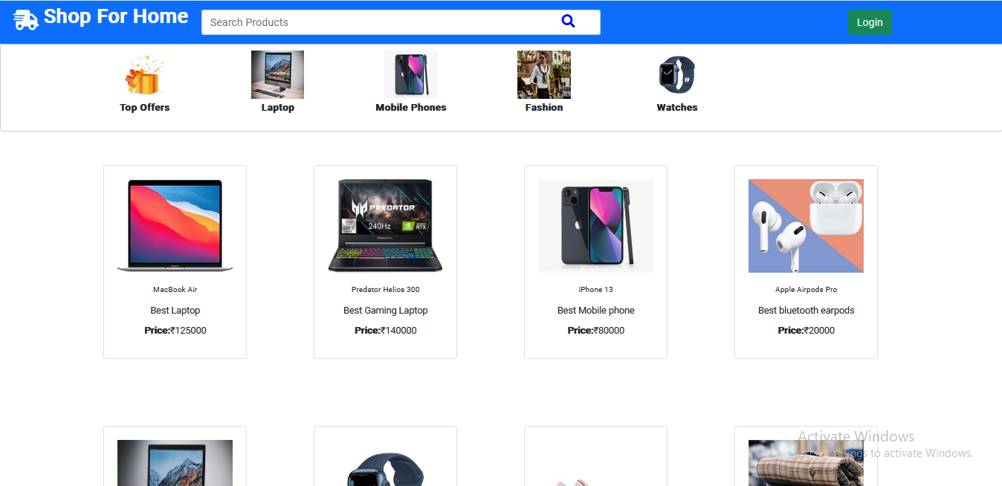
PROJECT PHOTOS :- (Dashboard)

Slide 16
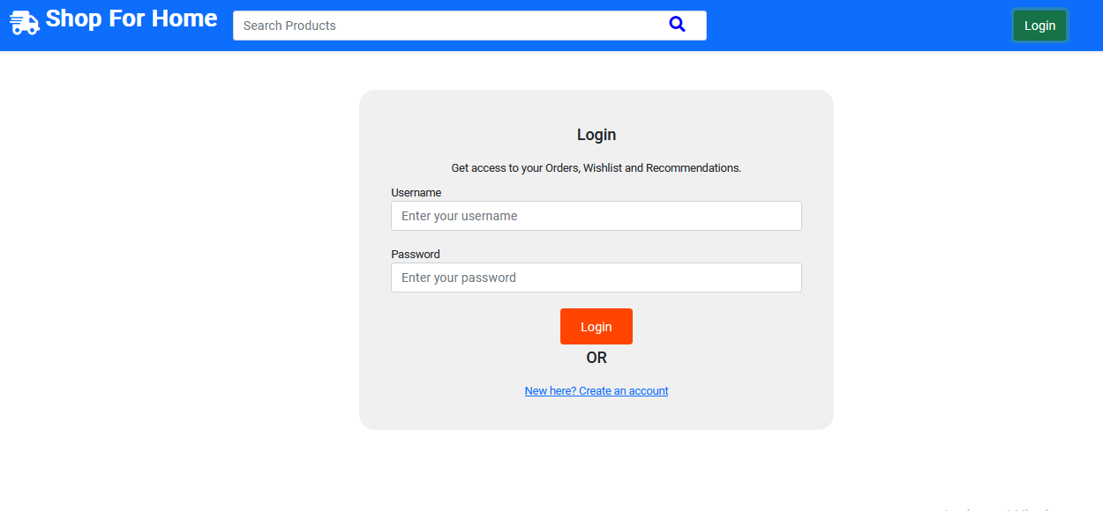
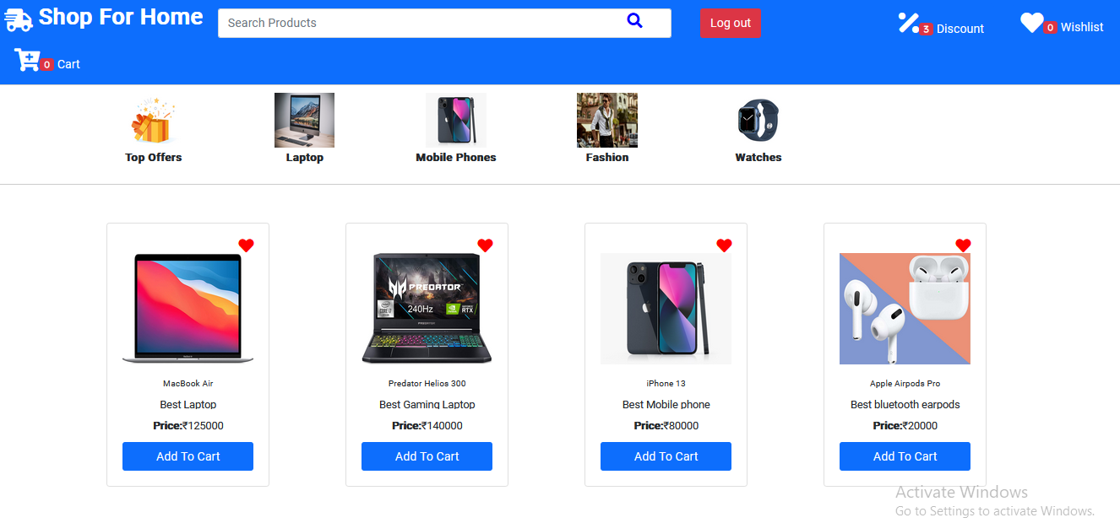
LOGIN AND AFTER LOGIN :-

Slide 17
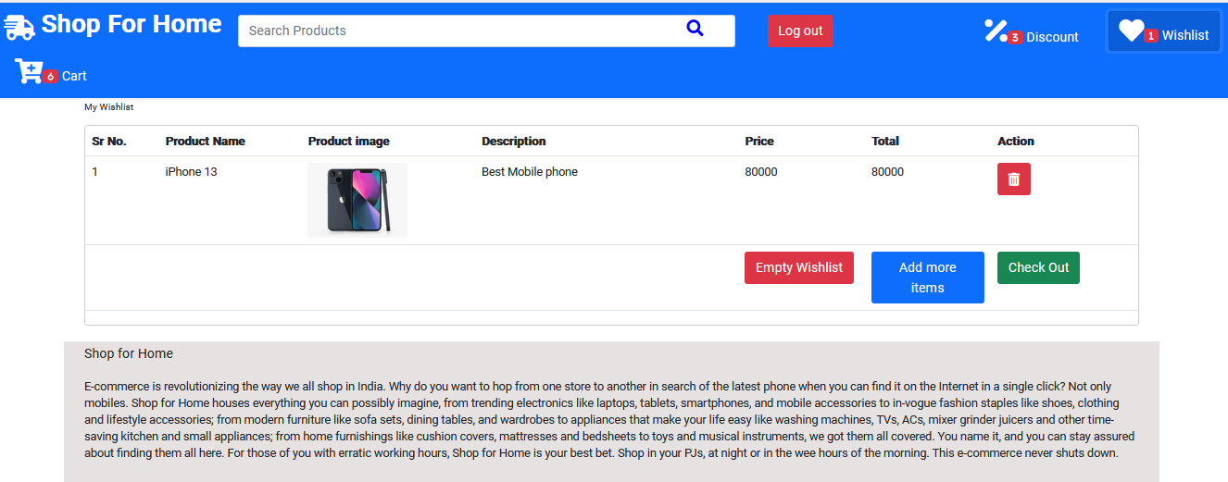
WISHLIST :-

Slide 18
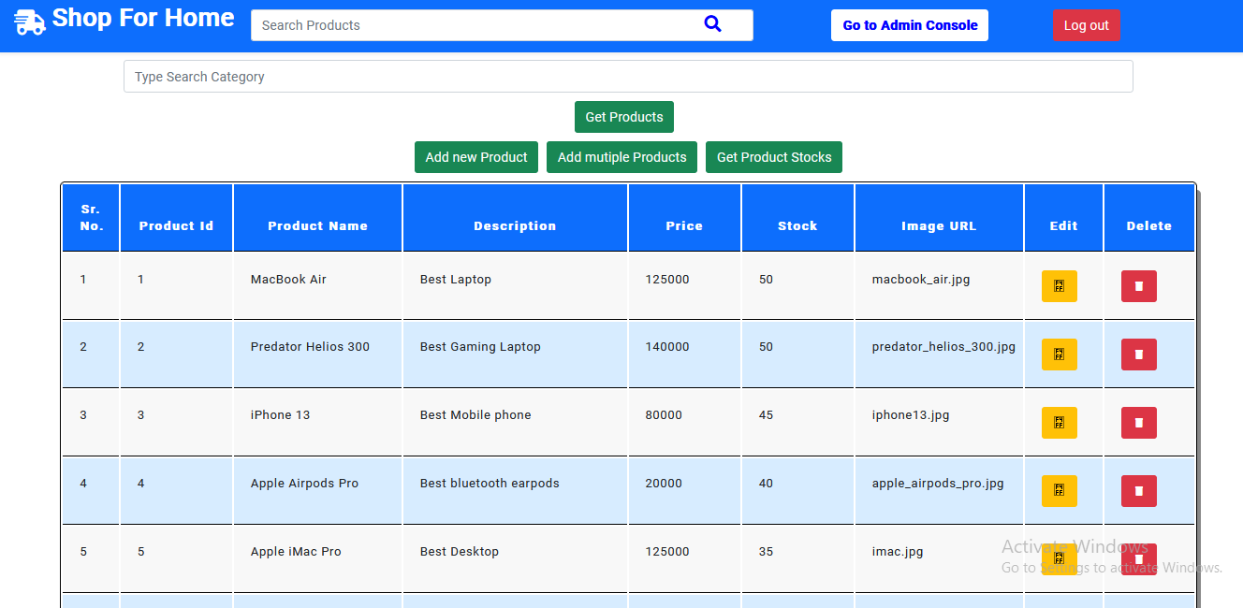
ADD PRODUCT (ADMIN) :-

Slide 19
CONCLUSION :-
The system has been developed with much care and free of errors and at the same time it is efficient and less time consuming.
The purpose of this project was to develop a web application and an android application for purchasing items from a shop.
This project helped us in gaining valuable information and practical knowledge on several topics like designing web pages using html & css, usage of responsive templates, designing of android applications, and management of database using H2 database.
The entire system is secured. Also the project helped us understanding about the development phases of a project and software development life cycle. We learned how to test different features of a project.

Slide 20
Technologies and Tools Used
PROJECT SCOPE :-
User could subscribe for receiving notification about best offers and deals prior to other users.
Users can have multiple shipping and billing information saved. During checkout they can use the drag and drop feature to select shipping and billing information.
The system recommends a facility to accept the orders 24*7 and a home delivery system which can make customers happy.
Users will receive product information from packaging to delivery.
Various products categories like Mobile and Electronics, Groceries, Health and Personal care will be added to the system.

Slide 21


Slide 22


