Slide 1

Presentation on
“Text To Speech Converter”
Submitted To:
Ms. Nikita Jain
Ms. Neetu Gupta
Submitted By:
Gaurav Goyal
16EGJCS061
4 Year , 7 Sem
DEPARTMENT OF COMPUTER SCIENCE & ENGINEERING
GLOBAL INSTITUTE OF TECHNOLOGY
JAIPUR (RAJASTHAN)-302022
2016-2020

Slide 2

Python
Python is a general purpose programming language that is often applied in scripting roles.
So, Python is programming language as well as scripting language.
Python is also called as Interpreted language

Slide 3

Why Python...?
The following primary factors cited by Python users seem to be these:
Python is object-oriented
It's free (open source)
It's portable
It's powerful

Slide 4
What can we do with Python…?
System programming
Graphical User Interface Programming
Internet Scripting
Database Programming
Gaming, Images, XML , Robot and more

Slide 5

Machine Learning
Automating automation
Getting computers to program themselves
Writing software is the bottleneck
Let the data do the work instead!

Slide 6
Types of Learning
Supervised (inductive) learning
Training data includes desired outputs
Unsupervised learning
Training data does not include desired outputs
Semi-supervised learning
Training data includes a few desired outputs
Reinforcement learning
Rewards from sequence of actions

Slide 7
ML in a Nutshell
Tens of thousands of machine learning algorithms
Hundreds new every year
Every machine learning algorithm has three components:
Representation
Evaluation
Optimization

Slide 8
Sample Applications
Web search
Computational biology
Finance
E-commerce
Space exploration
Robotics
Information extraction
Social networks
Debugging

Slide 9

Road Ahead Technologies Road Ahead Technologies (I) Pvt. Ltd. incorporated in 2004 is an ISO 9001:2008 certified organization that operates through well-defined systems and procedures. We have been relentlessly endeavoring to provide end to end solutions to the Information Technology Industry with our expertise developed through the profound experience we continue contributing in training, consulting and Software Development Services, all over Rajasthan. It provides information and resources on IT education, training, development and services for everyone involved in the sector - from students to educators and employers to employees. RAT through its strategic alliances with global leaders like Oracle formulates the link between individuals and agencies with IT skills, opportunities, and solutions.

Slide 10
Things I liked about Road Ahead Technologies 1. I learn how they communicate with the other person’s 2. Good learning environment. 3. Teaches were always ready to clear doubt. 4. Sprit of Teamwork

Slide 11
“Text To Speech Converter”
Name:- Mohd. Rashid Khan
Roll no:-16EGJCS113
Section:- B
Practical Tranning Seminar

Slide 12
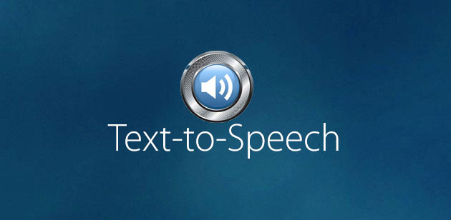
Working principle:-
The speech synthesis is often known as text to speech (TTS) system.
It usually consist of two parts:
First it takes the raw text and converts latters, numbers etc into their written-out word equivalents. This process is often called text normalization, pre-processing, or tokenization.
Then it assigns phonetic transcriptions to each word, and divides and marks the text into various linguistic units like phrases, clauses, and sentences.
In second it takes the symbolic linguistic representation and converts it into actual sound output.

Slide 13
Architecture of TTS systems:-
Text-to-phoneme module Phoneme-to-speech module
Synthetic speech output
Text input
Normalization
Abbreviation lexicon
Text in orthographic form
Various methods
Exceptions lexicon
Acoustic synthesis
Grapheme-to- phoneme conversion
Orthographic rules
Phoneme string +
prosodic annotation
Grammar rules
TH
Prosodic modelling
Prsodic model
Phoneme string

Slide 14
Students Who Need the Device
Reading Disabilities
Hearing Impaired
Vision Impaired
Physically Impaired
Regular Education Students

Slide 15
Positives
Read any text on the computer
Hard copies of texts can be scanned into the computer and saved as a PDF or Word Document.
The text to speech reading can be recorded and saved as a WAV or MP3 file, which gives the students the opportunity to listen to it later in their MP3 or CD players.

Slide 16
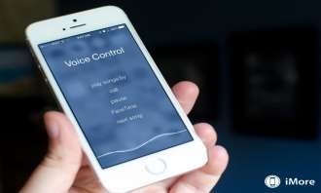
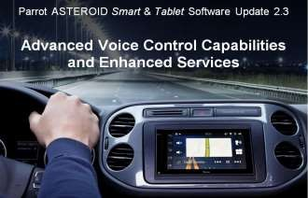
APPLICATIONS:-
Speech synthesis walking device for blind.
Automatic reading of computer screen.
Voice operating mode in smart phones.
Voice controlled vehicle.
Railway announcement.
Robotics. etc

Slide 17


42

