Slide 1

Python Lecture 4 – Libraries
Numpy
Scipy
Matplotlib

Slide 2
Bibliography and learning materials
Bibliography:
https://docs.scipy.org/doc/
http://docs.python.it/
https://matplotlib.org/
and much more available in internet
Learning Materials:
https://github.com/bertocco/bash_lectures

Slide 3
Numpy
numpy states for Numerical Python.
NumPy is the fundamental package for scientific computing in Python.
NumPy is a Python library that provides:
a multidimensional array object,
various derived objects (such as masked arrays and matrices),
an assortment of routines for fast operations on arrays, including:
  mathematical, logical, shape manipulation
  sorting
  selecting
  I/O
  discrete Fourier transforms
  basic linear algebra
  basic statistical operations
  random simulation
  and much more…..
Notes:
Masked arrays are arrays that may have missing or invalid entries.
A masked array is the combination of a standard numpy.ndarray and a mask. A mask is either nomask, indicating that no value of the associated array is invalid, or an array of booleans that determines for each element of the associated array whether the value is valid or not. When an element of the mask is False, the corresponding element of the associated array is valid and is said to be unmasked. When an element of the mask is True, the corresponding element of the associated array is said to be masked (invalid).
The package ensures that masked entries are not used in computations.
As an illustration, let’s consider the following dataset:
>>>
>>> import numpy as np
>>> import numpy.ma as ma
>>> x = np.array([1, 2, 3, -1, 5])
We wish to mark the fourth entry as invalid. The easiest is to create a masked array:
>>>
>>> mx = ma.masked_array(x, mask=[0, 0, 0, 1, 0])
We can now compute the mean of the dataset, without taking the invalid data into account:
>>>
>>> mx.mean()
2.75

Slide 4
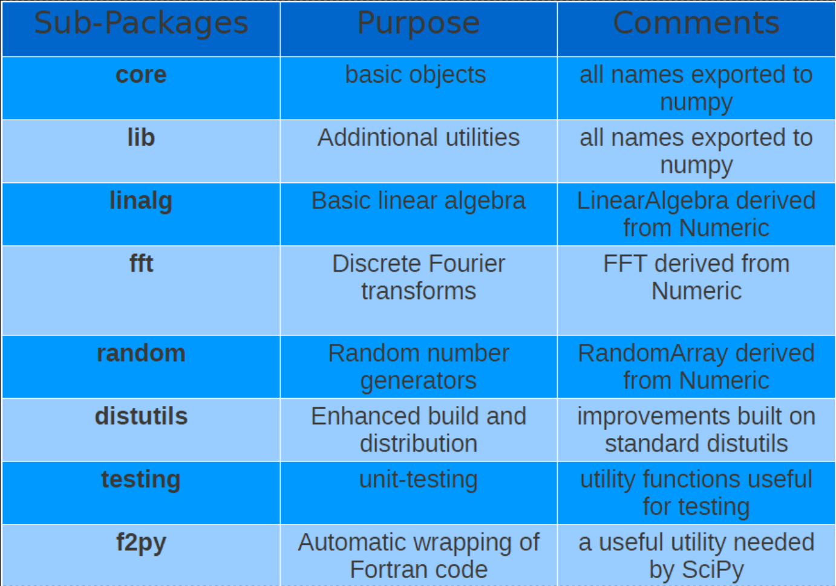
Numpy module organization
Notes:
Masked arrays are arrays that may have missing or invalid entries.
A masked array is the combination of a standard numpy.ndarray and a mask. A mask is either nomask, indicating that no value of the associated array is invalid, or an array of booleans that determines for each element of the associated array whether the value is valid or not. When an element of the mask is False, the corresponding element of the associated array is valid and is said to be unmasked. When an element of the mask is True, the corresponding element of the associated array is said to be masked (invalid).
The package ensures that masked entries are not used in computations.
As an illustration, let’s consider the following dataset:
>>>
>>> import numpy as np
>>> import numpy.ma as ma
>>> x = np.array([1, 2, 3, -1, 5])
We wish to mark the fourth entry as invalid. The easiest is to create a masked array:
>>>
>>> mx = ma.masked_array(x, mask=[0, 0, 0, 1, 0])
We can now compute the mean of the dataset, without taking the invalid data into account:
>>>
>>> mx.mean()
2.75

Slide 5
Scipy
SciPy is a collection of
  mathematical algorithms and
  convenience functions
built on the numpy extension of Python.
It provides the user with high-level commands and classes for manipulating and visualizing data.
Using an interactive Python session with scipy we have a data-processing and system-prototyping environment rivaling systems such as MATLAB and IDL.

Slide 6
Scipy modules
SciPy is organized into subpackages covering different scientific computing domains:
Subpackage | Description
cluster | Clustering algorithms
constants | Physical and mathematical constants
fftpack | Fast Fourier Transform routines
integrate | Integration and ordinary differential equation solvers
interpolate | Interpolation and smoothing splines
io | Input and Output
linalg | Linear algebra
ndimage | N-dimensional image processing
odr | Orthogonal distance regression
optimize | Optimization and root-finding routines
signal | Signal processing
sparse | Sparse matrices and associated routines
spatial | Spatial data structures and algorithms
special | Special functions
stats | Statistical distribution and function
Scipy sub-packages need to be imported separately. Example:
from scipy import linalg, io

Slide 7
Matplotlib
Matplotlib is a Python 2D plotting library which produces publication quality figures in a variety of hardcopy formats and interactive environments across platforms.
You can generate plots, histograms, power spectra, bar charts, errorcharts, scatterplots, etc., with just a few lines of code.
For simple plotting the pyplot sub-module provides a MATLAB-like interface, particularly when combined with IPython. It provides users with full control of line styles, font properties, axes properties, etc, via an object oriented interface or via a set of functions familiar to MATLAB users.

Slide 8
How to find documentation (1)
The dir(module) function can be used o look at the namespace of a module or package, i.e. to find out names that are defined inside the module.
The help(function) function is available for each module/object and allows to know the documentation for each module or function.
Try (in the interpreter) the commands:
import math
dir()
help(math.acos)
The type(object) function allows to know the type of the object passed as argument.
l = [1, "alfa", 0.9, (1, 2, 3)]; print [type(i) for i in l]
The source(function) function, when given a function written in Python as an argument, prints out a listing of the source code for that function. This can be helpful in learning about an algorithm or understanding exactly what a function is doing with its arguments.

Slide 9
How to find documentation (2)
numpy/scipy-specific help system is also available under the command numpy.info.
Example (try):
>>> import scipy.optimize
>>> import numpy as np
>>> np.info(scipy.optimize.fmin)
If you use a second keyword argument of numpy.info, it defines the maximum width of the line for printing. If a module is passed as the argument to help then a list of the functions and classes defined in that module is printed.
Example (try):
>>> np.info(scipy.optimize)

Slide 10
Name convention
Generally, for brevity and convenience, it is used a convention on names used to import packages (numpy, scipy, and matplotlib):
>>> import numpy as np
>>> import matplotlib as mpl
>>> import matplotlib.pyplot as plt
Generally scipy is not imported as module because interesting functions in scipy are actually located in the submodules, so submodules or single functions are imported:
The scipy namespace itself only contains functions imported from numpy. Therefore, importing only the scipy base package does only provide numpy content, which could be imported from numpy directly.
These functions still exist for backwards compatibility, but should be imported from numpy directly.
NOT used
used
from scipy import fftpack
from scipy import integrate
import scipy

Slide 11
numpy

Slide 12
Python arrays: numpy ndarray
ndarray object is an n-dimensional array of homogeneous data types, with many operations being performed in compiled code for performance.
Important differences between NumPy arrays and the standard Python sequences:
NumPy arrays have a fixed size at creation, unlike Python lists (which can grow dynamically). Changing the size of an ndarray will create a new array and delete the original.
The elements in a NumPy array are all required to be of the same data type, and thus will be the same size in memory. The exception: one can have arrays of (Python, including NumPy) objects, thereby allowing for arrays of different sized elements.
NumPy arrays facilitate advanced mathematical and other types of operations on large numbers of data. Typically, such operations are executed more efficiently and with less code than is possible using Python’s built-in sequences.
To know how to use NumPy arrays is needed to efficiently use much (perhaps even most) of today’s scientific/mathematical Python-based software because a growing plethora of scientific and mathematical Python-based packages are using NumPy arrays.
Notes:
Masked arrays are arrays that may have missing or invalid entries.
A masked array is the combination of a standard numpy.ndarray and a mask. A mask is either nomask, indicating that no value of the associated array is invalid, or an array of booleans that determines for each element of the associated array whether the value is valid or not. When an element of the mask is False, the corresponding element of the associated array is valid and is said to be unmasked. When an element of the mask is True, the corresponding element of the associated array is said to be masked (invalid).
The package ensures that masked entries are not used in computations.
As an illustration, let’s consider the following dataset:
>>>
>>> import numpy as np
>>> import numpy.ma as ma
>>> x = np.array([1, 2, 3, -1, 5])
We wish to mark the fourth entry as invalid. The easiest is to create a masked array:
>>>
>>> mx = ma.masked_array(x, mask=[0, 0, 0, 1, 0])
We can now compute the mean of the dataset, without taking the invalid data into account:
>>>
>>> mx.mean()
2.75

Slide 13
sequences vs ndarray by examples (2)
It is important to understand differences and performance issues related to the use of python built-in sequences and numpy.ndarray
We are going to learn by examples.
As a simple example, consider the case of multiplying each element in a 1-D sequence with the corresponding element in another sequence of the same length. If the data are stored in two Python lists, a and b, we could iterate over each element:
c = []
for i in range(len(a)):
c.append(a[i]*b[i])
This produces the correct answer, but if a and b each contain millions of numbers, we will pay the price for the inefficiencies of looping in Python.
We could accomplish the same task much more quickly in C by writing (variable declarations and initializations, memory allocation, etc. are neglected)
for (i = 0; i < rows; i++): {
c[i] = a[i]*b[i];
}
A
1
8
B
8
C
1 * 8
3 *16
15*11
9 * 5
3
16
48
*
=
15
11
165
9
5
45
This saves all the overhead involved in interpreting the Python code and manipulating Python objects, but at the expense of the benefits gained from coding in Python
Notes:
Masked arrays are arrays that may have missing or invalid entries.
A masked array is the combination of a standard numpy.ndarray and a mask. A mask is either nomask, indicating that no value of the associated array is invalid, or an array of booleans that determines for each element of the associated array whether the value is valid or not. When an element of the mask is False, the corresponding element of the associated array is valid and is said to be unmasked. When an element of the mask is True, the corresponding element of the associated array is said to be masked (invalid).
The package ensures that masked entries are not used in computations.
As an illustration, let’s consider the following dataset:
>>>
>>> import numpy as np
>>> import numpy.ma as ma
>>> x = np.array([1, 2, 3, -1, 5])
We wish to mark the fourth entry as invalid. The easiest is to create a masked array:
>>>
>>> mx = ma.masked_array(x, mask=[0, 0, 0, 1, 0])
We can now compute the mean of the dataset, without taking the invalid data into account:
>>>
>>> mx.mean()
2.75

Slide 14
sequences vs ndarray by examples (3)
If the array dimension increases, the coding work increases also and the produced code is less readable.
C code example with a 2-D array:
for (i = 0; i < rows; i++): {
for (j = 0; j < columns; j++): {
c[i][j] = a[i][j]*b[i][j];
}
}
Notes:
Masked arrays are arrays that may have missing or invalid entries.
A masked array is the combination of a standard numpy.ndarray and a mask. A mask is either nomask, indicating that no value of the associated array is invalid, or an array of booleans that determines for each element of the associated array whether the value is valid or not. When an element of the mask is False, the corresponding element of the associated array is valid and is said to be unmasked. When an element of the mask is True, the corresponding element of the associated array is said to be masked (invalid).
The package ensures that masked entries are not used in computations.
As an illustration, let’s consider the following dataset:
>>>
>>> import numpy as np
>>> import numpy.ma as ma
>>> x = np.array([1, 2, 3, -1, 5])
We wish to mark the fourth entry as invalid. The easiest is to create a masked array:
>>>
>>> mx = ma.masked_array(x, mask=[0, 0, 0, 1, 0])
We can now compute the mean of the dataset, without taking the invalid data into account:
>>>
>>> mx.mean()
2.75

Slide 15
sequences vs ndarray by examples (4)
NumPy gives us the best of both worlds: element-by-element operations are the “default mode” when an ndarray is involved, but the element-by-element operation is speedily executed by pre-compiled C code. In NumPy
c = a * b
does what the earlier examples do, at near-C speeds, but with the code simplicity we expect from something based on Python. Indeed, the NumPy idiom is even simpler!
Notes:
Masked arrays are arrays that may have missing or invalid entries.
A masked array is the combination of a standard numpy.ndarray and a mask. A mask is either nomask, indicating that no value of the associated array is invalid, or an array of booleans that determines for each element of the associated array whether the value is valid or not. When an element of the mask is False, the corresponding element of the associated array is valid and is said to be unmasked. When an element of the mask is True, the corresponding element of the associated array is said to be masked (invalid).
The package ensures that masked entries are not used in computations.
As an illustration, let’s consider the following dataset:
>>>
>>> import numpy as np
>>> import numpy.ma as ma
>>> x = np.array([1, 2, 3, -1, 5])
We wish to mark the fourth entry as invalid. The easiest is to create a masked array:
>>>
>>> mx = ma.masked_array(x, mask=[0, 0, 0, 1, 0])
We can now compute the mean of the dataset, without taking the invalid data into account:
>>>
>>> mx.mean()
2.75

Slide 16
Vectorization and broadcasting
This last example illustrates two of NumPy’s features which are the basis of much of its power: vectorization and broadcasting.
Broadcasting is the term used to describe the implicit element-by-element behavior of operations.
In NumPy all operations, not just arithmetic operations, but logical, bit-wise, functional, etc., behave in this implicit element-by-element fashion.
In the example above, a and b could be multidimensional arrays of the same shape, or a scalar and an array, or even two arrays of with different shapes, provided that the smaller array is “expandable” to the shape of the larger in such a way that the resulting broadcast is unambiguous.
Vectorization describes the absence of any explicit looping, indexing, etc., in the code - these things are taking place, of course, just “behind the scenes” in optimized, pre-compiled C code. Main vectorized code advantages are:
vectorized code is more concise and easier to read
fewer lines of code generally means fewer bugs
the code more closely resembles standard mathematical notation (making it easier, typically, to correctly code mathematical constructs)
Notes:
Masked arrays are arrays that may have missing or invalid entries.
A masked array is the combination of a standard numpy.ndarray and a mask. A mask is either nomask, indicating that no value of the associated array is invalid, or an array of booleans that determines for each element of the associated array whether the value is valid or not. When an element of the mask is False, the corresponding element of the associated array is valid and is said to be unmasked. When an element of the mask is True, the corresponding element of the associated array is said to be masked (invalid).
The package ensures that masked entries are not used in computations.
As an illustration, let’s consider the following dataset:
>>>
>>> import numpy as np
>>> import numpy.ma as ma
>>> x = np.array([1, 2, 3, -1, 5])
We wish to mark the fourth entry as invalid. The easiest is to create a masked array:
>>>
>>> mx = ma.masked_array(x, mask=[0, 0, 0, 1, 0])
We can now compute the mean of the dataset, without taking the invalid data into account:
>>>
>>> mx.mean()
2.75

Slide 17
numpy array glossary (1)
array size is the number of elements in the array
array rank is the number of axis/dimentions of the array
array shape is the array dimention, i.e. an integer tupla containing the number of integers for each dimention
The shape attribute specifies the array shape. Example:
import numpy as np
a=np.array([[1,2],[2,2]])
a.shape
(2,2)
b=array([[[1,2],[3,4]],[[5,6],[7,8]]])
b.shape
(2, 2, 2)
• L’attributo ndim specifica la dimensione dell’array
a.ndim
2
b.ndim
3
Notes:
Masked arrays are arrays that may have missing or invalid entries.
A masked array is the combination of a standard numpy.ndarray and a mask. A mask is either nomask, indicating that no value of the associated array is invalid, or an array of booleans that determines for each element of the associated array whether the value is valid or not. When an element of the mask is False, the corresponding element of the associated array is valid and is said to be unmasked. When an element of the mask is True, the corresponding element of the associated array is said to be masked (invalid).
The package ensures that masked entries are not used in computations.
As an illustration, let’s consider the following dataset:
>>>
>>> import numpy as np
>>> import numpy.ma as ma
>>> x = np.array([1, 2, 3, -1, 5])
We wish to mark the fourth entry as invalid. The easiest is to create a masked array:
>>>
>>> mx = ma.masked_array(x, mask=[0, 0, 0, 1, 0])
We can now compute the mean of the dataset, without taking the invalid data into account:
>>>
>>> mx.mean()
2.75

Slide 18
numpy array glossary (2)
itemsize allows to specify the dimension of each array element.
>>>b=array([[1, 2,3],[3, 4,5]])
>>> b.itemsize
8
>>> b.dtype
dtype('int64')
>>> b.strides # bytes to jump to get to the next element
# of each dimension
(24, 8) # skyp_byte_row, skype_byte_col
>>>c=array([[1,2,3],[4,5,6]],order='Fortran')
>>> c.strides # tuple of bytes to step in each dimension when
# traversing an array
(4, 8)
Notes:
Masked arrays are arrays that may have missing or invalid entries.
A masked array is the combination of a standard numpy.ndarray and a mask. A mask is either nomask, indicating that no value of the associated array is invalid, or an array of booleans that determines for each element of the associated array whether the value is valid or not. When an element of the mask is False, the corresponding element of the associated array is valid and is said to be unmasked. When an element of the mask is True, the corresponding element of the associated array is said to be masked (invalid).
The package ensures that masked entries are not used in computations.
As an illustration, let’s consider the following dataset:
>>>
>>> import numpy as np
>>> import numpy.ma as ma
>>> x = np.array([1, 2, 3, -1, 5])
We wish to mark the fourth entry as invalid. The easiest is to create a masked array:
>>>
>>> mx = ma.masked_array(x, mask=[0, 0, 0, 1, 0])
We can now compute the mean of the dataset, without taking the invalid data into account:
>>>
>>> mx.mean()
2.75

Slide 19
array creation
The easiest way to create an array is the function:
array(object, dtype=None, copy=1,order=None) -> array
allowing to convert the ‘object’ structure in an array.
Example:
>>>import numpy as np
>>>a = np.array([1,2,3,4])
>>>list1 = [1,2,3,4]
>>>tupla = (5,6,7,8)
>>>a = np.array(list) # from a list
>>>b = np.array(tupla) # from a tupla
>>>c = np.array([list,tupla]) # from a list and from a tupla
>>>a.dtype # check the array type
dtype('int32')
Notes:
Masked arrays are arrays that may have missing or invalid entries.
A masked array is the combination of a standard numpy.ndarray and a mask. A mask is either nomask, indicating that no value of the associated array is invalid, or an array of booleans that determines for each element of the associated array whether the value is valid or not. When an element of the mask is False, the corresponding element of the associated array is valid and is said to be unmasked. When an element of the mask is True, the corresponding element of the associated array is said to be masked (invalid).
The package ensures that masked entries are not used in computations.
As an illustration, let’s consider the following dataset:
>>>
>>> import numpy as np
>>> import numpy.ma as ma
>>> x = np.array([1, 2, 3, -1, 5])
We wish to mark the fourth entry as invalid. The easiest is to create a masked array:
>>>
>>> mx = ma.masked_array(x, mask=[0, 0, 0, 1, 0])
We can now compute the mean of the dataset, without taking the invalid data into account:
>>>
>>> mx.mean()
2.75

Slide 20
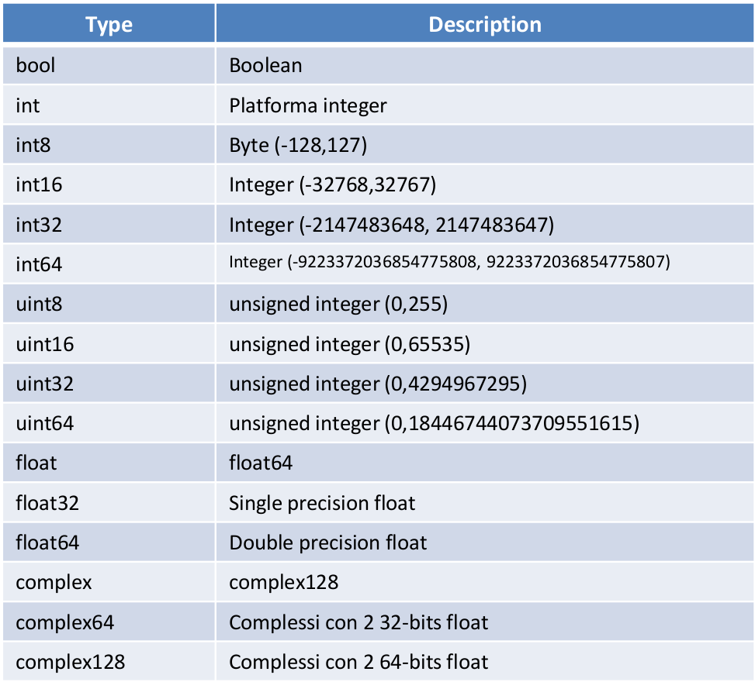
dtype
A numpy array is homogeneous, and contains elements described by a dtype object.
A dtype object can be constructed from different combinations of fundamental numeric types.
Numpy supports more data types than pure python (see table).
Notes:
Masked arrays are arrays that may have missing or invalid entries.
A masked array is the combination of a standard numpy.ndarray and a mask. A mask is either nomask, indicating that no value of the associated array is invalid, or an array of booleans that determines for each element of the associated array whether the value is valid or not. When an element of the mask is False, the corresponding element of the associated array is valid and is said to be unmasked. When an element of the mask is True, the corresponding element of the associated array is said to be masked (invalid).
The package ensures that masked entries are not used in computations.
As an illustration, let’s consider the following dataset:
>>>
>>> import numpy as np
>>> import numpy.ma as ma
>>> x = np.array([1, 2, 3, -1, 5])
We wish to mark the fourth entry as invalid. The easiest is to create a masked array:
>>>
>>> mx = ma.masked_array(x, mask=[0, 0, 0, 1, 0])
We can now compute the mean of the dataset, without taking the invalid data into account:
>>>
>>> mx.mean()
2.75

Slide 21
dtype definition and usage
Array with new user defined types can be created:
>>>dt=dtype([('Name','S3'),(‘Anni', numpy.int64)])
>>a=array([('Chiara',3),('Marco',4)],dtype=dt)
>>> a
array([('Chi', 3L), ('Mar', 4L)],
dtype=[('Name', '|S3'), ('Val', '<i8')])
>>>dt=dtype({'names':('Name','Anni','Cognome'),'formats':('S3','int64','S3')})
>>>a=array([('Chiara',3,'Bianchi'),('Marco',4,'Rossi')],dtype=dt)
>>> a
array([('Chiara', 3L, 'Bia'), ('Marco', 4L, 'Ros')],
dtype=[('Name', '|S10'), ('Anni', '<i8'), ('Cognome', '|S10')])
Notes:
Masked arrays are arrays that may have missing or invalid entries.
A masked array is the combination of a standard numpy.ndarray and a mask. A mask is either nomask, indicating that no value of the associated array is invalid, or an array of booleans that determines for each element of the associated array whether the value is valid or not. When an element of the mask is False, the corresponding element of the associated array is valid and is said to be unmasked. When an element of the mask is True, the corresponding element of the associated array is said to be masked (invalid).
The package ensures that masked entries are not used in computations.
As an illustration, let’s consider the following dataset:
>>>
>>> import numpy as np
>>> import numpy.ma as ma
>>> x = np.array([1, 2, 3, -1, 5])
We wish to mark the fourth entry as invalid. The easiest is to create a masked array:
>>>
>>> mx = ma.masked_array(x, mask=[0, 0, 0, 1, 0])
We can now compute the mean of the dataset, without taking the invalid data into account:
>>>
>>> mx.mean()
2.75

Slide 22
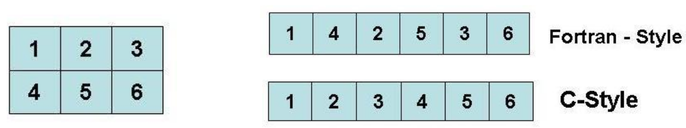
array memory allocation
Memory allocation refers to data store.
C-style memory allocation stores multi-dimensional data in row-major order in memory
Fortran-style memory allocation stores multi-dimensional data in column-major order in memory
Array to store:
Notes:
Masked arrays are arrays that may have missing or invalid entries.
A masked array is the combination of a standard numpy.ndarray and a mask. A mask is either nomask, indicating that no value of the associated array is invalid, or an array of booleans that determines for each element of the associated array whether the value is valid or not. When an element of the mask is False, the corresponding element of the associated array is valid and is said to be unmasked. When an element of the mask is True, the corresponding element of the associated array is said to be masked (invalid).
The package ensures that masked entries are not used in computations.
As an illustration, let’s consider the following dataset:
>>>
>>> import numpy as np
>>> import numpy.ma as ma
>>> x = np.array([1, 2, 3, -1, 5])
We wish to mark the fourth entry as invalid. The easiest is to create a masked array:
>>>
>>> mx = ma.masked_array(x, mask=[0, 0, 0, 1, 0])
We can now compute the mean of the dataset, without taking the invalid data into account:
>>>
>>> mx.mean()
2.75

Slide 23
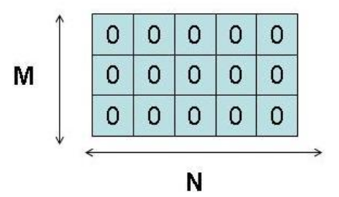
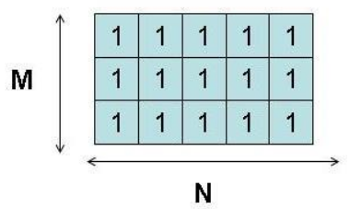
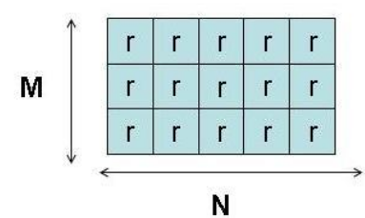
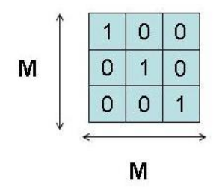
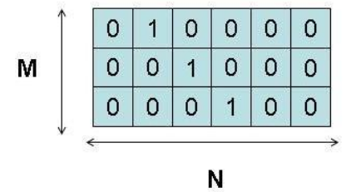
Other array creations
If the array content is unknown, there are functions to fill the array.
zeros( shape, dtype=float, order =‘C’ ) function
create an array of 0 of shape dimension
ones( shape,dtype=None, order =‘C’ )
create an array of 1 of shape dimension
empty( shape, dtype=None, order =‘C’ )
creates an array with shape dimension without initializing it
identity( n, dtype=None )
creates the NxN identity matrix
eye( N, M=None, k=0, dtype=float )
creates an MxM matrix filling with 1 the k-esima diagonal
Note: order : {‘C’, ‘F’}, optional, default: ‘C’. Means whether to store multi-dimensional data in row-major (C-style) or column-major (Fortran-style) order in memory.
Notes:
Masked arrays are arrays that may have missing or invalid entries.
A masked array is the combination of a standard numpy.ndarray and a mask. A mask is either nomask, indicating that no value of the associated array is invalid, or an array of booleans that determines for each element of the associated array whether the value is valid or not. When an element of the mask is False, the corresponding element of the associated array is valid and is said to be unmasked. When an element of the mask is True, the corresponding element of the associated array is said to be masked (invalid).
The package ensures that masked entries are not used in computations.
As an illustration, let’s consider the following dataset:
>>>
>>> import numpy as np
>>> import numpy.ma as ma
>>> x = np.array([1, 2, 3, -1, 5])
We wish to mark the fourth entry as invalid. The easiest is to create a masked array:
>>>
>>> mx = ma.masked_array(x, mask=[0, 0, 0, 1, 0])
We can now compute the mean of the dataset, without taking the invalid data into account:
>>>
>>> mx.mean()
2.75

Slide 24
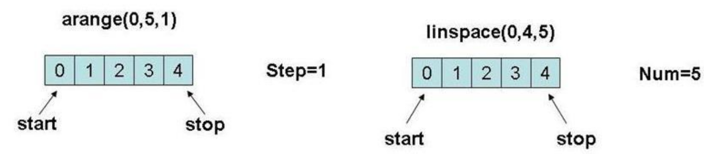
arange() and linspace()
An array can be created from a numbers sequence with functions similar to function range() for lists:
=> arange( [start,] stop[, step,], dtype=None )
creates an array of numbers between ‘start’ and ‘stop’ with step ‘step’
=> linspace( start, stop, num=50, endpoint=True, restep=False )
creates a sequence of num numbers uniformely distributed between start and stop distribuita compresa tra start e stop.
Notes:
Masked arrays are arrays that may have missing or invalid entries.
A masked array is the combination of a standard numpy.ndarray and a mask. A mask is either nomask, indicating that no value of the associated array is invalid, or an array of booleans that determines for each element of the associated array whether the value is valid or not. When an element of the mask is False, the corresponding element of the associated array is valid and is said to be unmasked. When an element of the mask is True, the corresponding element of the associated array is said to be masked (invalid).
The package ensures that masked entries are not used in computations.
As an illustration, let’s consider the following dataset:
>>>
>>> import numpy as np
>>> import numpy.ma as ma
>>> x = np.array([1, 2, 3, -1, 5])
We wish to mark the fourth entry as invalid. The easiest is to create a masked array:
>>>
>>> mx = ma.masked_array(x, mask=[0, 0, 0, 1, 0])
We can now compute the mean of the dataset, without taking the invalid data into account:
>>>
>>> mx.mean()
2.75

Slide 25
Create an array from string
An array can be created from a string using the function fromstring()
Example:
>>> np.fromstring('1 2', dtype=int, sep=' ')
array([1, 2])
>>> np.fromstring('1, 2', dtype=int, sep=',')
array([1, 2])
Notes:
Masked arrays are arrays that may have missing or invalid entries.
A masked array is the combination of a standard numpy.ndarray and a mask. A mask is either nomask, indicating that no value of the associated array is invalid, or an array of booleans that determines for each element of the associated array whether the value is valid or not. When an element of the mask is False, the corresponding element of the associated array is valid and is said to be unmasked. When an element of the mask is True, the corresponding element of the associated array is said to be masked (invalid).
The package ensures that masked entries are not used in computations.
As an illustration, let’s consider the following dataset:
>>>
>>> import numpy as np
>>> import numpy.ma as ma
>>> x = np.array([1, 2, 3, -1, 5])
We wish to mark the fourth entry as invalid. The easiest is to create a masked array:
>>>
>>> mx = ma.masked_array(x, mask=[0, 0, 0, 1, 0])
We can now compute the mean of the dataset, without taking the invalid data into account:
>>>
>>> mx.mean()
2.75

Slide 26
Numerical operations on arrays
Numerical operators in numpy acts elementwise (element-by-element) on arrays.
This rule is valid both for unary and binary operators and also for transcendental functions (like sin, cos, log, etc.)
Example:
b=array([5,6,7,8])
c=arange(1,5)
d=c+b
print “Sum “ ,b,”+”,c, “= “, b+c
b+=1
print “Autoincrement b +=1 b=“, b
print “Multiply c*3 ” ,c, “* 3= ”,c*3
print “Sin (c)”, sin(c)
Output:
Sum [5,6,7,8] + [1,2,3,4] = [6,8,10,12]
Autoincrement b+=1 b= [6,7,8,9]
Multiply c*3 [1,2,3,4] *3 = [3,6,9,12]
Sin(c) [ 0.84147098, 0.90929743, 0.14112001, -0.7568025 ]
To deep:
http://scipy-lectures.org/intro/numpy/operations.html
Notes:
Masked arrays are arrays that may have missing or invalid entries.
A masked array is the combination of a standard numpy.ndarray and a mask. A mask is either nomask, indicating that no value of the associated array is invalid, or an array of booleans that determines for each element of the associated array whether the value is valid or not. When an element of the mask is False, the corresponding element of the associated array is valid and is said to be unmasked. When an element of the mask is True, the corresponding element of the associated array is said to be masked (invalid).
The package ensures that masked entries are not used in computations.
As an illustration, let’s consider the following dataset:
>>>
>>> import numpy as np
>>> import numpy.ma as ma
>>> x = np.array([1, 2, 3, -1, 5])
We wish to mark the fourth entry as invalid. The easiest is to create a masked array:
>>>
>>> mx = ma.masked_array(x, mask=[0, 0, 0, 1, 0])
We can now compute the mean of the dataset, without taking the invalid data into account:
>>>
>>> mx.mean()
2.75

Slide 27
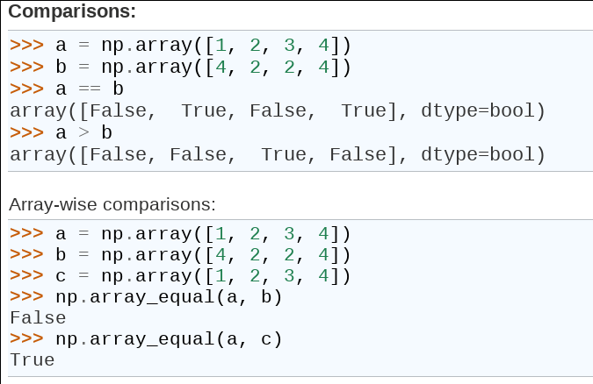
Numerical operations: comparisons
Notes:
Masked arrays are arrays that may have missing or invalid entries.
A masked array is the combination of a standard numpy.ndarray and a mask. A mask is either nomask, indicating that no value of the associated array is invalid, or an array of booleans that determines for each element of the associated array whether the value is valid or not. When an element of the mask is False, the corresponding element of the associated array is valid and is said to be unmasked. When an element of the mask is True, the corresponding element of the associated array is said to be masked (invalid).
The package ensures that masked entries are not used in computations.
As an illustration, let’s consider the following dataset:
>>>
>>> import numpy as np
>>> import numpy.ma as ma
>>> x = np.array([1, 2, 3, -1, 5])
We wish to mark the fourth entry as invalid. The easiest is to create a masked array:
>>>
>>> mx = ma.masked_array(x, mask=[0, 0, 0, 1, 0])
We can now compute the mean of the dataset, without taking the invalid data into account:
>>>
>>> mx.mean()
2.75

Slide 28
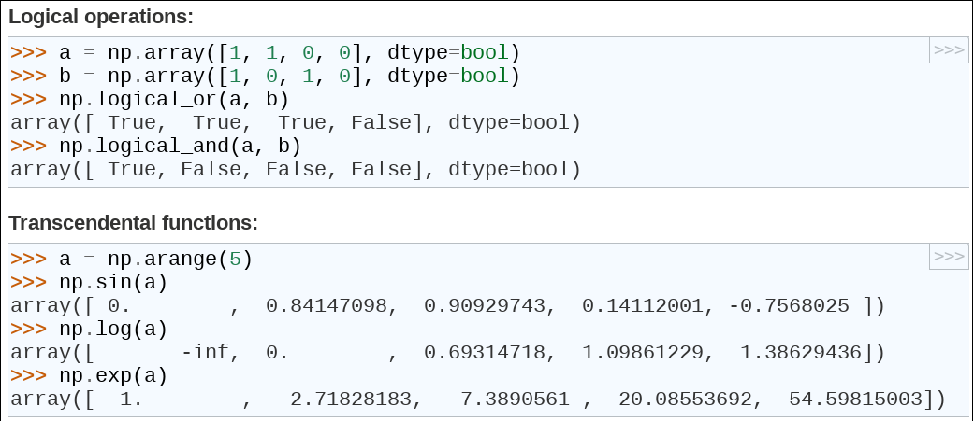
Numerical operations: logical ops and trascendental functions
Notes:
Masked arrays are arrays that may have missing or invalid entries.
A masked array is the combination of a standard numpy.ndarray and a mask. A mask is either nomask, indicating that no value of the associated array is invalid, or an array of booleans that determines for each element of the associated array whether the value is valid or not. When an element of the mask is False, the corresponding element of the associated array is valid and is said to be unmasked. When an element of the mask is True, the corresponding element of the associated array is said to be masked (invalid).
The package ensures that masked entries are not used in computations.
As an illustration, let’s consider the following dataset:
>>>
>>> import numpy as np
>>> import numpy.ma as ma
>>> x = np.array([1, 2, 3, -1, 5])
We wish to mark the fourth entry as invalid. The easiest is to create a masked array:
>>>
>>> mx = ma.masked_array(x, mask=[0, 0, 0, 1, 0])
We can now compute the mean of the dataset, without taking the invalid data into account:
>>>
>>> mx.mean()
2.75

Slide 29
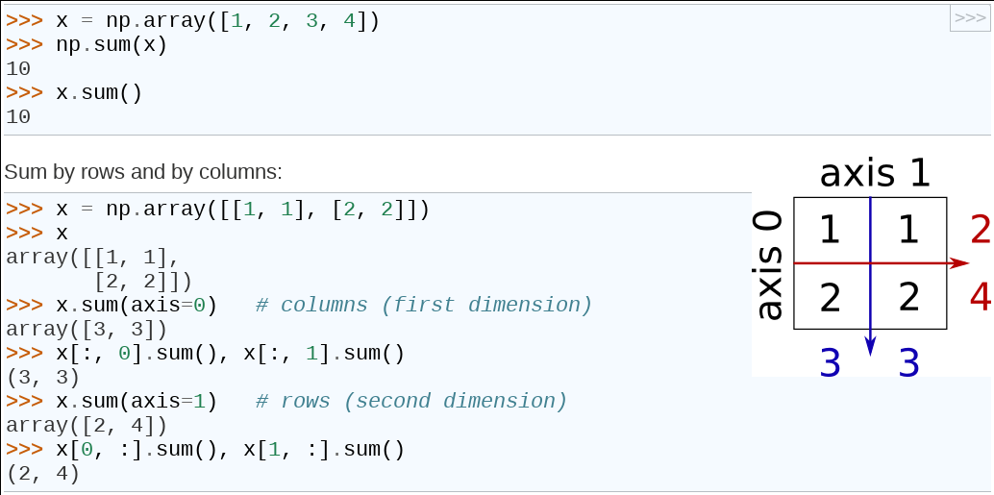
Computing sums
Notes:
Masked arrays are arrays that may have missing or invalid entries.
A masked array is the combination of a standard numpy.ndarray and a mask. A mask is either nomask, indicating that no value of the associated array is invalid, or an array of booleans that determines for each element of the associated array whether the value is valid or not. When an element of the mask is False, the corresponding element of the associated array is valid and is said to be unmasked. When an element of the mask is True, the corresponding element of the associated array is said to be masked (invalid).
The package ensures that masked entries are not used in computations.
As an illustration, let’s consider the following dataset:
>>>
>>> import numpy as np
>>> import numpy.ma as ma
>>> x = np.array([1, 2, 3, -1, 5])
We wish to mark the fourth entry as invalid. The easiest is to create a masked array:
>>>
>>> mx = ma.masked_array(x, mask=[0, 0, 0, 1, 0])
We can now compute the mean of the dataset, without taking the invalid data into account:
>>>
>>> mx.mean()
2.75

Slide 30
Reshaping and resizing arrays
Methods resize e reshape allow to modify shape and dimension of an array.
reshape(shape, order=‘C’)
Return a new data structure with array elements re-distributed on the base of the new shape with the new order
With reshape() the number of array elements is unmodified
resize(new_shape, refcheck=True, order=False)
Allow to modify the array shape and the dimension also
Resize gives an error if the array is referenced.
Examples:
>>>a=arange(20)
>>>a.resize(5,6)
#Ok
>>>b=a
>>>a.resize(3,3)
#Error a is referenced by b
Traceback (most recent call last):
File "<pyshell#160>", line 1, in <module>
a.resize(3,3)
ValueError: cannot resize an array that has been referenced or is referencing another array in this way. Use the resize function
Notes:
Masked arrays are arrays that may have missing or invalid entries.
A masked array is the combination of a standard numpy.ndarray and a mask. A mask is either nomask, indicating that no value of the associated array is invalid, or an array of booleans that determines for each element of the associated array whether the value is valid or not. When an element of the mask is False, the corresponding element of the associated array is valid and is said to be unmasked. When an element of the mask is True, the corresponding element of the associated array is said to be masked (invalid).
The package ensures that masked entries are not used in computations.
As an illustration, let’s consider the following dataset:
>>>
>>> import numpy as np
>>> import numpy.ma as ma
>>> x = np.array([1, 2, 3, -1, 5])
We wish to mark the fourth entry as invalid. The easiest is to create a masked array:
>>>
>>> mx = ma.masked_array(x, mask=[0, 0, 0, 1, 0])
We can now compute the mean of the dataset, without taking the invalid data into account:
>>>
>>> mx.mean()
2.75

Slide 31
reshape() example (try)
>>> a=array(range(1,9))
>>> print “Shape” , a.shape
>>> c_style = a.reshape((2,2,2),order=‘C’) # Array Method: Numpy Style
>>> f_style = reshape(a,(2,2,2),order=‘F’) # Numpy Function
>>> print “C-style “, c_style
>>> print “Fortran-style “, f_style
>>> c_style = c_style.reshape((2,4))
>>> print “Reshape c_style“, c_style
>>> f_style = f_style.reshape((2,4))
>>>print “Reshape f_style”,f_style
1 2 3 4 5 6 7 8
Notes:
Masked arrays are arrays that may have missing or invalid entries.
A masked array is the combination of a standard numpy.ndarray and a mask. A mask is either nomask, indicating that no value of the associated array is invalid, or an array of booleans that determines for each element of the associated array whether the value is valid or not. When an element of the mask is False, the corresponding element of the associated array is valid and is said to be unmasked. When an element of the mask is True, the corresponding element of the associated array is said to be masked (invalid).
The package ensures that masked entries are not used in computations.
As an illustration, let’s consider the following dataset:
>>>
>>> import numpy as np
>>> import numpy.ma as ma
>>> x = np.array([1, 2, 3, -1, 5])
We wish to mark the fourth entry as invalid. The easiest is to create a masked array:
>>>
>>> mx = ma.masked_array(x, mask=[0, 0, 0, 1, 0])
We can now compute the mean of the dataset, without taking the invalid data into account:
>>>
>>> mx.mean()
2.75

Slide 32
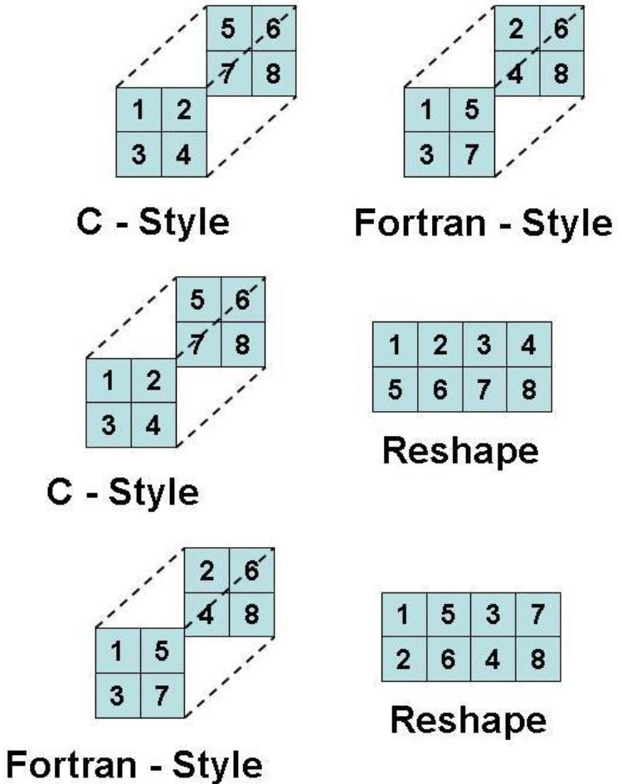
reshape() example output
Shape (8,)
C-style c_style [ [ [1, 2],
[3, 4] ],
[ [5, 6],
[7, 8] ] ]
Fortran-style f_style [ [ [1,5],
[3, 7] ]
[ [2, 6],
[4, 8] ] ]
Reshape c_style [[1, 2, 3, 4],
[5, 6, 7,8]]
Reshape f_style [[1, 5, 3, 7],
[2, 6, 4,8]]
Notes:
Masked arrays are arrays that may have missing or invalid entries.
A masked array is the combination of a standard numpy.ndarray and a mask. A mask is either nomask, indicating that no value of the associated array is invalid, or an array of booleans that determines for each element of the associated array whether the value is valid or not. When an element of the mask is False, the corresponding element of the associated array is valid and is said to be unmasked. When an element of the mask is True, the corresponding element of the associated array is said to be masked (invalid).
The package ensures that masked entries are not used in computations.
As an illustration, let’s consider the following dataset:
>>>
>>> import numpy as np
>>> import numpy.ma as ma
>>> x = np.array([1, 2, 3, -1, 5])
We wish to mark the fourth entry as invalid. The easiest is to create a masked array:
>>>
>>> mx = ma.masked_array(x, mask=[0, 0, 0, 1, 0])
We can now compute the mean of the dataset, without taking the invalid data into account:
>>>
>>> mx.mean()
2.75

Slide 33
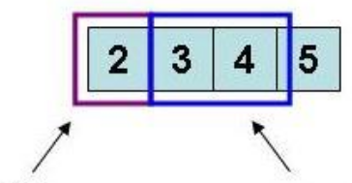
indexing – slicing – iteration (1)
Array Indexing e Slicing
L’accesso agli elementi di un array avviene tramite l’operatore [] . Anche sugli
array è applicabile l’operatore di slicing [:] .
Nel caso di array monodimensionali si adotta la stessa notazione delle liste.
Esempio
>>> a = np.ones(4)
>>> a
array([ 1., 1., 1., 1.])
>>> b = np.arange(1,5)
>>> b
array([1, 2, 3, 4])
>>> a+=b ; a # a+=b means a=a+b
array([ 2., 3., 4., 5.])
>>> print “a[0] “, a[0]
>>> 2.0
>>> a[1:3]=a[1:3]*3 # Modify the elements from 1 to 3
>>> print a
>>> [ 2., 9., 12., 5.]
a[0]
a[1:3]
Notes:
Masked arrays are arrays that may have missing or invalid entries.
A masked array is the combination of a standard numpy.ndarray and a mask. A mask is either nomask, indicating that no value of the associated array is invalid, or an array of booleans that determines for each element of the associated array whether the value is valid or not. When an element of the mask is False, the corresponding element of the associated array is valid and is said to be unmasked. When an element of the mask is True, the corresponding element of the associated array is said to be masked (invalid).
The package ensures that masked entries are not used in computations.
As an illustration, let’s consider the following dataset:
>>>
>>> import numpy as np
>>> import numpy.ma as ma
>>> x = np.array([1, 2, 3, -1, 5])
We wish to mark the fourth entry as invalid. The easiest is to create a masked array:
>>>
>>> mx = ma.masked_array(x, mask=[0, 0, 0, 1, 0])
We can now compute the mean of the dataset, without taking the invalid data into account:
>>>
>>> mx.mean()
2.75

Slide 34
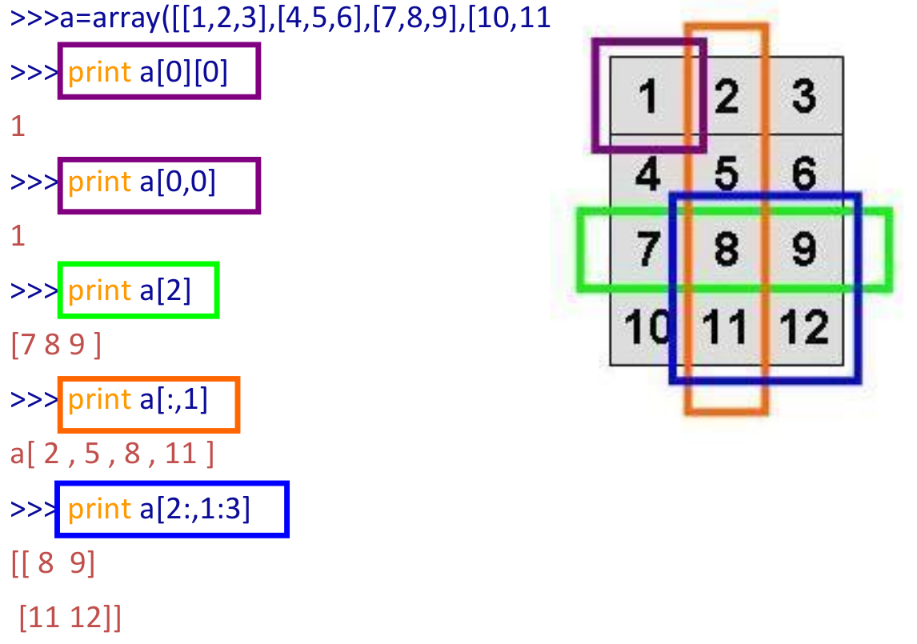
indexing – slicing – iteration (2)
,12]])
Notes:
Masked arrays are arrays that may have missing or invalid entries.
A masked array is the combination of a standard numpy.ndarray and a mask. A mask is either nomask, indicating that no value of the associated array is invalid, or an array of booleans that determines for each element of the associated array whether the value is valid or not. When an element of the mask is False, the corresponding element of the associated array is valid and is said to be unmasked. When an element of the mask is True, the corresponding element of the associated array is said to be masked (invalid).
The package ensures that masked entries are not used in computations.
As an illustration, let’s consider the following dataset:
>>>
>>> import numpy as np
>>> import numpy.ma as ma
>>> x = np.array([1, 2, 3, -1, 5])
We wish to mark the fourth entry as invalid. The easiest is to create a masked array:
>>>
>>> mx = ma.masked_array(x, mask=[0, 0, 0, 1, 0])
We can now compute the mean of the dataset, without taking the invalid data into account:
>>>
>>> mx.mean()
2.75

Slide 35
indexing – slicing – iteration (3)
Example:
>>> a=np.arange(25)
>>> a=a.reshape((5,5)) ; print(a)
array([[ 0, 1, 2, 3, 4],
[ 5, 6, 7, 8, 9],
[10, 11, 12, 13, 14],
[15, 16, 17, 18, 19],
[20, 21, 22, 23, 24]])
>>> print(a[::,1])
array([ 1, 6, 11, 16, 21])
>>> print(a[1])
array([5, 6, 7, 8, 9])
>>> print(a[1,:])
array([5, 6, 7, 8, 9])
>>> print(a[1,::])
array([5, 6, 7, 8, 9])
>>> print(a[1,::2])
array([5, 7, 9])
>>> print(a[1,10::-1])
array([9, 8, 7, 6, 5])
Notes:
Masked arrays are arrays that may have missing or invalid entries.
A masked array is the combination of a standard numpy.ndarray and a mask. A mask is either nomask, indicating that no value of the associated array is invalid, or an array of booleans that determines for each element of the associated array whether the value is valid or not. When an element of the mask is False, the corresponding element of the associated array is valid and is said to be unmasked. When an element of the mask is True, the corresponding element of the associated array is said to be masked (invalid).
The package ensures that masked entries are not used in computations.
As an illustration, let’s consider the following dataset:
>>>
>>> import numpy as np
>>> import numpy.ma as ma
>>> x = np.array([1, 2, 3, -1, 5])
We wish to mark the fourth entry as invalid. The easiest is to create a masked array:
>>>
>>> mx = ma.masked_array(x, mask=[0, 0, 0, 1, 0])
We can now compute the mean of the dataset, without taking the invalid data into account:
>>>
>>> mx.mean()
2.75

Slide 36
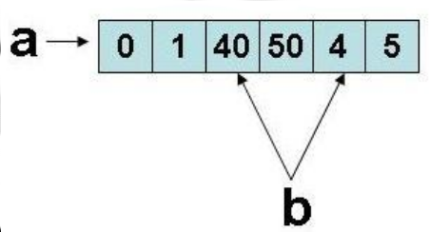
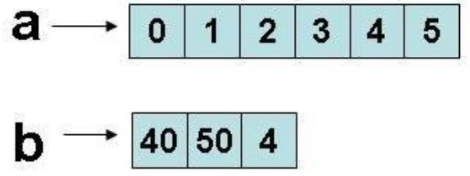
indexing – slicing – iteration (4)
Note:
The slicing operation for numpy arrays is different from slicing for python built-in lists:
in numpy array slicing the generated sub-array is a reference to the original memory area
in built-in python lists the generated sub-list is a by-value copy of the original memory area
>>> a=np.arange(6) ; a
array([0, 1, 2, 3, 4, 5])
>>> b=a[2:5] ; b
array([2, 3, 4])
>>> b[0]=40
>>> b[1]=50
>>> print “a:“, a , “b:”, b
a: [ 0 1 40 50 4 5] b: [40 50 4]
This impacts on performances and memory consumption and results.
>>> a=range(6) ; a
[0, 1, 2, 3, 4, 5]
>>> b=a[2:5] ; b
[2, 3, 4]
>>> b[0]=40
>>> b[1]=50
>>> print “a:“, a , “b:”, b
a: [ 0 1 2 3 4 5] b: [40 50 4]
Notes:
Masked arrays are arrays that may have missing or invalid entries.
A masked array is the combination of a standard numpy.ndarray and a mask. A mask is either nomask, indicating that no value of the associated array is invalid, or an array of booleans that determines for each element of the associated array whether the value is valid or not. When an element of the mask is False, the corresponding element of the associated array is valid and is said to be unmasked. When an element of the mask is True, the corresponding element of the associated array is said to be masked (invalid).
The package ensures that masked entries are not used in computations.
As an illustration, let’s consider the following dataset:
>>>
>>> import numpy as np
>>> import numpy.ma as ma
>>> x = np.array([1, 2, 3, -1, 5])
We wish to mark the fourth entry as invalid. The easiest is to create a masked array:
>>>
>>> mx = ma.masked_array(x, mask=[0, 0, 0, 1, 0])
We can now compute the mean of the dataset, without taking the invalid data into account:
>>>
>>> mx.mean()
2.75

Slide 37
indexing – slicing – iteration (5)
The copy is done element-by-element and the two objects are different.
Example:
>>> a = np.arange(5)
>>> b = np.zeros_like(a) # Return an array of zeros with the same shape and type as a given array.
>>> b[:] = a[:] # Copy is element-by-element and the two objects are different
>>> b[3] = 1000
>>> b == a
array([True,True,True,False,True],dtype=bool)
Notes:
Masked arrays are arrays that may have missing or invalid entries.
A masked array is the combination of a standard numpy.ndarray and a mask. A mask is either nomask, indicating that no value of the associated array is invalid, or an array of booleans that determines for each element of the associated array whether the value is valid or not. When an element of the mask is False, the corresponding element of the associated array is valid and is said to be unmasked. When an element of the mask is True, the corresponding element of the associated array is said to be masked (invalid).
The package ensures that masked entries are not used in computations.
As an illustration, let’s consider the following dataset:
>>>
>>> import numpy as np
>>> import numpy.ma as ma
>>> x = np.array([1, 2, 3, -1, 5])
We wish to mark the fourth entry as invalid. The easiest is to create a masked array:
>>>
>>> mx = ma.masked_array(x, mask=[0, 0, 0, 1, 0])
We can now compute the mean of the dataset, without taking the invalid data into account:
>>>
>>> mx.mean()
2.75

Slide 38
indexing – slicing – iteration (6)
Iteration on array elements can be done in different ways
by default iteration is along the first axis
Example:
>>>a=np.arange(9)
>>> for el in a:
… print el
>>>[ 0 1 2]
[ 1 2 3]
[ 2 3 4]
by for along one defined axis
Example:
>>> a=np.arange(9)
>>>a.shape=(3,3)
>>>for i in xrange(a.shape[0]):
… for j in xrange(a.shape[1]):
… a[i,j]=i+j
Through flat iterator on every array element.
Esempio:
>>> for i in a.flat:
… print i
0 1 2 1 2 3 2 3 4
Note:
The array iteration is computationally no efficient.
Python has specific functions (C written) to
work directly on the entire array (more efficient).
Avoid for loop when possible.
Notes:
Masked arrays are arrays that may have missing or invalid entries.
A masked array is the combination of a standard numpy.ndarray and a mask. A mask is either nomask, indicating that no value of the associated array is invalid, or an array of booleans that determines for each element of the associated array whether the value is valid or not. When an element of the mask is False, the corresponding element of the associated array is valid and is said to be unmasked. When an element of the mask is True, the corresponding element of the associated array is said to be masked (invalid).
The package ensures that masked entries are not used in computations.
As an illustration, let’s consider the following dataset:
>>>
>>> import numpy as np
>>> import numpy.ma as ma
>>> x = np.array([1, 2, 3, -1, 5])
We wish to mark the fourth entry as invalid. The easiest is to create a masked array:
>>>
>>> mx = ma.masked_array(x, mask=[0, 0, 0, 1, 0])
We can now compute the mean of the dataset, without taking the invalid data into account:
>>>
>>> mx.mean()
2.75

Slide 39
Array selection
The selection of array elements can be done in other different, more complex ways :
– Through an array of indices
>>> x = np.arange(10,1,-1); x
array([10, 9, 8, 7, 6, 5, 4, 3, 2])
>>> A=x[np.array([3,3,2,8])]; A
array([7, 7, 8, 2])
>>> AA=x[np.array([[3,3],[2,8]])]; AA
array([[7, 7],
[8, 2]])
– Using a boolean mask
>>> y = np.arange(18); y
>>> y=y.reshape(3,6); y
array([[ 0, 1, 2, 3, 4, 5],
[ 6, 7, 8, 9, 10, 11],
[12, 13, 14, 15, 16, 17]])
>>> y[y>10]
array([11, 12, 13, 14, 15, 16, 17] # 1d array
The new array:
➔ has the same shape of the array of indices
➔ has the same type and values of the original array
Notes:
Masked arrays are arrays that may have missing or invalid entries.
A masked array is the combination of a standard numpy.ndarray and a mask. A mask is either nomask, indicating that no value of the associated array is invalid, or an array of booleans that determines for each element of the associated array whether the value is valid or not. When an element of the mask is False, the corresponding element of the associated array is valid and is said to be unmasked. When an element of the mask is True, the corresponding element of the associated array is said to be masked (invalid).
The package ensures that masked entries are not used in computations.
As an illustration, let’s consider the following dataset:
>>>
>>> import numpy as np
>>> import numpy.ma as ma
>>> x = np.array([1, 2, 3, -1, 5])
We wish to mark the fourth entry as invalid. The easiest is to create a masked array:
>>>
>>> mx = ma.masked_array(x, mask=[0, 0, 0, 1, 0])
We can now compute the mean of the dataset, without taking the invalid data into account:
>>>
>>> mx.mean()
2.75

Slide 40
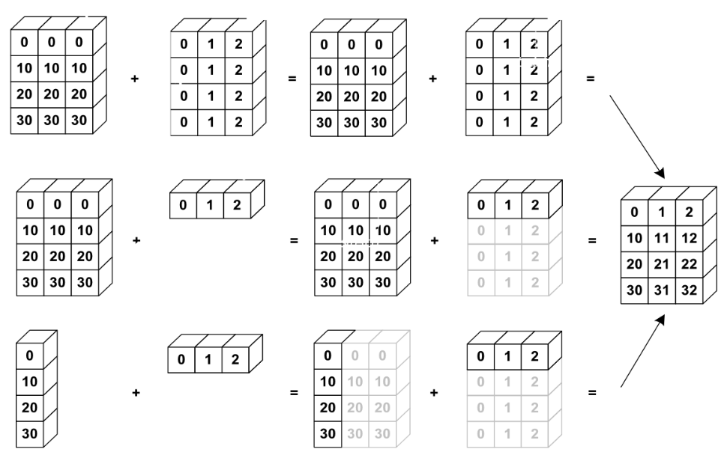
Broadcasting
Basic operations on numpy arrays (addition, etc.) are elementwise (element-by-element)
This works on arrays of the same size.
Nevertheless, It’s also possible to do operations on arrays of different sizes if NumPy can transform these arrays so that they all have the same size: this conversion is called broadcasting.
The image below gives an example of broadcasting:
Notes:
Masked arrays are arrays that may have missing or invalid entries.
A masked array is the combination of a standard numpy.ndarray and a mask. A mask is either nomask, indicating that no value of the associated array is invalid, or an array of booleans that determines for each element of the associated array whether the value is valid or not. When an element of the mask is False, the corresponding element of the associated array is valid and is said to be unmasked. When an element of the mask is True, the corresponding element of the associated array is said to be masked (invalid).
The package ensures that masked entries are not used in computations.
As an illustration, let’s consider the following dataset:
>>>
>>> import numpy as np
>>> import numpy.ma as ma
>>> x = np.array([1, 2, 3, -1, 5])
We wish to mark the fourth entry as invalid. The easiest is to create a masked array:
>>>
>>> mx = ma.masked_array(x, mask=[0, 0, 0, 1, 0])
We can now compute the mean of the dataset, without taking the invalid data into account:
>>>
>>> mx.mean()
2.75

Slide 41
Broadcasting rules
The broadcasting has two rules:
If the two arrays have not the same number of dimension
then the more little array is re-shaped (adding dimension ‘1’ until both arrays have the same dimension
Arrays with dimension ‘1’ along one direction behaves as the array bigger along that version. The value is repeated along the broadcast direction.
Notes:
Masked arrays are arrays that may have missing or invalid entries.
A masked array is the combination of a standard numpy.ndarray and a mask. A mask is either nomask, indicating that no value of the associated array is invalid, or an array of booleans that determines for each element of the associated array whether the value is valid or not. When an element of the mask is False, the corresponding element of the associated array is valid and is said to be unmasked. When an element of the mask is True, the corresponding element of the associated array is said to be masked (invalid).
The package ensures that masked entries are not used in computations.
As an illustration, let’s consider the following dataset:
>>>
>>> import numpy as np
>>> import numpy.ma as ma
>>> x = np.array([1, 2, 3, -1, 5])
We wish to mark the fourth entry as invalid. The easiest is to create a masked array:
>>>
>>> mx = ma.masked_array(x, mask=[0, 0, 0, 1, 0])
We can now compute the mean of the dataset, without taking the invalid data into account:
>>>
>>> mx.mean()
2.75

Slide 42
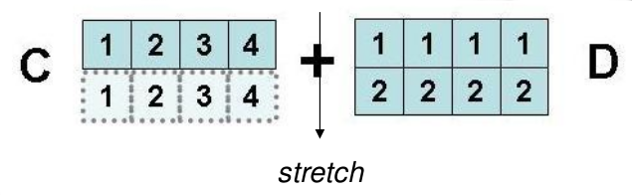
Broadcasting example
c=np.arange(1,5)
d=np.array([[1,1,1,1],[2,2,2,2]])
print d, ”+”, c “= “ d+c
Notes:
Masked arrays are arrays that may have missing or invalid entries.
A masked array is the combination of a standard numpy.ndarray and a mask. A mask is either nomask, indicating that no value of the associated array is invalid, or an array of booleans that determines for each element of the associated array whether the value is valid or not. When an element of the mask is False, the corresponding element of the associated array is valid and is said to be unmasked. When an element of the mask is True, the corresponding element of the associated array is said to be masked (invalid).
The package ensures that masked entries are not used in computations.
As an illustration, let’s consider the following dataset:
>>>
>>> import numpy as np
>>> import numpy.ma as ma
>>> x = np.array([1, 2, 3, -1, 5])
We wish to mark the fourth entry as invalid. The easiest is to create a masked array:
>>>
>>> mx = ma.masked_array(x, mask=[0, 0, 0, 1, 0])
We can now compute the mean of the dataset, without taking the invalid data into account:
>>>
>>> mx.mean()
2.75

Slide 43
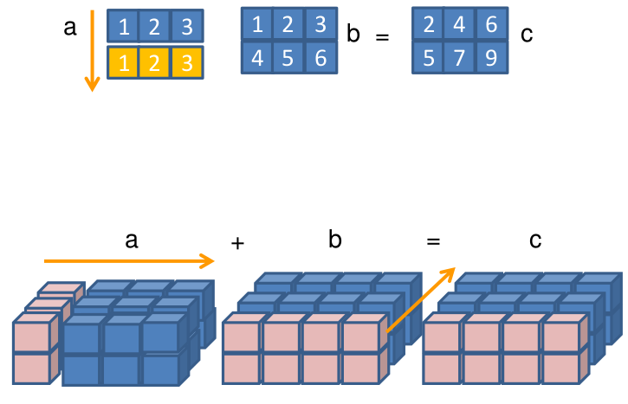
Broadcasting example
Broadcast can always be used on 1-dimensional arrays.
Examples:
a=np.array([1,2,3])
a.shape # (3,)
b=np.array([[1,2,3],[4,5,6]])
b.shape #(2,3)
c=a+b # OK!! Broadcastable
a=np.arange(6)
a=a.reshape((2,1,3))
b=np.arange(8)
b=b.reshape((2,4,1))
c=a+b # OK!! Broadcastable
a=np.arange(30)
a=a.reshape((2,5,3))
b=np.arange(8)
b=b.reshape((2,4,1))
c=a+b # No Broadcastable
Traceback (most recent call last):
File "<stdin>", line 1, in <module>
ValueError: operands could not be broadcast together with shapes (2,5,3) (2,4,1)
Notes:
Masked arrays are arrays that may have missing or invalid entries.
A masked array is the combination of a standard numpy.ndarray and a mask. A mask is either nomask, indicating that no value of the associated array is invalid, or an array of booleans that determines for each element of the associated array whether the value is valid or not. When an element of the mask is False, the corresponding element of the associated array is valid and is said to be unmasked. When an element of the mask is True, the corresponding element of the associated array is said to be masked (invalid).
The package ensures that masked entries are not used in computations.
As an illustration, let’s consider the following dataset:
>>>
>>> import numpy as np
>>> import numpy.ma as ma
>>> x = np.array([1, 2, 3, -1, 5])
We wish to mark the fourth entry as invalid. The easiest is to create a masked array:
>>>
>>> mx = ma.masked_array(x, mask=[0, 0, 0, 1, 0])
We can now compute the mean of the dataset, without taking the invalid data into account:
>>>
>>> mx.mean()
2.75

Slide 44
Vectorization
For loops are slow in Python.
One advatage in using numpy arrays is the provided ability to execute a lot of operations avoiding explicit loops.
Avoiding explicit loops is called vectorization.
Example:
Esempi:
a=np.arange(0,4*np.pi,0.1)
VECTORIZED VERSION
y=np.sin(a)*2
SCALAR VERSION
y=zeros(len(a))
for i in xrange(len(a)):
y[i]=np.sin(a[i])*2
Sometimes it is needed to vectorize explicitely the algorithm:
• Directly: vectorize(function) # a bit slow!
• Manually: withsuitable techniques, like slicing for example
Notes:
Masked arrays are arrays that may have missing or invalid entries.
A masked array is the combination of a standard numpy.ndarray and a mask. A mask is either nomask, indicating that no value of the associated array is invalid, or an array of booleans that determines for each element of the associated array whether the value is valid or not. When an element of the mask is False, the corresponding element of the associated array is valid and is said to be unmasked. When an element of the mask is True, the corresponding element of the associated array is said to be masked (invalid).
The package ensures that masked entries are not used in computations.
As an illustration, let’s consider the following dataset:
>>>
>>> import numpy as np
>>> import numpy.ma as ma
>>> x = np.array([1, 2, 3, -1, 5])
We wish to mark the fourth entry as invalid. The easiest is to create a masked array:
>>>
>>> mx = ma.masked_array(x, mask=[0, 0, 0, 1, 0])
We can now compute the mean of the dataset, without taking the invalid data into account:
>>>
>>> mx.mean()
2.75

Slide 45
Vectorization
Vectorization is not always possible.
Example:
def func(x):
if x<0: return 1
else: return sin(x)
func(3)
func(array([1,-2,9]))
Traceback (most recent call last):
ValueError: The truth value of an array with more than one element is
ambiguous. Use
a.any() or a.all()
Scalar version to work with arrays:
def func_NumPy(x):
r = x.copy() # allocate result array
for i in xrange(size(x)):
if x[i] < 0:
r[i] = 0.0
else:
r[i] = sin(x[i])
return r
This implementation is very slow in Python and it works only for 1-dimensional arrays
=> The ‘where’ statement can be used instead
Notes:
Masked arrays are arrays that may have missing or invalid entries.
A masked array is the combination of a standard numpy.ndarray and a mask. A mask is either nomask, indicating that no value of the associated array is invalid, or an array of booleans that determines for each element of the associated array whether the value is valid or not. When an element of the mask is False, the corresponding element of the associated array is valid and is said to be unmasked. When an element of the mask is True, the corresponding element of the associated array is said to be masked (invalid).
The package ensures that masked entries are not used in computations.
As an illustration, let’s consider the following dataset:
>>>
>>> import numpy as np
>>> import numpy.ma as ma
>>> x = np.array([1, 2, 3, -1, 5])
We wish to mark the fourth entry as invalid. The easiest is to create a masked array:
>>>
>>> mx = ma.masked_array(x, mask=[0, 0, 0, 1, 0])
We can now compute the mean of the dataset, without taking the invalid data into account:
>>>
>>> mx.mean()
2.75

Slide 46
Vectorization
def f(x):
if condition:
x = <expression1>
else:
x = <expression2>
return x
def f_vectorized(x):
x1 = <expression1>
x2 = <expression2>
return where(condition, x1, x2)
Using vectorization, the previous examples becpomes:
def func_NumPyV2(x):
return where(x < 0, 0.0, sin(x))
• Avoid for cicle usage
• Run on molti-dimentional structures
This is the famous pythonic way of work
Notes:
Masked arrays are arrays that may have missing or invalid entries.
A masked array is the combination of a standard numpy.ndarray and a mask. A mask is either nomask, indicating that no value of the associated array is invalid, or an array of booleans that determines for each element of the associated array whether the value is valid or not. When an element of the mask is False, the corresponding element of the associated array is valid and is said to be unmasked. When an element of the mask is True, the corresponding element of the associated array is said to be masked (invalid).
The package ensures that masked entries are not used in computations.
As an illustration, let’s consider the following dataset:
>>>
>>> import numpy as np
>>> import numpy.ma as ma
>>> x = np.array([1, 2, 3, -1, 5])
We wish to mark the fourth entry as invalid. The easiest is to create a masked array:
>>>
>>> mx = ma.masked_array(x, mask=[0, 0, 0, 1, 0])
We can now compute the mean of the dataset, without taking the invalid data into account:
>>>
>>> mx.mean()
2.75

Slide 47
Vectorization
Array slicing can be used to vectorize operations.
In scientific field, for example, applications regarding
– schemas for finite differences equations
– image processing
it is common to find expressions like:
xk = xk-1 + 2xk + xk-1 k=1,2,...,n-1
It can be managed:
with scalar functions
for i in xrange(len(x)-1):
x[i]=x[i-1]+2*x[i]+x[i+2]
or using vectorization:
x[1:n-1]=x[0:n-2]+2*x[1:n-1]+x[2:n]
Notes:
Masked arrays are arrays that may have missing or invalid entries.
A masked array is the combination of a standard numpy.ndarray and a mask. A mask is either nomask, indicating that no value of the associated array is invalid, or an array of booleans that determines for each element of the associated array whether the value is valid or not. When an element of the mask is False, the corresponding element of the associated array is valid and is said to be unmasked. When an element of the mask is True, the corresponding element of the associated array is said to be masked (invalid).
The package ensures that masked entries are not used in computations.
As an illustration, let’s consider the following dataset:
>>>
>>> import numpy as np
>>> import numpy.ma as ma
>>> x = np.array([1, 2, 3, -1, 5])
We wish to mark the fourth entry as invalid. The easiest is to create a masked array:
>>>
>>> mx = ma.masked_array(x, mask=[0, 0, 0, 1, 0])
We can now compute the mean of the dataset, without taking the invalid data into account:
>>>
>>> mx.mean()
2.75

Slide 48
Array copy
Copy can be of two types:
copy by reference (it is the copy of memory area pointer)
copy by value (a new memori area is crested with the same value)
Array copy is by default by reference:
>>>a=arange(5)
a: [0,1,2,3,4]
>>>b=a
>>>b[0]=100
>>>print “a:”, a , “b:” , b
a: [100,1,2,3,4] b: [100,1,2,3,4]
Array assignment by value is done using method copy: >>>c=a.copy()
>>>print “id(a): “, id(a), “id(c):”, id(c)
id(a): 18820584 id(c): 21335648
>>>c[0]=100
>>>print “c” , c , “a”, a
c [100, 1, 2, 3, 4] a [0, 1, 2, 3, 4]
a
a = b means:
b
a
3
b
3
a
100 1 2 3 4
b
Notes:
Masked arrays are arrays that may have missing or invalid entries.
A masked array is the combination of a standard numpy.ndarray and a mask. A mask is either nomask, indicating that no value of the associated array is invalid, or an array of booleans that determines for each element of the associated array whether the value is valid or not. When an element of the mask is False, the corresponding element of the associated array is valid and is said to be unmasked. When an element of the mask is True, the corresponding element of the associated array is said to be masked (invalid).
The package ensures that masked entries are not used in computations.
As an illustration, let’s consider the following dataset:
>>>
>>> import numpy as np
>>> import numpy.ma as ma
>>> x = np.array([1, 2, 3, -1, 5])
We wish to mark the fourth entry as invalid. The easiest is to create a masked array:
>>>
>>> mx = ma.masked_array(x, mask=[0, 0, 0, 1, 0])
We can now compute the mean of the dataset, without taking the invalid data into account:
>>>
>>> mx.mean()
2.75

Slide 49
I/O with array NumPy
Functions eval and repr can be used to write and read ASCII format files
a = linspace(1, 21, 21)
a.shape = (2,10)
# ASCII format:
file = open(’tmp.dat’, ’w’)
file.write(’Here is an array a:\n’)
file.write(repr(a)) # dump string representation of a
file.close()
# load the array from file into b:
file = open(’tmp.dat’, ’r’)
file.readline() # load the first line (a comment)
b = eval(file.read())
file.close()
Files I/O can be managed with loadtxt and savetxt
Write file:
numpy.loadtxt(fname, dtype=<type'float'>, comments='#', delimiter=None, converters=None, skiprows=0,usecols=None, unpack=False, ndmin=0)
Read file:
numpy.savetxt(fname, X, fmt='%.18e', delimiter='', newline='\n', header='', footer='',comments='#)
Notes:
Masked arrays are arrays that may have missing or invalid entries.
A masked array is the combination of a standard numpy.ndarray and a mask. A mask is either nomask, indicating that no value of the associated array is invalid, or an array of booleans that determines for each element of the associated array whether the value is valid or not. When an element of the mask is False, the corresponding element of the associated array is valid and is said to be unmasked. When an element of the mask is True, the corresponding element of the associated array is said to be masked (invalid).
The package ensures that masked entries are not used in computations.
As an illustration, let’s consider the following dataset:
>>>
>>> import numpy as np
>>> import numpy.ma as ma
>>> x = np.array([1, 2, 3, -1, 5])
We wish to mark the fourth entry as invalid. The easiest is to create a masked array:
>>>
>>> mx = ma.masked_array(x, mask=[0, 0, 0, 1, 0])
We can now compute the mean of the dataset, without taking the invalid data into account:
>>>
>>> mx.mean()
2.75

Slide 50
I/O with array NumPy
Text.txt
Student test1 test2 test3 test4
Lisa 98.3 94.2 95.3 91.3
Carlo 47.2 49.1 54.2 34.7
Mario 84.2 85.3 94.1 76.4
>>>a = loadtxt('textfile.txt',skiprows=2,usecols=range(1,5))‫‫‫‬
>>>print a
[[ 98.3 94.2 95.3 91.3]
[ 47.2 49.1 54.2 34.7]
[ 84.2 85.3 94.1 76.4]]
>>>b = loadtxt(‘textfile.txt’,skiprows=2,usecols=(1,-2))‫‫‫‬
>>> print b
[[ 98.3 95.3]
[ 47.2 54.2]
[ 84.2 94.1]]
Notes:
Masked arrays are arrays that may have missing or invalid entries.
A masked array is the combination of a standard numpy.ndarray and a mask. A mask is either nomask, indicating that no value of the associated array is invalid, or an array of booleans that determines for each element of the associated array whether the value is valid or not. When an element of the mask is False, the corresponding element of the associated array is valid and is said to be unmasked. When an element of the mask is True, the corresponding element of the associated array is said to be masked (invalid).
The package ensures that masked entries are not used in computations.
As an illustration, let’s consider the following dataset:
>>>
>>> import numpy as np
>>> import numpy.ma as ma
>>> x = np.array([1, 2, 3, -1, 5])
We wish to mark the fourth entry as invalid. The easiest is to create a masked array:
>>>
>>> mx = ma.masked_array(x, mask=[0, 0, 0, 1, 0])
We can now compute the mean of the dataset, without taking the invalid data into account:
>>>
>>> mx.mean()
2.75

Slide 51
Matrix
Numpy provides standard classes, inheriting by array and using its internal structure
• Matrix inherit from ndarray methods and attributes
• Matrix class specific attributes
– .T trasposta
– .H coniugata trasposta
– .I inversa
– .A array bidimensionale
• Matrix defines only bidimensional objects
• Matrix * operator executes multiplication
• Matrix objects have priority respect to simple arrays
Notes:
Masked arrays are arrays that may have missing or invalid entries.
A masked array is the combination of a standard numpy.ndarray and a mask. A mask is either nomask, indicating that no value of the associated array is invalid, or an array of booleans that determines for each element of the associated array whether the value is valid or not. When an element of the mask is False, the corresponding element of the associated array is valid and is said to be unmasked. When an element of the mask is True, the corresponding element of the associated array is said to be masked (invalid).
The package ensures that masked entries are not used in computations.
As an illustration, let’s consider the following dataset:
>>>
>>> import numpy as np
>>> import numpy.ma as ma
>>> x = np.array([1, 2, 3, -1, 5])
We wish to mark the fourth entry as invalid. The easiest is to create a masked array:
>>>
>>> mx = ma.masked_array(x, mask=[0, 0, 0, 1, 0])
We can now compute the mean of the dataset, without taking the invalid data into account:
>>>
>>> mx.mean()
2.75

Slide 52
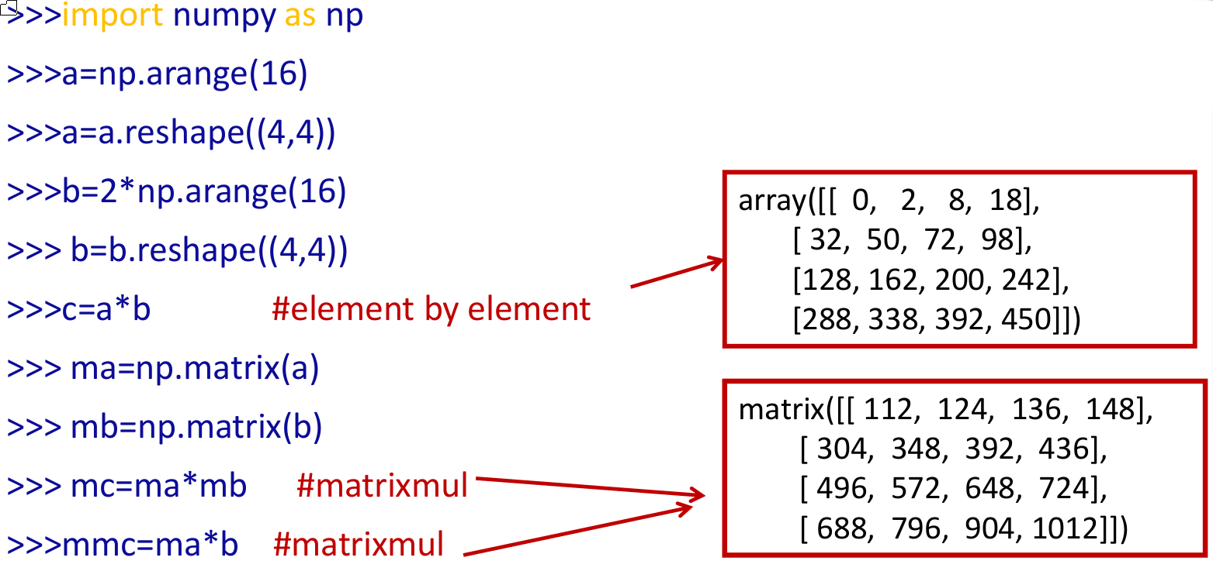
Matrix
Notes:
Masked arrays are arrays that may have missing or invalid entries.
A masked array is the combination of a standard numpy.ndarray and a mask. A mask is either nomask, indicating that no value of the associated array is invalid, or an array of booleans that determines for each element of the associated array whether the value is valid or not. When an element of the mask is False, the corresponding element of the associated array is valid and is said to be unmasked. When an element of the mask is True, the corresponding element of the associated array is said to be masked (invalid).
The package ensures that masked entries are not used in computations.
As an illustration, let’s consider the following dataset:
>>>
>>> import numpy as np
>>> import numpy.ma as ma
>>> x = np.array([1, 2, 3, -1, 5])
We wish to mark the fourth entry as invalid. The easiest is to create a masked array:
>>>
>>> mx = ma.masked_array(x, mask=[0, 0, 0, 1, 0])
We can now compute the mean of the dataset, without taking the invalid data into account:
>>>
>>> mx.mean()
2.75

Slide 53
linalg
The Numpy module contains interesting submodules. One of them is
linalg
containing some algorithm of linear algebra.
It contains functions to solve:
  linear systems
  compute eigenvalues
  compute eigenvectors
  factorization
  invert matrix
  matrix multiply
>>> dir(linalg)
Notes:
Masked arrays are arrays that may have missing or invalid entries.
A masked array is the combination of a standard numpy.ndarray and a mask. A mask is either nomask, indicating that no value of the associated array is invalid, or an array of booleans that determines for each element of the associated array whether the value is valid or not. When an element of the mask is False, the corresponding element of the associated array is valid and is said to be unmasked. When an element of the mask is True, the corresponding element of the associated array is said to be masked (invalid).
The package ensures that masked entries are not used in computations.
As an illustration, let’s consider the following dataset:
>>>
>>> import numpy as np
>>> import numpy.ma as ma
>>> x = np.array([1, 2, 3, -1, 5])
We wish to mark the fourth entry as invalid. The easiest is to create a masked array:
>>>
>>> mx = ma.masked_array(x, mask=[0, 0, 0, 1, 0])
We can now compute the mean of the dataset, without taking the invalid data into account:
>>>
>>> mx.mean()
2.75

Slide 54
linalg: example
>>> A = np.zeros((10,10)) # arrays initialization
>>> x = np.arange(10)/2.0
>>> for i in range(10):
… for j in range(10):
… A[i,j] = 2.0 + float(i+1)/float(j+i+1)
>>> b = np.dot(A, x)
>>> y = np.linalg.solve(A, b) # A*y=b → y=x
# eigenvalues only:
>>> A_eigenvalues = np.linalg.eigvals(A)
# eigenvalues and eigenvectors:
>>> A_eigenvalues, A_eigenvectors = np.linalg.eig(A)
Notes:
Masked arrays are arrays that may have missing or invalid entries.
A masked array is the combination of a standard numpy.ndarray and a mask. A mask is either nomask, indicating that no value of the associated array is invalid, or an array of booleans that determines for each element of the associated array whether the value is valid or not. When an element of the mask is False, the corresponding element of the associated array is valid and is said to be unmasked. When an element of the mask is True, the corresponding element of the associated array is said to be masked (invalid).
The package ensures that masked entries are not used in computations.
As an illustration, let’s consider the following dataset:
>>>
>>> import numpy as np
>>> import numpy.ma as ma
>>> x = np.array([1, 2, 3, -1, 5])
We wish to mark the fourth entry as invalid. The easiest is to create a masked array:
>>>
>>> mx = ma.masked_array(x, mask=[0, 0, 0, 1, 0])
We can now compute the mean of the dataset, without taking the invalid data into account:
>>>
>>> mx.mean()
2.75

Slide 55
random
random is another NumPy sub-module to generate random numbers
>>> dir(random)
The standard numpy module is not efficient in random number ganeration, it is more efficient to use numpy.random
Example:
>>> np.random.seed(100)
>>> x = np.random.random(4)
array([ 0.89132195, 0.20920212, 0.18532822,0.10837689])
>>> y = np.random.uniform(1, 1, n) # n uniform
numbers in interval (1,1)
Distribuzione normale
>>> mean = 0.0; stdev = 1.0
>>> u = np.random.normal(mean, stdev, n)
Notes:
Masked arrays are arrays that may have missing or invalid entries.
A masked array is the combination of a standard numpy.ndarray and a mask. A mask is either nomask, indicating that no value of the associated array is invalid, or an array of booleans that determines for each element of the associated array whether the value is valid or not. When an element of the mask is False, the corresponding element of the associated array is valid and is said to be unmasked. When an element of the mask is True, the corresponding element of the associated array is said to be masked (invalid).
The package ensures that masked entries are not used in computations.
As an illustration, let’s consider the following dataset:
>>>
>>> import numpy as np
>>> import numpy.ma as ma
>>> x = np.array([1, 2, 3, -1, 5])
We wish to mark the fourth entry as invalid. The easiest is to create a masked array:
>>>
>>> mx = ma.masked_array(x, mask=[0, 0, 0, 1, 0])
We can now compute the mean of the dataset, without taking the invalid data into account:
>>>
>>> mx.mean()
2.75

Slide 56
scipy

Slide 57
Scipy
SciPy is a collection of
  mathematical algorithms and
  convenience functions
built on the numpy extension of Python.
It provides the user with high-level commands and classes for manipulating and visualizing data.
Using an interactive Python session with scipy we have a data-processing and system-prototyping environment rivaling systems such as MATLAB, IDL.
https://docs.scipy.org/doc/scipy/reference/tutorial/index.html

Slide 58
Scipy modules
SciPy is organized into subpackages covering different scientific computing domains:
Subpackage | Description
cluster | Clustering algorithms
constants | Physical and mathematical constants
fftpack | Fast Fourier Transform routines
integrate | Integration and ordinary differential equation solvers
interpolate | Interpolation and smoothing splines
io | Input and Output
linalg | Linear algebra
ndimage | N-dimensional image processing
odr | Orthogonal distance regression
optimize | Optimization and root-finding routines
signal | Signal processing
sparse | Sparse matrices and associated routines
spatial | Spatial data structures and algorithms
special | Special functions
stats | Statistical distribution and function
Scipy sub-packages need to be imported separately. Example:
from scipy import linalg, io

Slide 59
matplotlib

Slide 60
Matplotlib
Matplotlib is a Python 2D plotting library which produces publication quality figures in a variety of hardcopy formats and interactive environments across platforms.
You can generate plots, histograms, power spectra, bar charts, errorcharts, scatterplots, etc., with just a few lines of code.
For simple plotting the pyplot sub-module provides a MATLAB-like interface, particularly when combined with IPython. For the power user, you have full control of line styles, font properties, axes properties, etc, via an object oriented interface or via a set of functions familiar to MATLAB users.

Slide 61
Matplotlib: Gallery
https://matplotlib.org/gallery/index.html#examples-index
This gallery contains examples of the many things you can do with Matplotlib.
It is completely searchable from the search page:
https://matplotlib.org/search.html
A set of tutorial is accessible:
https://matplotlib.org/tutorials/index.html

Slide 62
example code: simple_plot.py
Simple plot of a sin function, with labels on x and y axis (simple_plot.py):
import matplotlib.pyplot as plt
import numpy as np
t = np.arange(0.0, 2.0, 0.01)
s = 1 + np.sin(2*np.pi*t)
plt.plot(t, s)
plt.xlabel('time (s)')
plt.ylabel('voltage (mV)')
plt.title('About as simple as it gets, folks')
plt.grid(True)
plt.savefig("test.png")
plt.show()
https://matplotlib.org/examples/pylab_examples/simple_plot.html

Slide 63
Exercise
Using the previous example, make some try changing the scale and the labels.
Try to plot also different functions.

Slide 64
Example: subplots
import numpy as np
import matplotlib.pyplot as plt
x1 = np.linspace(0.0, 5.0)
x2 = np.linspace(0.0, 2.0)
y1 = np.cos(2 * np.pi * x1) * np.exp(-x1)
y2 = np.cos(2 * np.pi * x2)
plt.subplot(2, 1, 1)
plt.plot(x1, y1, 'o-')
plt.title('A tale of 2 subplots')
plt.ylabel('Damped oscillation')
plt.subplot(2, 1, 2)
plt.plot(x2, y2, '.-')
plt.xlabel('time (s)')
plt.ylabel('Undamped')
plt.show()
https://matplotlib.org/gallery/subplots_axes_and_figures/subplot.html

Slide 65
Example: statisctics
import numpy as np
from matplotlib import pyplot as plt
# read data by file
data = np.loadtxt('data/populations.txt')
# read variables by line
year, hares, lynxes, carrots = data.T
# plot populations
print("plot the 4 populations on the same graph")
plt.axes([0.2, 0.1, 0.5, 0.8])
plt.plot(year, hares, year, lynxes, year, carrots)
plt.legend(('Hare', 'Lynx', 'Carrot'), loc=(1.05, 0.5))
plt.show()
plt.close()
http://scipy-lectures.org/intro/numpy/operations.html
print("The mean populations over time:")
populations = data[:, 1:]
print(populations.mean(axis=0))
# Expected result:
# [ 34080.95238095 20166.66666667 42400. ]
print("The sample standard deviations:")
print(populations.std(axis=0))
# Expected result:
# [ 20897.90645809 16254.59153691 3322.5062]
print("Which species has the highest population
each year?:")
print(np.argmax(populations, axis=1))
# Expected result:
# [2 2 0 0 1 1 2 2 2 2 2 2 0 0 0 1 2 2 2 2 2]

Slide 66
astropy

Slide 67
Astropy
The astropy package contains key functionality and common tools needed for performing astronomy and astrophysics with Python.
It is at the core of the Astropy Project, which aims to enable the community to develop a robust ecosystem of Affiliated Packages covering a broad range of needs for astronomical research, data processing, and data analysis.
http://docs.astropy.org/en/stable/

Slide 68
Astropy: content
Data structures and transformations
Constants (astropy.constants)
Units and Quantities (astropy.units)
N-dimensional datasets (astropy.nddata)
Data Tables (astropy.table)
Time and Dates (astropy.time)
Astronomical Coordinate Systems (astropy.coordinates)
World Coordinate System (astropy.wcs)
Models and Fitting (astropy.modeling)
Uncertainties and Distributions (astropy.uncertainty)
Files, I/O, and Communication
Unified file read/write interface
FITS File handling (astropy.io.fits)
ASCII Tables (astropy.io.ascii)
VOTable XML handling (astropy.io.votable)
Miscellaneous: HDF5, YAML, ASDF, pickle (astropy.io.misc)
SAMP (Simple Application Messaging Protocol (astropy.samp)
http://docs.astropy.org/en/stable/

Slide 69
Astropy: content
Computations and utilities
Cosmological Calculations (astropy.cosmology)
Convolution and filtering (astropy.convolution)
Data Visualization (astropy.visualization)
Astrostatistics Tools (astropy.stats)
Nuts and bolts
Configuration system (astropy.config)
I/O Registry (astropy.io.registry)
Logging system
Python warnings system
Astropy Core Package Utilities (astropy.utils)
Astropy Testing Tools
Try the development version
http://docs.astropy.org/en/stable/

