Slide 1

NHS: Analysing Staffing and Resource Utilization

Slide 2
NHS Objectives
Efficiently allocate resources to improve effectiveness of the NHS.
Address capacity needs to meet the demands of the healthcare system.
Reduce missed appointments to improve overall efficiency.

Slide 3
Key NHS Inquiries
Should the NHS start looking at increasing staff levels?
How the healthcare professional types differ over time?
Are there significant changes in the attendance of appointments?
Are there any trends in time between booking an appointment?
Are there changes in terms of appointment type and the busiest months?
How do the various service settings compare?

Slide 4
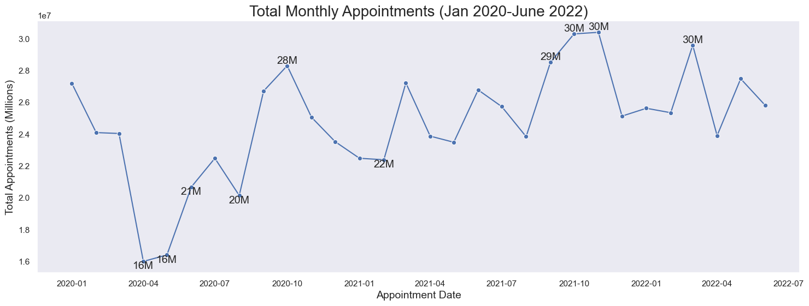
NHS appointments saw a significant drop with the first Covid-19 lockdown in March 2020.
The busiest months, October, November and March, after July 2021 by 30M.

Slide 5
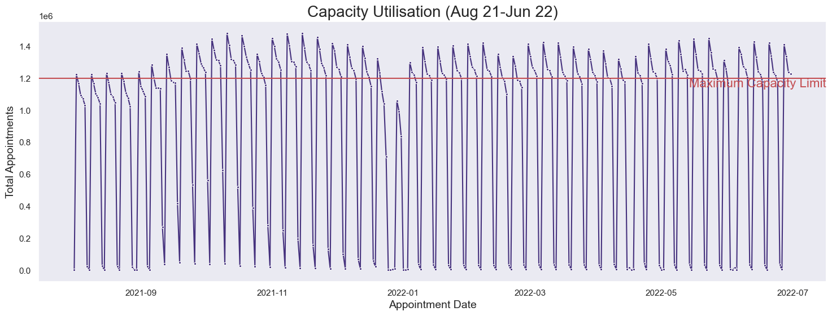
Should the NHS start looking at increasing staff levels?
52% of the days exceed the daily maximum capacity of 1.2M.

Slide 6
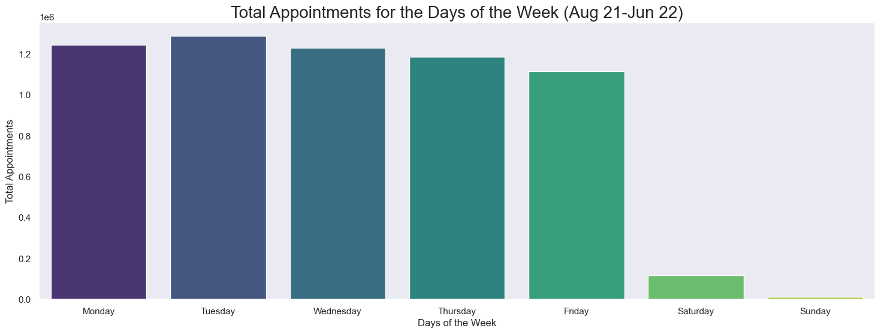
Tuesdays emerge as the busiest day, attracting the highest number of appointments.

Slide 7
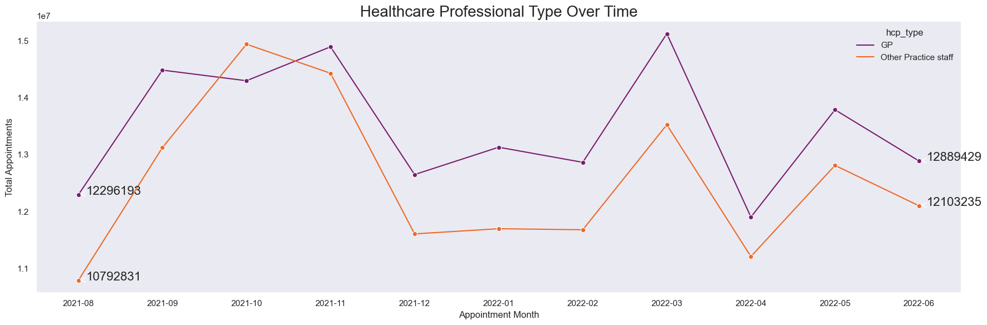
How do the healthcare professional types differ over time?
The number of patients attended to by Other Practice Staff saw a significant increase,1.3M, compared to the 600K rise for GPs.

Slide 8
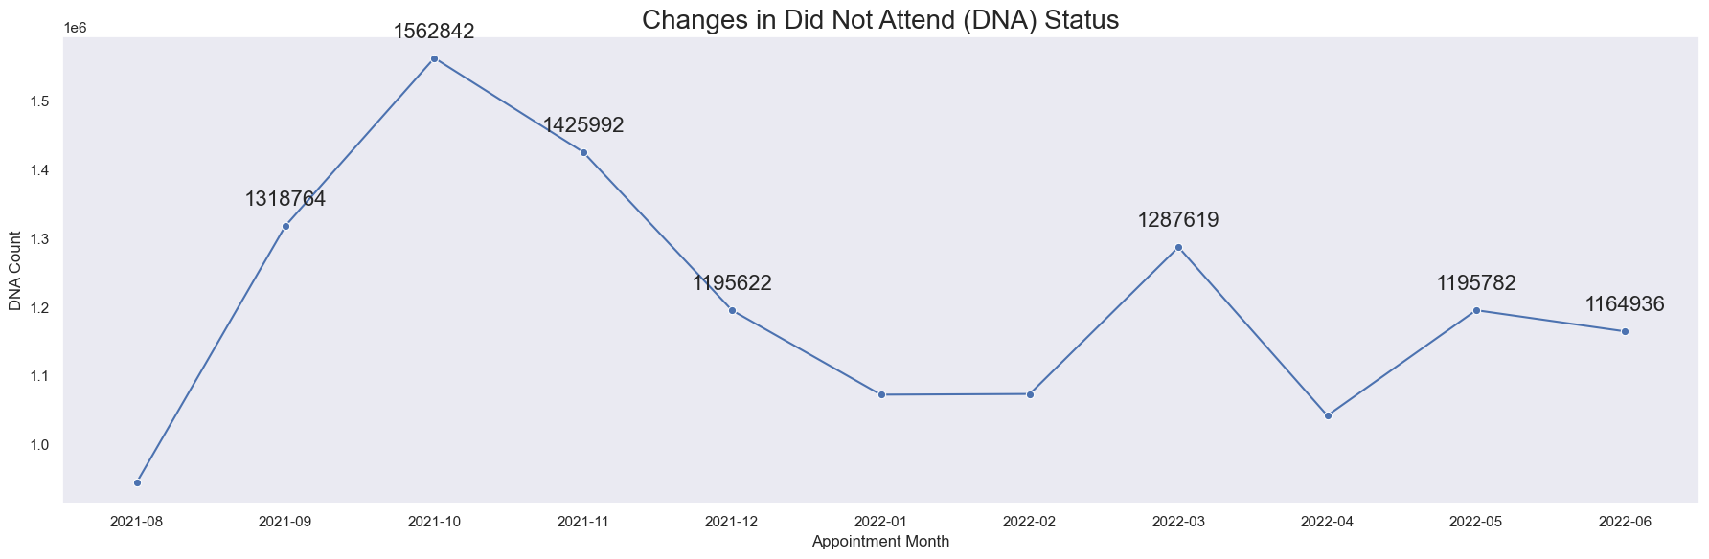
Are there significant changes in the attendance of appointments?
The positive correlation between the busiest months and DNA status.

Slide 9
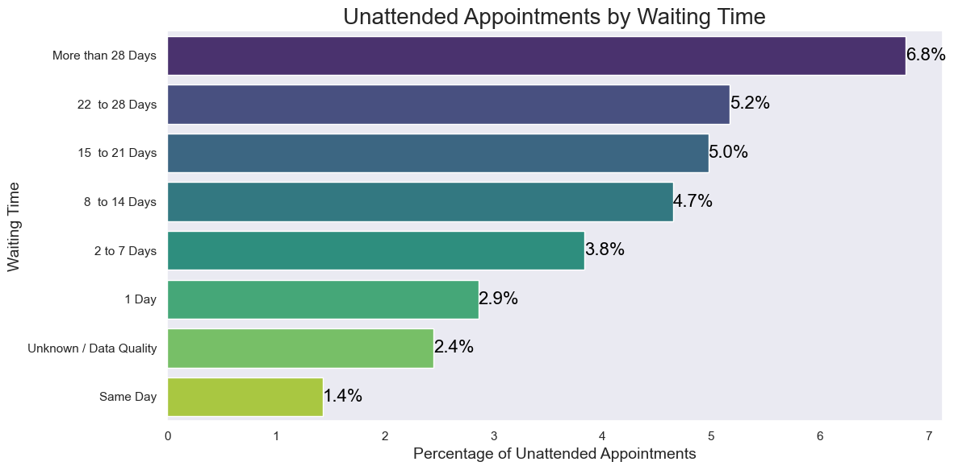
Are there any trends in time between booking an appointment?
The positive correlation between duration of patient waiting time and DNA status.

Slide 10
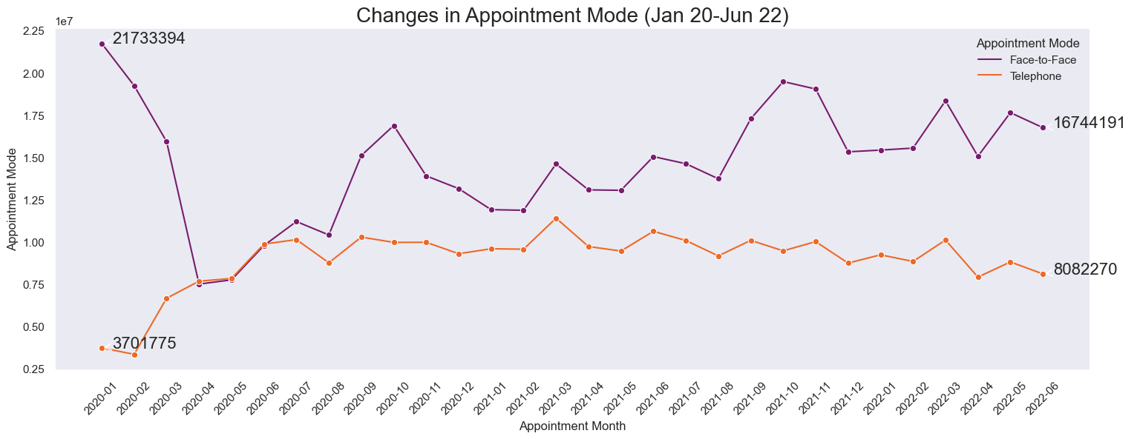
Are there changes in terms of appointment type and the busiest months?
Telephone appointments saw a substantial rise of 4.4M, while face-to-face app. decreased by 5M.

Slide 11
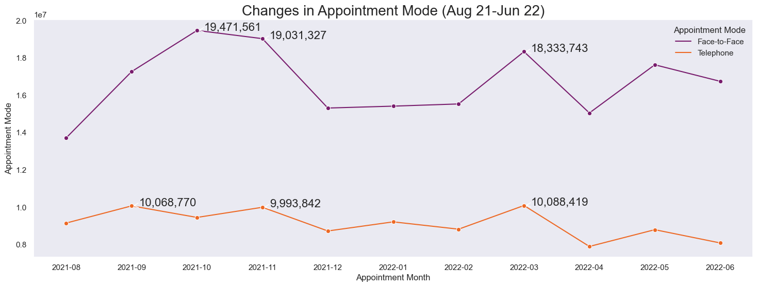
A notable rise in both telephone and face-to-face appointments in the busiest months.

Slide 12
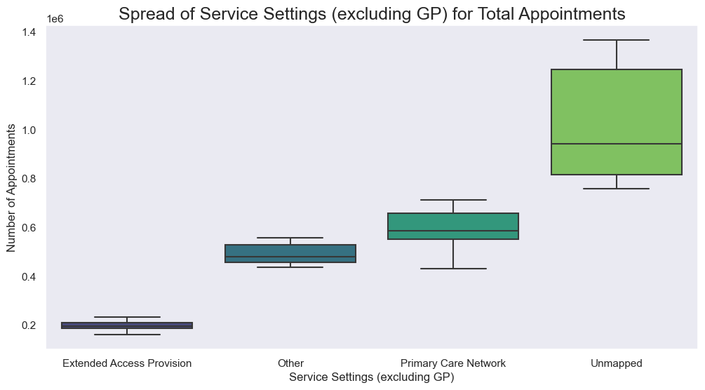
How do the various service settings compare?
Excluding General Practice, 91.5%, the appointments in unmapped service settings have exceed 1M.

Slide 13
Recommendations
Increase Early Week Staffing: Allocate more staff earlier in the week or/and extend staff availability on weekends.
Promote Telephone Appointments: Encourage the use of telephone appointments.
Same-Day Appointments: Prioritize scheduling and promoting same-day appointments or/and keep the time between booking and the actual appointment as short as possible.
Patient Preferences: Conduct consultations with patients to understand their preferences for appointment types and times.
Online Scheduling: Consider implementing an online scheduling system that allows patients to book appointments conveniently.

Slide 14
Gozde McGerr
4th March 2024

