Slide 1

Turtle games
Predictive Data Analytics for Customer Engagement and Marketing Optimization
Gozde McGerr
Notes:
Introduction

Slide 2
Business questions
customers
Who are our customers, and what level of loyalty do they exhibit?
loyalty
How can we improve customer loyalty accumulation to boost our sales?
marketing
Which specific customer groups can be targeted by marketing department?
Reviews
How can we use customer reviews and feedback to improve customer satisfaction?

Slide 3
Who are our Customers?
84%
57%
48%
AGE 20-60
FEMALE
GRADUATES
Age Does Not Influence Loyalty Accumulation
Females Accumulate More Loyalty Points compared to 43% of Males.
Education Plays a Role in Influencing Loyalty.
Notes:
Customer Demographics and Loyalty Insights

Slide 4
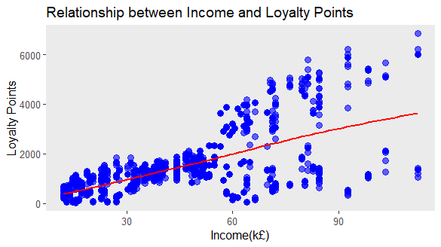
Increase in Customers’ Income Correlates with Higher Loyalty Points Accumulation.
Notes:
Boosting Customer Loyalty

Slide 5
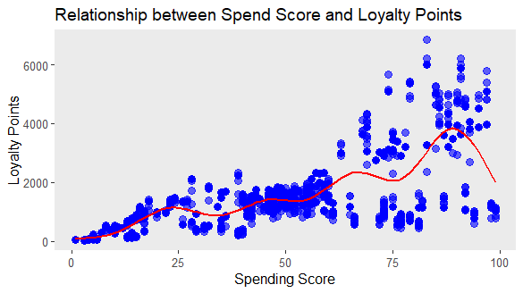
A Complex Relationship between Spending Scores and Loyalty Points, with Loyalty Initially Increasing but Later Declining Past a Certain Threshold.
Notes:
Complexities of Spending Behaviour

Slide 6
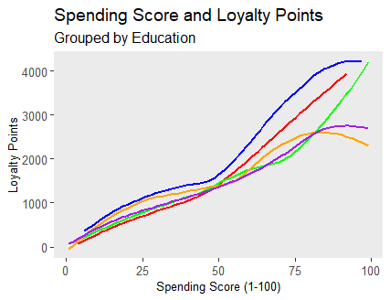
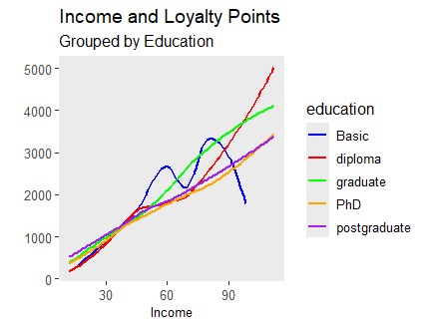
Education Level Impact: Basic Education Customers Show Highest Loyalty, suggesting Less Income Influence
Notes:
Loyalty and Education

Slide 7
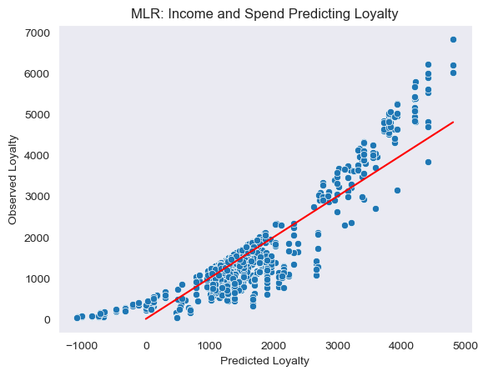
The Combined Effects of Income and Spend on Loyalty Significantly Positive
Notes:
Understanding Buying Behaviour

Slide 8
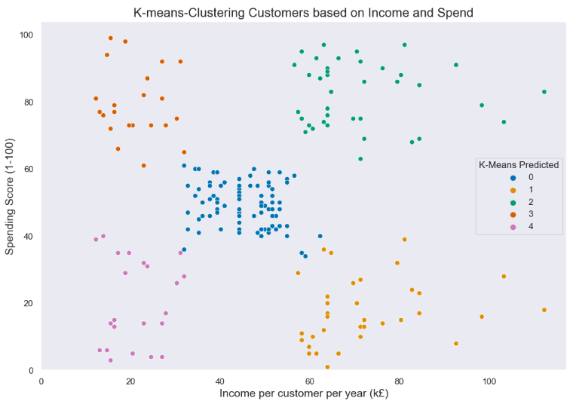
High-income Customers Need Attention due to their Unexpectedly Low Spending Habits.
0 Moderate Income Spending.
1 High Income but Low Spending.
3 High Income and Spending.
4 Low Income but High Spending.
5 Low Income and Spending.
Notes:
Customer Segmentation

Slide 9
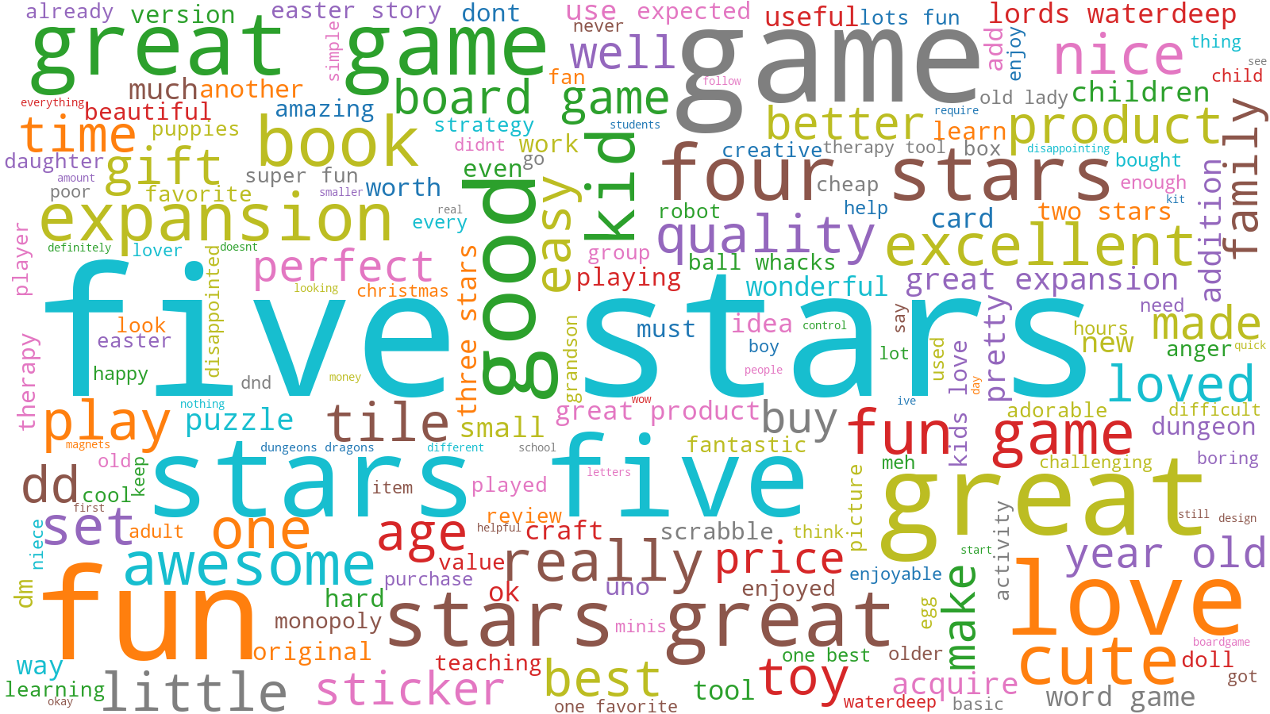
Notes:
Leveraging Customer Feedback

Slide 10
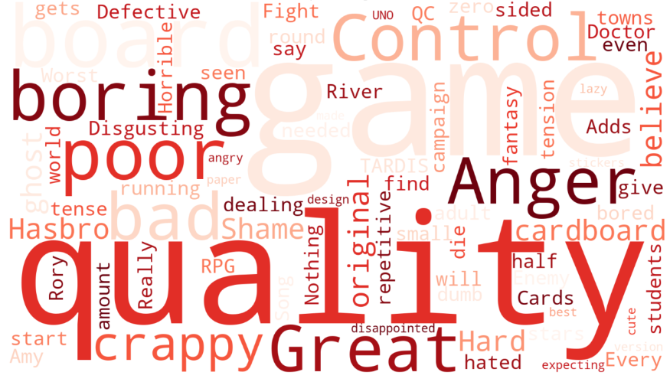
Notes:
Addressing Quality Concerns

Slide 11
recommendations
Refine Targeting Strategies: Encourage loyalty among high-spending customers and those with basic education.
Proactive Customer Engagement: Engage dissatisfied customers in direct consultations to understand their concerns and provide customized solutions.
Comprehensive Sales and Product Analysis: Analyse for reasons low customer spending, identify underperforming products, address quality issues, and optimize product offerings.

Slide 12
conclusion
By addressing these key areas—targeting specific customer groups, engaging with dissatisfied customers, conducting thorough sales analysis, and prioritising product quality—we can optimize our market offerings, and achieve sustained growth in the gaming industry.

Slide 13
THANK YOU
Gozde McGerr
22/04/2024

