Slide 1
Bon Voyage
A tour recommendation and management system
Perpetual Squad
Prachi Gupta - MT21135
Vishnumolakala Nikhila - MT21103
Madadi Vineeth Reddy - MT21046
Nellore Bhavana - MT21131
Elapanti Sri Sai Chaithanya - MT21120

Slide 2

Contents
Motivation
Problem statement
Related work
Features proposed
Challenges faced
Future work

Slide 3

Motivation
What does one do when they want to relax away from their monotonous life?
Go on a vacation!!!
The process of going through hotels, reviews, bookings, ratings, attractions, and fun things to do within budget. is tedious and time-consuming.
The user has to go through hundreds of websites to plan a vacation according to his preferences.
App provides a personalized recommendation based on the user's choice along with bookings and guide assistance.
“One stop solution to all of our travel needs”

Slide 4

Problem statement
To resolve the problem of spending a considerate amount of time planning a vacation, our app provides a one-stop solution to the user that not only suggests a place based on his preferences but also makes the travel easy by providing the transport, accommodation facilities and arranging a guide to show him around the selected place.
Hence, we propose Bon Voyage!

Slide 5



Related work
MakeMyTrip: Provides online travel services including airline tickets, domestic and international holiday packages, hotel reservations, rail, and bus tickets. Recommendation functionality was very limited to only a few user preferences.
TripAdvisor: Offers online hotel reservations and bookings for transportation, lodging, travel experiences, and restaurants. Suitable when user already has a location in mind.
Triplt: Arranges all the travel bookings, tickets, and reservations at one single place and recommends to the user all the schedules. It smoothly organizes all the travel plans and smoothens the hassle-free journey.

Slide 6

Features Proposed
User Registration and authentication
Recommendation System
Selection if already have a place in mind
Accommodation
Transportation
Booking a guide

Slide 7
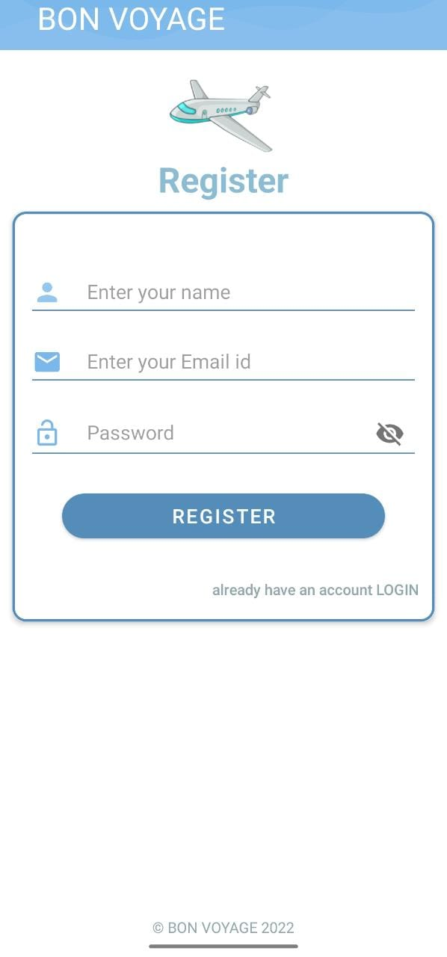
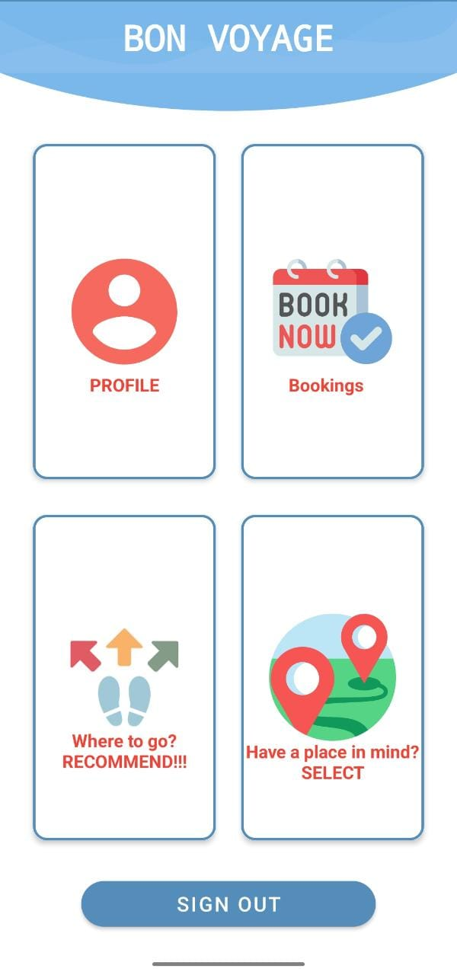
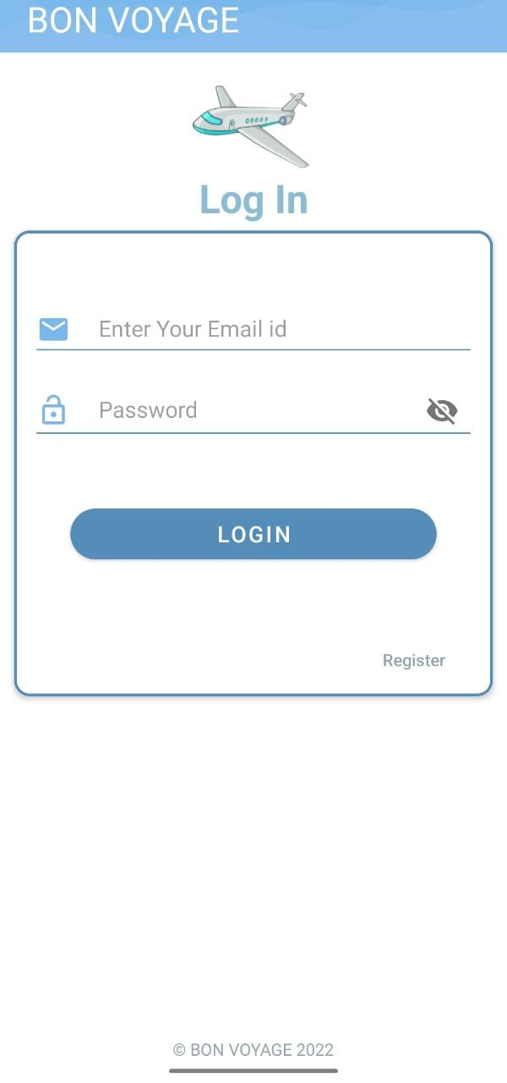
Features Implemented (a glimpse…..)
User registration and authentication

Slide 8
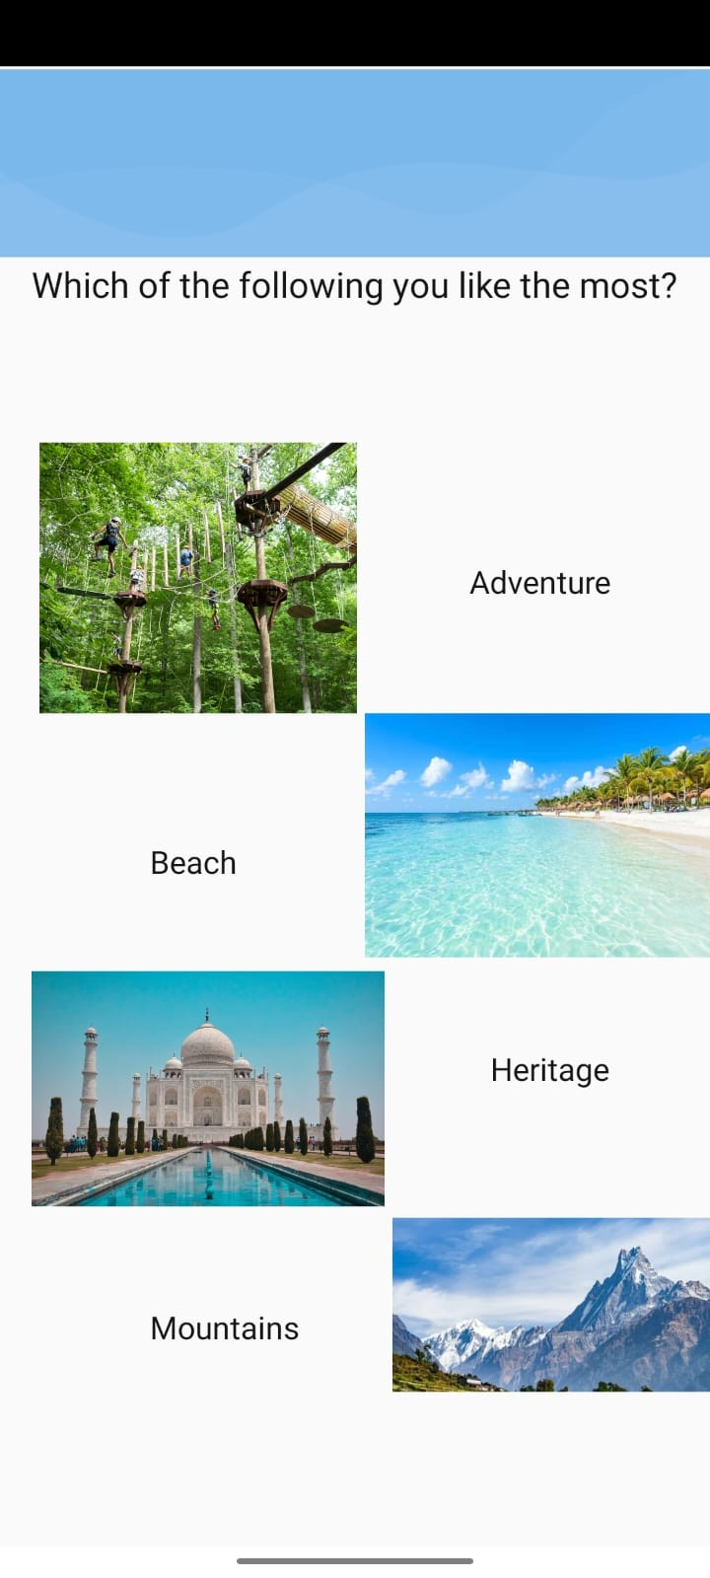
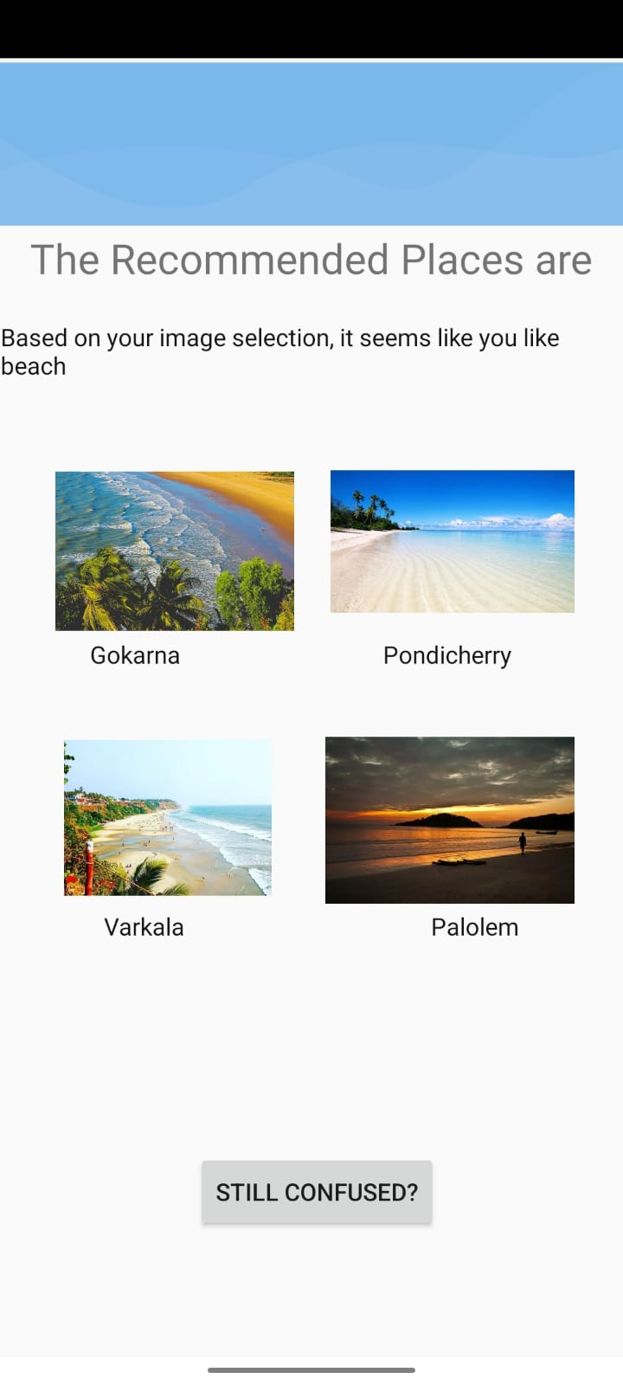
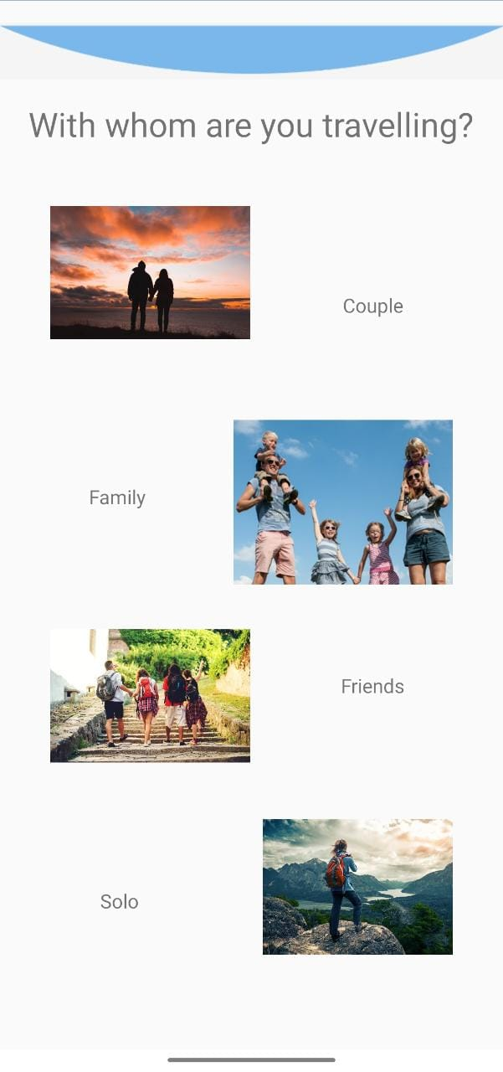
Recommendation

Slide 9
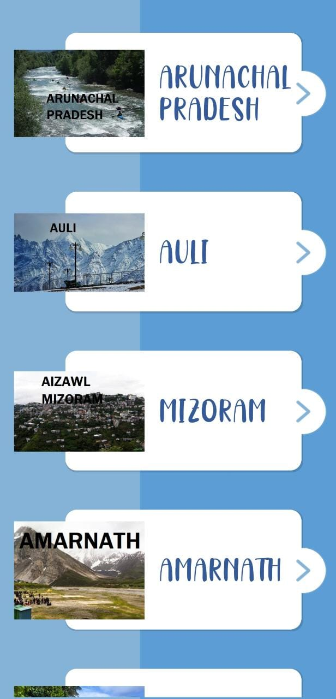
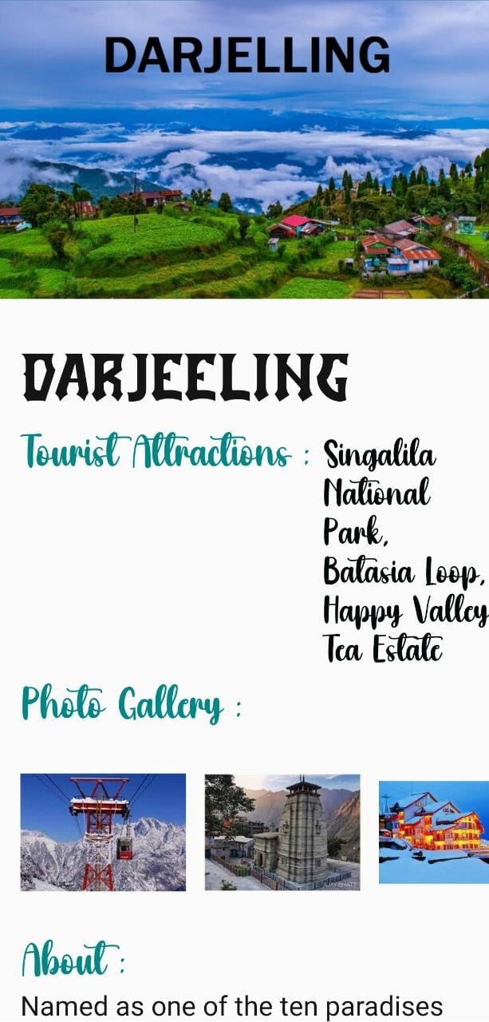
Already have a place in mind?

Slide 10
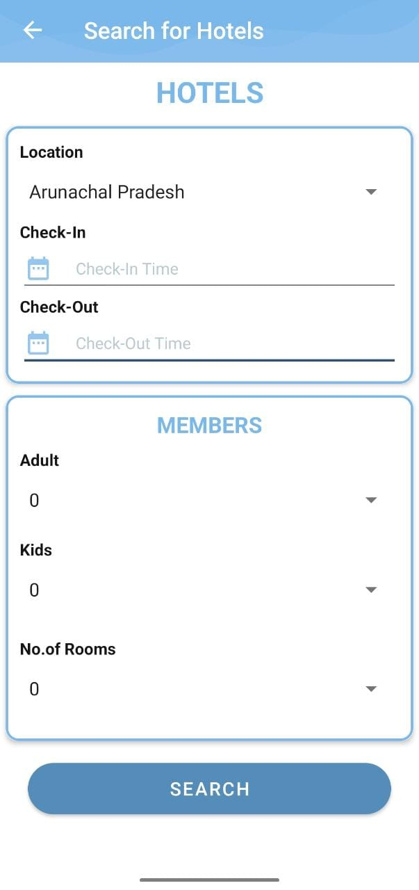
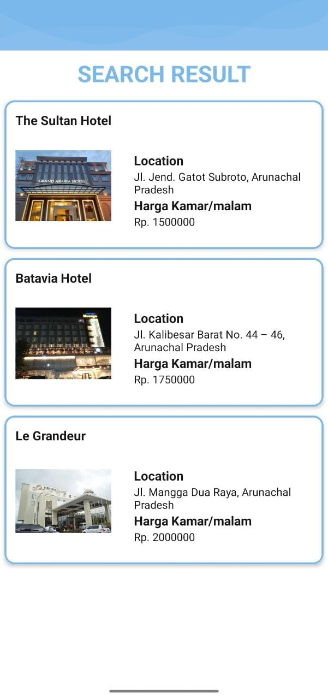
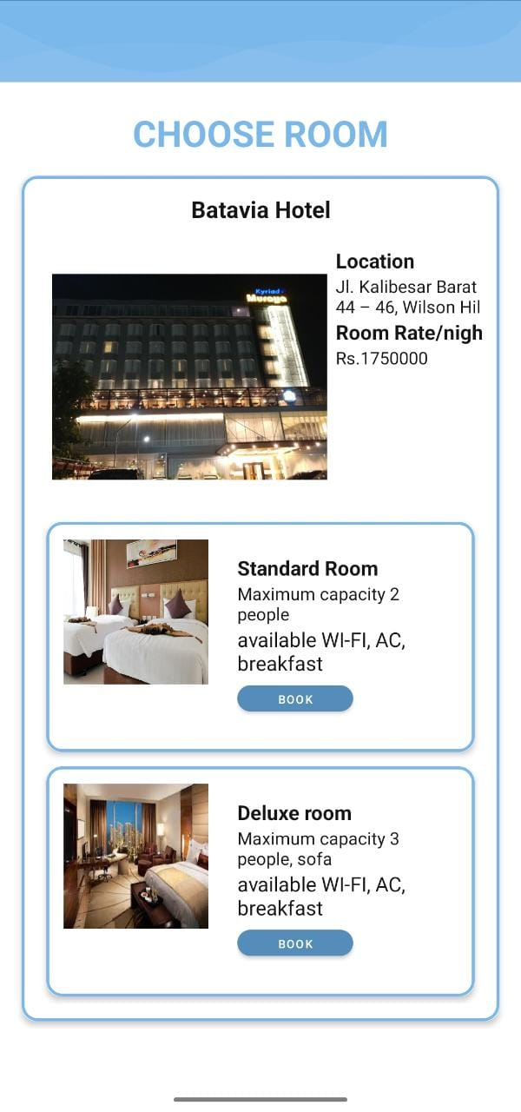
Accommodation

Slide 11
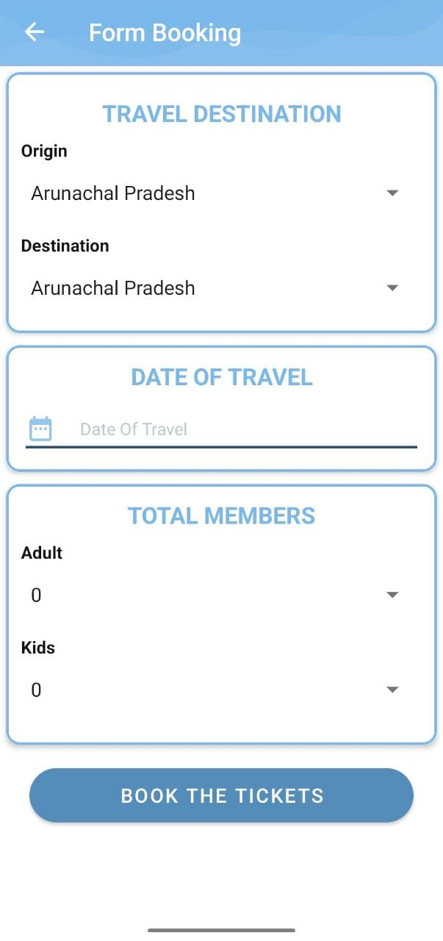
Transportation

Slide 12
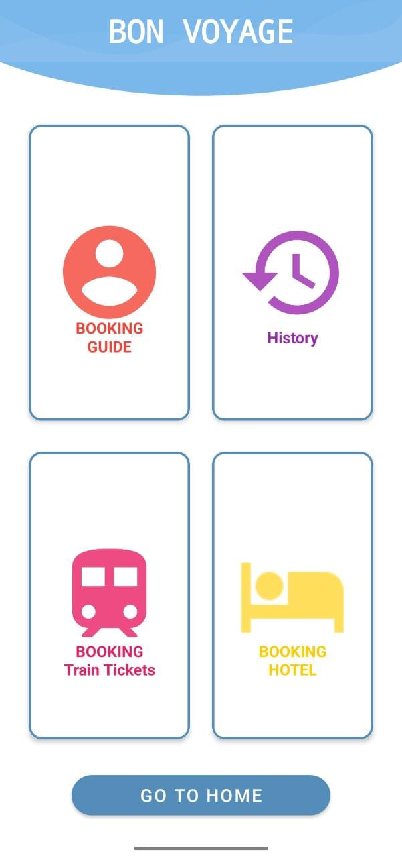
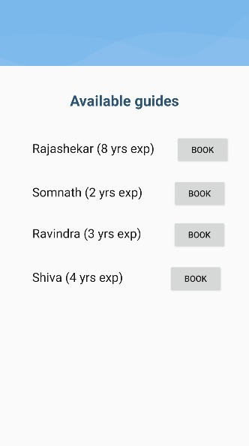
Book a Guide

Slide 13

Challenges Faced
Designing the set of questions
Integrating and debugging all the separate modules developed
Simplification of the entire process (many functionalities implemented)
Selecting pleasant images and themes and cross verifying with others also took some time to present a welcoming UI.

Slide 14

Future Scope
Features to suggest activities based on nearby location to the user at that place can be included.
Recommendation functionality can be built with Machine learning to provide more accurate results
Features like tracking the mode of travel like flights, and trains, and providing restaurant recommendations nearby can be included.
The application can be scaled for multiple travel destinations around the world and recommendations can be provided for various parts of the world.

Slide 15
Thank You!

