Slide 1
Quora Duplicate question Detection
Machine Learning Project Work
Presented by Priti Kumari Gupta

Slide 2
Introduction
Quora uploaded a competition on Kaggle where users were challenged to tackle the problem of duplicate questions having different threads.
The goal of this competition is to predict which of the provided pairs of questions contain two questions with the same meaning.
To develop a model capable of accurately identifying and classifying duplicate question pairs, automating the process, and improving the overall user experience on Quora.

Slide 3
Dataset
4000000 pairs of questions in the training dataset.
5 columns in the training dataset.
  id - the id of a training set question pair
  qid1, qid2 - unique ids of each question
  question1, question2 - the full text of each question
  is_duplicate - the target variable, set to 1 if question1 and question2 have essentially the same meaning and 0 otherwise.

Slide 4
Data Preprocessing
1 null value in question1 and 2 null values in question2.
Dropped rows completely as the null values are negligible to its overall dataset size.
No rows are similar to each other
Out of total question pairs, 255,024 were Non-duplicates where 149,263 duplicates

Slide 5
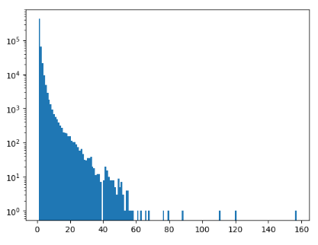
Out of 800K questions found 537929 were unique and 111778 were repeated

Slide 6
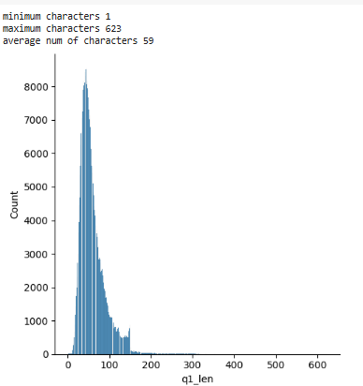
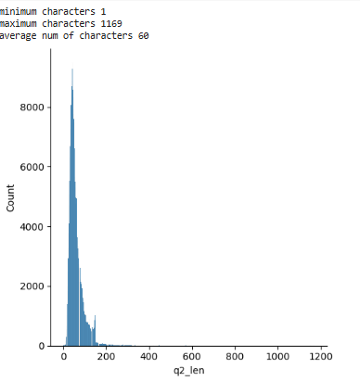
Feature Engineering
q1 len: char length of question1.
.
q2 len: char length of question2

Slide 7
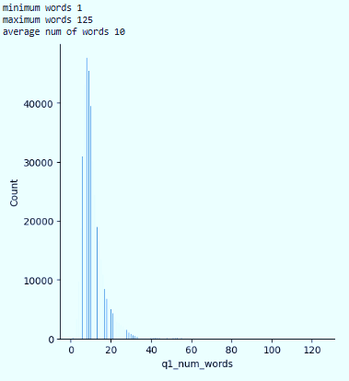
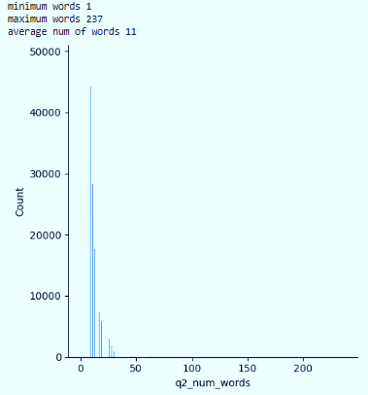
q1 num words: Number of words in question1 obtained by splitting the questions in the question1 column using ” ”.
q2 num words: Number of words in question2 obtained by splitting the questions in the question2 column using ” ”.

Slide 8
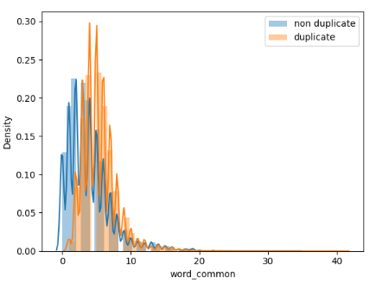
word common: number of common unique words obtained by taking the the intersection of the set of collections of all words in question 1 and question 2.

Slide 9
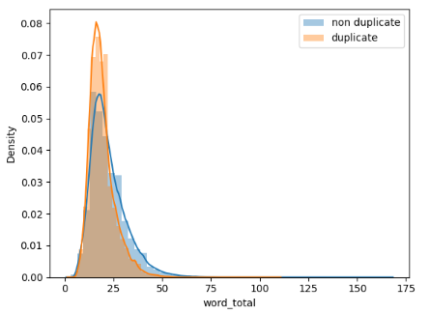
word total: sum of the total number of words in question 1 and question 2 obtained by taking the sum of a set of collections of all words in question 1 and question 2.

Slide 10
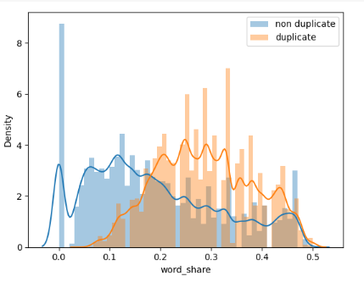
word share: word common/word total

Slide 11
Models
Random Forest
XGBoost
Naive Bayes
Logistic Regression

Slide 12
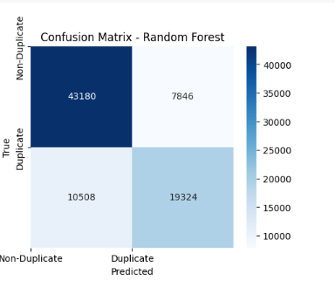
Random Forest
Accuracy=77.35%
Precision=71.1%
F1 Score= 67.9%

Slide 13
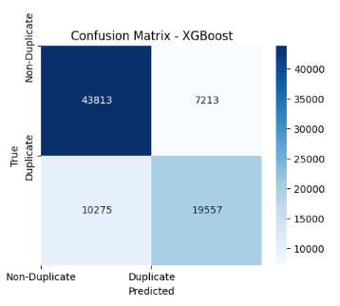
XGBoost
Accuracy=78.37%
Precision=73.5%
F1 Score= 69.1%

Slide 14
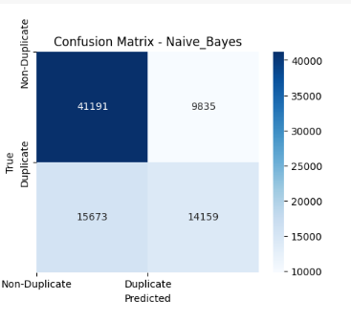
Naive Bayes
Accuracy=68.45%
Precision=59%
F1 Score= 52%

Slide 15
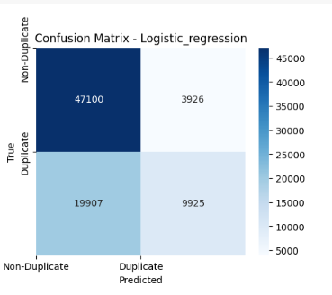
Logistic regression
Accuracy=70.52%
Precision=71.6%
F1 Score= 45%

Slide 16
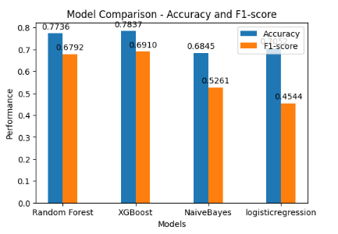
Conclusion
The two best models are XGboost with an accuracy of 78.37 and RandomForest with an accuracy of 77.35.
when we see the confusion Matrix of both the models, for the column of False Positive where models have predicted a Duplicated Question as Non-Duplicate is more in XGBoost as compared to RandomForest.

