Slide 1
Coursera Capstone Presentation
Opening a Shopping Centre in Toronto, Canada
By Pradeep Gandhe

Slide 2
Business Problem
• Location of the shopping mall is one of the most important decisions that will determine whether the mall will be a success or a failure.
• Objective: To analyse and select the best locations in the city of Toronto, Canada to open a new shopping mall.
• This project is timely as the city is currently suffering from oversupply of shopping malls.
• Business question-
➢In the city of Toronto, Canada, if a property developer is looking to open a new shopping mall, where would you recommend that they open it?

Slide 3
Data and Data Sources
• Data required :
➢List of neighborhoods in Toronto
➢Latitude and longitude coordinates of the neighborhoods.
➢Venue data, particularly data related to shopping malls.
• Sources of data :
➢Wikipedia page for the neighborhoods (https://en.wikipedia.org/wiki/List_of_postal_codes_of_Canada:_M)
➢Geospatial _Coordinates.csv file provided by IBM, for latitude and longitude coordinates
➢Foursquare API for venue data

Slide 4
Methodology
• Web scraping Wikipedia page for neighborhoods list
• Get latitude and longitude coordinates using Geospatial_Coordinates.csv file.
• Use Foursquare API to get venue data.
• Group data by neighborhood and taking the mean of the frequency of occurrence of each venue category.
• Filter venue category by Shopping Mall.
• Perform clustering on the data by using k-means clustering.
• Visualize the clusters in a map using Folium.

Slide 5
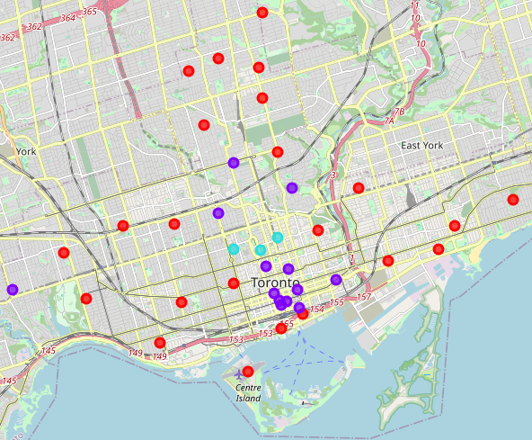
Results
• Categorized the neighborhoods into 3 clusters :
➢Cluster 0: Neighborhoods with low number to no existence of shopping malls - Red
➢Cluster 1: Neighborhoods with moderate number of shopping malls - Purple
➢Cluster 2: Neighborhoods with high concentration of shopping malls – Mint Green

Slide 6
Discussion
• Most of the shopping malls are concentrated in the central area of the city.
• Highest number in cluster 2 and moderate number in cluster 1.
• Cluster 0 has very low number to no shopping mall in the neighborhoods.
• Oversupply of shopping malls mostly happened in the central area of the city, with the suburb area still have very few shopping malls

Slide 7
Recommendations
• Open new shopping malls in neighborhoods in cluster 1 with little to no competition
• Can also open in neighborhoods in cluster 0 with moderate competition if have unique selling propositions to stand out from the competition
• Avoid neighborhoods in cluster 2, already high concentration of shopping malls and intense competition

Slide 8
Conclusion
• Answer to business question: The neighborhoods in cluster 1 are the most preferred locations to open a new shopping mall.
• Findings of this project will help the relevant stakeholders to capitalize on the opportunities on high potential locations while avoiding overcrowded areas in their decisions to open a new shopping mall.

Slide 9
THANK YOU!

