Slide 1

Multiscale In Silico Immunogenicity Pipeline
An autonomous, patient-specific safety screening network for gene therapies—collapsing the timeline to identify clinical failures from months to seconds.
FETCH AI & LANGGRAPH
SLIDE 1 OF 8

Slide 2


The Late-Stage Rejection Bottleneck
Timeline & Species Mismatch Cause Catastrophes
The Timeline Mismatch: Wet labs express edited protein sequences in vitro within 24-48 hours. However, the human adaptive immune system (HLA peptide presentation, T-cell clonal expansion) takes weeks to months to react.
90%+
The Species Blindspot: Standard pre-clinical screening relies heavily on mice. But mice have entirely different histocompatibility profiles (MHC) than humans, completely missing human-specific immunogenicity.
CLINICAL FAILURE RATE
Sun, D. et al. (2022).
"Why 90% of clinical drug development fails..."
IMMUNOLOGICAL BLINDSPOTS
SLIDE 2 OF 8
Notes:
Get rid of the words. Existing systems take your genes and make proteins in isolation. 90% of edits that work in the tube fail when it interacts with the immune system or at a cellular level

Slide 3
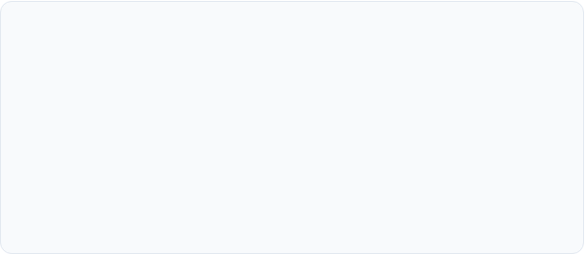

The Functional Trap & Lab Delay
ER Stress & Signaling Collapse
The 4-Week Wet-Lab Iteration Loop
Standard lab assays verify isolated binding (e.g. "does the protein hit Target X?"). They miss systems-level cellular stress.
Sourcing DNA, transfecting lines, expressing protein, and analyzing binding represents a painful physical bottleneck.
Slight changes in protein folding energy accumulate misfolded constructs in the Endoplasmic Reticulum, triggering the Unfolded Protein Response (UPR) and sudden cell apoptosis weeks later.
If variation #42 in a sequence triggers cytotoxicity or immune targeting, researchers find out weeks or months later, burning millions in laboratory assets before finding a safe candidate.
SYSTEMS-LEVEL TOXICITY
SLIDE 3 OF 8
Notes:
repeats first slide now - get rid of this slide - current process is very expensive and slow

Slide 4
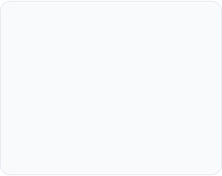
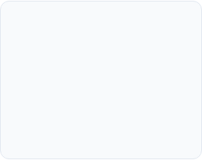
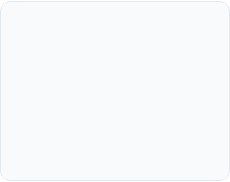


The Real Production Stack
We built a decentralized, multi-agent network that mirrors a real clinical team. Four highly specialized uAgents operate asynchronously using production-grade computational biology tools.
1. ESMFold
2. IEDB Pan-Binding
3. BepiPred (Linear)
4. GenBio AI (AIDO)
Ensures high-throughput structural stability, predicting folding confidence metrics to pre-emptively bypass ER stress.
Models patient-specific HLA binding dynamically, checking if edited peptides successfully fit the patient’s histocompatibility molecules.
Performs linear epitope mapping for B-cell response (Stage 3a/b are registry-ready to swap mock TCR models for custom endpoints).
Produces probabilistic cellular network risk metrics, capturing multi-pathway genetic perturbation vectors.
PRODUCTION ARCHITECTURES
SLIDE 4 OF 8
Notes:
simplify - write function of each agent

Slide 5

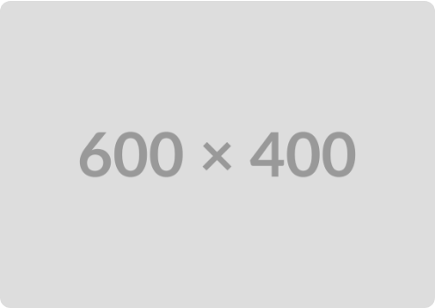
Orchestrated Safety Architecture
Orchestration Layers & Mandatory Checks
The system coordinates peer-to-peer specialized nodes, moving beyond simple static script executions to enforce deep cellular safety benchmarks.
Orchestration vs. Monolithic: The LangGraph state machine governs localized sequential execution solely for monolithic setups. The true agentic workflow leverages a dedicated Orchestrator uAgent managing asynchronous routing on Agentverse.
Direct Specialist Inquiries: Any external patient-matching or drug design agent can directly call an individual specialist node (e.g. the ESMFold or IEDB stage) if they already have the data they need, bypassing the rest of the loop.
Mandatory Stage 4 (No Early Exits): Exiting early after Stage 2 is deprecated. Even with perfect immune tolerance, Stage 4 (Systems Dynamics) must run—introducing any new protein fundamentally alters the host gene regulatory network.
ORCHESTRATION & ROUTING
SLIDE 5 OF 8

Slide 6


Engineering Realities & Modularity
Honest Computational Limits
Why Multi-Agent is the Answer
Biased Training Data: The global IEDB dataset is heavily skewed toward European HLA genotypes, decreasing accuracy for minority cohorts.
Instead of a brittle monolithic script, we built an independent node registry on Fetch.ai.
Linear Epitopes: BepiPred targets linear epitopes, missing conformational 3D geometry constraints.
If a better 3D conformational B-cell model drops next week, or non-biased global biobanks publish diverse HLA profiles, you simply swap out that single node.
Black-Box Predictions: Systems biology models like GenBio AIDO are probabilistic deep neural nets, not true physical pathway chemical simulators.
Our pipeline is built as a flexible interface. The software infrastructure remains future-proof as scientific tooling catches up.
THE COMPOSABLE VALUE
SLIDE 6 OF 8

Slide 7
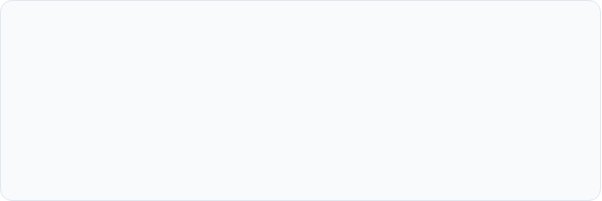

The Composable Safety Layer
Monolithic Mode
Multi-Agent Mode
Integrates the full LangGraph pipeline into a single uAgent deployment. Perfect for local hospitals and standalone clinics needing a simple, all-in-one local installation.
Each pipeline stage acts as an independent specialist agent on the Agentverse. Other drug design, patient matching, or synthetic biology agents can invoke them directly.
BEST FOR STANDALONE RESEARCH LABS
BEST FOR BIOLOGICAL INFRASTRUCTURE NETWORKS
FETCH.AI DEPLOYMENT
SLIDE 7 OF 8

Slide 8

Decentralized Safety API
Moving clinical safety screening from a late-stage manual bottleneck to an early-stage, patient-specific composable network primitive.
github.com/multiscale-pipeline
agentverse.ai/registry
Q&A SESSION
SLIDE 8 OF 8

Slide 10

Image Sources
https://miro.medium.com/v2/resize:fit:1400/1*z2Qe5oGbZY1dPcet4lyRlA.png
Source: medium.com

