Slide 1
My Game List
Comprehensive Gaming Platform Database

Slide 2
The Problem
Modern gamers need a centralized platform to:
Track games across multiple platforms
Remember personal ratings and progress
Share opinions and discover new games
Connect with gaming enthusiasts

Slide 3
Our Solution
Game Library
Reviews & Ratings
Track status, progress, and personal ratings
Share detailed reviews and community scores
Social Features
Custom Lists
Follow friends and discover new games
Create and share curated game collections

Slide 4
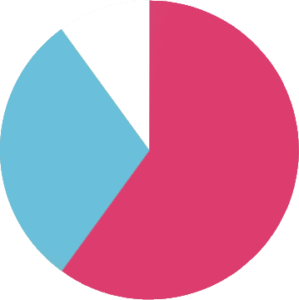
Target Audience
10%
Gaming Enthusiasts
30%
60%
Content Creators
Casual Gamers

Slide 5
Design Process
Analysis: Requirements gathering and data identification
ER Modeling: Entity relationships and schema design
Normalization: 3NF compliance and optimization
Implementation: Schema with constraints and indexes

Slide 6
Database Entities
Core Entities
Games - Game information
Users - User accounts
Platforms - Gaming systems
Genres - Game categories
Content Entities
Developers - Game creators
Publishers - Game distributors
Series - Game franchises
DLCs - Downloadable content
System Entities
Tags - Descriptive labels
Stores - Purchase platforms
Languages - Localization
Media_Types - Asset types

Slide 7
Database Entities
User Interaction
User_Reviews - Game reviews
User_Lists - Custom collections
User_Game_Status - Play tracking
User_Follows - Social connections
Extended Features
Achievements - Game goals
Game_Media - Rich content
System_Requirements - Tech specs
External_Links - Additional resources
Junction Tables
Game_Platforms - Availability
Game_Genres - Categorization
Game_Developers - Creation
Game_Publishers - Distribution

Slide 8
Core Schema Structure
Games Table (Primary Entity)
id, title, slug, description, release_date, rating, metacritic, playtime, status, age_rating
Users Table (User Management)
id, username, email, password_hash,bio, avatar_url, created_at
User_Game_Status (Core Relationship)
id, title, slug, description, release_date, rating, metacritic, playtime, status, age_rating

Slide 9
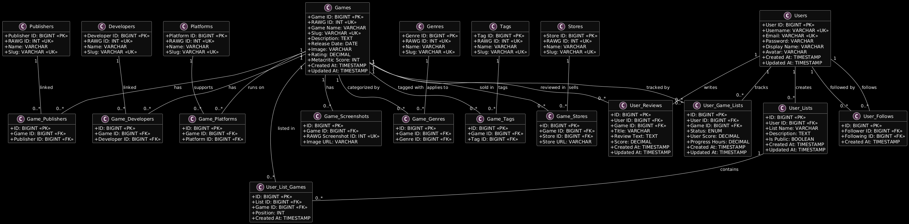
Entity Relationship Diagram

Slide 10
Normalization Analysis
1NF
Atomic values
Unique rows
No repeating groups
2NF
Meets 1NF
Full functional dependency
Proper junction tables
3NF
Meets 2NF
No transitive dependencies
Reduced redundancy
<5%
Data Redundancy
95%
Data consistency

Slide 11
Advanced Implementation
Indexing Strategy
Optimized for fast searches and queries
Security Measures
Password hashing and input validation
Data Validation
Constraints and integrity checks

Slide 12
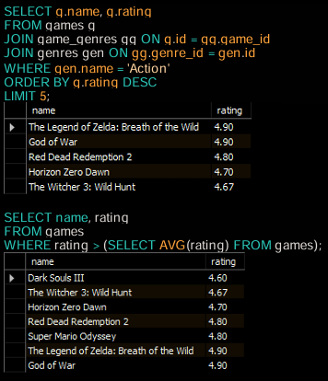
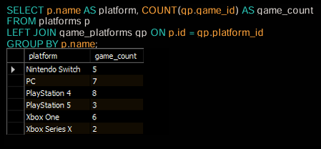
Testing & Validation
10
Games
10
Platforms
8
Genres
90%
Data Integrity
85%
Space Savings
7 Publishers
75%
Average Query Time

Slide 13
Future Enhancements
Features
Achievement System
AI Recommendations
Wishlist Functionality
Enhanced Social Features
Scalability
Mobile Application
API Development
Content Moderation
Analytics Dashboard
Technical Improvements
Database Sharding • Caching Layer • Cloud Migration • Real-time Features

Slide 14
Project Achievements
Fully Normalized Design (3NF)
15+ Interconnected Tables
Advanced Indexing Strategy
Security Implementation
Industry Standards Applied
Scalable Architecture
Multi-platform Support
Future-ready Design

Slide 15
Successfully demonstrated comprehensive database design principles
Conclusion
Academic Excellence
Applied theoretical concepts to real-world problems
Industry Relevance
Created scalable solution for gaming community

Slide 16
Thank You!
Questions and feedback welcome

