Slide 1
Design Plans for Assignment 14
Leszkovszky Alexandra, Kaselyák Péter, Márton Gergő

Slide 2
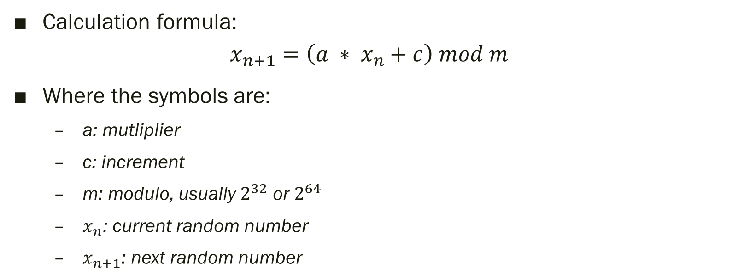
14. Linear Congruential Generator
Calculation formula:
$$x_{n+1}=\left(a ∗ x_{n}+c\right) mod m$$
Where the symbols are:
a: mutliplier
c: increment
m: modulo, usually $2^{32}$ or $2^{64}$
$x_{n}$: current random number
$x_{n+1}$: next random number

Slide 3
14. XORshift Generator
Applies XOR and shift operations at the bit level to generate random numbers
Example program (32 bites):
uint32_t xorshift32(uint32_t *state) {
uint32_t x = *state;
x ^= x << 13;
x ^= x >> 17;
x ^= x << 5;
*state = x;
return x;
}

Slide 4
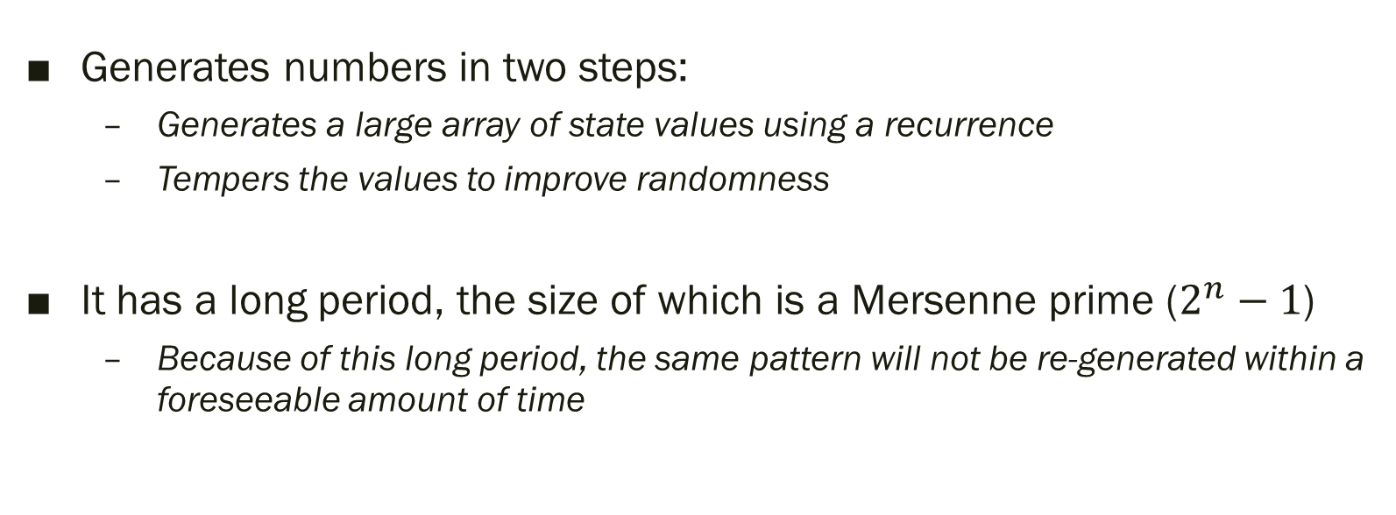
14. Mersenne Twister (opc)
Generates numbers in two steps:
Generates a large array of state values using a recurrence
Tempers the values to improve randomness
It has a long period, the size of which is a Mersenne prime ($2^{n}−1$)
Because of this long period, the same pattern will not be re-generated within a foreseeable amount of time

Slide 5
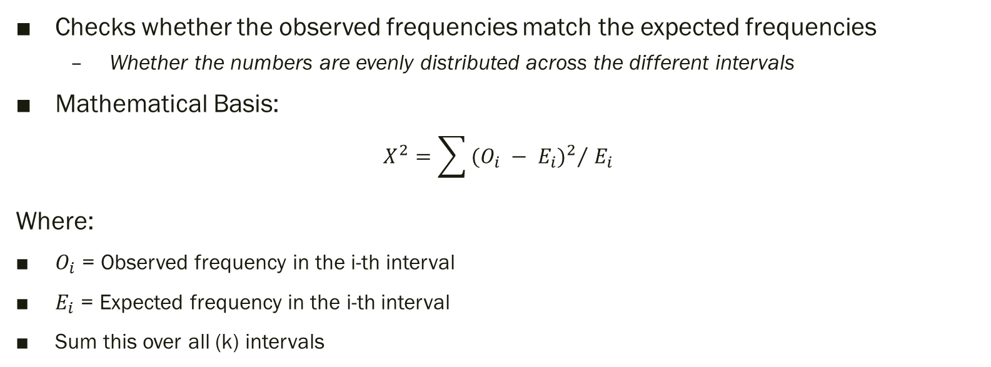
14. Chi-Square Test
Checks whether the observed frequencies match the expected frequencies
Whether the numbers are evenly distributed across the different intervals
Mathematical Basis:
$$X^{2}=\sum{{{(O_{i} − E_{i})}^{2}}/{{ E}_{i}}}$$
Where:
$O_{i}$ = Observed frequency in the i-th interval
$E_{i}$ = Expected frequency in the i-th interval
Sum this over all (k) intervals

Slide 6
14. Bonus Points
Local Memory
Workgroups
Profiling
Testing (+1)
Kolmogorov-Smirnov / Autocorrection
Monte Carlo simulation
π estimation
Financial Simulation (Option Pricing, VaR)

Slide 7
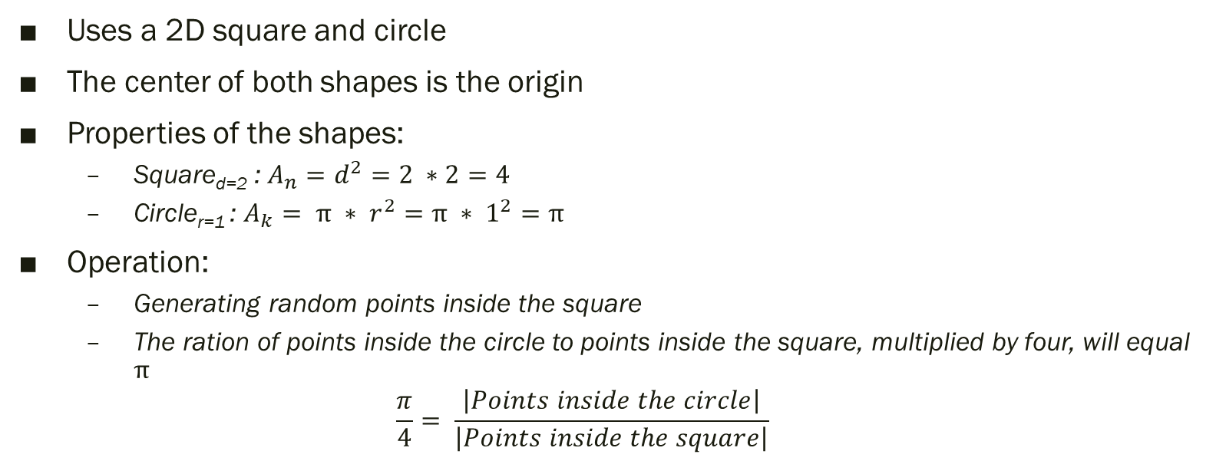
14. Monte Carlo (π estimation)
Uses a 2D square and circle
The center of both shapes is the origin
Properties of the shapes:
Square_{d=2} : $A_{n}=d^{2}=2 ∗2=4$
Circle_{r=1} : $A_{k}= π ∗ r^{2}=π ∗ 1^{2}=π$
Operation:
Generating random points inside the square
The ration of points inside the circle to points inside the square, multiplied by four, will equal $π$
$$\frac{π}{4}= \frac{\left|Points inside the circle\right|}{\left|Points inside the square\right|}$$

Slide 8
Thank you!
☺

