Slide 1
Potentials of data conflation
the example of webportals
Seminar: Time to take action!
Teachers: Melanie Eckle-Elze & Carolin Klonner
Presenter: Nikolaos Kolaxidis
University of Heidelberg
01.07.2022
Notes:
Hello and welcome to my presentation of our next topic “”
- My topic cannot stand alone for itself for it is a part of the series of User-Generated Data in Humanitarian Contexts from yesterday and of course of the whole participatory GIS topic of the seminar
- we heard information about Challenges of User-Generated Data, we heard about organisation`s perspectives on it and different kinds of knowledge and their advantages and disadvantages and even talked about the quality of the data and how to handle it
- But we didn´t hear anything about the potentials and challenges of putting all of this data together

Slide 2
01
Data conflation
What is it? How does it work?
02
Potentials
CONTENTS
Humanitarian GIS data and why conflation is needed
03
Webportals
Types, potentials, challenges
Notes:
We can split the aforementioned topic into 3 parts, which are:
01:
- what is data conflation?
- what kinds of data can you conflate in the humanitarian context and how
02:
- and in a next step we will look into the why, why would you conflate such data (which basically are the potentials of data conflation)
03:
- Afterwards we will take a look into the example of webportals as the most prominent way of aquiring and providing different types of conflated geospatial information data
- Of course the typical questions: what are GIS web portals, what types exist and what limitations/challenges do you need to consider when using them

Slide 3
01
Data conflation
What is it?
How does it work?

Slide 4
01
What is conflation?
Conflate (Merriam-Webster):
1 a: to bring together, blend
1 b: confuse
2: to combine into a composite whole
Conflation (ESRI):
[data editing] A set of procedures that align the features of two geographic data layers and
then transfers the attributes of one to the other
The goal of Conflation:
“To combine the best-quality elements of [...] datasets to create a composite dataset that is better than either of them” (Chen/Knoblock 2008, p133ff.)
Potentials of data conflation and webportals
Notes:
- I looked up the definition of conflation and got multiple results
- In the online dictionary Merriam-Webster it says that “”
- ESRI (you all know ESRI) states on their own Glossary that Conflation is “”
- This coincides with Chen/Knoblock who state that the goal of conflation is“”

Slide 5
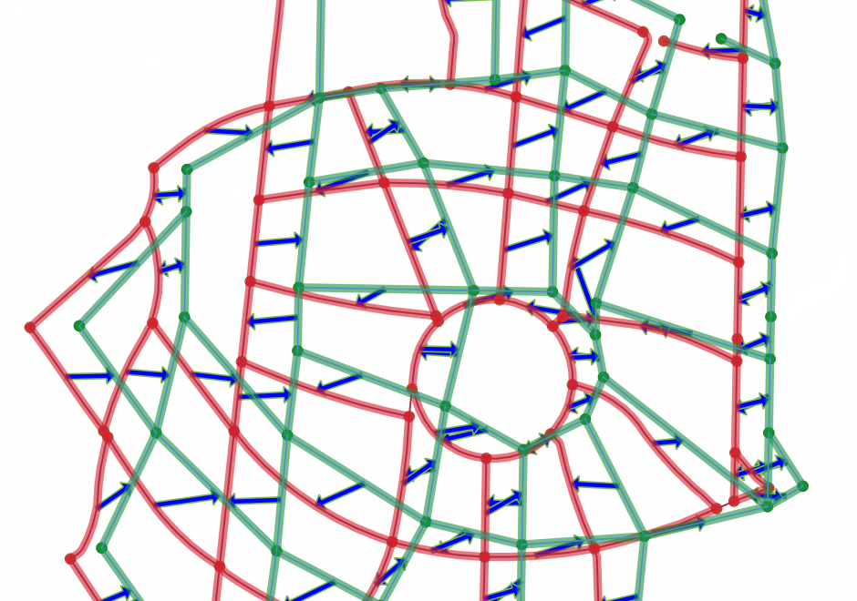
01
Conflation of GIS-data
Task: Estimation of next road repair works
Challenge:
NOT a simple move & merge task
Differently spatially transformed
Slightly different features
Needed action:
Assignment of same features to each other
Supervised spatial transformation/alignment
Merging of information
→ Enrichment of data
In Practice:
Manually (labor-intensive, time-consuming)
With GIS (no reliable automation yet)
UCGIS GIS&T 2021
Green: dataset A | Red: dataset B | Blue: spatial difference
Potentials of data conflation and webportals
Notes:
To visualize this method i brought two example datasets
- You see here some linestrings and point geometries probably showing like a road or pipe network
- both have a different quality, if you look here you see there is a more curved road or even the circle in red and a much coarse ring in green
- probably because of a different scope
- let´s say for the sake of this example, that the green dataset, let´s call it A, wants to show traffic situation over a year and the red datset B has specific data for every street like type of asphalt or date of construction and the precise course
- Estimation of where you will have to do road repair works based on the traffic situation and the age and type of the road
Challenge: “”
- Quite difficult if datasets aren`t spatially equal and the worst case don´t have equal names or there are different connections
So if you want to merge them, you need to:
- Point-Point or Line-Line assignment
- Spatial transformation with own rules
- Merging information
- In the end what you want to achieve is an enrichment the one spatially precise dataset with additional information, so that the composite is better than each of the datasets
In practice, conflation can be performed either manually or with the aid of GIS. Manual conflation is labor-intensive, time consuming and expensive (yesterday example of digitalizing the VGI data from Field papers). It is often adopted in practice, nonetheless, due to the lack of reliable automatic conflation methods (that´s why the Sketch Map tool is so interesting and in demand).

Slide 6
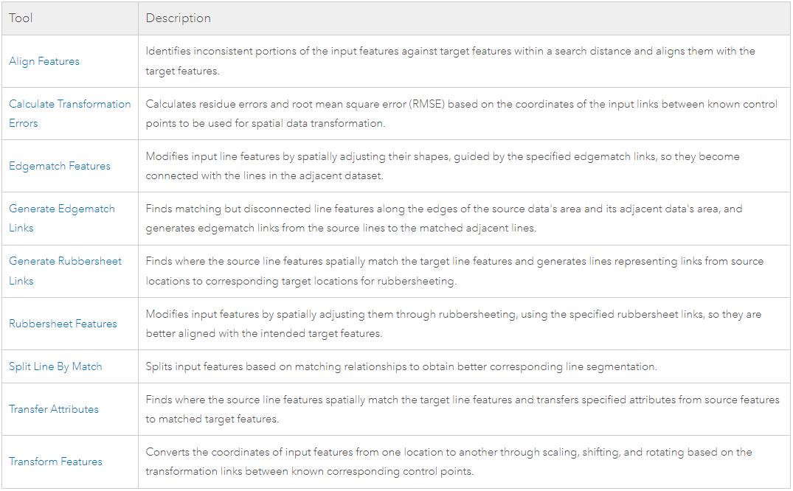
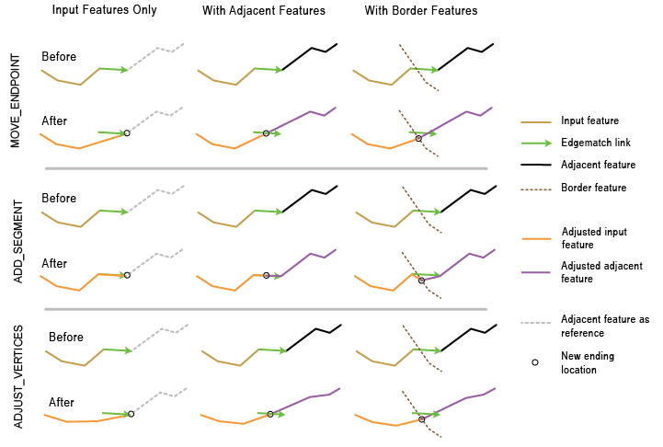
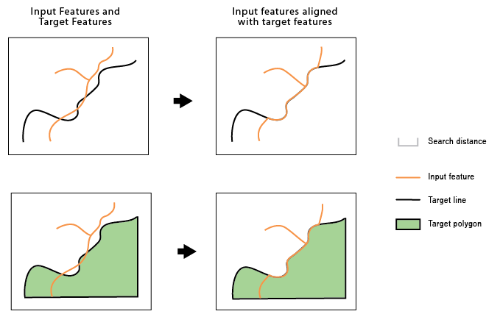
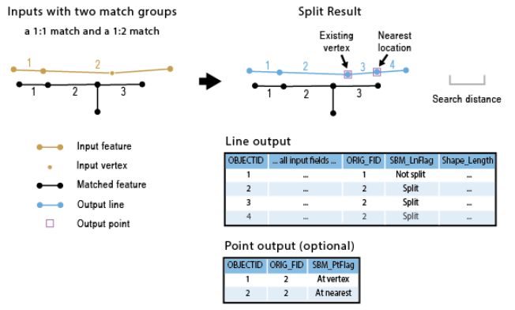
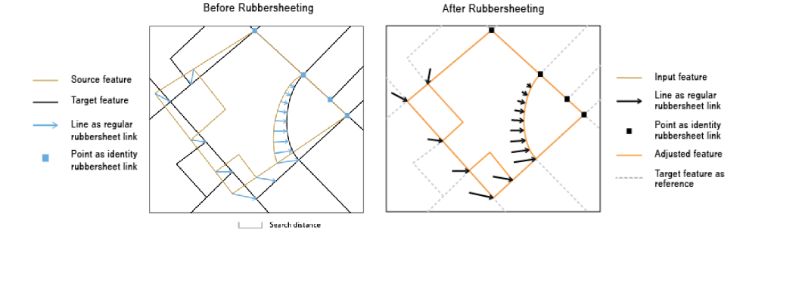
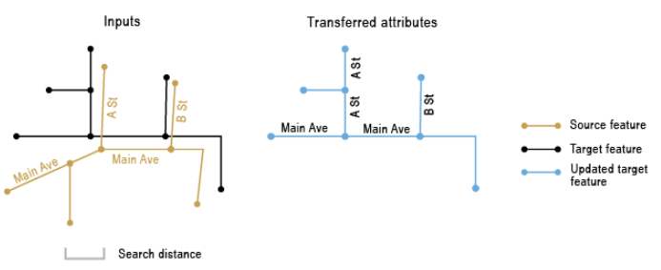
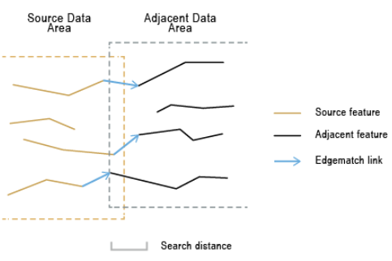
01
Conflation toolset (ArcGIS/ArcPro)
Align Features
Edgematch Links/Features
Rubbersheet Links/Features
Split Line by Match
Transform Attributes
ESRI 2022
Potentials of data conflation and webportals
Notes:
Still, there are GIS tools like the Conflation toolset in ArcGIS
- A main challenge of automatic conflation lies in the matching of corresponding features, precisely due to the varying quality and different representations of map data based on scope of the data and the type of aquisition
- Those tools all try to do the same but on different levels and with different algorithms
- They typically involve measuring the distance between each feature pair and trying to match feature pairs with smaller dissimilarity using a specially designed algorithm or model
- There are a lot of semi- or nonautomatic methods to conflate data (in most cases vector data), fully automated conflation is still an active research field and therefore a lot of people tend to do it manually from the beginning
That raises the question, when do you want to conflate? Do you really need it?

Slide 7
02
Potentials
Humanitarian GIS data and why conflation is needed
Notes:
That brings us straight to the potentials of data conflation especially in a humanitarian context where we collect a lot of different VGI data

Slide 8
02
Conflation of GIS-data
Task: Estimation of next road repair works
Do I need the info?
Can I aquire it without conflation?
Potentials:
Fusion of different data (sets/types/info etc.)
Enrichment of spatial data
Data is more accessible
UCGIS GIS&T 2021
→ Cost-benefit evaluation is important
Green: dataset A | Red: dataset B | Blue: spatial difference
Potentials of data conflation and webportals
Notes:
Let us get back to our example
Before conflating the data, we should ask ourselves:
- do i need the information from the second dataset?
- Can I aquire an answer without conflation?
Because the potentials can be:
- Fusion enables further calculations/relations, you can do more with the data
- Much easier to do the calculations when you merge the data and adjust them together
- Enrichment of spatial data with more spatial information or attributes
- if you have the data in one composite dataset the calculations will be faster and the data is more accessible (everything in one location = way easier)
But, why are the roads different in the first place?

Slide 9
02
Conflation in the humanitarian context
Different sources/types/scopes/formats of data:
Local knowledge and data acquisition (Passive sensing, Participatory Sensing/Mapping, Volunteer Thinking, Environmental and Ecological Observation, Civic/Community science etc.)
Indigenous knowledge and data acquisition (Focus groups, Word of mouth etc.)
VGI
Humanitarian Aid Organizations & Movements
Official public service data
Scientific data
“Often the best information comes from those who are closest to it” (J. McGlade, 2008)
Potentials of data conflation and webportals
Notes:
That brings us to the question why you would want to conflate data, it should be obvious but i will point out again nevertheless
- First, and this is the most obivous, there are different sources and types of data you can aquire
- These are all kinds of VGI, we saw different approaches like Focus groups, webportals, hub for your own GIS data, qualitative data through speaking with the locals, using subjective forms to observe the environment
- Why? Because “”
-Yesterday we saw the potentials of VGI data so i will not add anything more to that
- Additionally to this you still have official data from public service and science and professionally acquired data from humanitarian aid organizations and movements, which oftentimes/mostly use and create VGI data themselves
- To bring together this huge amount of data with different qualities, different types, different scopes, that can be a possible later help for risk management (because long term risk assessment method as we have seen in the first session), that is the task and usage of conflation

Slide 10
02
Conflation in the humanitarian context
Potentials:
Ensure data quality (regardless of source)
Building resilience of locals to risks by:
providing professionally edited data from different sources (regardless of data quality)
giving the option to participate (any data is welcome)
therefore rising awareness of local key issues
commenting the data and giving courses of action (strengthen adaptation)
Better GIS data for future analyses (giving it back to the community)
Public is Prosumer
Challenges:
Need to aquire all data
No worldwide standards for spatial data acquisition (CRS, notations, formats etc.)
Conflating data needs professionals
Not automated yet (time-consuming)
Conflated data needs a suitable platform to be provided back to locals (not scientific papers)
All challenges of VGI in general
Potentials of data conflation and webportals
Notes:
By bringing together all the data the potentials of conflation in a humanitarian context becomes clear “”
- Prosumers: the public is producer as well as consumer of geographic information
Well you can use one thing to collect different types of data and provide them again after using artificial intelligence (especially machine learning algorithms), and those are webportals

Slide 11
03
Webportals
Types, potentials, challenges
Notes:
Which brings us to the last chapter of the presentation
Webportals are just an example for a system of collecting VGI data for conflation and providing it, but i believe they are the most prominent and you will see why

Slide 12










03
What are web portals?
Web portals:
No unique definition
Efficient and fast search for information
Horizontal vs. vertical portals:
starting point for browsing the web
corporate portals
industry portals
customer portals
Geoportal/Web GIS portals:
Central point to find and access spatial data
GIS that uses web technologies
Types:
Collection of GIS data
Visualization & web mapping
Printing maps/customization
Geospatial analysis
Professional conflation
Potentials of data conflation and webportals
Notes:
If your were like me, i often used the word web portal, but never really could tell what it exactly is
- Horizontal: starting point for browsing the web
- Vertical: 3 subclasses:
- corporate portals, used by employees to get access to organizational data and services
- industry portals, used for information sharing and business transactions between business partners
- customer portals, used for customer support
- so there are different types of portals and they all come with their own benefits and limitations
- we got to know a lot of GIS portals and there are a lot more
But we are interested in Geoportals or Web GIS portals, right?
Simple definition: “”

Slide 13
03
Types of GIS webportals
Viewing/Navigating/Downloading
Viewing/Navigating/Downloading/Contributing/Communicating
directly
in the browser
Potentials of data conflation and webportals
Notes:
- I sorted them in 3 categories, can you tell why? I mean what are the main differences between the portals?
Left column:
- just viewing/reading data, communication in browser or through APIs
- Direct contribution not possible, the data comes from professionals like ESA, USGS or other organizations
Right column:
- Additional possibility - contribution and communication

Slide 14
03
Advantages of GIS webportals
GIS functionality regardless of location (global reachability)
Many users concurrently
Interoperability (cross-platform)
Flexibility (can provide only specific tools or add some)
Low cost (for users)
Ease of use (no advanced GIS knowledge needed)
Currentness (automatic updates)
Humanitarian context:
Open Access
Conflation of spatial data and additional information
Fast and easy acquisition of different data from different sources
Building resilience of locals to risks with an accessible and customizable platform
Potentials of data conflation and webportals
Notes:
What are the advantages of such webportals?

Slide 15
03
Challenges of GIS webportals in the humanitarian context
Open Access not always possible due to:
Governmental restrictions
Access to internet (fast and reliable Internet connection required)
Limited devices suitable
Language barrier
Security of provided data (who is responsible?)
Copyright infringement
Communication with government, locals and other organizations
Data quality of VGI, conflation or editing needed beforehand
Possible solutions:
Using the public and VGI to peer-review own VGI data
Strict framework or manuals to collect consistent data
Using the same basemap (OSM) and defining it as standard
Using standards for data and tags (Interoperability)
Potentials of data conflation and webportals

Slide 16
Literature
Will be provided correctly and completely in final PDF version.
Chen, CC./Knoblock, C. (2008): Conflation of Geospatial Data. - In: Shekhar, S./Xiong, H. (eds): Encyclopedia of GIS. Springer, Boston, MA.
Grajales, D. P., Degrossi, L. C., Barros, D. D. R., Khan, M. R., Silva, F. L. E., Cunha, M. A., Trajber, R. de Albuquerque, J. P. (accepted): Enabling Participatory Flood Monitoring Through Cloud Services. In: Proceedings of the 19th ISCRAM Conference, Tarbes, France, May 2022.
https://www.geeksforgeeks.org/web-1-0-web-2-0-and-web-3-0-with-their-difference/
https://gistbok.ucgis.org/topic-keywords/conflation
https://www.gislounge.com/gis-data-a-look-at-accuracy-precision-and-types-of-errors/
https://www.e-education.psu.edu/geog855/node/608
https://pro.arcgis.com/en/pro-app/latest/tool-reference/editing/an-overview-of-the-conflation-toolset.htm
https://www.citygategis.com/conflation
McGlade, J., 2008. Environmental information and public participation. - URL: http://www.eea.europa.eu/media/speeches/environmentalinformation-and-public-participation [as of 27.06.2022].
Ulrichs, M., Slater, R. and Costella, C. (2019): Building resilience to climate risks through social protection: from individualised models to systemic transformation. Disasters, 43: S368-S387.
Potentials of data conflation and webportals

Slide 17

Thank you very much
for your attention!
Seminar: Time to take action!
Presenter: Nikolaos Kolaxidis
University of Heidelberg
01.07.2022

Slide 18
Discussion
Discuss!

Slide 19
03
Lightning quick history of the WWW
World Wide Web
(Web 1.0)
Web 2.0
Semantic Web
(Web 3.0)
- “Viewing Web”
- Passive interaction (reading/viewing)
- Company focus
- Static pages
- Few content creators
Examples:
- Personal homepages
- Infopages
- “Participatory Web”
- Active interaction (creating/sharing)
- Community focus
- User-generated content (shift in content creation)
Examples:
- Social Media
- (Video) sharing sites
- Web applications
- Machine-readable data
- AI plays a much bigger role
- Individual focus
- Background interaction
Examples:
- Cross-plattform user-targeted advertising
- Live-Streams
-
Notes:
Web 3.0:
- Machines try to create content based on its semantic understanding of the data the web shows and the user provides
- Background interaction means that your computer sends data to the server and the server takes this data and puts it in a semantic sense so that it can then provide you with probably interesting content tailored only to you
- Examples are not types of webpages but rather technologies and possibilities of webpages
Difference Web2 vs. Web3:
- on a more technical level: Web2 primarly uses AJAX protocols written in JavaScrip, enabling a client-side communication with websites rather then sending every query directly to the server and focuses more on the front-end user-experience
- Web3 tries to alter the web into databases, intergrating different technologies like RDF or OWL to formally represent the metadata which is important for the encoding of semantics with the data (so to tell the machine how it can reason with the data) and therefore upgrading the back-end of the web (like not colorful pictures and lights and stuff but more like i have something i know you will want and i can give it to you)
Why am I telling you this?
- Well first, it`s good to know that www is not only one www but more like different kinds of technologies available in the internet with different scope and usage
- And secondly conflated geographic information can be shown in all 3 types of the www, by viewing maps and data as well as providing it and even using scripts to communicate with the background databases of Web3 applications for example access more suitable data
- It strongly depends on what you want to offer on your webpage/webportal and then you decide which technologies and which complexity of them you need or want to use

