Slide 1
UNIT-3

Slide 2
Coding Framework
• For software construction, a coding framework is needed that will ensure a consistent coding production with standard code that will be easy to debug and test .
• In object oriented programming, what base classes are to be made, which will be used throughout construction, is a subject that is part of the coding framework.
• In general, coding frameworks allow construction of the common infrastructure of basic functionality which can be extended later by the developers.
• Benefits: Increases productivity ,
Allows for a robust and
Well structured software product.

Slide 3
Reviews (Quality Control)
• Almost 70% of software defects arise from faulty software code.
• To solve this problem, software construction is the most labor intensive phase in software development.
• Any construction rework means wasting a lot of effort already put in.
• Moreover, it is also a fact that it is cheaper to fix any defects found during construction at the phase level itself.
• If those defects are allowed to go in software testing , then fixing those defects will become costlier .
• That is why review of the software code and fixing defects is very important.
• There are some techniques available like deskchecks, walkthroughs , code reviews, inspections, etc. that ensure quality of the written code.

Slide 4
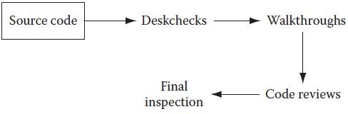
Source code review methods and their operation sequence

Slide 5
Deskchecks (Peer Reviews)
• Deskchecks are employed when a complete review of the source code is not important.
• Here, the developer sends his piece of code to the designated team members.
• These team members review the code and send feedback and comments to the developer as suggestions for improvement in the code.
• The developer reads those feedbacks and may decide to incorporate or to discard those suggestions.
• So this form of review is totally voluntary.
• Still, it is a powerful tool to eliminate defects or improve software code.

Slide 6
Object-Oriented Languages
• Most object-oriented languages are high-level languages.
• The focus of OOP languages is not on structure, but on modeling data.
• Programmers code using “blueprints” of data models called classes.
• Examples of OOP languages include C++, Visual Basic.NET and Java.

Slide 7
Object Oriented Programming
• Object – Unique programming entity that has methods, has attributes and can react to events.
• Method – Things which an object can do; the “verbs” of objects. In code, usually can be identified by an “action” word -- Hide, Show

Slide 8
Object Oriented Programming
• Attribute – Things which describe an object; the “adjectives” of objects. In code, usually can be identified by a “descriptive” word – Enabled, BackColor
• Events – Forces external to an object to which that object can react. In code, usually attached to an event procedure

Slide 9
Object Oriented Programming
• Class – Provides a way to create new objects based on a “meta-definition” of an object (Example: The automobile class)
• Constructors – Special methods used to create new instances of a class (Example: A Honda Civic is an instance of the automobile class.)

Slide 10
Data Abstraction
It refers to the act of re-presenting essential features without including the back ground details.

Slide 11
OOP - Encapsulation
•Incorporation into a class of data & operations in one package
•Data can only be accessed through that package
•“Information Hiding”

Slide 12
OOP - Polymorphism
• Creating methods which describe the way to do some general function (Example: The “drive” method in the automobile class)
• Polymorphic methods can adapt to specific types of objects.

Slide 13
Inheritance
• Inheritance should be seen as a way to specialize a class while retaining the relationship between methods
• In this way it is a just an extension of a data abstraction
general class
specialized class
12

Slide 14
Classes and Objects
• A class is a data type that allows programmers to create objects. A class provides a definition for an object, describing an object’s attributes (data) and methods (operations).
• An object is an instance of a class. With one class, you can have as many objects as required.
• This is analogous to a variable and a data type, the class is the data type and the object is the variable.

Slide 15
Binding
Binding refers to the linking of a procedure call to the code (its body) to be executed
in response to the call object oriented programming.
Binding is of two types :
Static binding :Linking of a function call to its body at the compile time is known is static binding.
It is also known as early binding.
Dynamic binding :linking of a function call to its body during run time. It is also known as late binding.

Slide 16
Automatic Code Generation
Automatic code generation refers to using programs to using programs generate code that the user would otherwise have to write themselves.

Slide 17
Why use Automatic Code Generation?
• Automatic code generation has certain advantages over traditional coding.
• High Quality
• Consistent
• Productive
• Coding Abstractly

Slide 18
Two Types of Active Code Generation
• Passive- Passive code generators creates code, then has nothing more to do with the project.
• Active- Active code generators create code then keep track of that code during its lifecycle.

Slide 19
More Classification
• Code munger
• Generates new code from existing code
• Inline code expander
• Expands special code in a program
• Mixed code generator
• Inserts new code into existing code
• Partial class generator
• Creates framework code from a model. i.e. empty function declarations
• Tier generator
• Creates complete code from a model
• Domain Language
• A new language to describe a specific type of problem

Slide 20
Walkthroughs and Technical Reviews

Slide 21
Overview
• Walkthroughs
• Code Reviews
• Paired Programming
• Alternative Approaches

Slide 22
Types of Review: Walkthroughs
• A walkthrough is an informal way of presenting a technical document in a meeting.
• Unlike other kinds of reviews, the author runs the walkthrough: calling the meeting, inviting the reviewers, soliciting comments and ensuring that everyone present understands the work product.
• Walkthroughs are used when the author of a work product needs to take into account the perspective of someone who does not have the technical expertise to review the document.
• After the meeting, the author should follow up with individual attendees who may have had additional information or insights. The document should then be corrected to reflect any issues that were raised.

Slide 23
Types of Review: Walkthroughs
• Guidelines for a Successful Walkthrough
• Verify that everyone is present who needs to review the work. This can include users, stakeholders, engineering leads, managers and other interested people.
• Verify that everyone present understands the purpose of the walkthrough meeting and how the material is going to be presented.
• Describe each section of the material to be covered by the walkthrough.
• Present the material in each section, ensure that everyone present understands the material.
• Lead a discussion to identify any missing sections or material.
• Document all issues that are raised by walkthrough attendees.

Slide 24
Types of Review: Code Review
• A code review is a special kind of inspection in which the team examines a sample of code and fixes any defects in it.
• In a code review, a defect is a block of code which does not properly implement its requirements, which does not function as the programmer intended, or which is not incorrect but could be improved
• For example, it could be made more readable or its performance could be improved

Slide 25
Types of Review:Code Review
• It’s important to review the code which is most likely to have defects. This will generally be the most complex, tricky or involved code.
• Good candidates for code review include:
• A portion of the software that only one person has the expertise to maintain
• Code that implements a highly abstract or tricky algorithm
• An object, library or API that is particularly difficult to work with
• Code written by someone who is inexperienced or has not written that kind of code before, or written in an unfamiliar language
• Code which employs a new programming technique
• An area of the code that will be especially catastrophic if there are defects

Slide 26
• Code Review Checklist
▷ Clarity
• Is the code clear and easy to understand?
• Did the programmer unnecessarily obfuscate any part of it?
• Can the code be refactored to make it clearer?
▷ Maintainability
• Will other programmers be able to maintain this code?
• Is it well commented and documented properly?
▷ Accuracy
• Does the code accomplish what it is meant to do?
• If an algorithm is being implemented, is it implemented correctly?
▷ Readability and Robustness
• Is the code fault-tolerant? Is the code error-tolerant?
• Will it handle abnormal conditions or malformed input?
• Does it fail gracefully if it encounters an unexpended condition?
▷ Security
• Is the code vulnerable to unauthorized access, malicious use, or modification?
▷ Scalability
• Could the code be a bottleneck that prevents the system from growing to accommodate increase
load, data, users, or input?
▷ Reusability
• Could this code be reused in other applications?
• Can it be made more general?
▷ Efficiency
• Does the code make efficient use if memory, CPU cycles, bandwidth, or other system resources?
• Can it be optimized?

Slide 27
Types of Review:Code Review
•Meetings are not the answer, why?
• Can’t see the new code working.
• Only covers other important code, which can leave mistakes or errors in other code.
• Hard to track changes in larger reviews.
•Using tools allows:
• Gathering changed files over multiple iterations of changes.
• No meetings required the review can be done at any time by any number of reviewers.
• All conversations, changes, and defects are tracked.
• Requires all participants to verify the code before the review is completed.

Slide 28
Types of Review: Pair Programming
• Pair programming is a technique in which two programmers work simultaneously at a single computer and continuously review each others’ work.
• Although many programmers were introduced to pair programming as a part of Extreme Programming, it is a practice that can be valuable in any development environment.
• Pair programming improves the organization by ensuring that at least two programmers are able to maintain any piece of the software.

Slide 29
Types of Review:Pair Programming
• In pair programming, two programmers sit at one computer to write code. Generally, one programmer will take control and write code, while the other watches and advises.
• Some teams have found that pair programming works best for them if the pairs are constantly rotated; this helps diffuse the shared knowledge throughout the organization. Others prefer to pair a more junior person with a more senior for knowledge sharing.
• The project manager should not try to force pair programming on the team; it helps to introduce the change slowly, and where it will meet the least resistance.
• It is difficult to implement pair programming in an organization where the programmers do not share the same nine-to-five (or ten-to-six) work schedule.
• Some people do not work well in pairs, and some pairs do not work well together.
http://www.stellman-greene.com

Slide 30
Alternative Approaches
• Automated Reviews:
▷ A review conducted by a computer.
▷ Reduced manual cost of code reviews
▷ Fast, consistent, and repeatable
▷ Removes emotion from the reviews: pride, ego, and ownership need to be constantly recognized when conducting a review
▷ In some cases you have tools that allow for real-time reviews, such as the Eclipse plug-in CodePro Analytix or Resharper for C#. These tools perform an examination of the code as it is being written.
http://www.stellman-greene.com

Slide 31
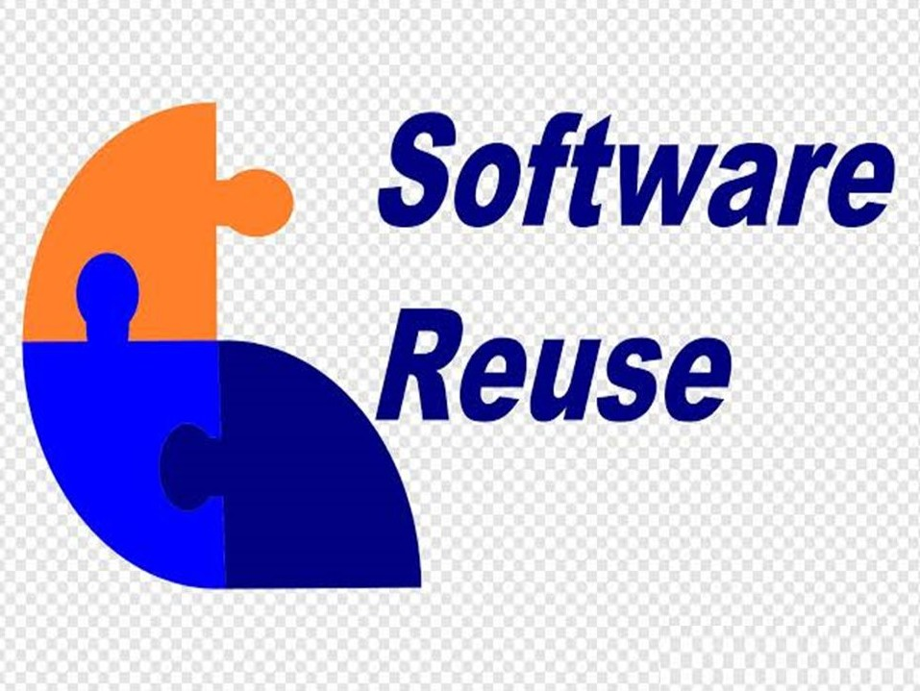

CODE

Slide 32
Topics covered
• The reuse landscape
• Application frameworks
• Software product lines
• Application system reuse

Slide 33
Software reuse
• In most engineering disciplines, systems are designed by composing existing components that have been used in other systems.
• Software engineering has been more focused on original development but it is now recognised that to achieve better software, more quickly and at lower cost, we need a design process that is based on systematic software reuse.
• There has been a major switch to reuse-based development over the past 10 years.

Slide 34
Reuse-based software engineering
• System reuse
– Complete systems, which may include application programs may be reused.
• Application reuse
several
– An application may be reused either by incorporating it without change into other or by developing application families.
• Component reuse
– Components of an application from sub-systems to single objects may be reused.
• Object and function reuse
– Small-scale software components that implement a single well-defined object or function may be reused.

Slide 35
Benefits of software reuse
Benefit | Explanation
Accelerated development | Bringing a system to market as early as possible is often more important than overall development costs. Reusing software can speed up system production because both development and validation time may be reduced.
Effective use of specialists | Instead of doing the same work over and over again, application specialists can develop reusable software that encapsulates their knowledge.
Increased dependability | Reused software, which has been tried and tested in working systems, should be more dependable than new software. Its design and implementation faults should have been found and fixed.

Slide 36
Benefits of software reuse
Benefit | Explanation
Lower development costs | Development costs are proportional to the size of the software being developed. Reusing software means that fewer lines of code have to be written.
Reduced process risk | The cost of existing software is already known, whereas the costs of development are always a matter of judgment. This is an important factor for project management because it reduces the margin of error in project cost estimation. This is particularly true when relatively large software components such as subsystems are reused.
Standards compliance | Some standards, such as user interface standards, can be implemented as a set of reusable components. For example, if menus in a user interface are implemented using reusable components, all applications present the same menu formats to users. The use of standard user interfaces improves dependability because users make fewer mistakes when presented with a familiar interface.

Slide 37
Problems with reuse
Problem | Explanation
Creating, maintaining, and using a component library | Populating a reusable component library and ensuring the software developers can use this library can be expensive. Development processes have to be adapted to ensure that the library is used.
Finding, understanding, and adapting reusable components | Software components have to be discovered in a library, understood and, sometimes, adapted to work in a new environment. Engineers must be reasonably confident of finding a component in the library before they include a component search as part of their normal development process.
Increased maintenance costs | If the source code of a reused software system or component is not available then maintenance costs may be higher because the reused elements of the system may become increasingly incompatible with system changes.

Slide 38
Problems with reuse
Problem | Explanation
Lack of tool support | Some software tools do not support development with reuse. It may be difficult or impossible to integrate these tools with a component library system. The software process assumed by these tools may not take reuse into account. This is particularly true for tools that support embedded systems engineering, less so for object-oriented development tools.
Not-invented-here syndrome | Some software engineers prefer to rewrite components because they believe they can improve on them. This is partly to do with trust and partly to do with the fact that writing original software is seen as more challenging than reusing other people’s software.

Slide 39
The reuse landscape

Slide 40
The reuse landscape
• Although reuse is often simply thought of as the reuse of system components, there are many different approaches to reuse that may be used.
• Reuse is possible at a range of levels from simple functions to complete application systems.
• The reuse landscape covers the range of possible reuse techniques.

Slide 41
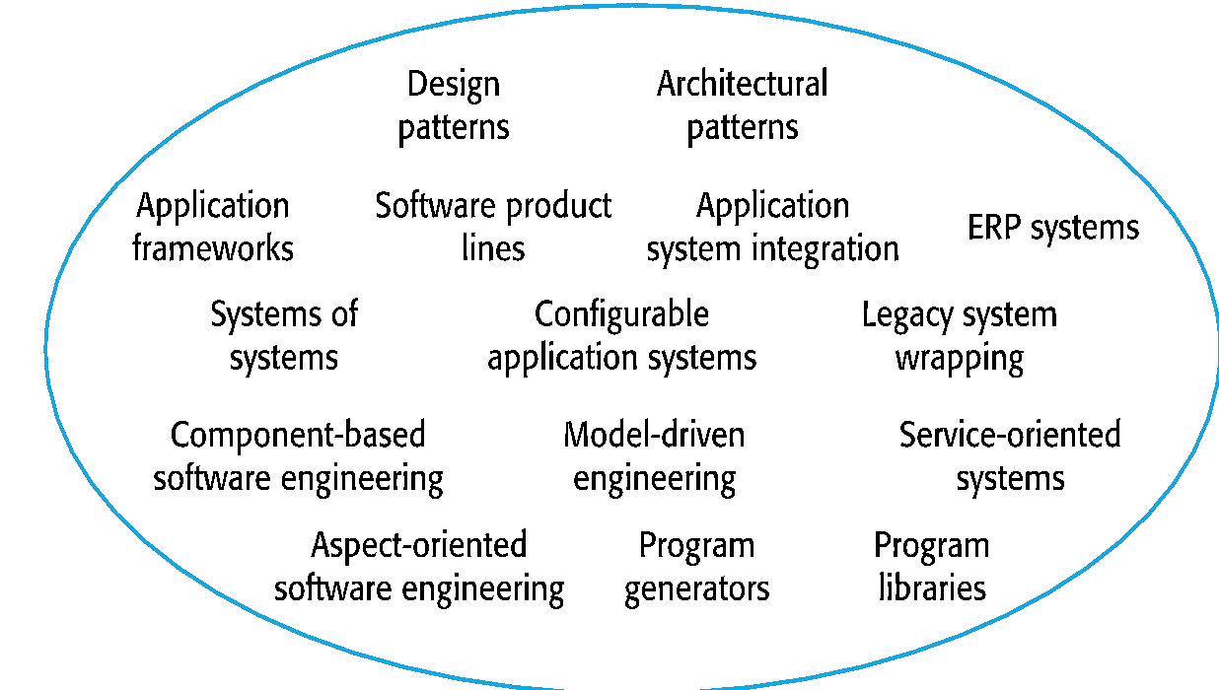


The reuse landscape

Slide 42
Approaches that support software reuse
Approach | Description
Application frameworks | Collections of abstract and concrete classes are adapted and extended to create application systems.
Application system integration | Two or more application systems are integrated to provide extended functionality
Architectural patterns | Standard software architectures that support common types of application system are used as the basis of applications..
Aspect-oriented software development | Shared components are woven into an application at different places when the program is compiled.
Component-based software engineering | Systems are developed by integrating components (collections of objects) that conform to component-model standards.

Slide 43
Approaches that support software reuse
Approach | Description
Configurable application systems | Domain-specific systems are designed so that they can be configured to the needs of specific system customers.
Design patterns | Generic abstractions that occur across applications are represented as design patterns showing abstract and concrete objects and interactions.
ERP systems | Large-scale systems that encapsulate generic business functionality and rules are configured for an organization.
Legacy system wrapping | Legacy systems are ‘wrapped’ by defining a set of interfaces and providing access to these legacy systems through these interfaces.
Model-driven engineering | Software is represented as domain models and implementation independent models and code is generated from these models.

Slide 44
Approaches that support software reuse
Approach | Description
Program generators | A generator system embeds knowledge of a type of application and is used to generate systems in that domain from a user-supplied system model.
Program libraries | Class and function libraries that implement commonly used abstractions are available for reuse.
Service-oriented systems | Systems are developed by linking shared services, which may be externally provided.
Software product lines | An application type is generalized around a common architecture so that it can be adapted for different customers.
Systems of systems | Two or more distributed systems are integrated to create a new system.

Slide 45
Reuse planning factors
• The development schedule for the software.
• The expected software lifetime.
• The background, skills and experience of the development team.
• The criticality of the software and its non-functional requirements.
• The application domain.
• The execution platform for the software.

Slide 46
Application frameworks

Slide 47
Framework definition
• “..an integrated set of software artefacts (such as classes, objects and components) that collaborate to provide a reusable architecture for a family of related applications.”

Slide 48
Application frameworks
• Frameworks are moderately large entities that can be reused. They are somewhere between system and component reuse.
• Frameworks are a sub-system design made up of a collection of abstract and concrete classes and the interfaces between them.
• The sub-system is implemented by adding components to fill in parts of the design and by instantiating the abstract classes in the framework.

Slide 49
Web application frameworks
• Support the construction of dynamic websites as a front-end for web applications.
• WAFs are now available for all of the commonly used web programming languages e.g. Java, Python, Ruby, etc.
• Interaction model is based on the
Model-View-Controller composite pattern.

Slide 50
Model-view controller
• System infrastructure framework for GUI design.
• Allows for multiple presentations of an object and separate interactions with these presentations.
• MVC framework involves the instantiation of a number of patterns

Slide 51
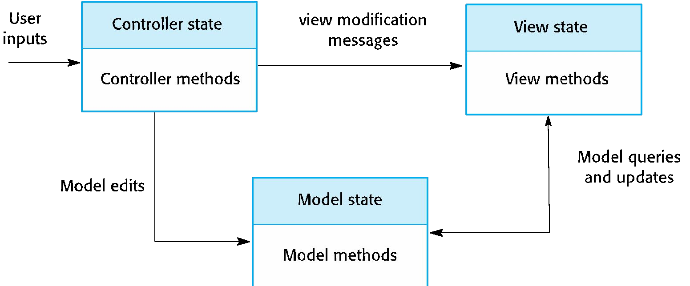
The Model-View-Controller pattern

Slide 52
WAF features
• Security
– WAFs may include classes to help implement user authentication (login) and access.
• Dynamic web pages
– Classes are provided to help you define web page templates and to populate these dynamically from the system database.
• Database support
– The framework may provide classes that provide an abstract interface to different databases.
• Session management
– Classes to create and manage sessions (a number of interactions with the system by a user) are usually part of a WAF.
• User interaction
– Most web frameworks now provide AJAX support (Holdener, 2008), which allows more interactive web pages to be created.

Slide 53
Extending frameworks
• Frameworks are generic and are extended to create a more specific application or sub-system. They provide a skeleton architecture for the system.
• Extending the framework involves
– Adding concrete classes that inherit operations from abstract classes in the framework;
– Adding methods that are called in response to events that are recognised by the framework.
• Problem with frameworks is their complexity which means that it takes a long time to use them effectively.

Slide 54
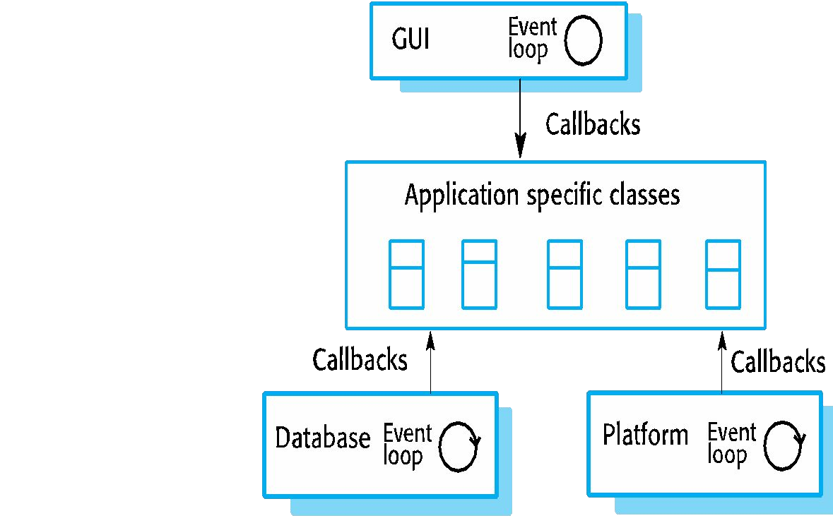
Inversion of control in frameworks

Slide 55
Framework classes
• System infrastructure frameworks
– Support the development of system infrastructures such as communications, user interfaces and compilers.
• Middleware integration frameworks
– Standards and classes that support component communication and information exchange.
• Enterprise application frameworks
– Support the development of specific types of
or
application such as telecommunications
financial systems.

Slide 56
Software product lines

Slide 57
Software product lines
• Software product lines or application families are applications with generic functionality that can be adapted and configured for use in a specific context.
• A software product line is a set of applications with a common architecture and shared components, with each application specialized to reflect different requirements.
• Adaptation may involve:
– Component and system configuration;
– Adding new components to the system;
– Selecting from a library of existing components;
– Modifying components to meet new requirements.

Slide 58
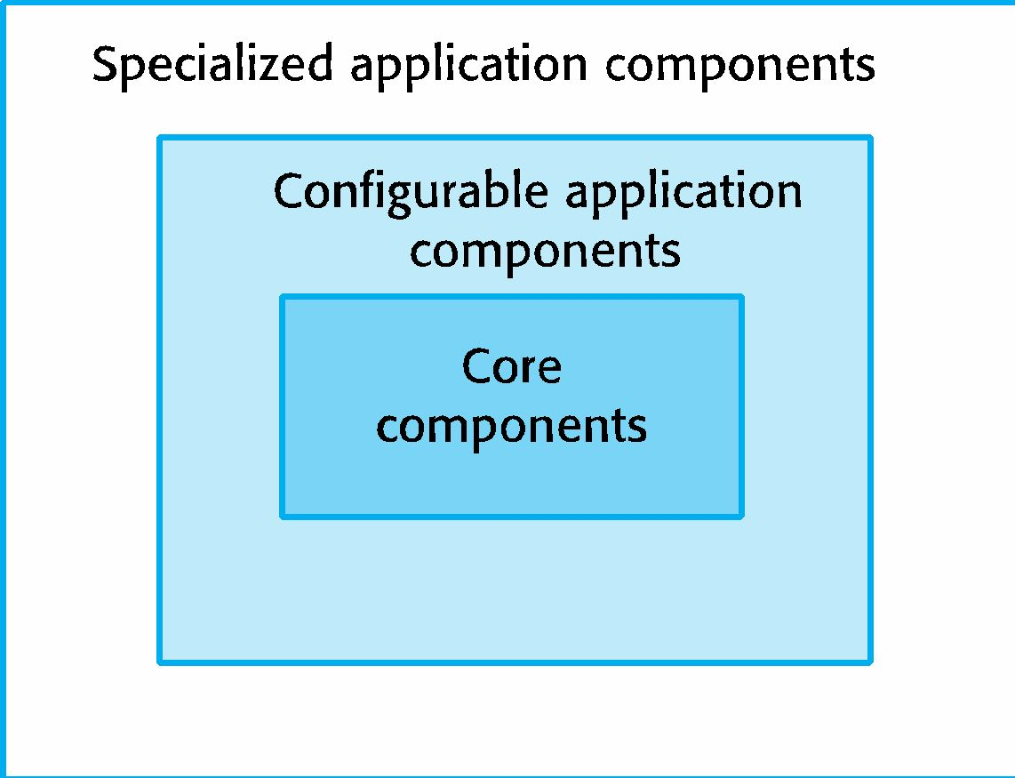
Base systems for a software product line

Slide 59
Base applications
• Core components that provide infrastructure support. These are not usually modified when developing a new instance of the product line.
• Configurable components that may be modified and configured to specialize them to a new application. Sometimes, it is possible to reconfigure these components without changing their code by using a built-in component configuration language.
• Specialized, domain-specific components some or all of which may be replaced when a new instance of a product line is created.

Slide 60
Application frameworks and product lines
• Application frameworks rely on object-oriented features such as polymorphism to implement extensions. Product lines need not be object-oriented (e.g. embedded software for a mobile phone)
• Application frameworks focus on providing technical rather than domain-specific support. Product lines embed domain and platform information.
• Product lines often control applications for equipment.
• Software product lines are made up of a family of applications, usually owned by the same organization.

Slide 61
Product line architectures
• Architectures must be structured in such a way to separate different sub-systems and to allow them to be modified.
• The architecture should also separate entities and their descriptions and the higher levels in the system access entities through descriptions rather than directly.

Slide 62
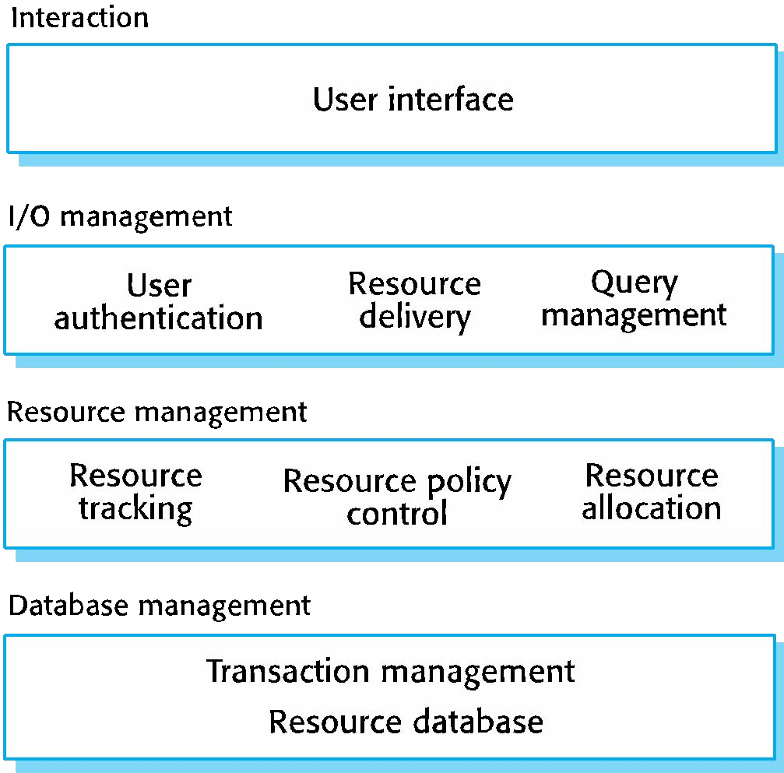
The architecture of a resource allocation system

Slide 63
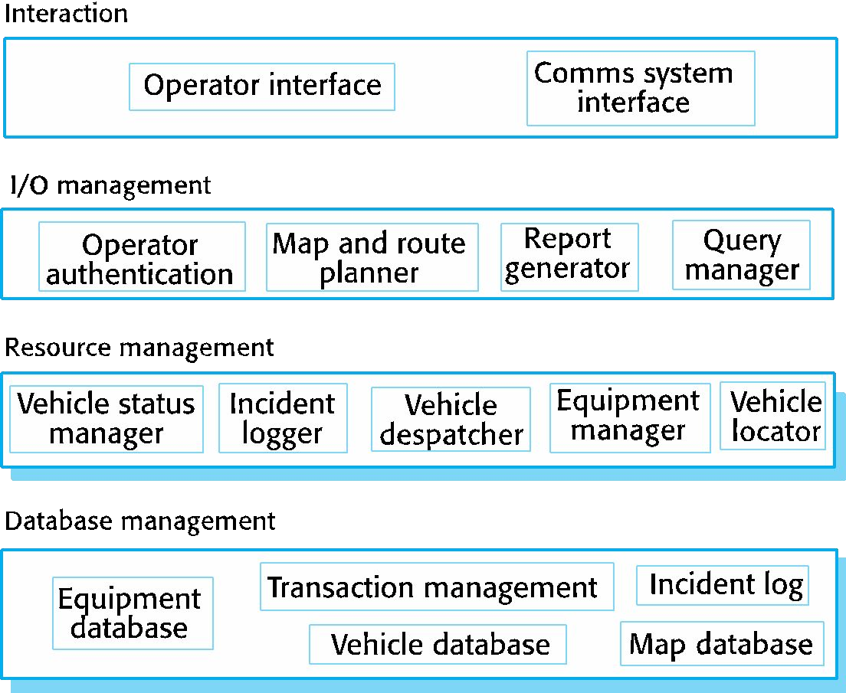
The product line architecture of a vehicle dispatcher

Slide 64
Vehicle dispatching
• A specialised resource management system where the aim is to allocate resources (vehicles) to handle incidents.
• Adaptations include:
– At the UI level, there are components for operator display and communications;
– At the I/O management level, there are components that handle authentication, reporting and route planning;
– At the resource management level, there are components for vehicle location and despatch, managing vehicle status and incident logging;
– The database includes equipment, vehicle and map databases.

Slide 65
Product line specialisation
• Platform specialization
– Different versions of the application are developed for different platforms.
• Environment specialization
– Different versions of the application are created to handle different operating environments e.g. different types of communication equipment.
• Functional specialization
– Different versions of the application are created for customers with different requirements.
• Process specialization
– Different versions of the application are created to support different business processes.

Slide 66
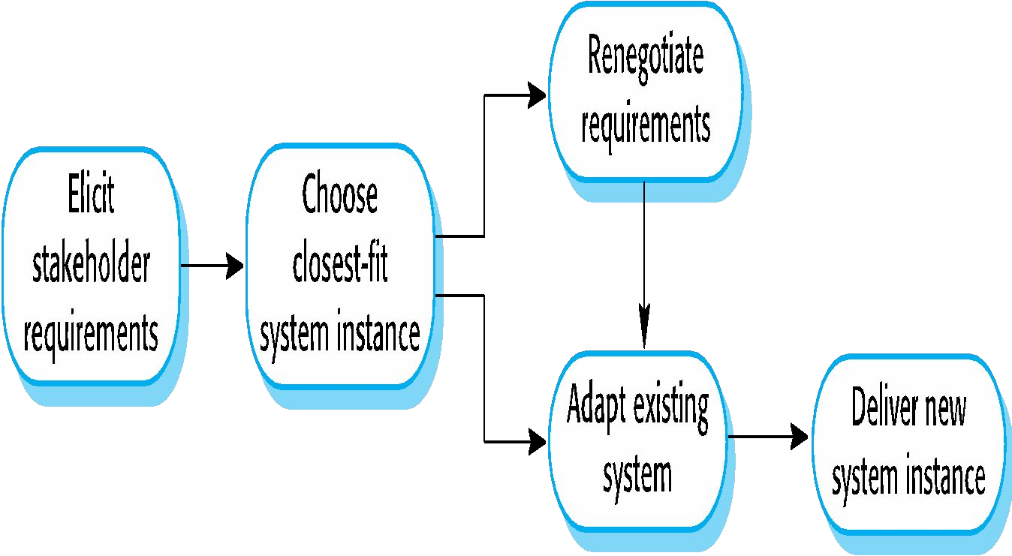
Product instance development

Slide 67
Product instance development
• Elicit stakeholder requirements
– Use existing family member as a prototype
• Choose closest-fit family member
– Find the family member that best meets the requirements
• Re-negotiate requirements
– Adapt requirements as necessary to capabilities of the software
• Adapt existing system
– Develop new modules and make changes for family member
• Deliver new family member
– Document key features for further member development

Slide 68
Product line configuration
• Design time configuration
– The organization that is developing the software modifies a common product line core by developing, selecting or adapting components to create a new system for a customer.
• Deployment time configuration
– A generic system is designed for configuration by a customer or consultants working with the customer. Knowledge of the customer’s specific requirements and the system’s operating environment is embedded in configuration data that are used by the generic system.

Slide 69
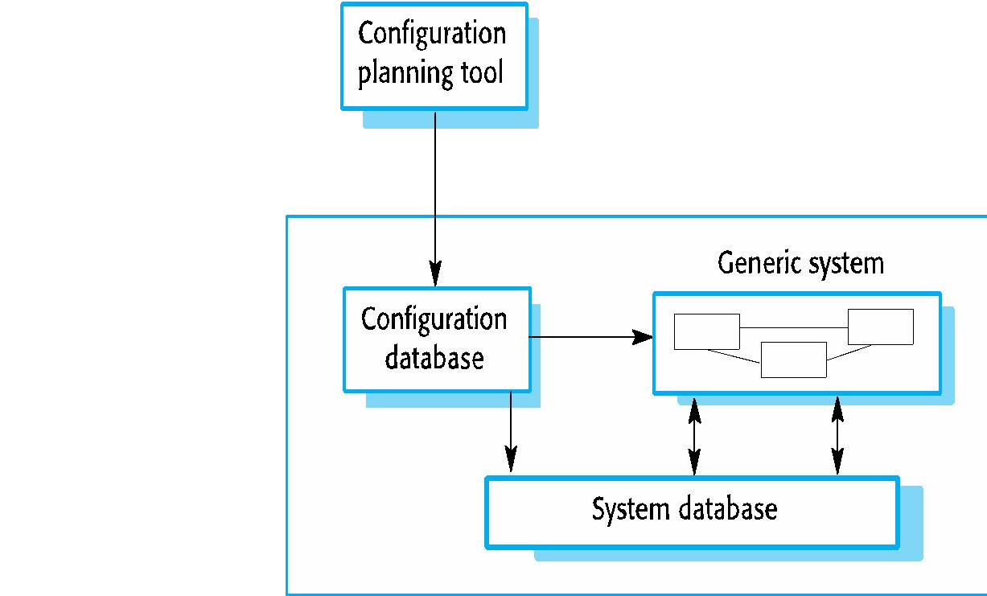
Deployment-time configuration

Slide 70
Levels of deployment time configuration
• Component selection, where you select the modules in a system that provide the required functionality.
• Workflow and rule definition, where you define workflows (how information is processed, stage-by-stage) and validation rules that should apply to information entered by users or generated by the system.
• Parameter definition, where you specify the values of specific system parameters that reflect the instance of the application that you are creating

Slide 71
Application system reuse

Slide 72
Application system reuse
• An application system product is a software system that can be adapted for different customers without changing the source code of the system.
• Application systems have generic features and so can be used/reused in different environments.
• Application system products are adapted by using built-in configuration mechanisms that allow the functionality of the system to be tailored to specific customer needs.
– For example, in a hospital patient record system, separate input forms and output reports might be defined for different types of patient.

Slide 73
Benefits of application system reuse
• As with other types of reuse, more rapid deployment of a reliable system may be possible.
• It is possible to see what functionality is provided by the applications and so it is easier to judge whether or not they are likely to be suitable.
• Some development risks are avoided by using existing software. However, this approach has its own risks, as I discuss below.
• Businesses can focus on their core activity without having to devote a lot of resources to IT systems development.
• As operating platforms evolve, technology updates may be simplified as these are the responsibility of the COTS product vendor rather than the customer.

Slide 74
Problems of application system reuse
• Requirements usually have to be adapted to reflect the functionality and mode of operation of the COTS product.
• The COTS product may be based on assumptions that are practically impossible to change.
• Choosing the right COTS system for an enterprise can be a difficult process, especially as many COTS products are not well documented.
• There may be a lack of local expertise to support systems development.
• The COTS product vendor controls system support and evolution.
73

Slide 75
Configurable application systems
• Configurable application systems are generic application systems that may be designed to support a particular business type, business activity or, sometimes, a complete business enterprise.
– For example, an application system may be produced for dentists that handles appointments, dental records, patient recall, etc.
• Domain-specific systems, such as systems to support a business function (e.g. document management) provide functionality that is likely to be required by a range of
potential users.

Slide 76
COTS-solution and COTS-integrated systems
Configurable application systems | Application system integration
Single product that provides the functionality required by a customer | Several heterogeneous system products are integrated to provide customized functionality
Based around a generic solution and standardized processes | Flexible solutions may be developed for customer processes
Development focus is on system configuration | Development focus is on system integration
System vendor is responsible for maintenance | System owner is responsible for maintenance
System vendor provides the platform for the system | System owner provides the platform for the system

Slide 77
ERP systems
• An Enterprise Resource Planning (ERP) system is a
generic system that
supports common business ordering and invoicing,
processes such as
manufacturing, etc.
• These are very widely used in large companies - they represent probably the most common form of software reuse.
• The generic core is adapted by including modules and by incorporating knowledge of business processes and rules.

Slide 78
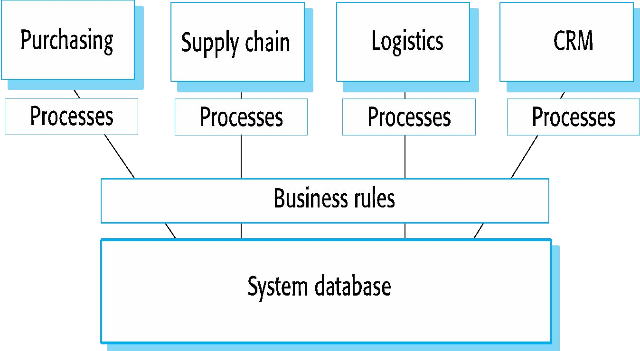
The architecture of an ERP system

Slide 79
ERP architecture
• A number of modules to support different business functions.
• A defined set of business processes, associated with each module, which relate to activities in that module.
• A common database that maintains information about all related business functions.
• A set of business rules that apply to all data in the database.

Slide 80
ERP configuration
• Selecting the required functionality from the system.
• Establishing a data model that defines how the organization’s data will be structured in the system database.
• Defining business rules that apply to that data.
• Defining the expected interactions with external systems.
• Designing the input forms and the output reports generated by the system.
• Designing new business processes that conform to the underlying process model supported by the system.
• Setting parameters that define how the system is deployed on its underlying platform.

Slide 81
Integrated application systems
• Integrated application systems are applications that include two or more application system products and/or legacy application systems.
• You may use this approach when there is no single application system that meets all of your needs or when you wish to integrate a new application system with systems that you already use.

Slide 82
Design choices
• Which individual application systems offer the most appropriate functionality?
– Typically, there will be several application system products available, which can be combined in different ways.
• How will data be exchanged?
– Different products normally use unique data structures and formats. You have to write adaptors that convert from one representation to another.
• What features of a product will actually be used?
– Individual application systems may include more functionality than you need and functionality may be duplicated across different products.

Slide 83
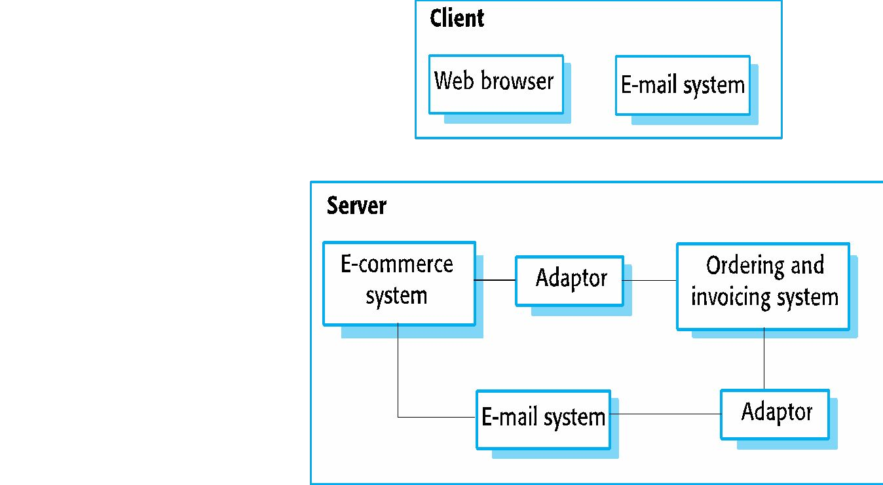
An integrated procurement system

Slide 84
Service-oriented interfaces
• Application system integration can be simplified if a service-oriented approach is used.
• A service-oriented approach means allowing access to the application system’s functionality through a standard service interface, with a service for each discrete unit of functionality.
• Some applications may offer a service interface but, sometimes, this service interface has to be implemented by the system integrator. You have to program a wrapper that hides the application and provides externally visible services.

Slide 85
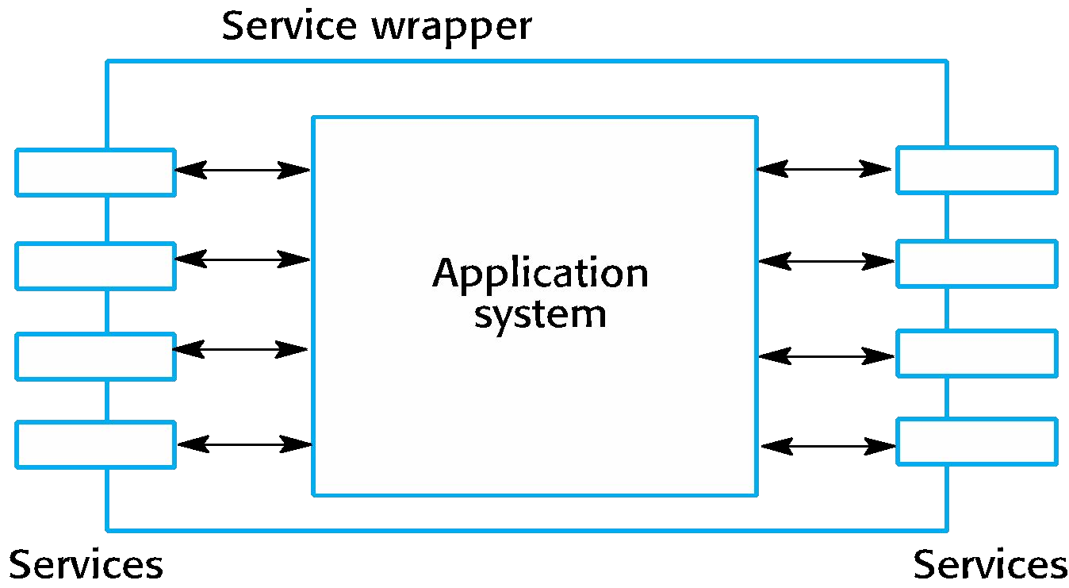
Application wrapping

Slide 86
Application system integration problems
• Lack of control over functionality and performance
– Application systems may be less effective than they appear
• Problems with application system inter-operability
– Different application systems may make different assumptions that means integration is difficult
• No control over system evolution
– Application system vendors not system users control evolution
• Support from system vendors
– Application system vendors may not offer support over the lifetime of the product

Slide 87
Key points
• There are many different ways to reuse software. These range from the reuse of classes and methods in libraries to the reuse of complete application systems.
• The advantages of software reuse are lower costs, faster software development and lower risks. System dependability is increased. Specialists can be used more effectively by concentrating their expertise on the design of reusable components.
• Application frameworks are collections of concrete
and abstract objects
that are designed for reuse and the addition of new
through specialization
objects. They usually incorporate good design practice through design patterns.

Slide 88
Key points
• Software product lines are related applications that are developed from one or more base applications. A generic system is adapted and specialized to meet specific requirements for functionality, target platform or operational configuration.
• Application system reuse is concerned with the reuse of large-scale, off-the-shelf systems. These provide a lot of functionality and their reuse can radically reduce costs and development time. Systems may be developed by configuring a single, generic application system or by integrating two or more application systems.
• Potential problems with application system reuse include lack of control over functionality and performance, lack of control over system evolution, the need for support from external vendors and difficulties in ensuring that systems can inter-operate.

