Slide 1
Chicago Car Crash Prediction
Predicting injury outcomes using machine learning
Dataset: Chicago crashes (2019–2022)

Slide 2
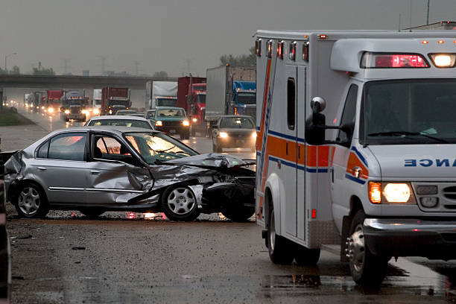

Slide 3
Business Problem
Traffic accidents are a major concern in Chicago. Understanding the conditions that lead to severe crashes will help the Vehicle safety board.
This project aims to build a classification model that predicts whether a car crash will result in injuries based on environmental factors or other factors. The insights from this model will help identify high risk conditions and implement preventive measures to improve road safety.

Slide 4
Stakeholders
Vehicle Safety Board
Responsible for road safety
Implement safety programs
They will use this model to identify high risk driving
City of Chicago
Responsible for transportation infrastructure

Slide 5
Key Questions
What factors contribute to most crashes?
Under what conditions are crashes most likely to result in injuries?
Can we predict whether a crash will result in injuries based on environmental conditions?
Can we predict the primary contributory cause of accidents?

Slide 6
Data Understanding
The dataset we are using has been obtained from kaggle, it contains car crashes in chicago from 2019 to 2022. Its particulary useful because it includes car crash variables and environmental factors that influence crash outcomes. It allows us to analyze patterns in traffic accidents.

Slide 7
Data Preparation
Several preprocessing steps were performed before training the models:
Cleaning missing values
Mapping injury values to numeric format
Creating a binary target variable (`crash_severity_class`)
Feature engineering from crash dates
One-hot encoding categorical variables
Selecting relevant model features
Standardizing numerical variables using StandardScaler
Target Variable:`crash_severity_class` - 1 = crash resulted in injuries - 0 = crash resulted in no injuries

Slide 8
Feature Engineering
The following features were selected for modeling:
windspeed
winddir
pressure
visibility
cloudcover
moonphase
lattitude
days_temp
num_vehicles_in_crash
These features represent environmental conditions and crash characteristics that may influence injury outcomes.

Slide 9
Modeling Approach
Train-test split (80/20)
Standardization applied
Cross-validation
Models:
- Logistic Regression
- Decision Tree

Slide 10
Evaluation Metrics
Accuracy
Confusion Matrix
ROC-AUC
Classification Report
These metrics help measure how well the models predict injury outcomes.

Slide 11
Key Insights
The analysis helps identify:
Environmental conditions associated with higher injury risk
Crash patterns linked to severe accidents
Predictive indicators of injury-causing crashes
These insights can help authorities implement preventative measures to improve road safety.

Slide 12
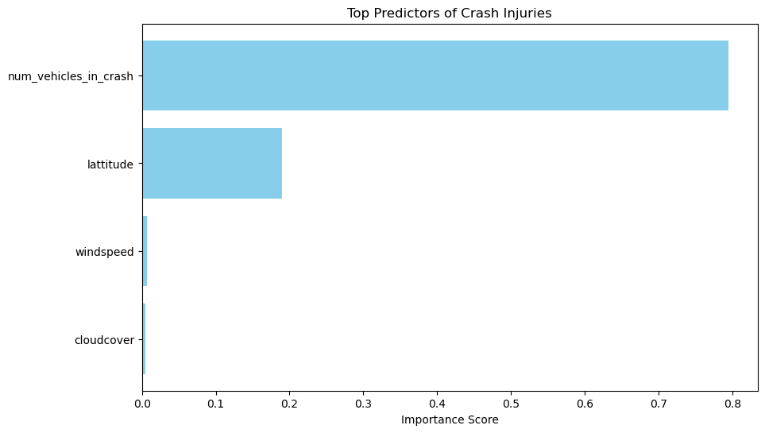
Top predictors plot

Slide 13
Recommendations
1. Since num_vehicles_in_crash is your strongest predictor, the city should prioritize on conflict point reduction. By converting high crash intersections into round abouts or adding more signals. This will slow the speed of the cars and drivers will have ample time for reaction as well as reduce the number of injuries
2. For location safety, because lattitude is a significant, the city should investigate the specific streets within the high risk lattitude zones. Then enforce speed cameras or increased patrols officers.
3. The city should issue amber alerts when there are changes in weather conditions, because different drivers react differently as well as focus on infustructure diring these weather changes
4. The city should integrate an emergency dispatch system. This is because we a 69% recall, which flags when a crash is likely to have an injury.

Slide 14
Conclusion
While a standard model prioritizes on accuracy, we optimized for recall. The model reveals that the more the cars at in intersections the higher the impact of accidents. The city should focus on multi vehicle intersections within the high risk lattitude and the allocate resources where they will have immediate impact on saving lives.

Slide 15
Project work flow
1. Business Understanding
2. Data Understanding
3. Data Preparation
4. Modeling
5. Evaluation
6. Conclusion and Recommendations

