Slide 1

C programming socket communication 2024 Eugene KO

Slide 2
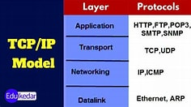
Application Layer: This layer is responsible for providing network services directly to end-users or applications. It includes protocols such as HTTP (Hypertext Transfer Protocol), FTP (File Transfer Protocol), SMTP (Simple Mail Transfer Protocol), and DNS (Domain Name System).
Transport Layer: The transport layer is responsible for end-to-end communication between the source and destination hosts. It ensures reliable and orderly delivery of data by handling issues such as flow control, error correction, and congestion control. The most common protocols at this layer are TCP (Transmission Control Protocol) and UDP (User Datagram Protocol).
Internet Layer: This layer is responsible for routing packets across different networks to reach their destination. It deals with logical addressing (such as IP addresses) and packet forwarding. The main protocol at this layer is the Internet Protocol (IP).
Link Layer: Also known as the Network Interface Layer or Network Access Layer, this layer deals with the physical transmission of data over the network medium. It includes protocols and standards for connecting devices within the same local network, such as Ethernet, Wi-Fi, and PPP (Point-to-Point Protocol).

Slide 3
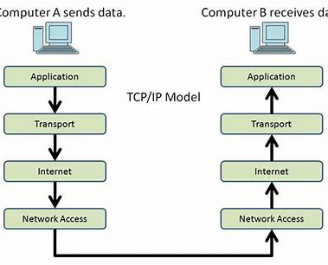
encapsulation
encapsulation refers to the process of adding protocol headers (and possibly trailers) to data packets as they move down the protocol stack. Each layer of the TCP/IP model adds its own header to the data received from the layer above before passing it down to the next layer. When data is transmitted across a network, each layer of the TCP/IP model encapsulates the data with its own header, creating a packet.

Slide 4
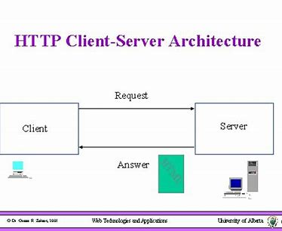
Client server model

Slide 5
Client program
// Create socket
if ((client_socket = socket(AF_INET, SOCK_STREAM, 0)) == INVALID_SOCKET)
{
printf("Socket creation failed.\n");
WSACleanup();
return 1;
}
// Prepare the sockaddr_in structure
server.sin_family = AF_INET;
server.sin_addr.s_addr = inet_addr("127.0.0.1");
server.sin_port = htons(PORT);
// Connect to server
if (connect(client_socket, (struct sockaddr*)&server, sizeof(server)) < 0)
{
printf("Connection failed.\n");
closesocket(client_socket);
WSACleanup();
return 1;
}
#include <stdio.h>
#include <winsock2.h>
#pragma comment(lib, "ws2_32.lib")
#define PORT 8080
#define MAX_BUFFER_SIZE 1024
int main() {
WSADATA wsa;
SOCKET client_socket;
struct sockaddr_in server;
char buffer[MAX_BUFFER_SIZE];
// Initialize Winsock
if (WSAStartup(MAKEWORD(2, 2), &wsa) != 0)
{
printf("WSAStartup failed.\n");
return 1;
}
// Actual communication
char message[] = "Hello from client";
send(client_socket, message, strlen(message), 0);
printf("Message sent to server: %s\n", message);
int bytes_received = recv(client_socket, buffer, MAX_BUFFER_SIZE, 0);
printf("Message from server: %s\n", buffer);
closesocket(client_socket);
WSACleanup();
return 0;
}

Slide 6
server program
#include <stdio.h>
#include <winsock2.h>
#define PORT 8080
#define MAX_BUFFER_SIZE 1024
int main() {
WSADATA wsa;
SOCKET server_socket, client_socket;
struct sockaddr_in server, client;
int client_len = sizeof(client);
char buffer[MAX_BUFFER_SIZE];
// Initialize Winsock
if (WSAStartup(MAKEWORD(2, 2), &wsa) != 0) {
printf("WSAStartup failed.\n");
return 1;
}
// Create socket
if ((server_socket = socket(AF_INET, SOCK_STREAM, 0)) == INVALID_SOCKET) {
printf("Socket creation failed.\n");
return 1;
}
// Prepare the sockaddr_in structure
server.sin_family = AF_INET;
server.sin_addr.s_addr = INADDR_ANY;
server.sin_port = htons(PORT);
// Bind
if (bind(server_socket, (struct sockaddr*)&server, sizeof(server)) == SOCKET_ERROR)
{
printf("Bind failed.\n");
closesocket(server_socket);
WSACleanup();
return 1;
}
// Listen
listen(server_socket, 3);
// Accept an incoming connection
if ((client_socket = accept(server_socket, (struct sockaddr*)&client, &client_len)) == INVALID_SOCKET)
{
printf("Accept failed.\n");
closesocket(server_socket);
WSACleanup();
return 1;
}
// Actual communication
int bytes_received = recv(client_socket, buffer, MAX_BUFFER_SIZE, 0);
send(client_socket, buffer, bytes_received, 0);
printf("Message from client: %s\n", buffer);
closesocket(server_socket);
closesocket(client_socket);
WSACleanup();
return 0;
}

Slide 7
WSAStartup()
initializing the Winsock library
Winsock (Windows Sockets)
a programming interface and the supporting library
handling communication between a client and server applications over a network in the Windows operating system.

Slide 8
SOCK_STREAM
specify the type of communication protocol
Stream-oriented communication: This type of communication establishes a virtual connection between two endpoints, providing a continuous and reliable data flow. It ensures that data is delivered in the same order it was sent and without duplication or loss

Slide 9
AF_INET
specify that we are using the IPv4 address family

Slide 10
struct sockaddr_in
specify the address and port of the server

Slide 11
bind
bind the server_socket to the local address and port specified

Slide 12
INADDR_ANY
bind the socket to all available network interfaces on the machine

Slide 13
htons()
convert the port number from host byte order to network byte order

