Slide 1


C language
talk

Slide 2
翻譯員
Translater
C language
compiler
talk

Slide 3
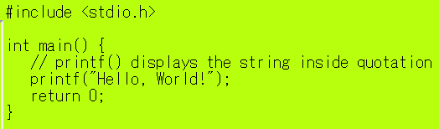
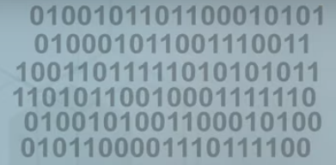
翻譯員
Translator
C language
compiler
talk
Machine code
101100101

Slide 4
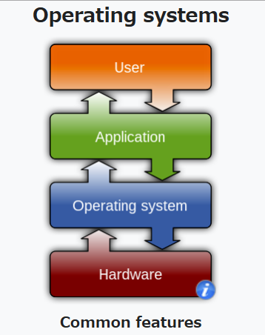
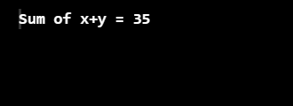
C program
Windows 11

Slide 5

Command terminator, end of command, called semicolon
Assignment
One direction only
Assing 10 to vaiable x
One direction only

Slide 6
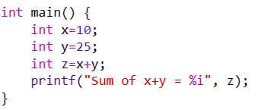
Curly baraces 大括號

Slide 7
Main function, the starting point of execution

Slide 8
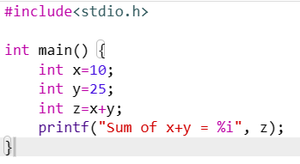
Bring in library functions

