Slide 1
程式設計（一）
9/26 福山友美加 Maya

Slide 2
②
A: name of the variable
B: in the view of hard-ware.
It’s a memory location with space to restore data.
④
Semicolon
A terminator of a statement
①
②
③
④
①date type
integer 0,1,2,3…
-1,-2,-3…
Rule →before using a variable
must define its data type.
③
A:This sigh will assign the data in the right side to the last variable’s space
B:this operation is called ‘assignment’
Its is an execution symbol (or sigh)

Slide 3
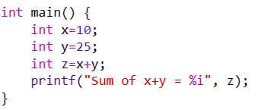
{ } braces 大括號
↑
Statements: composed of descriptions, logic, loop etc.
Google to find out
C language braces: used to signify the start and end of a series of statements

Slide 4
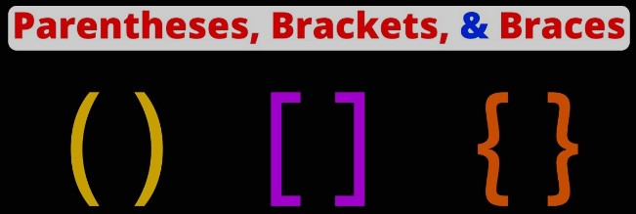
（ ）Parentheses
A: in the end of function name. there is a parentheses
B: it is used to indicate a function
Google to find out
C language parentheses: used to surround input parameters of a function call.
[ ] Brackets
Use to indicate an array which is a data structure in C
{ } Braces 大括號
↑
Statements: composed of descriptions, logic, loop etc.
Google to find out
C language braces: used to signify the start and end of a series of statements

Slide 5
Date type of variable
A: before using a variable we must declare its data type B: the reason for example, our integer and character are, same to the machines

Slide 6
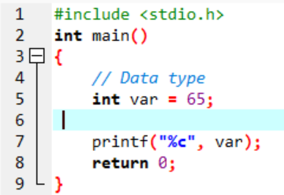
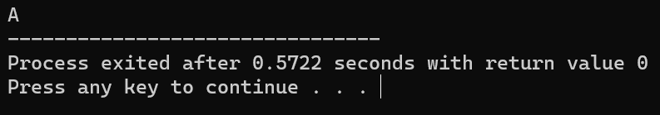
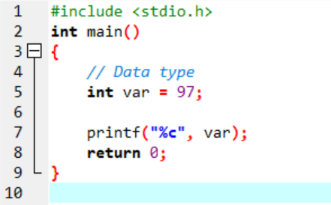
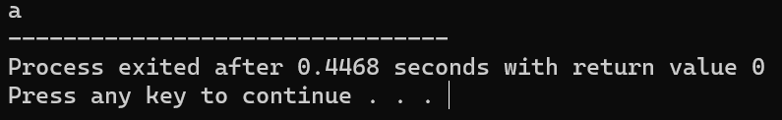
ANSI A . N . S . I
American national standard Institute
Program→ASCII→Compiler→Machine code
≠
Chinese
Japanese
Execute → compile → execute → run
Execute → compile → execute → run

Slide 7

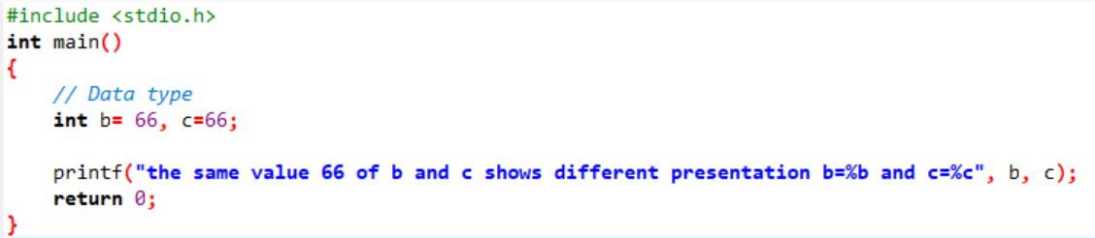
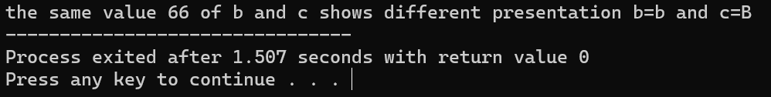
A is the control statement control format for presentation
B,C … are arguments, no control

