Slide 1
Hands on Build Tools to Automate stuff with Python Table Extractor from PDF
Overview

Slide 2
PDF – Portable File Format
The Portable Document Format (PDF) is a file format developed by Adobe in the 1990s to present documents that include text, graphics and images, independent of software, hardware, and operating systems. Let’s say, Whether It’s Appple Mac or Microsoft Windows – a document should look the same and hence PDF was developed.
The first version, 1.0, was introduced in 1993.
PDF is based on the PostScript language, each PDF file encapsulates a complete description of a fixed-layout flat document

Slide 3
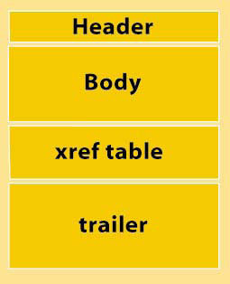
The general structure of a PDF file is composed of the following code components:
header,
body,
cross-reference (xref) table, and
trailer,
The header contains just one line that identifies the version of PDF. Example: %PDF-1.5
The trailer contains pointers to the xref table and to key objects contained in the trailer dictionary. It ends with %%EOF to identify end of file.
The xref table contains pointers to all the objects included in the PDF file. It identifies how many objects are in the table, where the object begins (the offset), and its length in bytes.
The body contains all the object information — fonts, images, words, bookmarks, form fields, and so on.

Slide 4
Other Python Modules:
Tabula
pdfplumber
pdftables
pdf-table-extract

Slide 5
Why Camelot?¶
You are in control. Unlike other libraries and tools which either give a nice output or fail miserably (with no in-between), Camelot gives you the power to tweak table extraction. (This is important since everything in the real world, including PDF table extraction, is fuzzy.)
Bad tables can be discarded based on metrics like accuracy and whitespace, without ever having to manually look at each table.
Each table is a pandas DataFrame, which seamlessly integrates into ETL and data analysis workflows.
Export to multiple formats, including JSON, Excel and HTML.

