Slide 1
PDF – Portable File Format
The Portable Document Format (PDF) is a file format developed by Adobe in the 1990s to present documents, including text formatting and images, in a manner independent of application software, hardware, and operating systems.
The first version, 1.0, was introduced in 1993.
PDF is based on the PostScript language, each PDF file encapsulates a complete description of a fixed-layout flat document

Slide 2
Table Extractor from PDF
Overview

Slide 3
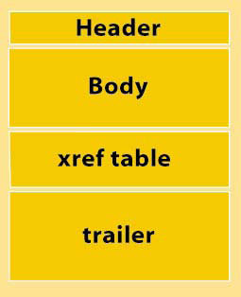
The general structure of a PDF file is composed of the following code components:
header,
body,
cross-reference (xref) table, and
trailer,
The header contains just one line that identifies the version of PDF. Example: %PDF-1.5
The trailer contains pointers to the xref table and to key objects contained in the trailer dictionary. It ends with %%EOF to identify end of file.
The xref table contains pointers to all the objects included in the PDF file. It identifies how many objects are in the table, where the object begins (the offset), and its length in bytes.
The body contains all the object information — fonts, images, words, bookmarks, form fields, and so on.

Slide 4
In 2008 , PDF was standardized as an open format, ISO 32000

