Slide 1
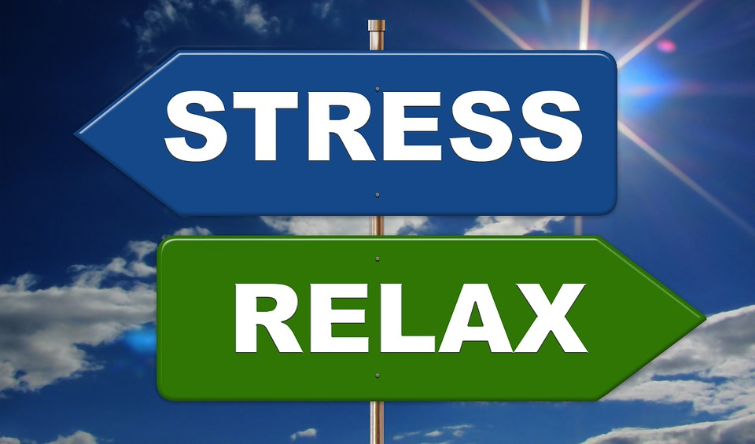
HUMAN STRESS DETECTION AND PREDICTION SYSTEM USING ANN
Lilly Grace

Slide 2
INTRODUCTION
Stress is a natural human response to challenges or threats in life that can cause a state of worry or mental tension. There is no drug to cure stress, but there are ways to cope with it. Some people use psychological and physical approaches, such as yoga, mindfulness, or relaxation techniques.
To address this challenge, we propose the development of a Stress Monitoring and Prediction System designed to assess and analyze physiological data, such as sleep patterns, movement, and respiration rates.
The primary objective of this project is to create an Artificial Neural Network (ANN) model that accurately predicts individual stress levels based on the analysis This proactive approach empowers individuals to implement effective stress management strategies, ultimately enhancing their overall well-being and resilience in the face of daily challenges. of collected data.

Slide 3
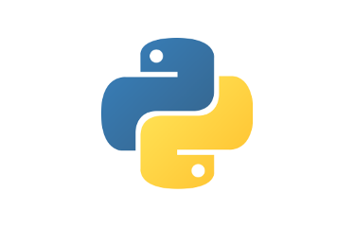


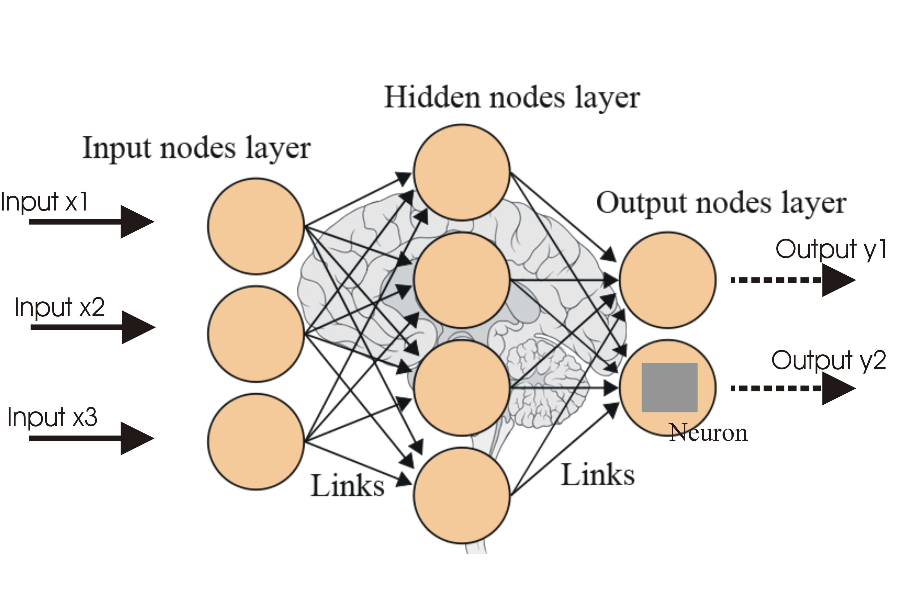
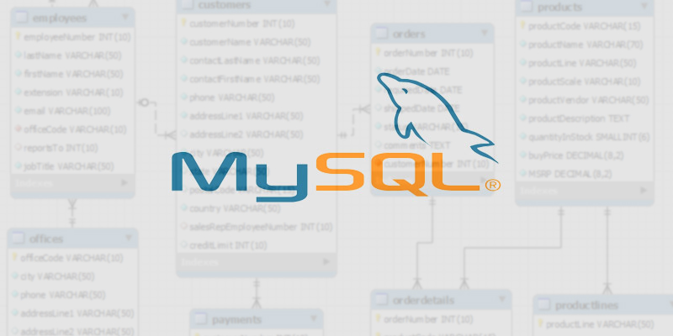
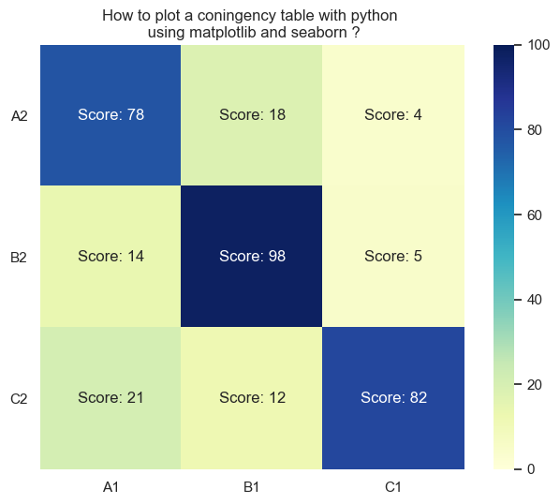
TECHNOLOGIES USED
Programming Language: Python
Framework: Django
IDE: Visual Studio Code
Model Type: Artificial Neural Network (ANN)
Data Visualization: Matplotlib, Seaborn
Database: MySQL
This Photo by Unknown Author is licensed under CC BY-SA

Slide 4
PROJECT OVERVIEW
Home page
Signup page
Login page
Input health data
Result page

Slide 5
MILESTONES-4
Data preprocessing
ANN Model Design
Model Training and Visualization
Model Deployment & User Interface

Slide 6
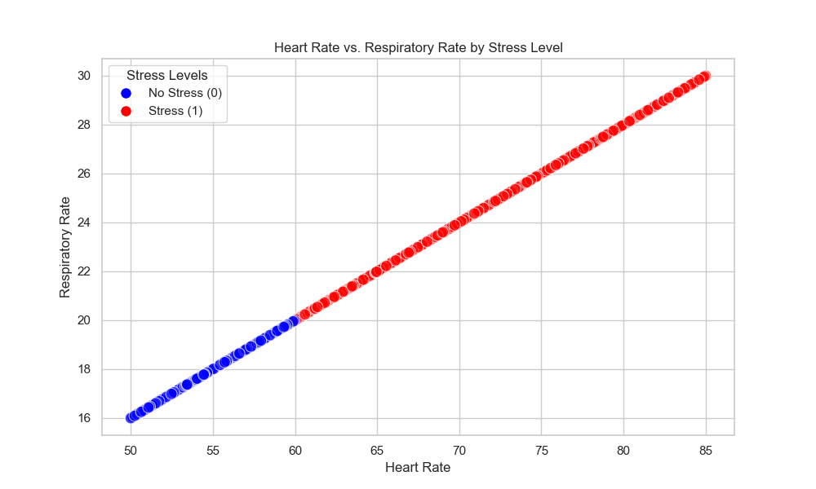
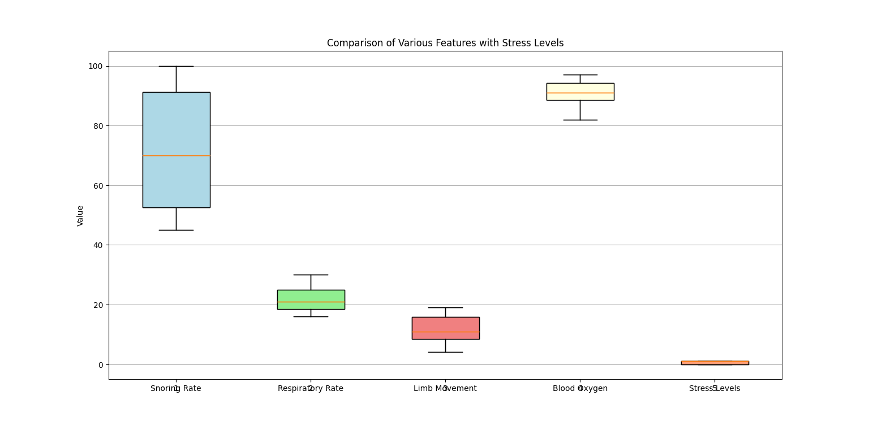
MILESTONE 1: DATA PREPROCESSING AND VISUALIZATION
SCATTER PLOT
BOX PLOT

Slide 7
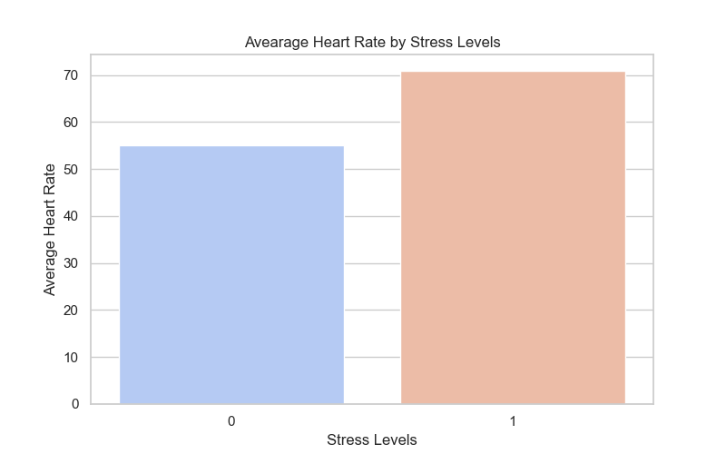
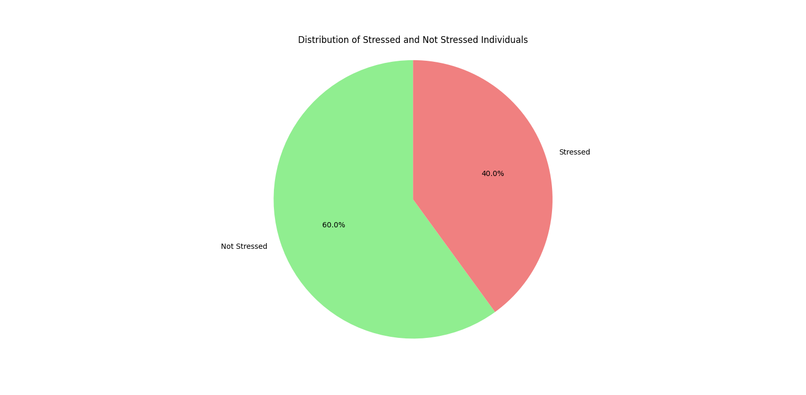
MILESTONE 1: DATA PREPROCESSING AND VISUALIZATION
BAR PLOT
PIE CHART

Slide 8
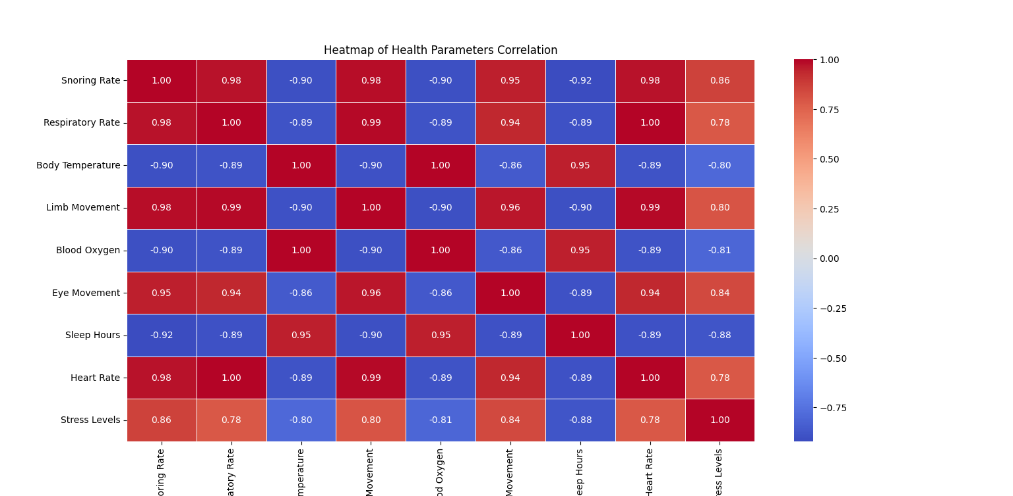
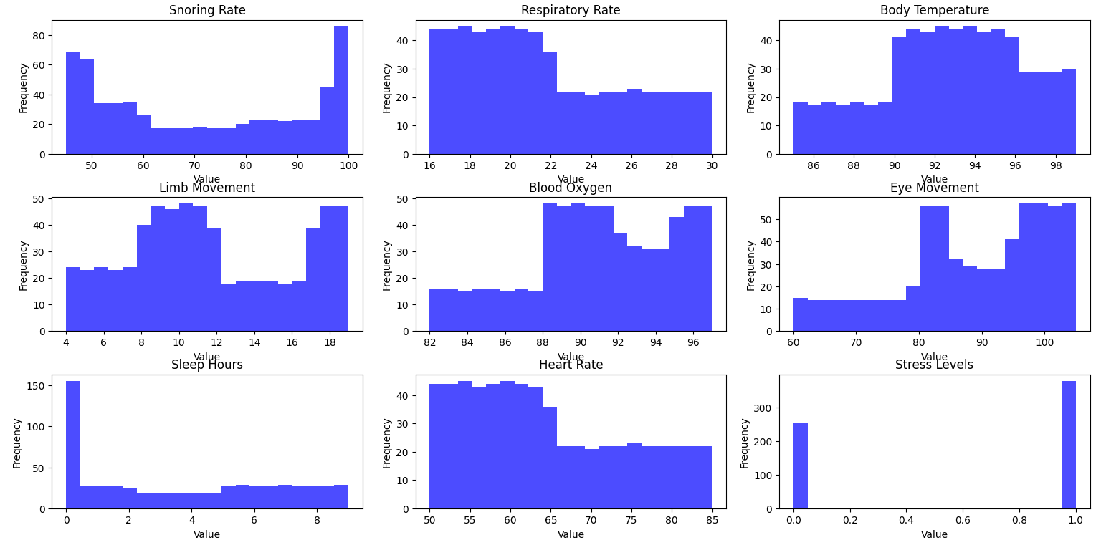
MILESTONE 1: DATA PREPROCESSING AND VISUALIZATION
HEAT MAP
HISTOGRAM

Slide 9
MILESTONE 2:ANN MODEL DESIGN
Input Layer:Accepts 8 numerical features derived from sleep data: Heart Rate, Body Movements, Respiratory Rate, EEG Data, Sleeping Hours, Blood Oxygen Level, Snoring Rate, and Limb Movement Rate.
First Hidden Layer:64 neurons with ReLU activation function for capturing complex patterns and relationships in the input data.
Second Hidden Layer:32 neurons with ReLU activation, reducing the feature space while retaining significant patterns.
Output Layer:A single neuron with a sigmoid activation function, designed for binary classification, outputting a probability of being stressed or not stressed.

Slide 10
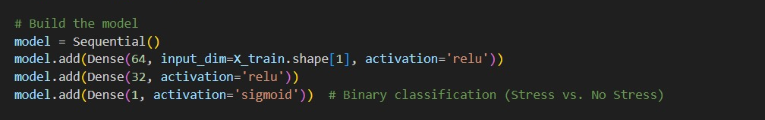
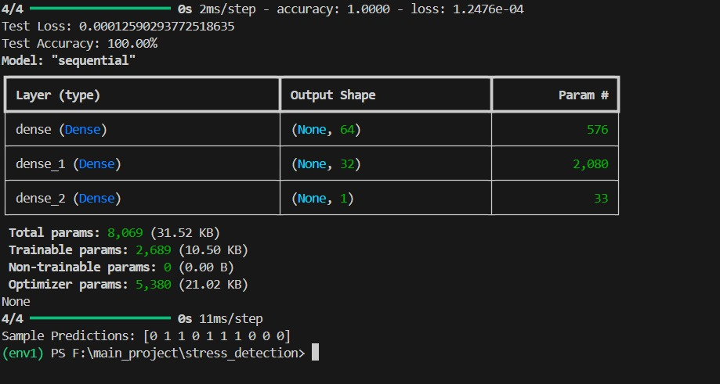
MILESTONE 2:ANN MODEL DESIGN

Slide 11
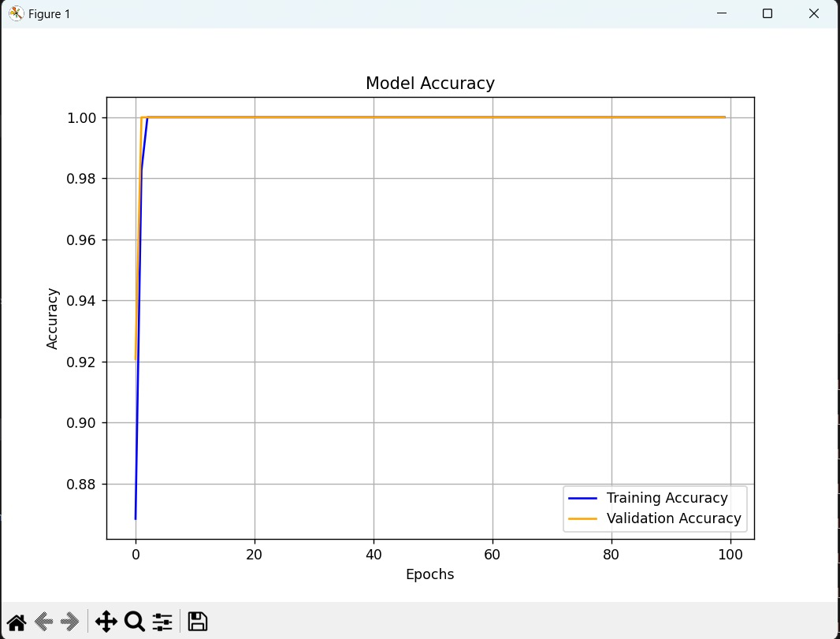
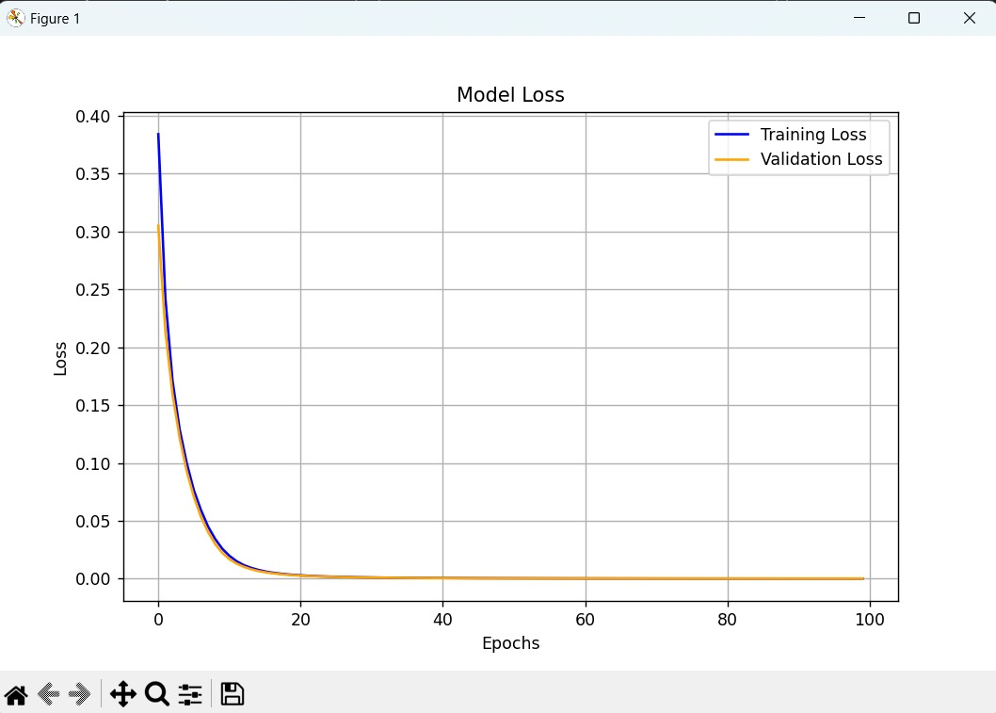
MILESTONE 3:MODEL TRAINING&VISUALISATION

Slide 12
MILESTONE 4: MODEL DEPLOYMENT&USER INTERFACE
Framework: Django
To deploy the trained model, I integrated it into a Django-based web application. The web app provides a user-friendly interface where users can: Log in securely, Input their physiological data, Instantly receive their stress prediction, along with insights into contributing factor.
Database: MySQL
For the database, I implemented MySQL to store all relevant user data,including: User login information, User physiological data inputs, Stress prediction results.
MySQL's robust and scalable features ensure the secure storage and retrieval of user data, enabling the web application to provide a reliable and trustworthy service.
By combining the capabilities of Django and MySQL, I was able to create a comprehensive and user-centric web application that seamlessly integrates the trained stress detection model.

Slide 13
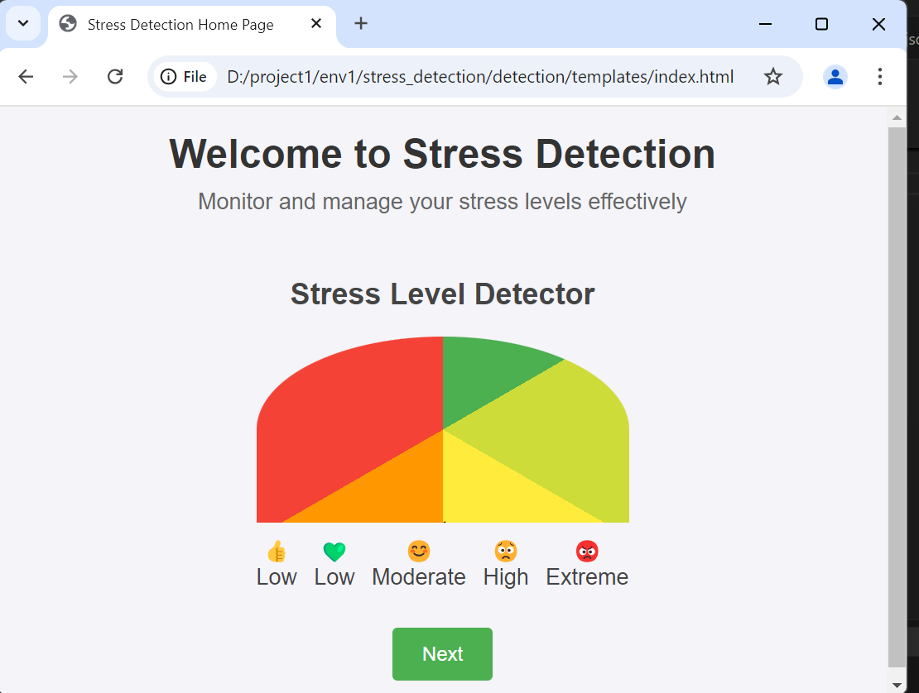
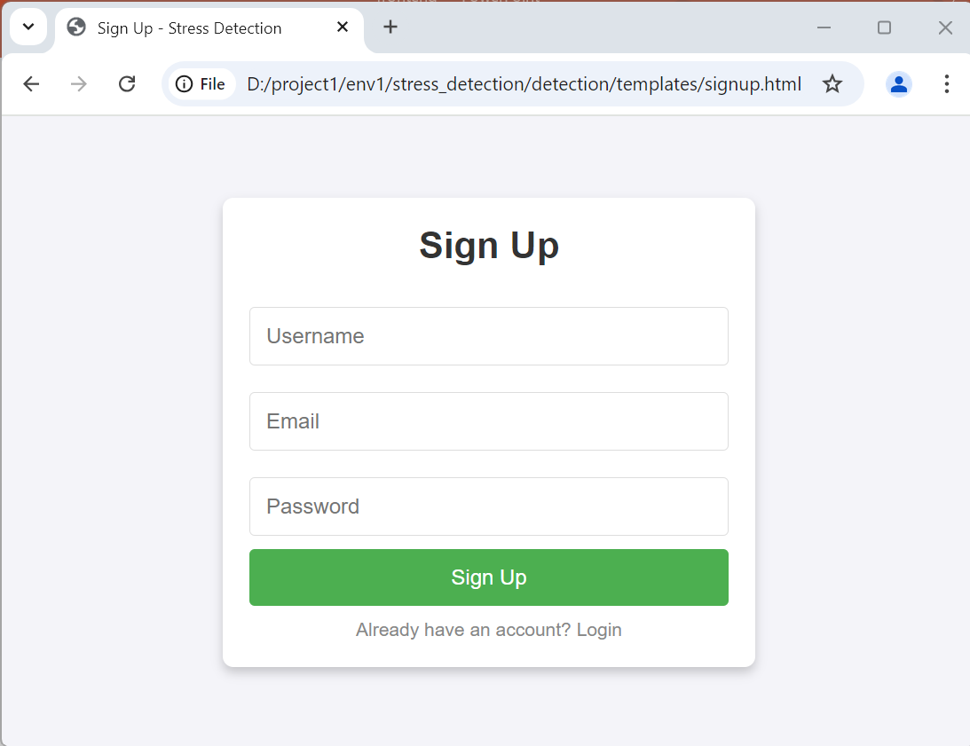
MILESTONE 4: MODEL DEPLOYMENT&USER INTERFACE
HOME PAGE
SIGNUP PAGE

Slide 14
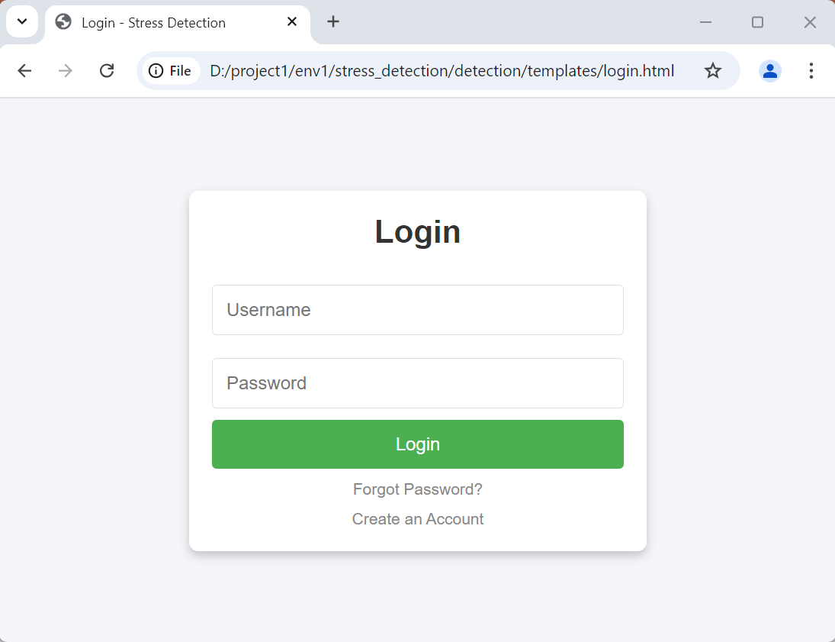
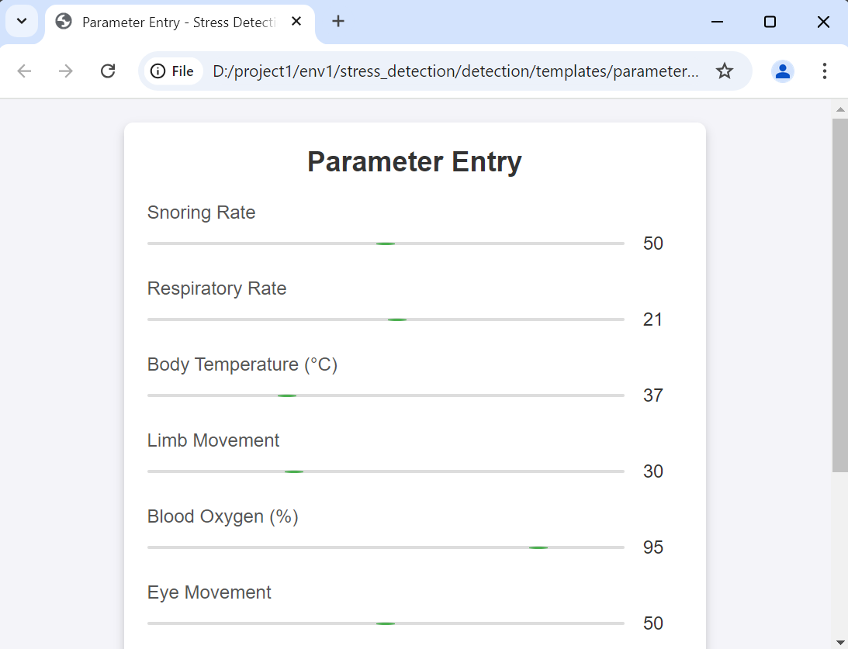
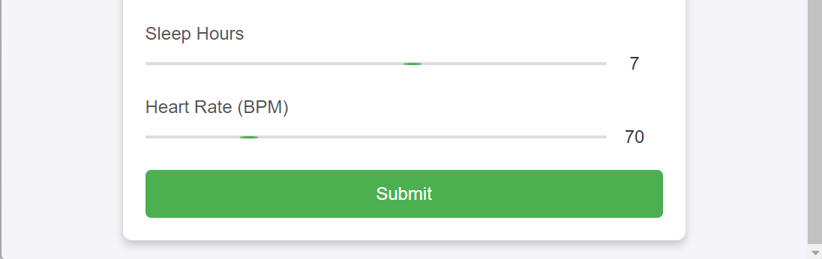
MILESTONE 4: MODEL DEPLOYMENT&USER INTERFACE
LOGIN PAGE
PARAMETER ENTRY PAGE

Slide 15
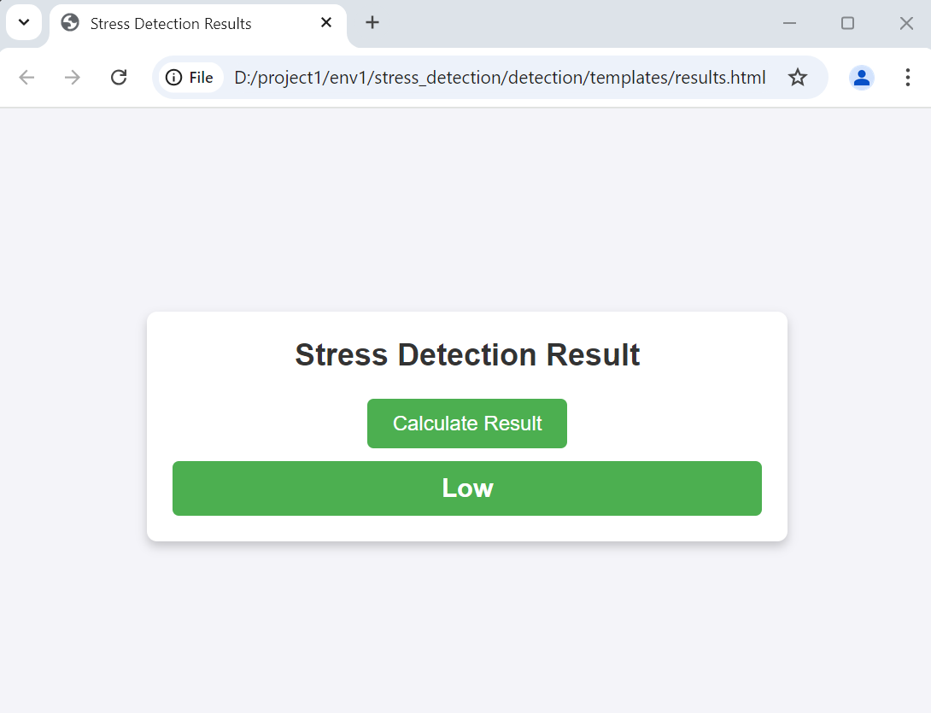
MILESTONE 4: MODEL DEPLOYMENT&USER INTERFACE
RESULT PAGE

Slide 16
CONCLUSION
In conclusion, this project has developed and deployed a highly accurate stress detection model integrated into a user-friendly Django-based web application. Leveraging the power of machine learning and the robust MySQL database, the web app allows users to securely input their data and receive instant stress predictions with personalized insights.
By bridging the gap between cutting-edge technology and practical application, this project empowers individuals to better understand and manage their stress levels, leading to improved overall well-being. Moving forward, we aim to continuously refine and expand the capabilities of this system, with the goal of making this technology widely accessible and integrated into various healthcare and wellness applications

Slide 17
THANK YOU

