Slide 1
Why IPMs?
Process-based demography
Continuous stages
Account for heterogeneity
Few parameters
Borrow strength across stages
Multiple state variables
Include covariates
IPMs make these easy
Notes:
TODO: add something about bias from discrete stages

Slide 2
Lots of advantages to using regression….
Notes:
It’s easy
loads of established methods for fitting, making complex functions, and comparing models

Slide 3
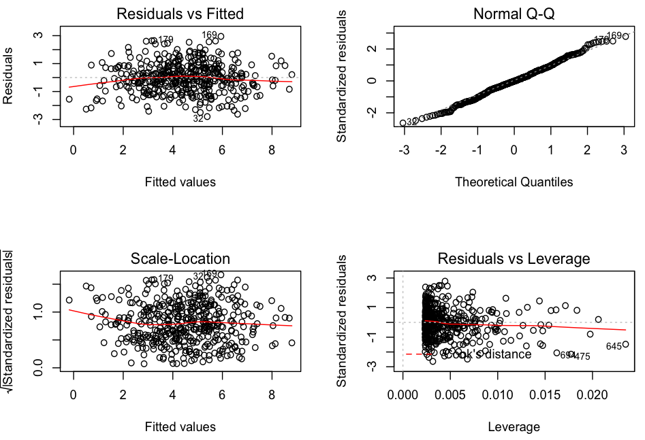
Advantages of regression
Lots of well-developed tools
Goodness of fit diagnostics
Notes:
-Compared to matrix models, an ipm should produce more robust parameter estimates if more samples affect each parameter
-If I used the background grid to discretize the model and make a matrix, I’d need 19 parameters, whereas an IPM does the same thing at heigher resolution with only 5 parameters
TODO: add figures of stuff I use more

Slide 4
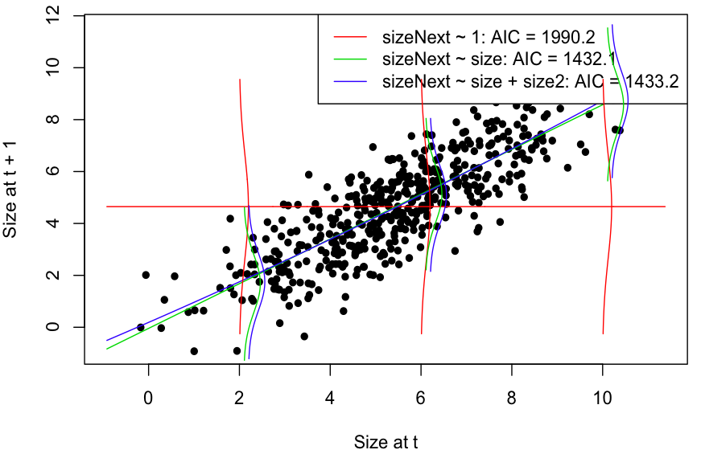
Advantages of regression
Lots of well-developed tools
Goodness of fit diagnostics
Model comparison
Notes:
-Compared to matrix models, an ipm should produce more robust parameter estimates if more samples affect each parameter
-If I used the background grid to discretize the model and make a matrix, I’d need 19 parameters, whereas an IPM does the same thing at heigher resolution with only 5 parameters

Slide 5
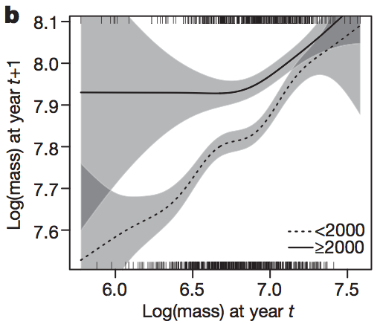
Advantages of regression
Lots of well-developed tools
Goodness of fit diagnostics
Model comparison
Complex curves
Ozgul et al. 2010
Notes:
-Compared to matrix models, an ipm should produce more robust parameter estimates if more samples affect each parameter
-If I used the background grid to discretize the model and make a matrix, I’d need 19 parameters, whereas an IPM does the same thing at heigher resolution with only 5 parameters

Slide 6
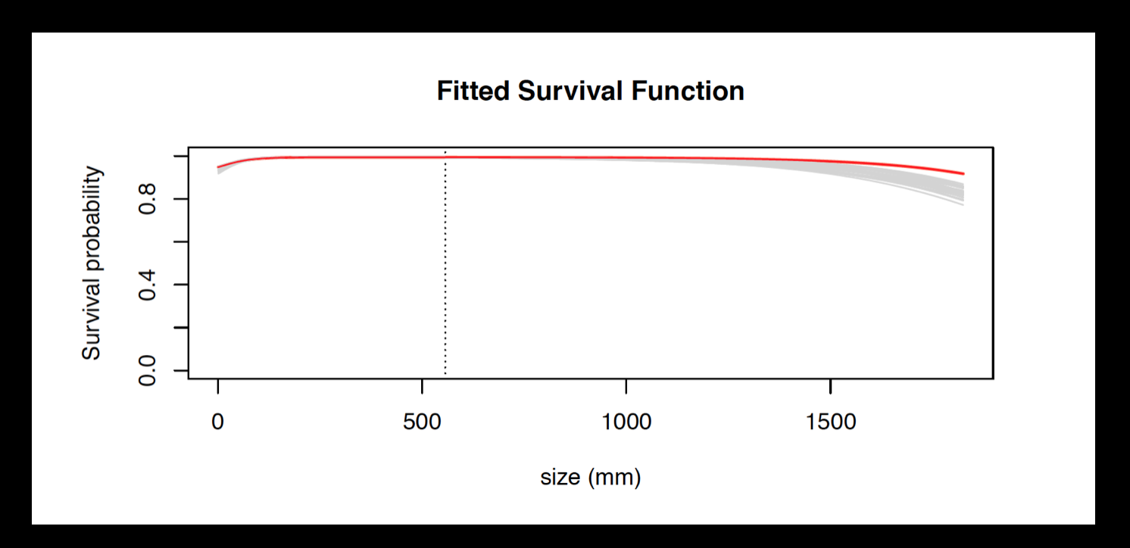
Advantages of regression
Lots of well-developed tools
Goodness of fit diagnostics
Model comparison
Complex curves
Notes:
-Compared to matrix models, an ipm should produce more robust parameter estimates if more samples affect each parameter
-If I used the background grid to discretize the model and make a matrix, I’d need 19 parameters, whereas an IPM does the same thing at heigher resolution with only 5 parameters

Slide 7
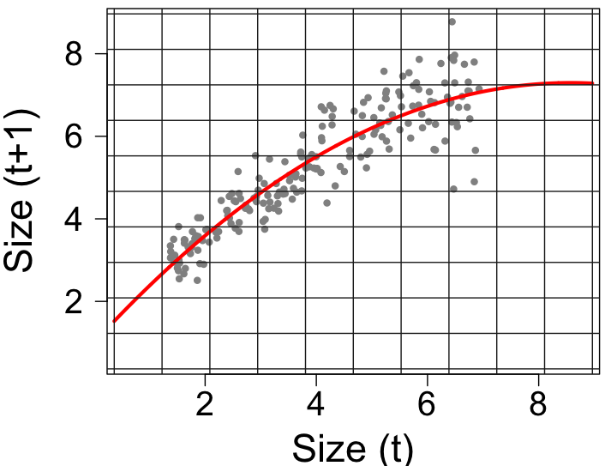
Advantages of regression
Notes:
-Compared to matrix models, an ipm should produce more robust parameter estimates if more samples affect each parameter
-If I used the background grid to discretize the model and make a matrix, I’d need 19 parameters, whereas an IPM does the same thing at heigher resolution with only 5 parameters

Slide 8
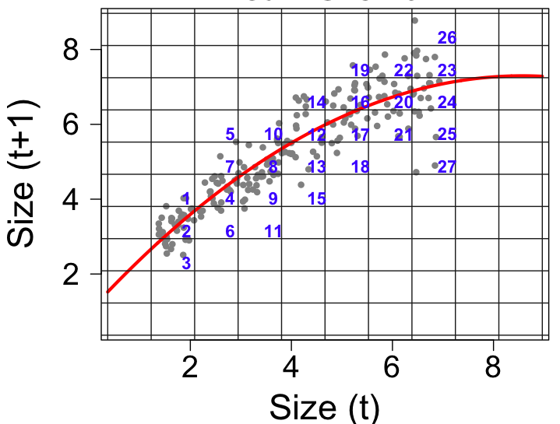
Advantages of regression
Notes:
-Compared to matrix models, an ipm should produce more robust parameter estimates if more samples affect each parameter
-If I used the background grid to discretize the model and make a matrix, I’d need 19 parameters, whereas an IPM does the same thing at heigher resolution with only 5 parameters

Slide 9
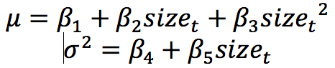
Advantages of regression
Notes:
-Compared to matrix models, an ipm should produce more robust parameter estimates if more samples affect each parameter
-If I used the background grid to discretize the model and make a matrix, I’d need 19 parameters, whereas an IPM does the same thing at heigher resolution with only 5 parameters

Slide 10
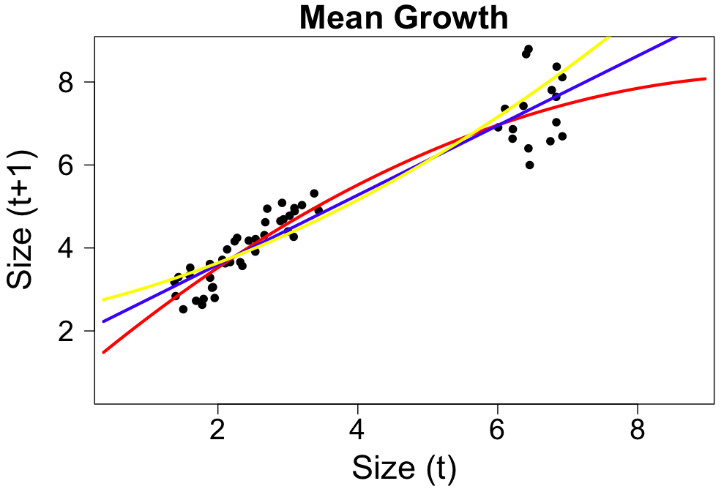
Advantages of regression
Borrow strength
across stages
Notes:
-relatedly, we can borrow strength across stages
- with a little knowldege of the species, often pretty clear what will happen in the middle
-less clear what should happen for larger sizes

Slide 11
Including heterogenity

Slide 12
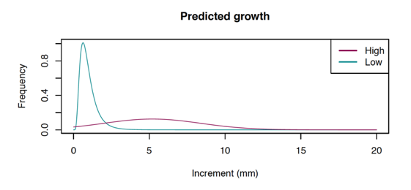
Individual heterogeneity
More structure in
individual heterogeneity

Slide 13
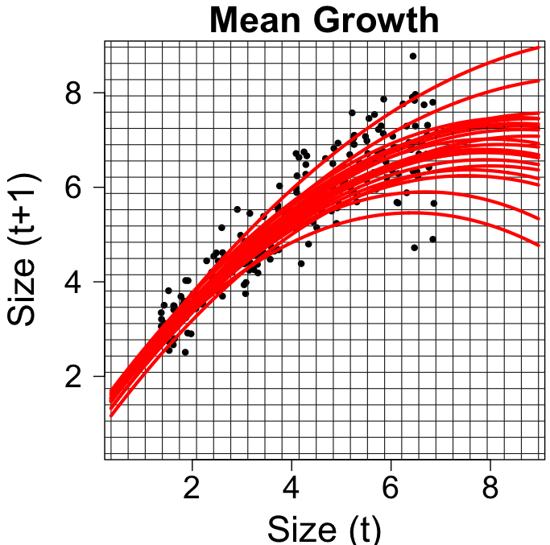
Additional tools: Covariates
Notes:
These are just regressions, so we can build them with environmental covariates and get different curves in different environments

Slide 14
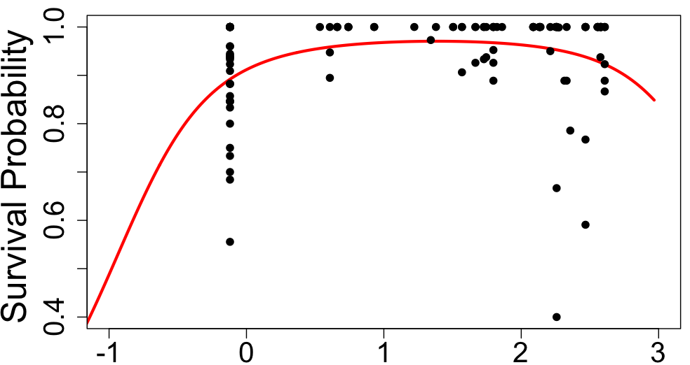
Advantages of regression
Borrow strength
across environments
Precipitation
Notes:
-Possible because we use multivariate regressions
- Not enough data from any one of these populations, but together..
-Example: Protea demography – monitor populations across range, use env covariates, map vital rates
-5-10 individuals/ population but 30 or so populations
When is it better to use env in standard regression, and when is it better to make the slope/intercept hierarchical across plots and make those random terms related to the environment?

Slide 15
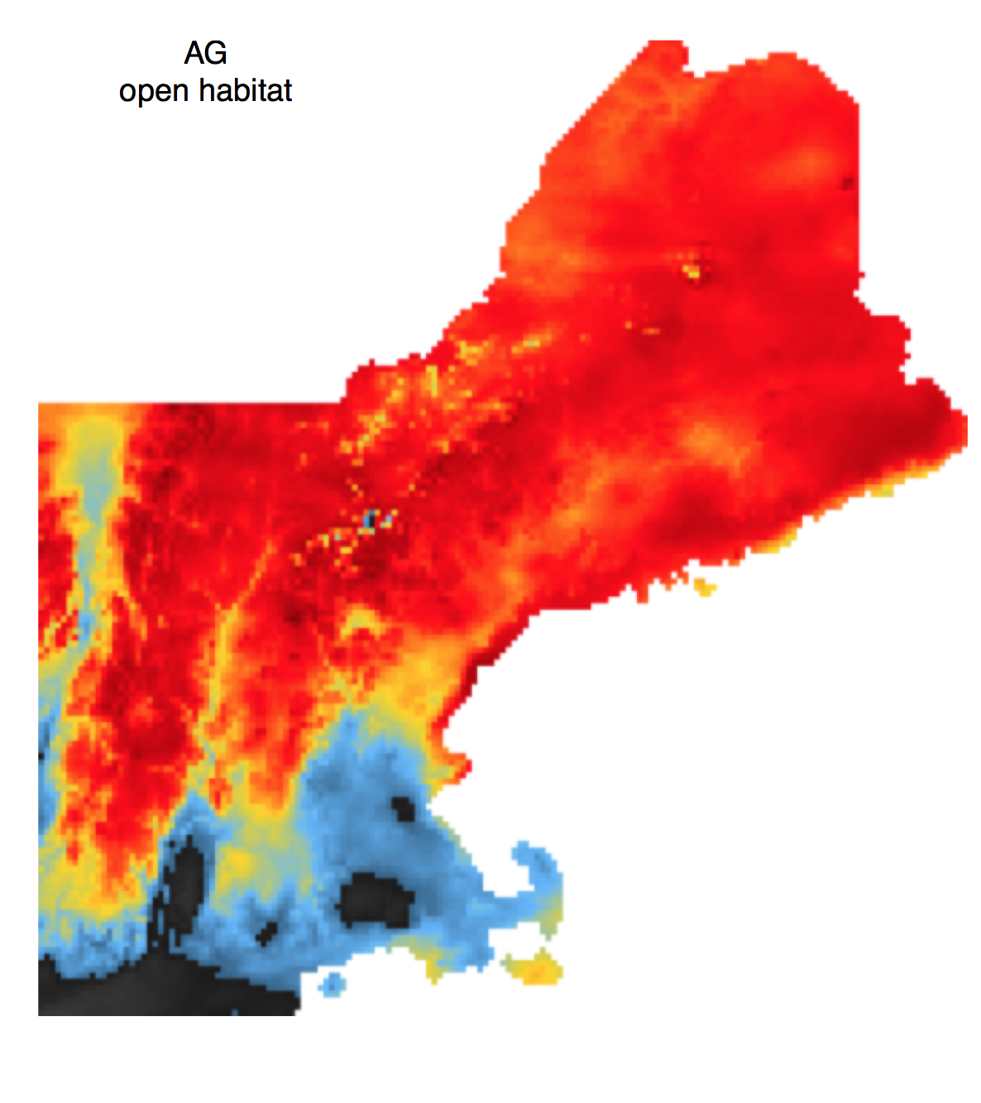
Easy to build maps of …
Population growth rate (λ)
Passage time to given size
Life expectancy
Size distributions
Sensitivities/elasticities
Notes:
Maps of these quantities are another, more mechanistic way of looking at habitat suitability.
Passage time good for harvest size or burn

Slide 16
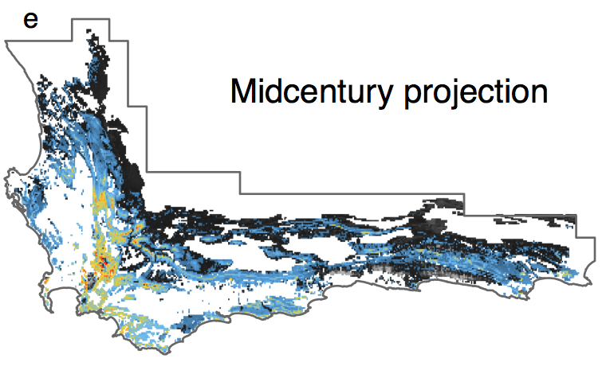
Range Modeling
Predicting Invasions
Notes:
Temporal dynamics,
Mechanistic, so we can extrapolate better

Slide 17
Advantages of regression
Using other state variables
Age (Lots of papers)
Genotype (Coulson et al. 2011)
Space (Jongejans et al. 2011)
Infection (Bruno et al. 2010)
Hierarchical models
Linking covariates to vital rates
Species interactions using spatial arrangement and frequency dependence to (Adler, Dalgleish, Ellner 2011)
Notes:
Can model survival as a function of size, but can also model survival intercept as a function of environment

Slide 18
IPMs are pretty much matrix models….

Slide 19
Additional tools for IPMs
Add discrete states (seed banks, larval states)

Slide 20
Additional tools for IPMs
Add discrete states (seed banks, larval states)
Different functions describe discrete transitions

Slide 21
Additional tools for IPMs
Add discrete states (seed banks, larval states)
Different functions describe discrete transitions

Slide 22
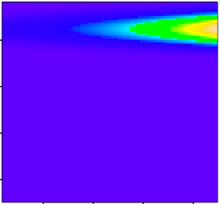
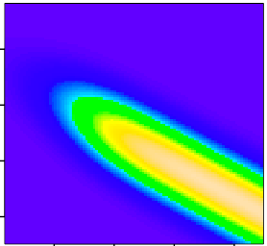
Additional tools for IPMs
Age x Stage models
0
 |  |  |  | 0
Recruits
Age 1
Age 2
Age 3
Age 4

Slide 23
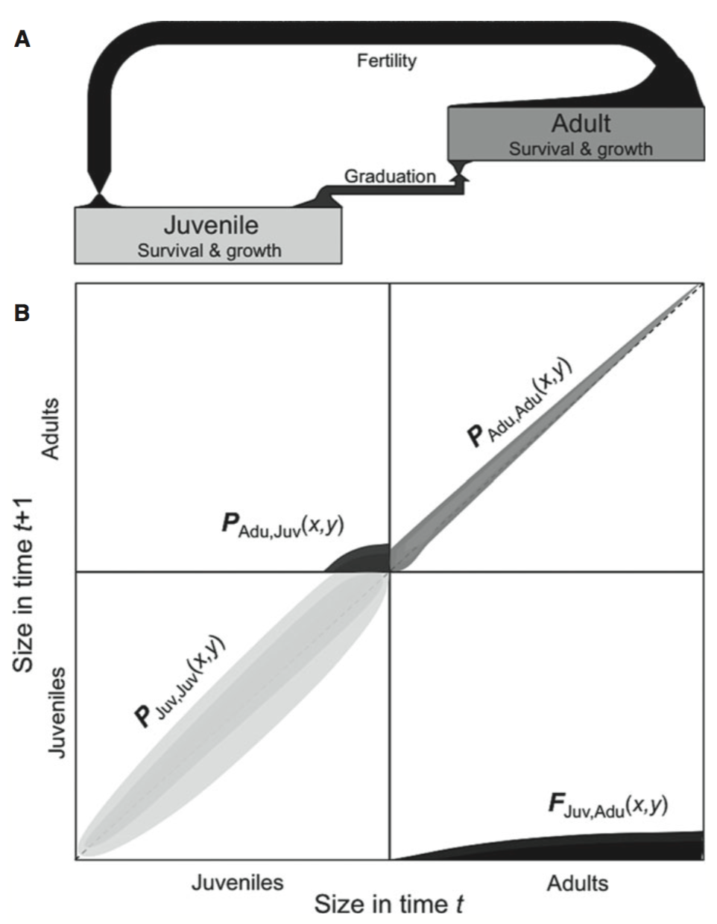
Multiple state variables
Zambrano and Salguero-Gomez 2014

Slide 24
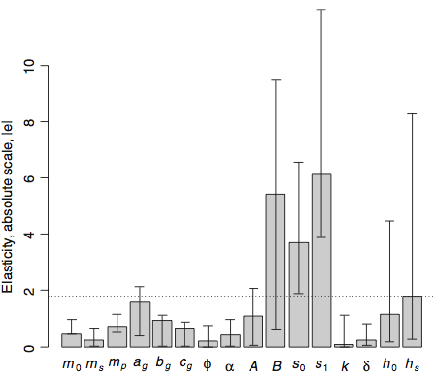
Additional tools for IPMs
Parameter sensitivity – retrospective parameter perturbation
Parameters
Metcalf et al. 2008
Notes:
Account for changes across all sizes simultaneously

Slide 25
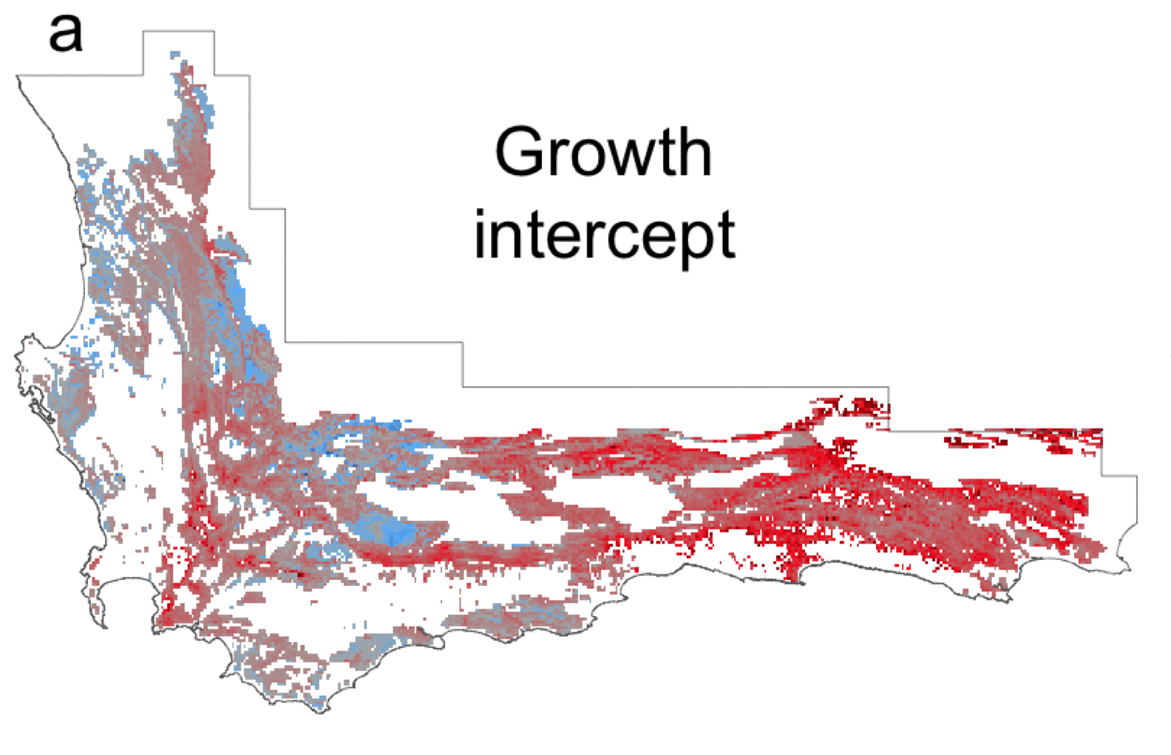
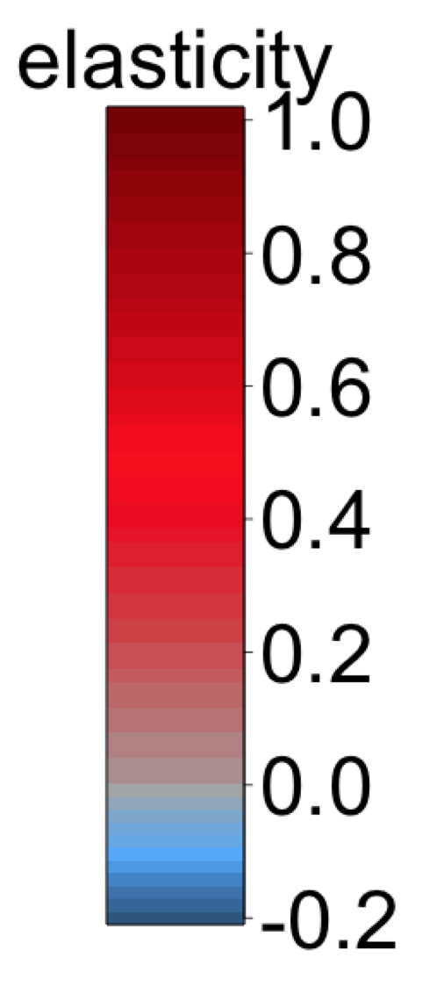
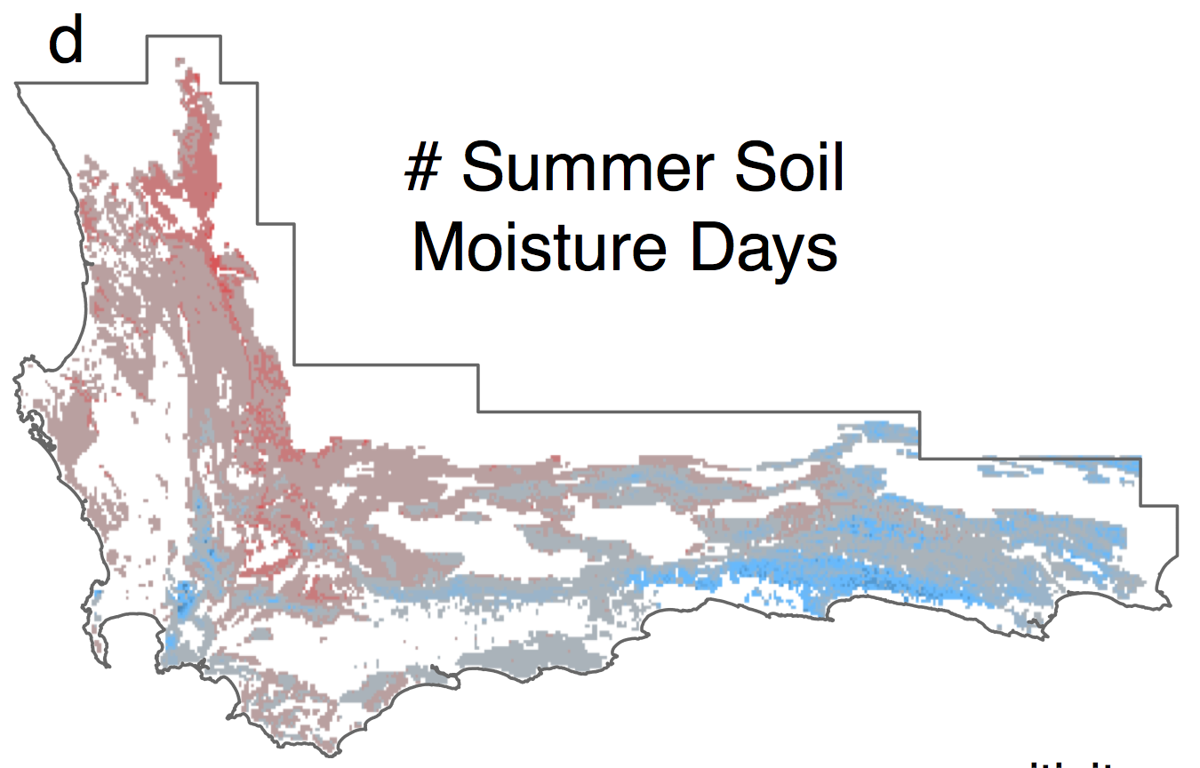
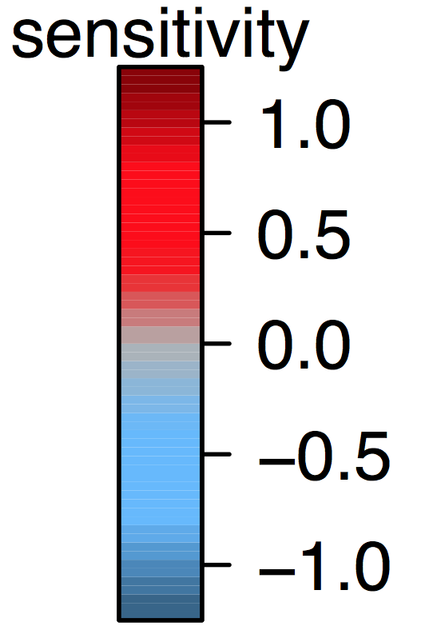
Sensitivity/Elasticity
Merow et al. 2014

Slide 26
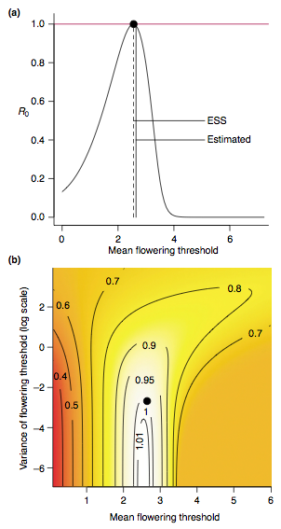
Additional tools
Optimizing parameters
Metcalf et al. 2003
Notes:
e.g. find evolutionary stable strategies
2-dimensions for correlated parameters

Slide 27
Why IPMs?
Process-based demography
Continuous stages
Account for heterogeneity
Few parameters
Borrow strength across stages
Multiple state variables
Include covariates

