Slide 1
Population Ecology & Demography; Leslie Matrices and Population Projection Methods
Introduction to linking demography, population growth and extinction due to climate warming

Slide 2
What is Population Ecology?
Goal is to understand factors and processes that govern abundance
Two types of Factors
Proximate
Ultimate
Two general processes
Extrinsic (Density Independent)
Intrinsic (Density Dependent)

Slide 3
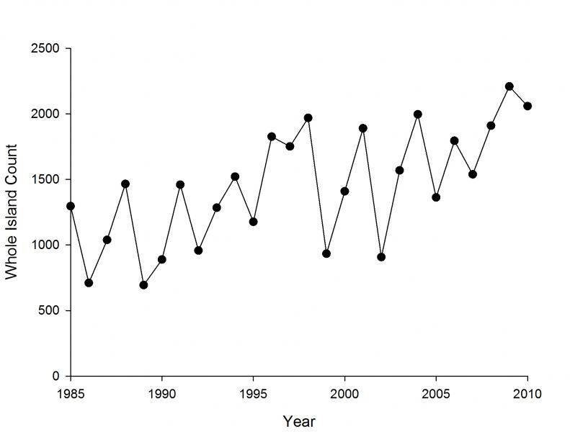
Population Descriptions
Population Growth
Population Regulation

Slide 4
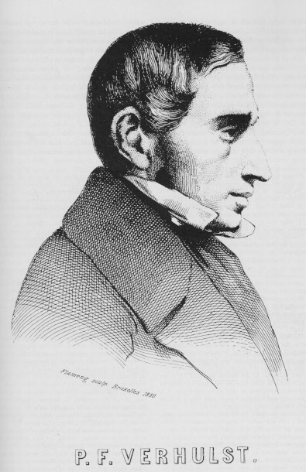
A Simple Model of Population Growth

Slide 5
Population Growth
What is the rate of change in a population over time?
A model of population growth for species without age-structure

Slide 6
Project Population Size
assumes finite rate of increase (population growth rate) is invariant over time

Slide 7
Growth in Age-Structured Populations
Offspring and adults coexist
age-specific contribution to recruitment and mortality

Slide 8
Data Required for estimating Population Growth Rate
Cohort Analysis
Longitudinal Analysis

Slide 9
The Life Table
A compendium of age-specific survival
Age-specific birth
Requires:
known age
cohort (longitudinal)
cross-sectional

Slide 10
A life table
Age | n_{x} | l_{x} | S_{x} | m_{x} | l_{x}m_{x}
0 | 1000 | 1.0 | 0.5 | 0.0 | 0.0
1 | 500 | 0.5 | 0.2 | 0.0 | 0.0
2 | 100 | 0.1 | 0.5 | 5.0 | 0.5
3 | 50 | 0.05 | 0.1 | 9.0 | 4.5
4 | 5 | 0.0 | - | - | -
n_{x} = probability a newborn attains age x
l_{x} = probability a newborn attains age x
s_{x} = age-specific survival, i.e., survival between age x ➔ x+1
m_{x} = Number of female progeny per female

Slide 11
Population Parameters
Net Reproductive Rate – R₀
Average lifetime number of offspring produced per female
Cohort Generation Time - G

Slide 12
Population Growth Rate - r
intrinsic rate of increase - r

Slide 13
A Population Model
F₄
F₃
0
1
2
3
4
s₀
s₁
s₂
s₄

Slide 14
Population Projection for Age-structured Populations
The population size at time t
= sum of individuals in each age class

Slide 15
Estimate population growth in Age Structured Populations
2 Components – Birth and Death
Birth:
Death:

Slide 16


Matrix Population Models
Hal Caswell

Slide 17
Population Projection Matrix
How to predict population growth rate for age-structured populations?
Need to link age structure with estimate of λ

Slide 18
Leslie Matrix

Slide 19
Elements of Leslie Matrix (L)
F_{x} – Age-specific Fecundity × age-specific survival
F_{x} = S_{x} m_{x+1}
S_{x} –Age-specific Survival

Slide 20
How does the Leslie Matrix estimate Population Growth?

Slide 21
Population Projection

Slide 22
Population Projection

Slide 23
Assumptions
Individuals can be aged reliably
No age-effects in vital rates
Vital rates are constant
Constant environment
No density dependence
stochastic Leslie Matrices possible
Sex ratio at birth is 1:1
i.e., male and female vital rates are congruent

Slide 24
Advantages of Leslie Matrix
Stable-age distribution not assumed
Sensitivity analyses –
can identify main age-specific vital rates that affect abundance and age structure
Modify the analyses to include density-dependence
Derive finite rate of population change (λ) and SAD

Slide 25
Disadvantage of Leslie Matrix
See assumptions
Age data may not be available
can use stage-based Lefkovitch Matrix
Fecundity data may not be available for all ages

Slide 26
EigenAnalysis of L
Eigenvalues –
dominant = population growth rate
asymptotic growth rate at Stable Age Distribution
Stable Age Structure
right eigenvector
Reproductive Value
left eigenvector

Slide 27
Other Statistics
Sensitivities
how λ varies with a change in matrix elements
absolute changes in matrix elements
Elasticities
how λ varies with a change in a vital rate holding other rates constant
Damping ratio
rate population approaches equilibrium - SAD

Slide 28
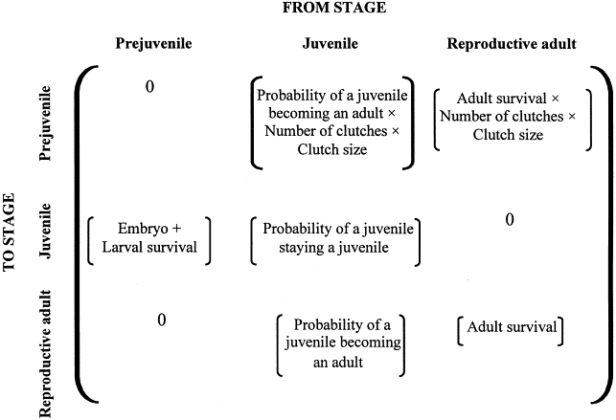
Relevance of Population Projection Matrices for modeling extinction due to Climate Warming
from Funk & Mills 2003. Biological Conservation 111:205 - 214

Slide 29
Consequences of Climate Warming
Rising temperatures:
Survivorship
Reduce Adult Survivorship
Reduce Juvenile Survivorship
Smaller Body Size
Higher Metabolic Rate
More energy diverted to maintenance, less to growth
Change in Precipitation
Lower food availability

Slide 30
Results
ΔN_{x,t} decline
Reduction in recruitment
Reduced survivorship

Slide 31
Simulations
Using predicted responses one can simulate expected population dynamics.
Modified PVA
Population Viability Analysis

Slide 32
Population Projection Methods in R
Available Packages
popbio (Stubben, Milligan, Nantel 2005)
primer (Stevens 2009)
popdemo (Stott et al. 2009)

Slide 33
Population Projection using Excel
PopTools
www.poptools.org
add-in for excel

Slide 34
Main Functions (popbio)
Estimate Population Growth Rate λ
lambda(A)
Estimate Sensitivity, Elasticity, Damping Ratio
sensitivity(A)
elasticity(A)
damping.ratio(A)
Full analysis of Leslie Matrix
eigen.analysis(A)

Slide 35
Population Projection Methods
Population Projection
pop.projection(A, n, interations)

