Slide 1
General Course Introductory Materials

Slide 2
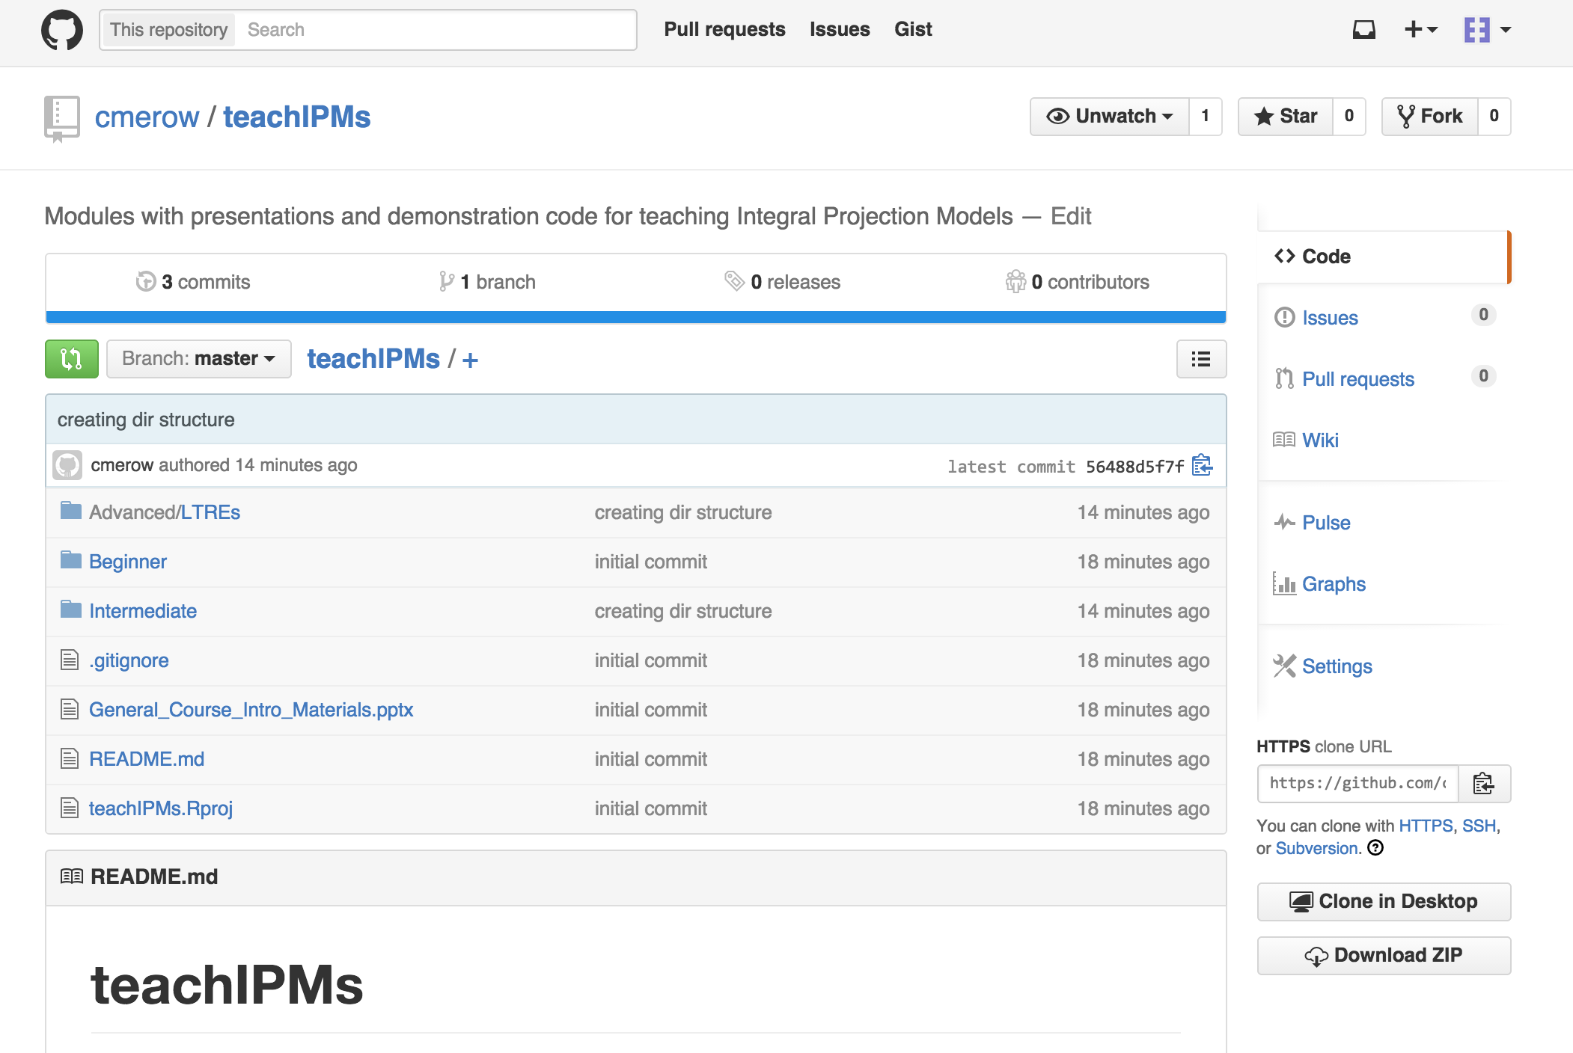
Download Course Materials From Github
Go to https://github.com/cmerow/teachIPMs
Click ‘Download zip’

Slide 3
Tentative Schedule
12:00-12:45 Introduction to IPMs
12:45-2:00 Introductory exercises
2:00-2:20 Introduction to IPMpack v2.0
2:20-3:00 IPMpack Vignette
3:00-3:15 Fecundity Models
3:15-4:00 Fecundity Exercises
4:00-4:15 Regression Strategies
4:15-4:30 Demographically Driven Range Models
4:30-5:00 Questions/Finish Exercises
Notes:
Ask whether people have used ipms, read about ipms, generally work in demography, other
R proficient, r beginner, never used it

Slide 4
Schedule
12-1215 Talk: General Intro to group, download materials
1215-1245 Talk: Intro to IPMs (Cory)
1245-115 Code: A basic IPM (Cory)
115-145 Talk: Strengths of IPMs (Cory)
145-230 Code: Improving your IPM (Cory)
230-245 Break
245-3 Talk: Intro to IPMpack (Sean)
3-330 Code: Intro to IPMpack (Sean)
330-345 Talk: Something interesting (Rob)
345-4 Code: (Rob)
4-415 Talk: Something interesting (Eelke)
415-430 Code: (Eelke)
430-5 Talk: Speeding up computations in R (Marco)

