Slide 1

INSY7315 EXPO · TEAM LOGISYN · 10 November 2026
Order in,
Production sheet out.
A desktop system that turns a supermarket order PDF into a full production plan. Every pan, trolley and kilogram of flour, worked out automatically.
Grace Berrill · Adriaan Kock · Matthew Rosselli · Luc Naude

Slide 2




A bakery that puts people first
Local Cape Town business
Our Client
Bakes all different types of baked goods
Supplies all over the country
Shops such as Checkers and Spar send in their orders as PDFs.
Anderson’s Silwood Bakery
Cape Town, Western Cape
Jobs first, automation second
Many staff have little to no formal education therefore, complex systems are not an option.

Slide 3




From workbooks to one screen
BEFORE
AFTER
Production sheets pieced together by hand across separate workbooks
One system that reads the order PDFs
Recipes scale into pans, trolley and raw materials automatically
Slow and error-prone
Hard to see where stock went, so theft slipped through
Every order tracked to completed

Slide 4
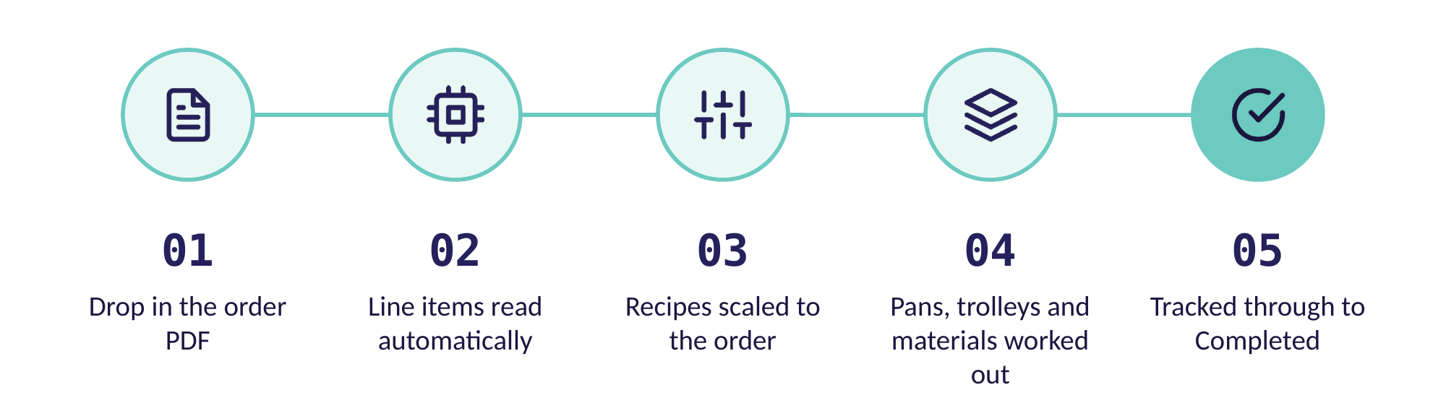
How it works
No retyping. No calculator. No separate workbooks.

Slide 5

Live Demo
Full video walkthrough on the system.

Slide 6
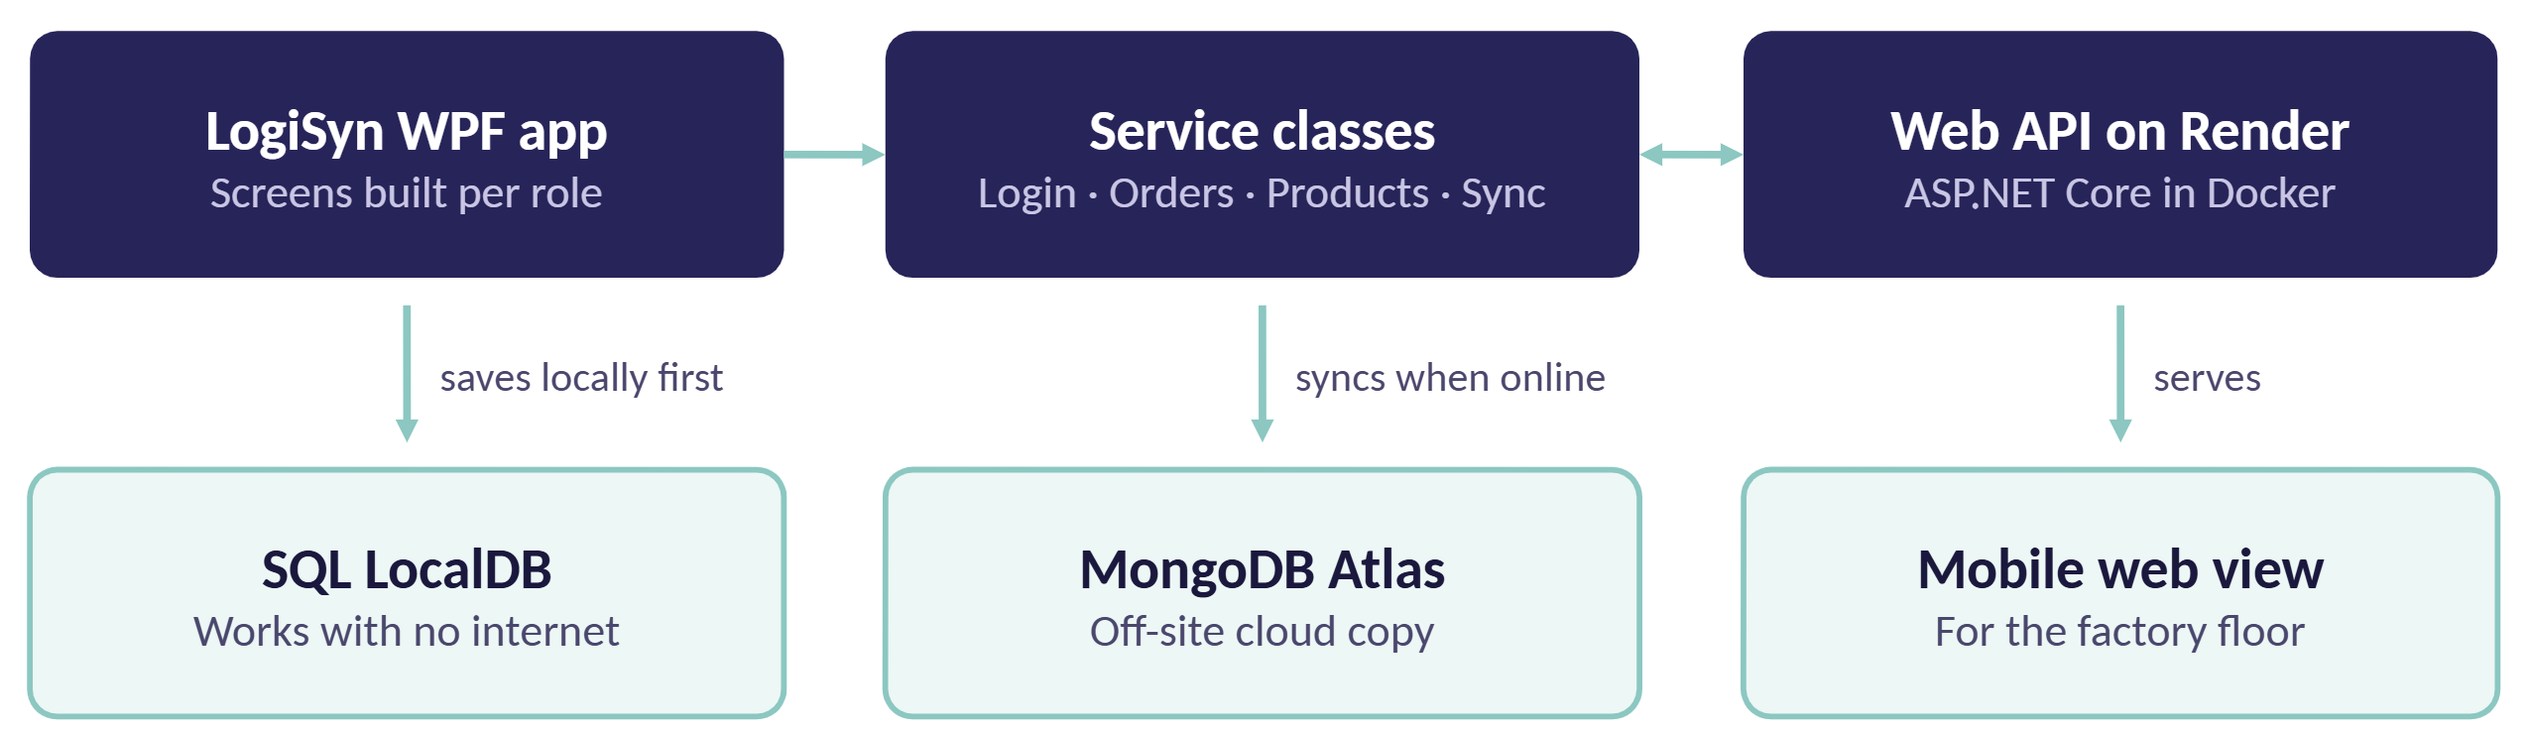
One install, no server to babysit
The desktop app calls the service classes in-process, so it runs as a single install. The API tries cloud for 2 seconds, then falls back to local services.

Slide 7

Made for patchy factory WiFi
3
2s
10min
Copies of every order
Before falling back
Keep-alive ping
Saved to a local file, SQL and MongoDB, so a dead PC does not loose work
If the cloud API is slow, the app switches to local services
Keep the free Render host awake, so there’s no 30 second cold start
Availability over consistency, the floor never waits on the cloud.

Slide 8



Everyone sees only what they need
Admin
Manager
User
Manage user and products.
Excel and email export.
Everything a manager sees.
All orders with filters.
Editable production sheets.
History of completed orders.
A simple view of their orders.
Fill in and submit their order sheet.

Slide 9
Every tool learned its place
z
C# · WFP · .NET10
SQL Server LocalDB
MongoDB Atlas
ASP.NET Core API
Native Windows application that works offline.
Free, no server setup, no internet needed.
Off-site copy if the factory PC fails.
Groundwork for multi device use.
Docker · Render
PDFPIG
ClosedXML
Hashing
Free, sustainable hosting for the client.
Reads supermarket PDFs, no Adobe needed.
Excel exports staff already knows.
Salted passwords, no extra library.

Slide 10
Thank you!
Questions?
GB
Grace Berrill
AK
Adriaan Kock
ST10440118
ST10263443
MR
Matthew Rosselli
LN
Luc Naude
ST10258193
ST10443241

