Slide 1

Welcome to Bible Class
欢迎您参加圣经课程
The Messiah in the Old Testament
旧约中的弥赛亚

Slide 2

Part 1
第一部分
The Messiah in the Law
律法书中的弥赛亚
Lesson 2 = The Promise of the Messiah to Adam and Eve
第二课 = 弥赛亚应许给亚当和夏娃
Lesson 3 = The Messiah is Promised to the Patriarchs
第三课 = 弥赛亚应许给列祖
Lesson 4 = The Messiah Promised through Balaam and Moses
第四课 = 藉着巴兰和摩西所应许的弥赛亚

Slide 3

Lesson 2
第二课
The First Gospel Promise
第一个福音的应许

Slide 4
Genesis 3:15
“And I will put enmity between you and the woman, and between your offspring and hers; he will crush your head, and you will strike his heel.”
创世记 3：15
我又要叫你和女人彼此为仇； 你的后裔和女人的后裔也彼此为仇。 女人的后裔要伤你的头； 你要伤他的脚跟。

Slide 5
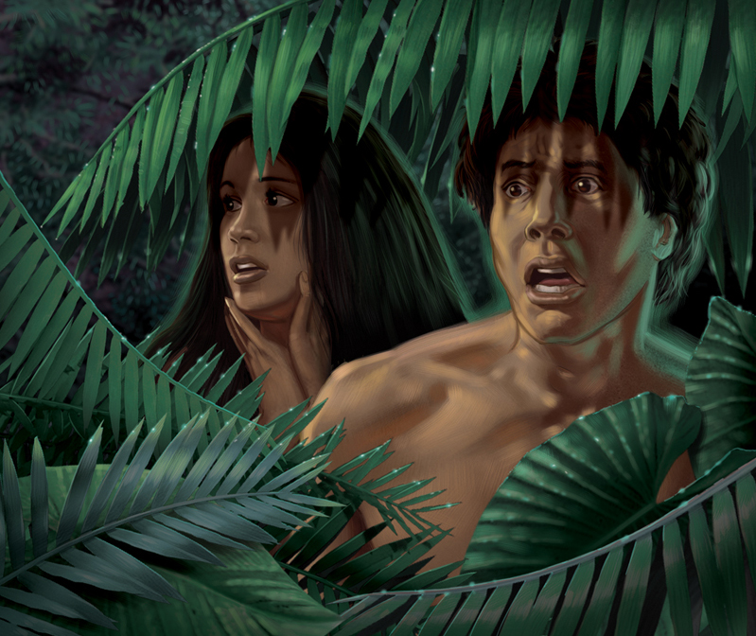
The Context
背景

Slide 6
VERSE 14
第14节
“Because you have done this, “Cursed are you above all the livestock and all the wild animals! You will crawl on your belly and you will eat dust all the days of your life.”
耶和华 神对蛇说： 你既做了这事，就必受咒诅， 比一切的牲畜野兽更甚； 你必用肚子行走， 终身吃土。

Slide 7
VERSE 14
第14节
“Now the serpent was more crafty than any of the wild animals the Lord God had made.” Genesis 3:1
耶和华 神所造的，惟有蛇比田野一切的活物更狡猾。蛇对女人说：「 神岂是真说不许你们吃园中所有树上的果子吗？」
创世记 3:1
“be as shrewd as snakes” (Matthew 10:16)
“你们要灵巧像蛇”（马太福音 10:16 ）
“crafty”
“狡猾”
In the positive sense it can mean wise and discerning, sensible.
按照褒义来理解，是指聪明、有辨别力，敏感。
In the negative it can mean tricky, cunning, with a focus on treachery.
按照贬义来理解，是指狡猾、狡诈，含有欺骗和背叛的意思。

Slide 8
VERSE 14
第14节
Was this an animal or Satan?
是指动物还是撒旦？
“Satan himself masquerades as an angel of light” – 2 Corinthians 11:14
“撒但也装作光明的天使。” - 哥林多后书 11:14

Slide 9
Was this an animal or Satan?
是指动物还是撒旦？
Revelation 12:9 “The great dragon was hurled down, that ancient serpent called the devil, or Satan, who leads the whole world astray. He was hurled to the earth, and his angels with him.”
启示录 12:9 大龙就是那古蛇，名叫魔鬼，又叫撒但，是迷惑普天下的。它被摔在地上，它的使者也一同被摔下去。
Revelation 20:2 “seized the dragon, that ancient serpent, who is the devil, or Satan, and bound him for a thousand years.”
启示录 20：2 他捉住那龙，就是古蛇，又叫魔鬼，也叫撒但，把它捆绑一千年
2 Corinthians 11:3,14 “Eve was deceived by the serpent's cunning ... Satan himself masquerades as an angel of light.”
哥林多后书 11:3,14 就像蛇用诡诈诱惑了夏娃一样……因为连撒但也装作光明的天使。
VERSE 14
第14节

Slide 10
VERSE 14
第14节
“Because you have done this, “Cursed are you above all the livestock and all the wild animals! You will crawl on your belly and you will eat dust all the days of your life.”
“耶和华 神对蛇说： 你既做了这事，就必受咒诅， 比一切的牲畜野兽更甚； 你必用肚子行走， 终身吃土。 ”

Slide 11
VERSE 14
第14节
“Because you have done this, “Cursed are you above all the livestock and all the wild animals! You will crawl on your belly and you will eat dust all the days of your life.”
“耶和华 神对蛇说： 你既做了这事，就必受咒诅， 比一切的牲畜野兽更甚； 你必用肚子行走， 终身吃土。 ”
Leviticus 11:42 – “You are not to eat any creature that moves about on the ground, whether it moves on its belly or walks on all fours or on many feet; it is detestable.”
利未记 11:42 凡用肚子行走的和用四足行走的，或是有许多足的，就是一切爬在地上的，你们都不可吃，因为是可憎的。

Slide 12
VERSE 14
第14节
“Because you have done this, “Cursed are you above all the livestock and all the wild animals! You will crawl on your belly and you will eat dust all the days of your life.”
“耶和华 神对蛇说： 你既做了这事，就必受咒诅， 比一切的牲畜野兽更甚； 你必用肚子行走， 终身吃土。 ”
Micah 7:17 -- “They will lick dust like a snake, like creatures that crawl on the ground. They will come trembling out of their dens; they will turn in fear to the LORD our God and will be afraid of you.”
弥迦书 7:17 他们必舔土如蛇， 又如土中腹行的物， 战战兢兢地出他们的营寨。 他们必战惧投降耶和华， 也必因我们的 神而惧怕。
Isaiah 49:23 -- “Kings will be your foster fathers, and their queens your nursing mothers. They will bow down before you with their faces to the ground; they will lick the dust at your feet. Then you will know that I am the LORD; those who hope in me will not be disappointed.””
以赛亚书 49:23 列王必作你的养父； 王后必作你的乳母。 他们必将脸伏地，向你下拜， 并舔你脚上的尘土。 你便知道我是耶和华； 等候我的必不致羞愧。
Psalm 72:9 - “The desert tribes will bow before him and his enemies will lick the dust.”
诗篇 72:9 住在旷野的，必在他面前下拜； 他的仇敌必要舔土。

Slide 13
Was this an animal or Satan?
是指动物还是撒旦？
Revelation 12:9 “The great dragon was hurled down, that ancient serpent called the devil, or Satan, who leads the whole world astray. He was hurled to the earth, and his angels with him.”
启示录 12:9 大龙就是那古蛇，名叫魔鬼，又叫撒但，是迷惑普天下的。它被摔在地上，它的使者也一同被摔下去。
Revelation 20:2 “seized the dragon, that ancient serpent, who is the devil, or Satan, and bound him for a thousand years.”
启示录 20：2 他捉住那龙，就是古蛇，又叫魔鬼，也叫撒但，把它捆绑一千年
2 Corinthians 11:3,14 “Eve was deceived by the serpent's cunning ... Satan himself masquerades as an angel of light.”
哥林多后书 11:3,14 就像蛇用诡诈诱惑了夏娃一样……因为连撒但也装作光明的天使。
VERSE 14
第14节

Slide 14
SNAKES OR SATAN?
蛇还是撒旦？
Genesis 9:5 -- “And for your lifeblood I will surely demand an accounting. I will demand an accounting from every animal. And from each man, too, I will demand an accounting for the life of his fellow man.”
创世记 9:5 -- 流你们血、害你们命的，无论是兽是人，我必讨他的罪，就是向各人的弟兄也是如此。

Slide 15
VERSE 15
第15节
“And I will put enmity between you and the woman, and between your offspring and hers; he will crush your head, and you will strike his heel.”
我又要叫你和女人彼此为仇； 你的后裔和女人的后裔也彼此为仇。 女人的后裔要伤你的头； 你要伤他的脚跟。

Slide 16
VERSE 15
15节
“And I will put enmity between you and the woman, and between your offspring and hers; he will crush your head, and you will strike his heel.”
我又要叫你和女人彼此为仇； 你的后裔和女人的后裔也彼此为仇。 女人的后裔要伤你的头； 你要伤他的脚跟。

Slide 17
VERSE 15
第15节
ENMITY
为仇
Numbers 35:21-22= “or if in hostility he hits him with his fist so that he dies, that person shall be put to death; he is a murderer. The avenger of blood shall put the murderer to death when he meets him. But if without hostility someone suddenly shoves another or throws something at him unintentionally”
民数记 35:21–22 = 或是因仇恨用手打人，以致于死，那打人的必被治死。他是故杀人的；报血仇的一遇见就杀他。倘若人没有仇恨，忽然将人推倒，或是没有埋伏把物扔在人身上，
Ezekiel 25:15 = “This is what the Sovereign LORD says: ‘Because the Philistines acted in vengeance and took revenge with malice in their hearts, and with ancient hostility sought to destroy Judah.”
以西结书 25:15 = 主耶和华如此说：「因非利士人向犹大人报仇，就是以恨恶的心报仇雪恨，永怀仇恨，要毁灭他们，
Ezekiel 35:5 = “Because you harbored an ancient hostility and delivered the Israelites over to the sword at the time of their calamity, the time their punishment reached its climax,”
以西结书 35:5 = 因为你永怀仇恨，在以色列人遭灾、罪孽到了尽头的时候，将他们交与刀剑，

Slide 18
VERSE 15
第15节
“And I will put enmity between you and the woman, and between your offspring and hers; he will crush your head, and you will strike his heel.”
我又要叫你和女人彼此为仇； 你的后裔和女人的后裔也彼此为仇。 女人的后裔要伤你的头； 你要伤他的脚跟。
Eve
夏娃
Enmity为仇
Satan
撒旦
Matthew 13:39 -- “The enemy who sows them is the devil”
马太福音 13:39 -- 撒稗子的仇敌就是魔鬼；
1 Peter 5:8 - “Be self-controlled and alert. Your enemy the devil prowls around like a roaring lion looking for someone to devour.”
彼得前书 5:8 务要谨守，警醒。因为你们的仇敌魔鬼，如同吼叫的狮子，遍地游行，寻找可吞吃的人。

Slide 19
VERSE 15
第15节
“And I will put enmity between you and the woman, and between your offspring and hers ^{(offspring)}; he will crush your head, and you will strike his heel.”
我又要叫你和女人彼此为仇； 你的后裔和女人的后裔也彼此为仇。 女人的后裔要伤你的头； 你要伤他的脚跟。

Slide 20
VERSE 15
第15节
“your offspring”
“你的后裔”
Matthew 13:38-39 - “The good seed stands for the sons of the kingdom. The weeds are the sons of the evil one, and the enemy who sows them is the devil.”
马太福音 13:38–39 田地就是世界；好种就是天国之子；稗子就是那恶者之子；撒稗子的仇敌就是魔鬼；收割的时候就是世界的末了；收割的人就是天使。
Matthew 23:33 - “You snakes! You brood of vipers! How will you escape being condemned to hell?”
马太福音 23:33 你们这些蛇类、毒蛇之种啊，怎能逃脱地狱的刑罚呢？
John 8:44 - “You belong to your father, the devil, and you want to carry out your father’s desire. He was a murderer from the beginning, not holding to the truth, for there is no truth in him. When he lies, he speaks his native language, for he is a liar and the father of lies.”
约翰福音 8:44 你们是出于你们的父魔鬼，你们父的私欲你们偏要行。他从起初是杀人的，不守真理，因他心里没有真理。他说谎是出于自己；因他本来是说谎的，也是说谎之人的父。

Slide 21
VERSE 15
第15节
“your offspring”
“你的后裔”
1 John 3:8-13 -- “He who does what is sinful is of the devil, because the devil has been sinning from the beginning. The reason the Son of God appeared was to destroy the devil’s work. No one who is born of God will continue to sin, because God’s seed remains in him; he cannot go on sinning, because he has been born of God. This is how we know who the children of God are and who the children of the devil are: Anyone who does not do what is right is not a child of God; nor is anyone who does not love his brother. This is the message you heard from the beginning: We should love one another. Do not be like Cain, who belonged to the evil one and murdered his brother. And why did he murder him? Because his own actions were evil and his brother’s were righteous. Do not be surprised, my brothers, if the world hates you.”
约翰一书 3:8–13 犯罪的是属魔鬼，因为魔鬼从起初就犯罪。 神的儿子显现出来，为要除灭魔鬼的作为。凡从 神生的，就不犯罪，因 神的道存在他心里；他也不能犯罪，因为他是由 神生的。从此就显出谁是 神的儿女，谁是魔鬼的儿女。凡不行义的就不属 神，不爱弟兄的也是如此。我们应当彼此相爱。这就是你们从起初所听见的命令。不可像该隐；他是属那恶者，杀了他的兄弟。为什么杀了他呢？因自己的行为是恶的，兄弟的行为是善的。弟兄们，世人若恨你们，不要以为希奇。

Slide 22
VERSE 15
第15节
“her offspring”
“女人的后裔”
1 John 3:8-13 -- “He who does what is sinful is of the devil, because the devil has been sinning from the beginning. The reason the Son of God appeared was to destroy the devil’s work. No one who is born of God will continue to sin, because God’s seed remains in him; he cannot go on sinning, because he has been born of God. This is how we know who the children of God are and who the children of the devil are: Anyone who does not do what is right is not a child of God; nor is anyone who does not love his brother. This is the message you heard from the beginning: We should love one another. Do not be like Cain, who belonged to the evil one and murdered his brother. And why did he murder him? Because his own actions were evil and his brother’s were righteous. Do not be surprised, my brothers, if the world hates you.”
约翰一书 3:8–13 犯罪的是属魔鬼，因为魔鬼从起初就犯罪。 神的儿子显现出来，为要除灭魔鬼的作为。凡从 神生的，就不犯罪，因 神的道存在他心里；他也不能犯罪，因为他是由 神生的。从此就显出谁是 神的儿女，谁是魔鬼的儿女。凡不行义的就不属 神，不爱弟兄的也是如此。我们应当彼此相爱。这就是你们从起初所听见的命令。不可像该隐；他是属那恶者，杀了他的兄弟。为什么杀了他呢？因自己的行为是恶的，兄弟的行为是善的。弟兄们，世人若恨你们，不要以为希奇。

Slide 23
VERSE 15
第15节
“And I will put enmity between you and the woman, and between your offspring and hers; he will crush your head, and you will strike his heel.”
我又要叫你和女人彼此为仇； 你的后裔和女人的后裔也彼此为仇。 女人的后裔要伤你的头； 你要伤他的脚跟。

Slide 24
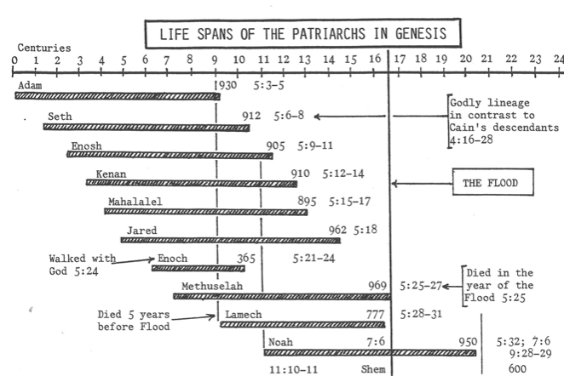
VERSE 15
第15节
“And I will put enmity between you and the woman, and between your offspring and hers; he will crush your head, and you will strike his heel.”
我又要叫你和女人彼此为仇； 你的后裔和女人的后裔也彼此为仇。 女人的后裔要伤你的头； 你要伤他的脚跟。

Slide 25
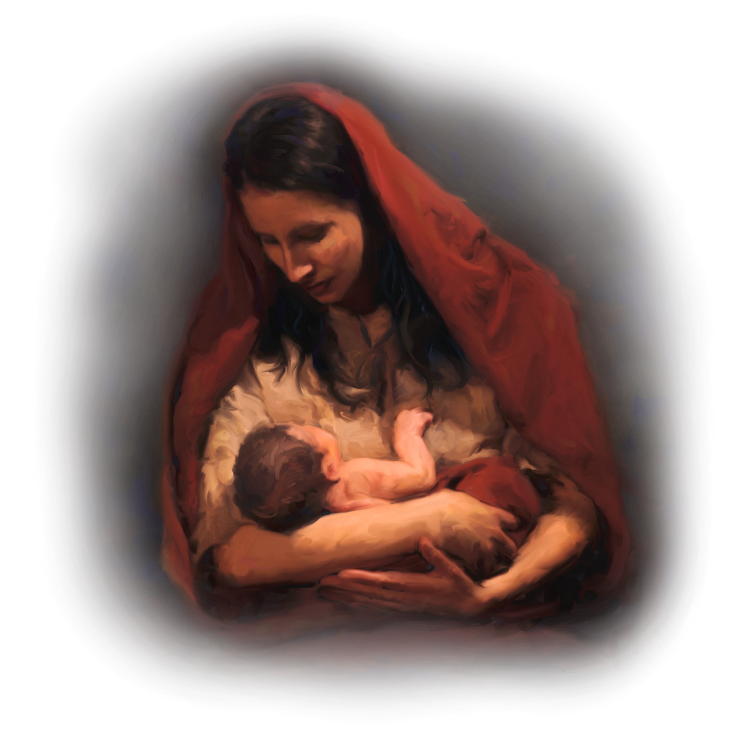
VERSE 15
第15节
“And I will put enmity between you and the woman, and between your offspring and hers; he will crush your head, and you will strike his heel.”
我又要叫你和女人彼此为仇； 你的后裔和女人的后裔也彼此为仇。 女人的后裔要伤你的头； 你要伤他的脚跟。
Galatians 4:4 -- “But when the time had fully come, God sent his Son, born of a woman, born under law.”
加拉太书 4:4 及至时候满足， 神就差遣他的儿子，为女子所生，且生在律法以下，

Slide 26
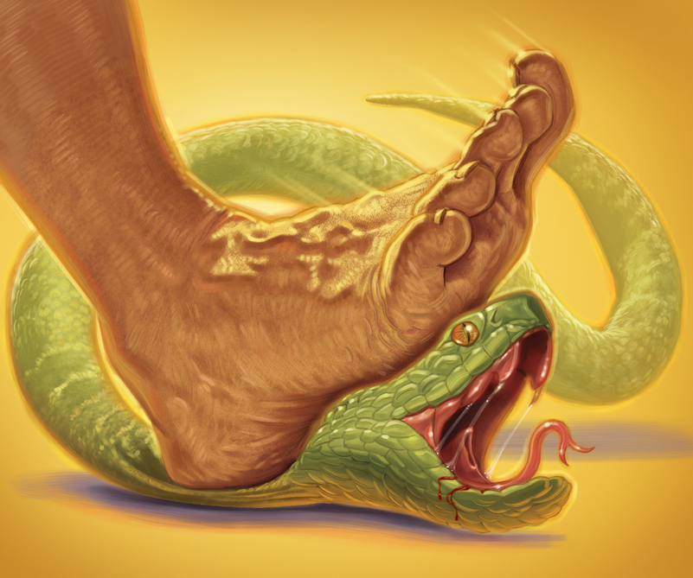
VERSE 15
第15节
“And I will put enmity between you and the woman, and between your offspring and hers; he will crush your head, and you will strike his heel.”
我又要叫你和女人彼此为仇； 你的后裔和女人的后裔也彼此为仇。 女人的后裔要伤你的头； 你要伤他的脚跟。
1 John 3:8 - “The reason the Son of God appeared was to destroy the devil’s work.”
约翰一书 3:8 犯罪的是属魔鬼，因为魔鬼从起初就犯罪。 神的儿子显现出来，为要除灭魔鬼的作为。
Romans 16:20 - “The God of peace will soon crush Satan under your feet. The grace of our Lord Jesus be with you”
罗马书 16:20 赐平安的 神快要将撒但践踏在你们脚下。愿我主耶稣基督的恩常和你们同在！

Slide 27
VERSE 15
第15节
“And I will put enmity between you and the woman, and between your offspring and hers; he will crush your head, and you will strike his heel.”
我又要叫你和女人彼此为仇； 你的后裔和女人的后裔也彼此为仇。 女人的后裔要伤你的头； 你要伤他的脚跟。

Slide 28
PROTEVANGELIUM
原初福音
“the first announcement of the gospel”
“第一次宣告福音”

Slide 29
PROTEVANGELIUM
原初福音
“HER offspring”
“女人的后裔”
The virgin birth of the Messiah (offspring of a woman)
弥赛亚由童女所生（女人的后裔）

Slide 30
PROTEVANGELIUM
原初福音
“STRIKE his heel”
“伤他的脚跟”
The virgin birth of the Messiah (offspring of a woman)
弥赛亚由童女所生（女人的后裔）
The suffering of the Messiah (“strike his heel”)
弥赛亚的受难（伤他的脚跟）

Slide 31
PROTEVANGELIUM
原初福音
“STRIKE his heel”
“伤他的脚跟”
The virgin birth of the Messiah (offspring of a woman)
弥赛亚由童女所生（女人的后裔）
The suffering of the Messiah (“strike his heel”)
弥赛亚的受难（伤他的脚跟）
The resurrection of the Messiah (“heel” not head) – a wound from which one recovers
弥赛亚的复活（“脚跟”而不是头）- 可医治的伤

Slide 32
PROTEVANGELIUM
原初福音
“CRUSH your HEAD”
“伤你的头”
The virgin birth of the Messiah (offspring of a woman)
弥赛亚由童女所生（女人的后裔）
The suffering of the Messiah (“strike his heel”)
弥赛亚的受难（伤他的脚跟）
The resurrection of the Messiah (“heel” not head) – a wound from which one recovers
弥赛亚的复活（“脚跟”而不是头）- 可医治的伤
The defeat of Satan (“crush your head”)
击败撒旦（“伤你的头”）

Slide 33
PROTEVANGELIUM
原初福音
The Eternal Decision
永恒中的决定
“He was chosen before the creation of the world but was revealed in these last times for your sake.” (1 Peter 1:20)
基督在创世以前是预先被 神知道的，却在这末世才为你们显现。（彼得前书 1:20）

Slide 34
PROTEVANGELIUM
原初福音
Father, God of grace, you knew us,
天父，慈爱的神，你认识我们，
Chose us, named us as your own,
拣选我们，称我们为你的儿女，
Through eternal ages planning
在创世以前预先计划
To redeem us in your Son.
藉你儿子来救赎我们。
Praise the Father, God who loved us
赞美天父，爱我们的神
Ere creation was begun!
始于创世之先！

Slide 35
PROTEVANGELIUM
原初福音
We, your creatures, sinned against you,
我们，是你的受造之物，得罪了你，
And our guilt was crimson red.
我们的罪红如丹颜。
Son of God, you came incarnate,
神的儿子，降世为人，
Crushed the crafty serpent’s head,
打伤狡猾的蛇头，
Died our death, now live triumphant:
为我们而死，如今得胜永活：
Praise the firstborn from the dead!
赞美归于脱离死亡、头生的儿子！

Slide 36
WHAT DOES THIS VERSE TEACH US ABOUT GOD?
这节经文向我们显明神是一位怎样的神？

