Slide 1

Welcome to Bible Class
欢迎参加圣经课程
The Messiah in the Old Testament
旧约中的弥赛亚

Slide 2

第一部分Part 1
律法书中的弥赛亚The Messiah in the Law
Lesson 2 = The Promise of the Messiah to Adam and Eve
第二课 =应许弥赛亚给亚当和夏娃
Lesson 3 = The Messiah is Promised to Abraham
第三课 =应许弥赛亚给列祖
Lesson 4 = The Messiah Promised to the Children of Israel
第四课 = 应许弥赛亚给以色列的子孙

Slide 3

THE LION OF JUDAH
Genesis 49:8-12

Slide 4
Genesis 49:8-12
“Judah, your brothers will praise you; your hand will be on the neck of your enemies; your father’s sons will bow down to you. ⁹ You are a lion’s cub, O Judah; you return from the prey, my son. Like a lion he crouches and lies down, like a lioness who dares to rouse him? ¹⁰ The scepter will not depart from Judah, nor the ruler’s staff from between his feet, until he comes to whom it belongs and the obedience of the nations is his. ¹¹ He will tether his donkey to a vine, his colt to the choicest branch; he will wash his garments in wine, his robes in the blood of grapes. ¹² His eyes will be darker than wine, his teeth whiter than milk.”
创49:8-12
犹大阿，你弟兄们必赞美你。你手必掐住仇敌的颈项。你父亲的儿子们必向你下拜。
犹大是个小狮子。我儿阿，你抓了食便上去。你屈下身去，卧如公狮，蹲如母狮，谁敢惹你。圭必不离犹大，杖必不离他两脚之间，直等细罗来到，万民都必归顺。犹大把小驴拴在葡萄树上，把驴驹拴在美好的葡萄树上。他在葡萄酒中洗了衣服，在葡萄汁中洗了袍褂。他的眼睛必因酒红润。他的牙齿必因奶白亮。

Slide 5
Genesis 49:8-12
“Judah, your brothers will praise you; your hand will be on the neck of your enemies; your father’s sons will bow down to you. ⁹ You are a lion’s cub, O Judah; you return from the prey, my son. Like a lion he crouches and lies down, like a lioness who dares to rouse him? ¹⁰ The scepter will not depart from Judah, nor the ruler’s staff from between his feet, until he comes to whom it belongs and the obedience of the nations is his. ¹¹ He will tether his donkey to a vine, his colt to the choicest branch; he will wash his garments in wine, his robes in the blood of grapes. ¹² His eyes will be darker than wine, his teeth whiter than milk.”
创49:8-12
犹大阿，你弟兄们必赞美你。你手必掐住仇敌的颈项。你父亲的儿子们必向你下拜。
犹大是个小狮子。我儿阿，你抓了食便上去。你屈下身去，卧如公狮，蹲如母狮，谁敢惹你。圭必不离犹大，杖必不离他两脚之间，直等细罗来到，万民都必归顺。犹大把小驴拴在葡萄树上，把驴驹拴在美好的葡萄树上。他在葡萄酒中洗了衣服，在葡萄汁中洗了袍褂。他的眼睛必因酒红润。他的牙齿必因奶白亮。

Slide 6
Genesis 49:8-12
“Judah, your brothers will praise you; your hand will be on the neck of your enemies; your father’s sons will bow down to you. ⁹ You are a lion’s cub, O Judah; you return from the prey, my son. Like a lion he crouches and lies down, like a lioness who dares to rouse him? ¹⁰ The scepter will not depart from Judah, nor the ruler’s staff from between his feet, until he comes to whom it belongs and the obedience of the nations is his. ¹¹ He will tether his donkey to a vine, his colt to the choicest branch; he will wash his garments in wine, his robes in the blood of grapes. ¹² His eyes will be darker than wine, his teeth whiter than milk.”
创49:8-12
犹大阿，你弟兄们必赞美你。你手必掐住仇敌的颈项。你父亲的儿子们必向你下拜。
犹大是个小狮子。我儿阿，你抓了食便上去。你屈下身去，卧如公狮，蹲如母狮，谁敢惹你。圭必不离犹大，杖必不离他两脚之间，直等细罗来到，万民都必归顺。犹大把小驴拴在葡萄树上，把驴驹拴在美好的葡萄树上。他在葡萄酒中洗了衣服，在葡萄汁中洗了袍褂。他的眼睛必因酒红润。他的牙齿必因奶白亮。

Slide 7
Genesis 49:8-12
“Judah, your brothers will praise you; your hand will be on the neck of your enemies; your father’s sons will bow down to you. ⁹ You are a lion’s cub, O Judah; you return from the prey, my son. Like a lion he crouches and lies down, like a lioness who dares to rouse him? ¹⁰ The scepter will not depart from Judah, nor the ruler’s staff from between his feet, until he comes to whom it belongs and the obedience of the nations is his. ¹¹ He will tether his donkey to a vine, his colt to the choicest branch; he will wash his garments in wine, his robes in the blood of grapes. ¹² His eyes will be darker than wine, his teeth whiter than milk.”
创49:8-12
犹大阿，你弟兄们必赞美你。你手必掐住仇敌的颈项。你父亲的儿子们必向你下拜。
犹大是个小狮子。我儿阿，你抓了食便上去。你屈下身去，卧如公狮，蹲如母狮，谁敢惹你。圭必不离犹大，杖必不离他两脚之间，直等细罗来到，万民都必归顺。犹大把小驴拴在葡萄树上，把驴驹拴在美好的葡萄树上。他在葡萄酒中洗了衣服，在葡萄汁中洗了袍褂。他的眼睛必因酒红润。他的牙齿必因奶白亮。

Slide 8
Genesis 49:8-12
“Judah, your brothers will praise you; your hand will be on the neck of your enemies; your father’s sons will bow down to you. ⁹ You are a lion’s cub, O Judah; you return from the prey, my son. Like a lion he crouches and lies down, like a lioness who dares to rouse him? ¹⁰ The scepter will not depart from Judah, nor the ruler’s staff from between his feet, until he comes to whom it belongs and the obedience of the nations is his. ¹¹ He will tether his donkey to a vine, his colt to the choicest branch; he will wash his garments in wine, his robes in the blood of grapes. ¹² His eyes will be darker than wine, his teeth whiter than milk.”
创49:8-12
犹大阿，你弟兄们必赞美你。你手必掐住仇敌的颈项。你父亲的儿子们必向你下拜。
犹大是个小狮子。我儿阿，你抓了食便上去。你屈下身去，卧如公狮，蹲如母狮，谁敢惹你。圭必不离犹大，杖必不离他两脚之间，直等细罗来到，万民都必归顺。犹大把小驴拴在葡萄树上，把驴驹拴在美好的葡萄树上。他在葡萄酒中洗了衣服，在葡萄汁中洗了袍褂。他的眼睛必因酒红润。他的牙齿必因奶白亮。

Slide 9
Genesis 49:8-12
“Judah, your brothers will praise you; your hand will be on the neck of your enemies; your father’s sons will bow down to you. ⁹ You are a lion’s cub, O Judah; you return from the prey, my son. Like a lion he crouches and lies down, like a lioness who dares to rouse him? ¹⁰ The scepter will not depart from Judah, nor the ruler’s staff from between his feet, until he comes to whom it belongs and the obedience of the nations is his. ¹¹ He will tether his donkey to a vine, his colt to the choicest branch; he will wash his garments in wine, his robes in the blood of grapes. ¹² His eyes will be darker than wine, his teeth whiter than milk.”
创49:8-12
犹大阿，你弟兄们必赞美你。你手必掐住仇敌的颈项。你父亲的儿子们必向你下拜。
犹大是个小狮子。我儿阿，你抓了食便上去。你屈下身去，卧如公狮，蹲如母狮，谁敢惹你。圭必不离犹大，杖必不离他两脚之间，直等细罗来到，万民都必归顺。犹大把小驴拴在葡萄树上，把驴驹拴在美好的葡萄树上。他在葡萄酒中洗了衣服，在葡萄汁中洗了袍褂。他的眼睛必因酒红润。他的牙齿必因奶白亮。

Slide 10
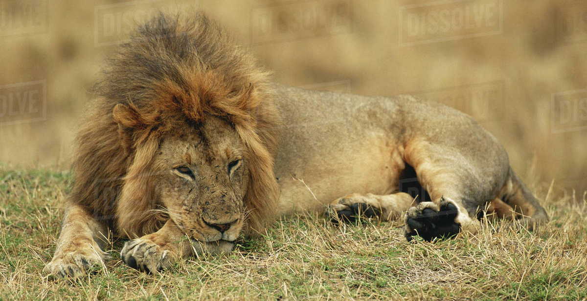
Genesis 49:8-12
“Judah, your brothers will praise you; your hand will be on the neck of your enemies; your father’s sons will bow down to you. ⁹ You are a lion’s cub, O Judah; you return from the prey, my son. Like a lion he crouches and lies down, like a lioness who dares to rouse him? ¹⁰ The scepter will not depart from Judah, nor the ruler’s staff from between his feet, until he comes to whom it belongs and the obedience of the nations is his. ¹¹ He will tether his donkey to a vine, his colt to the choicest branch; he will wash his garments in wine, his robes in the blood of grapes. ¹² His eyes will be darker than wine, his teeth whiter than milk.”
创49:8-12
犹大阿，你弟兄们必赞美你。你手必掐住仇敌的颈项。你父亲的儿子们必向你下拜。
犹大是个小狮子。我儿阿，你抓了食便上去。你屈下身去，卧如公狮，蹲如母狮，谁敢惹你。圭必不离犹大，杖必不离他两脚之间，直等细罗来到，万民都必归顺。犹大把小驴拴在葡萄树上，把驴驹拴在美好的葡萄树上。他在葡萄酒中洗了衣服，在葡萄汁中洗了袍褂。他的眼睛必因酒红润。他的牙齿必因奶白亮。

Slide 11
Genesis 49:8-12
“Judah, your brothers will praise you; your hand will be on the neck of your enemies; your father’s sons will bow down to you. ⁹ You are a lion’s cub, O Judah; you return from the prey, my son. Like a lion he crouches and lies down, like a lioness who dares to rouse him? ¹⁰ The scepter will not depart from Judah, nor the ruler’s staff from between his feet, until he comes to whom it belongs and the obedience of the nations is his. ¹¹ He will tether his donkey to a vine, his colt to the choicest branch; he will wash his garments in wine, his robes in the blood of grapes. ¹² His eyes will be darker than wine, his teeth whiter than milk.”
创49:8-12
犹大阿，你弟兄们必赞美你。你手必掐住仇敌的颈项。你父亲的儿子们必向你下拜。
犹大是个小狮子。我儿阿，你抓了食便上去。你屈下身去，卧如公狮，蹲如母狮，谁敢惹你。圭必不离犹大，杖必不离他两脚之间，直等细罗来到，万民都必归顺。犹大把小驴拴在葡萄树上，把驴驹拴在美好的葡萄树上。他在葡萄酒中洗了衣服，在葡萄汁中洗了袍褂。他的眼睛必因酒红润。他的牙齿必因奶白亮。
“Like a lion they crouch and lie down, like a lioness—who dares to rouse them? “May those who bless you be blessed and those who curse you be cursed!” (Numbers 24:9)
他蹲如公狮，卧如母狮，谁敢惹他，凡给你祝福的，愿他蒙福。凡咒诅你的，愿他受咒诅。（民24:9）

Slide 12
Genesis 49:8-12
“Judah, your brothers will praise you; your hand will be on the neck of your enemies; your father’s sons will bow down to you. ⁹ You are a lion’s cub, O Judah; you return from the prey, my son. Like a lion he crouches and lies down, like a lioness who dares to rouse him? ¹⁰ The scepter will not depart from Judah, nor the ruler’s staff from between his feet, until he comes to whom it belongs and the obedience of the nations is his. ¹¹ He will tether his donkey to a vine, his colt to the choicest branch; he will wash his garments in wine, his robes in the blood of grapes. ¹² His eyes will be darker than wine, his teeth whiter than milk.”
创49:8-12
犹大阿，你弟兄们必赞美你。你手必掐住仇敌的颈项。你父亲的儿子们必向你下拜。
犹大是个小狮子。我儿阿，你抓了食便上去。你屈下身去，卧如公狮，蹲如母狮，谁敢惹你。圭必不离犹大，杖必不离他两脚之间，直等细罗来到，万民都必归顺。犹大把小驴拴在葡萄树上，把驴驹拴在美好的葡萄树上。他在葡萄酒中洗了衣服，在葡萄汁中洗了袍褂。他的眼睛必因酒红润。他的牙齿必因奶白亮。
“Then one of the elders said to me, “Do not weep! See, the Lion of the tribe of Judah, the Root of David, has triumphed. He is able to open the scroll and its seven seals.” (Revelation 5:5)
长老中有一位对我说，不要哭。看哪，犹大支派中的狮子，大卫的根，他已得胜，能以展开那书卷，揭开那七印。（启5:5）

Slide 13
Genesis 49:8-12
“Judah, your brothers will praise you; your hand will be on the neck of your enemies; your father’s sons will bow down to you. ⁹ You are a lion’s cub, O Judah; you return from the prey, my son. Like a lion he crouches and lies down, like a lioness who dares to rouse him?
¹⁰ The scepter will not depart from Judah,
nor the ruler’s staff from between his feet,
until he comes to whom it belongs
and the obedience of the nations is his.
¹¹ He will tether his donkey to a vine, his colt to the choicest branch; he will wash his garments in wine, his robes in the blood of grapes. ¹² His eyes will be darker than wine, his teeth whiter than milk.”
创49:8-12
犹大阿，你弟兄们必赞美你。你手必掐住仇敌的颈项。你父亲的儿子们必向你下拜。犹大是个小狮子。我儿阿，你抓了食便上去。你屈下身去，卧如公狮，蹲如母狮，谁敢惹你。
圭必不离犹大，
杖必不离他两脚之间，
直等细罗来到，
万民都必归顺。
犹大把小驴拴在葡萄树上，把驴驹拴在美好的葡萄树上。他在葡萄酒中洗了衣服，在葡萄汁中洗了袍褂。他的眼睛必因酒红润。他的牙齿必因奶白亮。

Slide 14
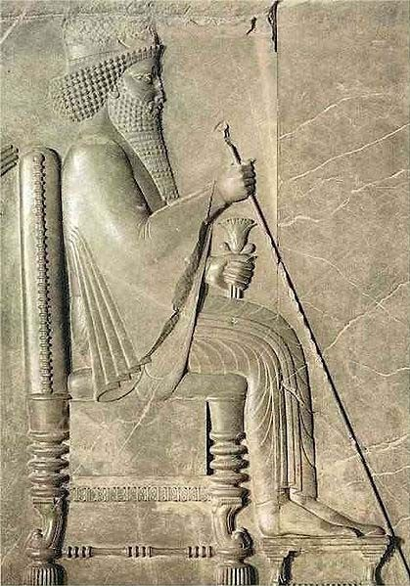
Genesis 49:8-12
“Judah, your brothers will praise you; your hand will be on the neck of your enemies; your father’s sons will bow down to you. ⁹ You are a lion’s cub, O Judah; you return from the prey, my son. Like a lion he crouches and lies down, like a lioness who dares to rouse him?
¹⁰ The scepter will not depart from Judah,
nor the ruler’s staff from between his feet,
until he comes to whom it belongs
and the obedience of the nations is his.
¹¹ He will tether his donkey to a vine, his colt to the choicest branch; he will wash his garments in wine, his robes in the blood of grapes. ¹² His eyes will be darker than wine, his teeth whiter than milk.”
创49:8-12
犹大阿，你弟兄们必赞美你。你手必掐住仇敌的颈项。你父亲的儿子们必向你下拜。犹大是个小狮子。我儿阿，你抓了食便上去。你屈下身去，卧如公狮，蹲如母狮，谁敢惹你。
圭必不离犹大，
杖必不离他两脚之间，
直等细罗来到，
万民都必归顺。
犹大把小驴拴在葡萄树上，把驴驹拴在美好的葡萄树上。他在葡萄酒中洗了衣服，在葡萄汁中洗了袍褂。他的眼睛必因酒红润。他的牙齿必因奶白亮。
“For the LORD is our judge, the LORD is our lawgiver, the LORD is our king; it is he who will save us.” (Isaiah 33:22).
因为耶和华是审判我们的，耶和华是给我们设律法的，耶和华是我们的王。他必拯救我们。（赛33:22）

Slide 15
Genesis 49:8-12
“Judah, your brothers will praise you; your hand will be on the neck of your enemies; your father’s sons will bow down to you. ⁹ You are a lion’s cub, O Judah; you return from the prey, my son. Like a lion he crouches and lies down, like a lioness who dares to rouse him?
¹⁰ The scepter will not depart from Judah,
nor the ruler’s staff from between his feet,
until he comes to whom it belongs
and the obedience of the nations is his.
¹¹ He will tether his donkey to a vine, his colt to the choicest branch; he will wash his garments in wine, his robes in the blood of grapes. ¹² His eyes will be darker than wine, his teeth whiter than milk.”
创49:8-12
犹大阿，你弟兄们必赞美你。你手必掐住仇敌的颈项。你父亲的儿子们必向你下拜。犹大是个小狮子。我儿阿，你抓了食便上去。你屈下身去，卧如公狮，蹲如母狮，谁敢惹你。
圭必不离犹大，
杖必不离他两脚之间，
直等细罗来到，
万民都必归顺。
犹大把小驴拴在葡萄树上，把驴驹拴在美好的葡萄树上。他在葡萄酒中洗了衣服，在葡萄汁中洗了袍褂。他的眼睛必因酒红润。他的牙齿必因奶白亮。
“until Shiloh come”
“直等到细罗来到”

Slide 16
Genesis 49:8-12
“Judah, your brothers will praise you; your hand will be on the neck of your enemies; your father’s sons will bow down to you. ⁹ You are a lion’s cub, O Judah; you return from the prey, my son. Like a lion he crouches and lies down, like a lioness who dares to rouse him?
¹⁰ The scepter will not depart from Judah,
nor the ruler’s staff from between his feet,
until he comes to whom it belongs
and the obedience of the nations is his.
¹¹ He will tether his donkey to a vine, his colt to the choicest branch; he will wash his garments in wine, his robes in the blood of grapes. ¹² His eyes will be darker than wine, his teeth whiter than milk.”
创49:8-12
犹大阿，你弟兄们必赞美你。你手必掐住仇敌的颈项。你父亲的儿子们必向你下拜。犹大是个小狮子。我儿阿，你抓了食便上去。你屈下身去，卧如公狮，蹲如母狮，谁敢惹你。
圭必不离犹大，
杖必不离他两脚之间，
直等细罗来到，
万民都必归顺。
犹大把小驴拴在葡萄树上，把驴驹拴在美好的葡萄树上。他在葡萄酒中洗了衣服，在葡萄汁中洗了袍褂。他的眼睛必因酒红润。他的牙齿必因奶白亮。
“It will not be restored until he comes to whom it rightfully belongs; to him I will give it.” (Ezekiel 21:27 )
“这国也必不再有，直等到那应得的人来到，我就赐给他。”（结21:27）
“until Shiloh come”
“直等细罗来到”

Slide 17
Genesis 49:8-12
“Judah, your brothers will praise you; your hand will be on the neck of your enemies; your father’s sons will bow down to you. ⁹ You are a lion’s cub, O Judah; you return from the prey, my son. Like a lion he crouches and lies down, like a lioness who dares to rouse him?
¹⁰ The scepter will not depart from Judah,
nor the ruler’s staff from between his feet,
until he comes to whom it belongs
and the obedience of the nations is his.
¹¹ He will tether his donkey to a vine, his colt to the choicest branch; he will wash his garments in wine, his robes in the blood of grapes. ¹² His eyes will be darker than wine, his teeth whiter than milk.”
创49:8-12
犹大阿，你弟兄们必赞美你。你手必掐住仇敌的颈项。你父亲的儿子们必向你下拜。犹大是个小狮子。我儿阿，你抓了食便上去。你屈下身去，卧如公狮，蹲如母狮，谁敢惹你。
圭必不离犹大，
杖必不离他两脚之间，
直等细罗来到，
万民都必归顺。
犹大把小驴拴在葡萄树上，把驴驹拴在美好的葡萄树上。他在葡萄酒中洗了衣服，在葡萄汁中洗了袍褂。他的眼睛必因酒红润。他的牙齿必因奶白亮。
“The Lamb will overcome them because he is Lord of lords and King of kings—and with him will be his called, chosen and faithful followers.” (Revelation 17:14)
“羔羊必胜过他们，因为羔羊是万主之主，万王之王。同着羔羊的，就是蒙召被选有忠心的，也必得胜。”（启17:14）

Slide 18
Genesis 49:8-12
“Judah, your brothers will praise you; your hand will be on the neck of your enemies; your father’s sons will bow down to you. ⁹ You are a lion’s cub, O Judah; you return from the prey, my son. Like a lion he crouches and lies down, like a lioness who dares to rouse him?
¹⁰ The scepter will not depart from Judah,
nor the ruler’s staff from between his feet,
until he comes to whom it belongs
and the obedience of the nations is his.
¹¹ He will tether his donkey to a vine, his colt to the choicest branch; he will wash his garments in wine, his robes in the blood of grapes. ¹² His eyes will be darker than wine, his teeth whiter than milk.”
创49:8-12
犹大阿，你弟兄们必赞美你。你手必掐住仇敌的颈项。你父亲的儿子们必向你下拜。犹大是个小狮子。我儿阿，你抓了食便上去。你屈下身去，卧如公狮，蹲如母狮，谁敢惹你。
圭必不离犹大，
杖必不离他两脚之间，
直等细罗来到，
万民都必归顺。
犹大把小驴拴在葡萄树上，把驴驹拴在美好的葡萄树上。他在葡萄酒中洗了衣服，在葡萄汁中洗了袍褂。他的眼睛必因酒红润。他的牙齿必因奶白亮。
“See, the Lion of the tribe of Judah, the Root of David, has triumphed.” (Revelation 5:5)
“看哪，犹大支派中的狮子，大卫的根，他已得胜”（启5:5）

Slide 19
Genesis 49:8-12
“Judah, your brothers will praise you; your hand will be on the neck of your enemies; your father’s sons will bow down to you. ⁹ You are a lion’s cub, O Judah; you return from the prey, my son. Like a lion he crouches and lies down, like a lioness who daresto rouse him?
¹⁰ The scepter will not depart from Judah,
nor the ruler’s staff from between his feet,
until he comes to whom it belongs
and the obedience of the nations is his.
¹¹ He will tether his donkey to a vine, his colt to the choicest branch; he will wash his garments in wine, his robes in the blood of grapes. ¹² His eyes will be darker than wine, his teeth whiter than milk.”
创49:8-12
犹大阿，你弟兄们必赞美你。你手必掐住仇敌的颈项。你父亲的儿子们必向你下拜。犹大是个小狮子。我儿阿，你抓了食便上去。你屈下身去，卧如公狮，蹲如母狮，谁敢惹你。
圭必不离犹大，
杖必不离他两脚之间，
直等细罗来到，
万民都必归顺。
犹大把小驴拴在葡萄树上，把驴驹拴在美好的葡萄树上。他在葡萄酒中洗了衣服，在葡萄汁中洗了袍褂。他的眼睛必因酒红润。他的牙齿必因奶白亮。
“Out of his mouth comes a sharp sword with which to strike down the nations. “He will rule them with an iron scepter.” He treads the winepress of the fury of the wrath of God Almighty. On his robe and on his thigh he has this name written: King of Kings and Lord of Lords.” (Revelation 19:15–16)
有利剑从他口中出来，可以击杀列国。他必用铁杖辖管他们。并要踹全能神烈怒的酒榨。在他衣服和大腿上，有名写着说，万王之王，万主之主。（启19:15-16）

Slide 20
GENESIS 49:8-12
创49:8-12
6) What do we now know about the Messiah?
He will come from the line of Judah (“For it is clear that our Lord descended from Judah.” - Hebrews 7:14)
He will take his prey (be victorious): “For he must reign until he has put all his enemies under his feet. The last enemy to be destroyed is death.” (1 Corinthians 15:25–26)
He will be a king who will rule over all people. “The Root of Jesse will spring up, one who will arise to rule over the nations; the Gentiles will hope in him.”” (Romans 15:12)
The obedience of the nations will be given to him -- “who have been chosen according to the foreknowledge of God the Father for obedience to Jesus Christ” (1 Peter 1:2)
6）关于弥赛亚我们知道什么信息？
他会从犹大而出（我们的主分明是从犹大出来的。-来7:14）
他会取得猎物（得胜）：“因为基督必要作王，等神把一切仇敌，都放在他的脚下。尽末了所毁灭的仇敌，就是死。”（林前15:25-26）
他是君王，要统管万民。“又有以赛亚说，将来有耶西的根，就是那兴起来要治理外邦的。外邦人要仰望他。”（罗15:12）
万国都要归顺他—“就是照父神的先见被拣选，以致顺服耶稣基督”（彼前1:2）

Slide 21
A STAR OUT OF JACOB
雅各之星
Numbers 24:15-19
民24:15-19

Slide 22
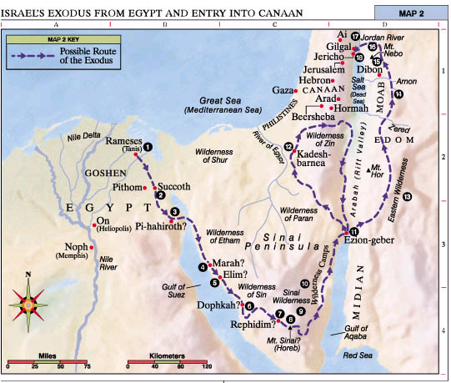
Balak
King of Moab
巴勒
摩押王

Slide 23
Numbers 24:15-19
Then he uttered his oracle: “The oracle of Balaam son of Beor, the oracle of one whose eye sees clearly, ¹⁶ the oracle of one who hears the words of God, who has knowledge from the Most High, who sees a vision from the Almighty, who falls prostrate, and whose eyes are opened: ¹⁷ “I see him, but not now; I behold him, but not near. A star will come out of Jacob; a scepter will rise out of Israel. He will crush the foreheads of Moab, the skulls of all the sons of Sheth. ¹⁸ Edom will be conquered; Seir, his enemy, will be conquered, but Israel will grow strong. ¹⁹ A ruler will come out of Jacob and destroy the survivors of the city.”
民24:15-19
他就题起诗歌说，比珥的儿子巴兰说，眼目闭住的人说，得听神的言语，明白至高者的意旨，看见全能者的异象，眼目睁开而仆倒的人说，我看他却不在现时。我望他却不在近日。有星要出于雅各，有杖要兴于以色列，必打破摩押的四角，毁坏扰乱之子。他必得以东为基业，又得仇敌之地西珥为产业。以色列必行事勇敢。有一位出于雅各的，必掌大权。他要除灭城中的余民。

Slide 24
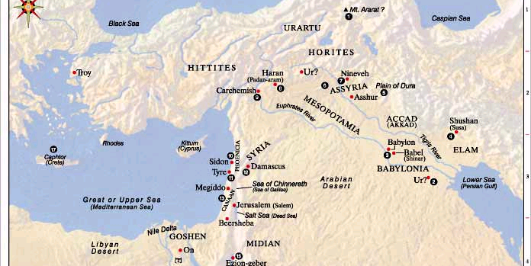
Numbers 24:15-19
Then he uttered his oracle: “The oracle of Balaam son of Beor, the oracle of one whose eye sees clearly, ¹⁶ the oracle of one who hears the words of God, who has knowledge from the Most High, who sees a vision from the Almighty, who falls prostrate, and whose eyes are opened: ¹⁷ “I see him, but not now; I behold him, but not near. A star will come out of Jacob; a scepter will rise out of Israel. He will crush the foreheads of Moab, the skulls of all the sons of Sheth. ¹⁸ Edom will be conquered; Seir, his enemy, will be conquered, but Israel will grow strong. ¹⁹ A ruler will come out of Jacob and destroy the survivors of the city.”
民24:15-19
他就题起诗歌说，比珥的儿子巴兰说，眼目闭住的人说，得听神的言语，明白至高者的意旨，看见全能者的异象，眼目睁开而仆倒的人说，我看他却不在现时。我望他却不在近日。有星要出于雅各，有杖要兴于以色列，必打破摩押的四角，毁坏扰乱之子。他必得以东为基业，又得仇敌之地西珥为产业。以色列必行事勇敢。有一位出于雅各的，必掌大权。他要除灭城中的余民。
巴比伦 吾珥？
迦南
Numbers 22:5 “Balak sent messengers to summon Balaam son of Beor, who was at Pethor, near the River, in his native land.”
民22:5 “他差遣使者往大河边的毗夺去，到比珥的儿子巴兰本乡那里，召巴兰来。”

Slide 25
Numbers 24:15-19
Then he uttered his oracle: “The oracle of Balaam son of Beor, the oracle of one whose eye sees clearly, ¹⁶ the oracle of one who hears the words of God, who has knowledge from the Most High, who sees a vision from the Almighty, who falls prostrate, and whose eyes are opened: ¹⁷ “I see him, but not now; I behold him, but not near. A star will come out of Jacob; a scepter will rise out of Israel. He will crush the foreheads of Moab, the skulls of all the sons of Sheth. ¹⁸ Edom will be conquered; Seir, his enemy, will be conquered, but Israel will grow strong. ¹⁹ A ruler will come out of Jacob and destroy the survivors of the city.”
民24:15-19
他就题起诗歌说，比珥的儿子巴兰说，眼目闭住的人说，得听神的言语，明白至高者的意旨，看见全能者的异象，眼目睁开而仆倒的人说，我看他却不在现时。我望他却不在近日。有星要出于雅各，有杖要兴于以色列，必打破摩押的四角，毁坏扰乱之子。他必得以东为基业，又得仇敌之地西珥为产业。以色列必行事勇敢。有一位出于雅各的，必掌大权。他要除灭城中的余民。

Slide 26
Numbers 24:15-19
Then he uttered his oracle: “The oracle of Balaam son of Beor, the oracle of one whose eye sees clearly, ¹⁶ the oracle of one who hears the words of God, who has knowledge from the Most High, who sees a vision from the Almighty, who falls prostrate, and whose eyes are opened: ¹⁷ “I see him, but not now; I behold him, but not near. A star will come out of Jacob; a scepter will rise out of Israel. He will crush the foreheads of Moab, the skulls of all the sons of Sheth. ¹⁸ Edom will be conquered; Seir, his enemy, will be conquered, but Israel will grow strong. ¹⁹ A ruler will come out of Jacob and destroy the survivors of the city.”
民24:15-19
他就题起诗歌说，比珥的儿子巴兰说，眼目闭住的人说，得听神的言语，明白至高者的意旨，看见全能者的异象，眼目睁开而仆倒的人说，我看他却不在现时。我望他却不在近日。有星要出于雅各，有杖要兴于以色列，必打破摩押的四角，毁坏扰乱之子。他必得以东为基业，又得仇敌之地西珥为产业。以色列必行事勇敢。有一位出于雅各的，必掌大权。他要除灭城中的余民。

Slide 27
NUMBERS 24:15-19
民24:15-19
Jacob’s blessing雅各的祝福 | Balaam’s blessing巴兰的祝福
“Like a lion he crouches and lies down, like a lioness who dares to rouse him?” (Genesis 49:9) “你屈下身去，卧如公狮，蹲如母狮，谁敢惹你。”（创49:9） | “Like a lion they crouch and lie down, like a lioness—who dares to rouse them?” (Numbers 24:9) “他蹲如公狮，卧如母狮，谁敢惹他”（民24:9）
“The scepter will not depart from Judah” (Genesis 49:10) “圭必不离犹大”（创49:10） | “a scepter will rise out of Israel” (Numbers 24:17) “有杖要兴于以色列”（民24:17）
“nor the ruler’s staff from between his feet, until he comes” (Genesis 49:10) “杖必不离他两脚之间，直等细罗来到”（创49:10） | “A ruler will come out of Jacob” (Numbers 24:19) “有一位出于雅各的，必掌大权。”（民24:9）

Slide 28
NUMBERS 24:15-19
民24:15-19
Who was Balaam referring to?
巴兰所指的是谁？

Slide 29
Numbers 24:15-19
Then he uttered his oracle: “The oracle of Balaam son of Beor, the oracle of one whose eye sees clearly, ¹⁶ the oracle of one who hears the words of God, who has knowledge from the Most High, who sees a vision from the Almighty, who falls prostrate, and whose eyes are opened: ¹⁷ “I see him, but not now; I behold him, but not near. A star will come out of Jacob; a scepter will rise out of Israel. He will crush the foreheads of Moab, the skulls of all the sons of Sheth. ¹⁸ Edom will be conquered; Seir, his enemy, will be conquered, but Israel will grow strong. ¹⁹ A ruler will come out of Jacob and destroy the survivors of the city.”
阿卡德
巴比伦
耶路撒冷
Magi from the east came to Jerusalem and asked, “Where is the one who has been born king of the Jews? We saw his star in the east and have come to worship him.” (Matthew 2:1–2)
有几个博士从东方来到耶路撒冷，说，那生下来作犹太人之王的在哪里？我们在东方看见他的星，特来拜他。（太2:1-2）

Slide 30
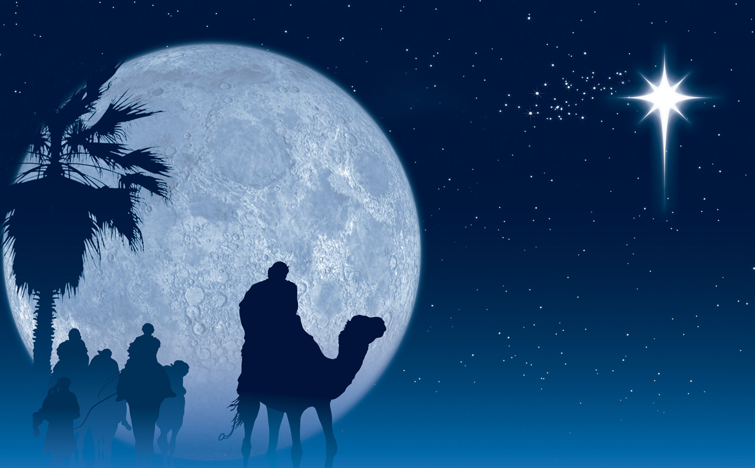
Numbers 24:15-19
Then he uttered his oracle: “The oracle of Balaam son of Beor, the oracle of one whose eye sees clearly, ¹⁶ the oracle of one who hears the words of God, who has knowledge from the Most High, who sees a vision from the Almighty, who falls prostrate, and whose eyes are opened: ¹⁷ “I see him, but not now; I behold him, but not near. A star will come out of Jacob; a scepter will rise out of Israel. He will crush the foreheads of Moab, the skulls of all the sons of Sheth. ¹⁸ Edom will be conquered; Seir, his enemy, will be conquered, but Israel will grow strong. ¹⁹ A ruler will come out of Jacob and destroy the survivors of the city.”
民24:15-19
他就题起诗歌说，比珥的儿子巴兰说，眼目闭住的人说，得听神的言语，明白至高者的意旨，看见全能者的异象，眼目睁开而仆倒的人说，我看他却不在现时。我望他却不在近日。有星要出于雅各，有杖要兴于以色列，必打破摩押的四角，毁坏扰乱之子。他必得以东为基业，又得仇敌之地西珥为产业。以色列必行事勇敢。有一位出于雅各的，必掌大权。他要除灭城中的余民。
“Know and understand this: From the issuing of the decree to restore and rebuild Jerusalem until the Anointed One (Messiah), the ruler, comes, there will be seven ‘sevens,’ and sixty-two ‘sevens.’” (Daniel 9:25)
你当知道，当明白，从出令重新建造耶路撒冷，直到有受膏君的时候，必有七个七和六十二个七。（但9:25）

Slide 31
Numbers 24:15-19
Then he uttered his oracle: “The oracle of Balaam son of Beor, the oracle of one whose eye sees clearly, ¹⁶ the oracle of one who hears the words of God, who has knowledge from the Most High, who sees a vision from the Almighty, who falls prostrate, and whose eyes are opened: ¹⁷ “I see him, but not now; I behold him, but not near. A star will come out of Jacob; a scepter will rise out of Israel. He will crush the foreheads of Moab, the skulls of all the sons of Sheth. ¹⁸ Edom will be conquered; Seir, his enemy, will be conquered, but Israel will grow strong. ¹⁹ A ruler will come out of Jacob and destroy the survivors of the city.”
民24:15-19
他就题起诗歌说，比珥的儿子巴兰说，眼目闭住的人说，得听神的言语，明白至高者的意旨，看见全能者的异象，眼目睁开而仆倒的人说，我看他却不在现时。我望他却不在近日。有星要出于雅各，有杖要兴于以色列，必打破摩押的四角，毁坏扰乱之子。他必得以东为基业，又得仇敌之地西珥为产业。以色列必行事勇敢。有一位出于雅各的，必掌大权。他要除灭城中的余民。
“And we have the word of the prophets made more certain, and you will do well to pay attention to it, as to a light shining in a dark place, until the day dawns and the morning star rises in your hearts. Above all, you must understand that no prophecy of Scripture came about by the prophet’s own interpretation. For prophecy never had its origin in the will of man, but men spoke from God as they were carried along by the Holy Spirit.” (2 Peter 1:19–21)
我们并有先知更确的预言，如同灯照在暗处。你们在这预言上留意，直等到天发亮晨星在你们心里出现的时候，才是好的。第一要紧的，该知道经上所有的预言，没有可随私意解说的。因为预言从来没有出于人意的，乃是人被圣灵感动说出神的话来。（彼后19-21）

Slide 32
Numbers 24:15-19
Then he uttered his oracle: “The oracle of Balaam son of Beor, the oracle of one whose eye sees clearly, ¹⁶ the oracle of one who hears the words of God, who has knowledge from the Most High, who sees a vision from the Almighty, who falls prostrate, and whose eyes are opened: ¹⁷ “I see him, but not now; I behold him, but not near. A star will come out of Jacob; a scepter will rise out of Israel. He will crush the foreheads of Moab, the skulls of all the sons of Sheth. ¹⁸ Edom will be conquered; Seir, his enemy, will be conquered, but Israel will grow strong. ¹⁹ A ruler will come out of Jacob and destroy the survivors of the city.”
民24:15-19
他就题起诗歌说，比珥的儿子巴兰说，眼目闭住的人说，得听神的言语，明白至高者的意旨，看见全能者的异象，眼目睁开而仆倒的人说，我看他却不在现时。我望他却不在近日。有星要出于雅各，有杖要兴于以色列，必打破摩押的四角，毁坏扰乱之子。他必得以东为基业，又得仇敌之地西珥为产业。以色列必行事勇敢。有一位出于雅各的，必掌大权。他要除灭城中的余民。
“I, Jesus, am the Root and the Offspring of David, and the bright Morning Star.” (Revelation 22:16)
“我耶稣，是大卫的根，又是他的后裔。我是明亮的晨星。”（启22:16）
“And we have the word of the prophets made more certain, and you will do well to pay attention to it, as to a light shining in a dark place, until the day dawns and the morning star rises in your hearts. Above all, you must understand that no prophecy of Scripture came about by the prophet’s own interpretation. For prophecy never had its origin in the will of man, but men spoke from God as they were carried along by the Holy Spirit.” (2 Peter 1:19–21)
我们并有先知更确的预言，如同灯照在暗处。你们在这预言上留意，直等到天发亮晨星在你们心里出现的时候，才是好的。第一要紧的，该知道经上所有的预言，没有可随私意解说的。因为预言从来没有出于人意的，乃是人被圣灵感动说出神的话来。（彼后19-21）

Slide 33
A PROPHET LIKE MOSES
像摩西的先知
Deuteronomy 18:15-19
申18:15-19

Slide 34
Deuteronomy 18:15-19
“The Lord your God will raise up for you a prophet like me from among your own brothers. You must listen to him. ¹⁶For this is what you asked of the Lord your God at Horeb on the day of the assembly when you said, “Let us not hear the voice of the Lord our God nor see this great fire anymore, or we will die.”
¹⁷The Lord said to me: “What they say is good. ¹⁸I will raise up for them a prophet like you from among their brothers; I will put my words in his mouth, and he will tell them everything I command him. ¹⁹If anyone does not listen to my words that the prophet speaks in my name, I myself will call him to account.”
申18:15-19
耶和华你的神要从你们弟兄中间给你兴起一位先知，像我，你们要听从他。正如你在何烈山大会的日子求耶和华你神一切的话，说，求你不再叫我听见耶和华我神的声音，也不再叫我看见这大火，免得我死亡。耶和华就对我说，他们所说的是。我必在他们弟兄中间，给他们兴起一位先知象你。我要将当说的话传给他。他要将我一切所吩咐的都传给他们。谁不听他奉我名所说的话，我必讨谁的罪。

Slide 35
DEUTERONOMY 18:15-19
申18:15-19
“Are you the Prophet?” He answered, “No.” “Why then do you baptize if you are not the Christ, nor Elijah, nor the Prophet?” (John 1:21,25)
“是那先知吗？他回答说，不是。他们就问他说，你既不是基督，不是以利亚，也不是那先知，为什么施洗呢？”（约1:21，25）
“We have found the one Moses wrote about in the Law, and about whom the prophets also wrote—Jesus of Nazareth, the son of Joseph.” (John 1:45)
“摩西在律法上所写的，和众先知所记的那一位，我们遇见了，就是约瑟的儿子拿撒勒人耶稣。”（约1:45）
“Surely this is the Prophet who is to come into the world.” (John 6:14)
“众人看见耶稣所行的神迹。就说，这真是那要到世间来的先知。”（约6:14）
“Surely this man is the Prophet.” Others said, “He is the Christ.” (John 7:40–41)
“众人听见这话，有的说，这真是那先知。有的说，这是基督。但也有的说，基督岂是从加利利出来的吗？”（约7:40-41）

Slide 36
DEUTERONOMY 18:15-19
申18:15-19
How do we know that this passage was a reference to Jesus?
我们怎么知道这段经文是指着耶稣说的？
“Repent, then, and turn to God, so that your sins may be wiped out, that times of refreshing may come from the Lord, and that he may send the Christ, who has been appointed for you—even Jesus. He must remain in heaven until the time comes for God to restore everything, as he promised long ago through his holy prophets. For Moses said, ‘The Lord your God will raise up for you a prophet like me from among your own people; you must listen to everything he tells you.” (Acts 3:19–22)
“所以你们当悔改归正，使你们的罪得以涂抹，这样，那安舒的日子，就必从主面前来到。主也必差遣所预定给你们的基督耶稣降临。天必留他，等到万物复兴的时候，就是神从创世以来，借着圣先知的口所说的。摩西曾说，主神要从你们弟兄中间，给你们兴起一位先知像我，凡他向你们所说的，你们都要听从。”（徒3:19-22）

Slide 37
DEUTERONOMY 18:15-19
申18:15-19
14) Moses wrote that the Prophet would be “like me.” How was Jesus like Moses?
摩西说那位先知会“像我”。耶稣怎么像摩西？

Slide 38
DEUTERONOMY 18:15-19
申18:15-19
14) Moses wrote that the Prophet would be “like me.” How was Jesus like Moses?摩西说那位先知会“像我”。耶稣怎么像摩西？
Moses and Christ were alike in that both were sent by the will and act of God. 摩西和基督都是按照神的旨意由神差遣而来。
Both were descendants of Abraham.二者都是亚伯拉罕的子孙。
Both grew up in Egypt. 都在埃及长大。
Both were saved from a childhood death.童年都被从死亡当中拯救出来。
Both proclaimed the word of the Lord as the Lord’s prophets.二者都作为主的先知宣讲主的话语。
Both were called to free people from slavery (see Galatians 5:1 and Hebrews 2:15).二者都是蒙召带领百姓从奴役当中得到自由（见加5:1和来2:15）
Both went up a mountain in order to represent the people in establishing a covenant with God (Moses was the mediator of the Old Covenant, and Jesus was the Mediator of the New Covenant).二者都代表百姓上山，与神立约（摩西乃是旧约中保，耶稣是新约中保）

