Slide 1
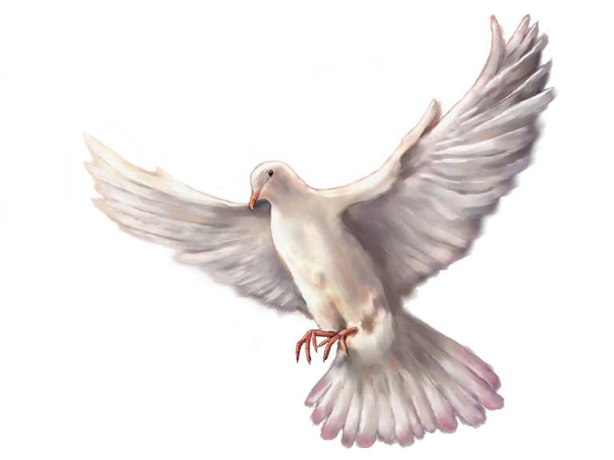
给万民施洗 BAPTISM FOR ALL NATIONS
关于施洗的圣经学习
A Bible Study of Baptism

Slide 2
开始祷告 Opening Prayer

Slide 3
家庭作业 Homework

Slide 4
使徒行传 22:16
现在你为什么耽延呢？起来，求告他的名受洗，洗去你的罪！’
Acts 22:16
“And now what are you waiting for? Get up, be baptized and wash your sins away, calling on his name.”
根据这节经文，罪是如何“洗去”的？
According to this verse, how are sins “washed away”?

Slide 5
哥林多前书 6:11
你们中间也有人从前是这样，但如今你们奉主耶稣基督的名，并借着我们神的灵，已经洗净、成圣、称义了。
1 Corinthians 6:11
“And that is what some of you were. But you were washed, you were sanctified, you were justified in the name of the Lord Jesus Christ and by the Spirit of our God.”
保罗在这节经文中所说的“你们已经被洗净”是什么意思？
What did Paul mean by “you were washed” in this verse?

Slide 6
提多书 3:5
他便救了我们，并不是因我们自己所行的义，乃是照他的怜悯，借着重生的洗和圣灵的更新。
Titus 3:5
“he saved us, not because of righteous things we had done, but because of his mercy. He saved us through the washing of rebirth and renewal by the Holy Spirit,”
什么是“重生的洗”？
What is a “washing of rebirth?”

Slide 7
以弗所书 5:25-27
你们做丈夫的，要爱你们的妻子，正如基督爱教会，为教会舍己， 要用水借着道把教会洗净，成为圣洁， 可以献给自己，做个荣耀的教会，毫无玷污、皱纹等类的病，乃是圣洁没有瑕疵的。
Ephesians 5:25–27
“Christ loved the church and gave himself up for her to make her holy, cleansing her by the washing with water through the word, and to present her to himself as a radiant church, without stain or wrinkle or any other blemish, but holy and blameless.”
基督给了教会怎样的洗净？
What kind of washing did Christ give the church?

Slide 8
学习提纲 Outline of Our Study
1.洗礼这词的意义
The Meaning Of The Word “Baptism”
2.仪式洗濯与约翰施洗的事工
Ceremonial Washings and the Ministry of John the Baptist
3.耶稣受洗
The Baptism of Jesus
4. 基督设立的洗礼
The Baptism Instituted by Christ
早期基督徒进行的洗礼
The Practice of Baptism among Early Christians

Slide 9
复习与介绍 Review and Introduction
我们上周学到了什么？
What did we learn last week?
Was the baptism of John another ceremonial washing, or did it have the same purpose and results as a Christian baptism?
约翰的洗礼是另一种仪式洗濯吗？它与基督徒的洗礼有着同样的目的与效果吗？

Slide 10
耶稣受洗
THE BAPTISM OF JESUS
马太福音 3:13-17 Matthew 3:13-17
马可福音 1:9-11 Mark 1:9-11
路加福音 3:21-22 Luke 3:21-22
约翰福音 1:32-34 John 1:32-34

Slide 11
路加福音 3:21
众百姓都受了洗，耶稣也受了洗，正祷告的时候天就开了，
Luke 3:21
“When all the people were being baptized, Jesus was baptized too. And as he was praying, heaven was opened …”

Slide 12
马太福音 3:14
约翰想要拦住他，说：“我当受你的洗，你反倒上我这里来吗？”
Matthew 3:14
“But John tried to deter him, saying, “I need to be baptized by you, and do you come to me?”

Slide 13
What was John confessing by this statement?
约翰的这个陈述道出了什么？
That John knew that Jesus was greater than he?
约翰知道耶稣比他大？
That he knew that Jesus was sinless, and had no need to repent or be forgiven?
约翰知道耶稣无罪，不需要悔改或者被赦免？
Both of the above? (and more)
以上两者（或更多）都对？
Neither of the above?
以上两者都不对？

Slide 14
False Teachings About Jesus’ Baptism 有关耶稣受洗的错误教导

Slide 15
False Teachings About Jesus’ Baptism 有关耶稣受洗的错误教导
Jesus wasn’t God until his baptism
耶稣在受洗之前不是神
Jesus did not have any divine powers until his baptism
耶稣在受洗之前没有神的能力
Jesus had a religious experience at his baptism that made him realize that he was a prophet of God
耶稣在受洗时有一个属灵的经历，这经历使他意识到他是神的一个先知。

Slide 16
马太福音 3:15
耶稣回答说：“你暂且许我，因为我们理当这样尽诸般的义。”于是约翰许了他。
Matthew 3:15
“Let it be so now; it is proper for us to do this to fulfill all righteousness.”

Slide 17
路加福音 3:21
众百姓都受了洗，耶稣也受了洗，正祷告的时候天就开了
Luke 3:21
“When all the people were being baptized, Jesus was baptized too. And as he was praying, heaven was opened.”

Slide 18
路加福音 3:21-22
众百姓都受了洗，耶稣也受了洗，正祷告的时候天就开了， 圣灵降临在他身上，形状仿佛鸽子；又有声音从天上来说：“你是我的爱子，我喜悦你。”
Luke 3:21–22
“When all the people were being baptized, Jesus was baptized too. And as he was praying, heaven was opened and the Holy Spirit descended on him in bodily form like a dove. And a voice came from heaven: “You are my Son, whom I love; with you I am well pleased.”

Slide 19
路加福音 3:21-22
众百姓都受了洗，耶稣也受了洗，正祷告的时候天就开了， 圣灵降临在他身上，形状仿佛鸽子；又有声音从天上来说：“你是我的爱子，我喜悦你。”
Luke 3:21–22
“When all the people were being baptized, Jesus was baptized too. And as he was praying, heaven was opened and the Holy Spirit descended on him in bodily form like a dove. And a voice came from heaven: “You are my Son, whom I love; with you I am well pleased.”

Slide 20
路加福音 3:21-22
众百姓都受了洗，耶稣也受了洗，正祷告的时候天就开了， 圣灵降临在他身上，形状仿佛鸽子；又有声音从天上来说：“你是我的爱子，我喜悦你。”
Luke 3:21–22
“When all the people were being baptized, Jesus was baptized too. And as he was praying, heaven was opened and the Holy Spirit descended on him in bodily form like a dove. And a voice came from heaven: “You are my Son, whom I love; with you I am well pleased.”

Slide 21
以赛亚书 11:2-3
耶和华的灵必住在他身上，就是使他有智慧和聪明的灵，谋略和能力的灵，知识和敬畏耶和华的灵。 他必以敬畏耶和华为乐，行审判不凭眼见，断是非也不凭耳闻；
Isaiah 11:2-3
“The Spirit of the LORD will rest on him—the Spirit of wisdom and of understanding, the Spirit of counsel and of power, the Spirit of knowledge and of the fear of the LORD”

Slide 22
以赛亚书 11:3-5
他必以敬畏耶和华为乐，行审判不凭眼见，断是非也不凭耳闻； ⁴ 却要以公义审判贫穷人，以正直判断世上的谦卑人，以口中的杖击打世界，以嘴里的气杀戮恶人。 ⁵ 公义必当他的腰带，信实必当他胁下的带子。
Isaiah 11:3-5
“He will delight in the fear of the LORD . . . Righteousness will be his belt and faithfulness the sash around his waist”

Slide 23
以赛亚书 42:1-4
“看哪，我的仆人，我所扶持、所拣选，心里所喜悦的，我已将我的灵赐给他，他必将公理传给外邦。 。 。 他凭真实将公理传开。 ⁴ 他不灰心，也不丧胆，直到他在地上设立公理。 。 。”
Isaiah 42:1-4
“Here is my servant, whom I uphold, my chosen one in whom I delight; I will put my Spirit on him and he will bring justice to the nations. . . . In faithfulness he will bring forth justice; he will not falter or be discour¬aged.”

Slide 24
提多书 3:5-6
借着重生的洗和圣灵的更新。 圣灵就是神借着耶稣基督——我们救主厚厚浇灌在我们身上的，
Titus 3:5-6
“He saved us through the washing of rebirth and renewal by the Holy Spirit, whom he poured out on us generously through Jesus Christ our Savior.”

Slide 25
路加福音 3:21-22
众百姓都受了洗，耶稣也受了洗，正祷告的时候天就开了， 圣灵降临在他身上，形状仿佛鸽子；又有声音从天上来说：“你是我的爱子，我喜悦你。”
Luke 3:21–22
“When all the people were being baptized, Jesus was baptized too. And as he was praying, heaven was opened and the Holy Spirit descended on him in bodily form like a dove. And a voice came from heaven: “You are my Son, whom I love; with you I am well pleased.”

Slide 26
约翰福音 12:28-30
父啊，愿你荣耀你的名！”当时就有声音从天上来说：“我已经荣耀了我的名，还要再荣耀。” 站在旁边的众人听见，就说：“打雷了。”还有人说：“有天使对他说话。”
耶稣说：“这声音不是为我，是为你们来的。
John 12:28-30
“Father, glorify your name!” Then a voice came from heaven, “I have glorified it, and will glorify it again.” 29 The crowd that was there and heard it said it had thundered; others said an angel had spoken to him. Jesus said, “This voice was for your benefit, not mine.”

Slide 27
路加福音 3:21-22
众百姓都受了洗，耶稣也受了洗，正祷告的时候天就开了， 圣灵降临在他身上，形状仿佛鸽子；又有声音从天上来说：“你是我的爱子，我喜悦你。”
Luke 3:21–22
“When all the people were being baptized, Jesus was baptized too. And as he was praying, heaven was opened and the Holy Spirit descended on him in bodily form like a dove. And a voice came from heaven: “You are my Son, whom I love; with you I am well pleased.”

Slide 28
约翰福音 1:33-34
我先前不认识他，只是那差我来用水施洗的对我说：‘你看见圣灵降下来，住在谁的身上，谁就是用圣灵施洗的。’ 我看见了，就证明这是神的儿子。”
John 1:33-34
I would not have known him, except that the one who sent me to baptize with water told me, ‘The man on whom you see the Spirit come down and remain is he who will baptize with the Holy Spirit.’ I have seen and I testify that this is the Son of God.”

Slide 29
路加福音 4:1
耶稣被圣灵充满，从约旦河回来，圣灵将他引到旷野，
Luke 4:1
Jesus, full of the Holy Spirit, returned from the Jordan and was led by the Spirit in the desert,

Slide 30
路加福音 4:14
耶稣满有圣灵的能力，回到加利利，他的名声就传遍了四方。
Luke 4:14
Jesus returned to Galilee in the power of the Spirit, and news about him spread through the whole countryside.”

Slide 31
路加福音 4:18
“主的灵在我身上，因为他用膏膏我，叫我传福音给贫穷的人
Luke 4:18
“The scroll of the prophet Isaiah was handed to him. Unrolling it, he found the place where it is written: “The Spirit of the Lord is on me, because he has anointed me to preach good news to the poor.”

Slide 32
使徒行传 10:37-38
这话在约翰宣传洗礼以后，从加利利起，传遍了犹太。 神怎样以圣灵和能力膏拿撒勒人耶稣，这都是你们知道的。他周流四方，行善事，医好凡被魔鬼压制的人，因为神与他同在。
Acts 10:37-38
“You know what has happened throughout Judea, beginning in Galilee after the baptism that John preached—how God anointed Jesus of Nazareth with the Holy Spirit and power, and how he went around doing good and healing all who were under the power of the devil, because God was with him.”

Slide 33


Slide 34
有什么问题吗？
Questions?

Slide 35
家庭作业 Homework

