Slide 1

Welcome to Bible Class
欢迎参加圣经课程
The Messiah in the Old Testament
旧约中的弥赛亚

Slide 2

Part 3
第三部分
THE MESSIAH IN THE PSALMS
诗篇中的弥赛亚
Lesson 9 = The Messiah Does God’s Will (Psalm 40)
第九课=弥赛亚行神的旨意（诗40）
Lesson 10 = The Messiah is Crucified (Psalm 22)
第十课=弥赛亚被钉十字架（诗22）
Lesson 11 = The Messiah is the Risen Lord (Psalm 16)
第十一课=弥赛亚是复活的主（诗16）
Lesson 12 = The Messiah is the King of Glory (Ps 2 & 110)
第十二课=弥赛亚是荣耀的君王（诗2及诗110）

Slide 3
PSALM 2
诗2

Slide 4
“You spoke by the Holy Spirit through the mouth of your servant, our father David: “ ‘Why do the nations rage and the peoples plot in vain? The kings of the earth take their stand and the rulers gather together against the Lord and against his Anointed One.’” (Acts 4:25–26)
“你曾借着圣灵，托你仆人我们祖宗大卫的口，说，外邦为什么争闹，万民为什么谋算虚妄的事。世上的君王一齐起来，臣宰也聚集，要敌挡主，并主的受膏者。”（徒4:25-26）

Slide 5
诗2:1-3 PSALM 2:1-3
¹ Why do the nations conspire and the peoples plot in vain?
² The kings of the earth take their stand and the rulers gather together against the LORD and against his Anointed One.
³ “Let us break their chains,” they say, “and throw off their fetters.”
1外邦为什么争闹，万民为什么谋算虚妄的事。2世上的君王一齐起来，臣宰一同商议，要敌挡耶和华，并他的受膏者，3说，我们要挣开他们的捆绑，脱去他们的绳索。

Slide 6
The “Anointed One” “受膏者”
PSALM 2:2 诗2:2 “The kings of the earth take their stand and the rulers gather together against the LORD and against his Anointed One. 世上的君王一齐起来，臣宰一同商议，要敌挡耶和华，并他的受膏者。 | Acts 4:25–28 “You spoke by the Holy Spirit through the mouth of your servant, our father David: “ ‘Why do the nations rage and the peoples plot in vain? The kings of the earth take their stand and the rulers gather together against the Lord and against his Anointed One.’ Indeed Herod and Pontius Pilate met together with the Gentiles and the people of Israel in this city to conspire against your holy servant Jesus, whom you anointed. They did what your power and will had decided beforehand should happen.” 徒4:25-28 你曾借着圣灵，托你仆人我们祖宗大卫的口，说，外邦为什么争闹，万民为什么谋算虚妄的事。世上的君王一齐起来，臣宰也聚集，要敌挡主，并主的受膏者。希律和本丢彼拉多，外邦人和以色列民，果然在这城里聚集，要攻打你所膏的圣仆耶稣。成就你手和你意旨所预定必有的事。

Slide 7
诗2:1-3 PSALM 2:1-3
¹ Why do the nations conspire and the peoples plot in vain? ² The kings of the earth take their stand and the rulers gather together against the LORD and against his Anointed One. ³ “Let us break their chains,” they say, “and throw off their fetters.”
1外邦为什么争闹，万民为什么谋算虚妄的事。2世上的君王一齐起来，臣宰一同商议，要敌挡耶和华，并他的受膏者，3说，我们要挣开他们的捆绑，脱去他们的绳索。
“The next day the rulers, elders and teachers of the law met in Jerusalem. Annas the high priest was there, and so were Caiaphas, John, Alexander and the other men of the high priest’s family.” (Acts 4:5–6)
“第二天，官府，长老，和文士，在耶路撒冷聚会。又有大祭司亚那，和该亚法，约翰，亚力山大，并大祭司的亲族都在那里。”（徒4:5-6）
“Indeed Herod and Pontius Pilate met together with the Gentiles and the people of Israel in this city to conspire against your holy servant Jesus, whom you anointed.” (Acts 4:27)
“希律和本丢彼拉多，外邦人和以色列民，果然在这城里聚集，要攻打你所膏的圣仆耶稣”（徒4:27）

Slide 8
诗2:1-3 PSALM 2:1-3
¹ Why do the nations conspire and the peoples plot in vain?
² The kings of the earth take their stand and the rulers gather together against the LORD and against his Anointed One.
³ “Let us break their chains,” they say, “and throw off their fetters.”
1外邦为什么争闹，万民为什么谋算虚妄的事。
2世上的君王一齐起来，臣宰一同商议，要敌挡耶和华，并他的受膏者，
3说，我们要挣开他们的捆绑，脱去他们的绳索。
“My yoke is easy and my burden is light.” (Matthew 11:30)
“因为我的轭是容易的，我的担子是轻省的。”（太11:30）

Slide 9
诗2:4-6 PSALM 2:4-6
⁴ The One enthroned in heaven laughs; the Lord scoffs at them.
⁵ Then he rebukes them in his anger and terrifies them in his wrath, saying,
⁶ “I have installed my King on Zion, my holy hill.”
4那坐在天上的必发笑。主必嗤笑他们。
5那时他要在怒中责备他们，在烈怒中惊吓他们，
6说，我已经立我的君在锡安我的圣山上了。

Slide 10
诗2:4-6 PSALM 2:4-6
⁴ The One enthroned in heaven laughs; the Lord scoffs at them.
⁵ Then he rebukes them in his anger and terrifies them in his wrath, saying,
⁶ “I have installed my King on Zion, my holy hill.”
4那坐在天上的必发笑。主必嗤笑他们。
5那时他要在怒中责备他们，在烈怒中惊吓他们，
6说，我已经立我的君在锡安我的圣山上了。

Slide 11
PSALM 2:4-6
诗2:4-6
⁴ The One enthroned in heaven laughs; the Lord scoffs at them.
⁵ Then he rebukes them in his anger and terrifies them in his wrath, saying,
⁶ “I have installed my King on Zion, my holy hill.”
4那坐在天上的必发笑。主必嗤笑他们。
5那时他要在怒中责备他们，在烈怒中惊吓他们，
6说，我已经立我的君在锡安我的圣山上了。
“When the centurion and those with him who were guarding Jesus saw the earthquake and all that had happened, they were terrified, and exclaimed, “Surely he was the Son of God!” (Matthew 27:54)
“百夫长和一同看守耶稣的人，看见地震，并所经历的事，就极其害怕，说，这真是神的儿子了。”（太27:54）

Slide 12
诗2:4-6 PSALM 2:4-6
⁵ Then he rebukes them in his anger and terrifies them in his wrath, saying,
⁶ “I have installed my King on Zion, my holy hill.”
5那时他要在怒中责备他们，在烈怒中惊吓他们，
6说，我已经立我的君在锡安我的圣山上了。
“When the kings of the earth who committed adultery with her and shared her luxury see the smoke of her burning, they will weep and mourn over her. Terrified at her torment, they will stand far off and cry: “ ‘Woe! Woe, O great city, O Babylon, city of power! In one hour your doom has come!’” (Revelation 18:9–10)
“地上的君王，素来与她行淫一同奢华的，看见烧她的烟，就必为她哭泣哀号。因怕她的痛苦，就远远地站着说，哀哉，哀哉，巴比伦大城，坚固的城阿，一时之间你的刑罚就来到了。”（启18:9-10）

Slide 13
诗2:4-6 PSALM 2:4-6
⁴ The One enthroned in heaven laughs; the Lord scoffs at them.
⁵ Then he rebukes them in his anger and terrifies them in his wrath, saying,
⁶ “I have installed my King on Zion, my holy hill.”
4那坐在天上的必发笑。主必嗤笑他们。
5那时他要在怒中责备他们，在烈怒中惊吓他们，
6说，我已经立我的君在锡安我的圣山上了。

Slide 14
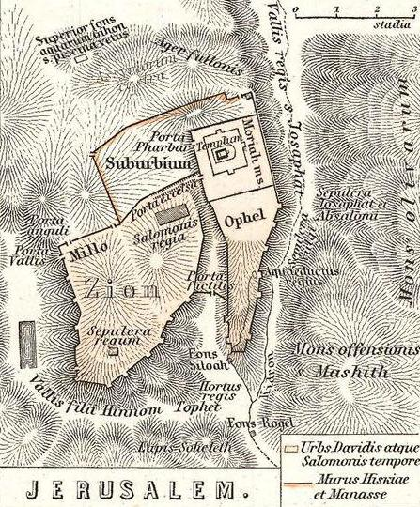
ZION = the Jebusite stronghold
锡安=耶布斯的保障
2 Samuel 5:7 = “Nevertheless, David captured the fortress of Zion, the City of David.”
撒下5:7=“然而大卫攻取锡安的保障，就是大卫的城。”

Slide 15
ZION = the hill on which the temple was built
锡安=圣殿所在的山
Isaiah 8:18 = “Here am I, and the children the LORD has given me. We are signs and symbols in Israel from the LORD Almighty, who dwells on Mount Zion.”
赛8:18=“看哪，我与耶和华所给我的儿女，就是从住在锡安山万军之耶和华来的，在以色列中作为预兆和奇迹。”

Slide 16
ZION = the whole city of Jerusalem
锡安=耶路撒冷全城
2 Kings 19:21 “This is the word that the LORD has spoken against him: “ ‘The Virgin Daughter of Zion despises you and mocks you. The Daughter of Jerusalem tosses her head as you flee.”
王下19:21 “耶和华论他这样说，锡安的处女藐视你，嗤笑你。耶路撒冷的女子向你摇头。”

Slide 17
ZION = God’s people, the true believers
锡安=神的百姓，真正信主的人
Psalm 129:5 “May all who hate Zion be turned back in shame.”
诗129:5 “愿恨恶锡安的，都蒙羞退后。”

Slide 18
ZION = the holy Christian Church, the communion of saints
锡安=圣基督教会，圣徒的集合体
Hebrews 12:22-23 “But you have come to Mount Zion, to the heavenly Jerusalem, the city of the living God. You have come to thousands upon thousands of angels in joyful assembly, to the church of the firstborn, whose names are written in heaven. You have come to God, the judge of all men, to the spirits of righteous men made perfect.”
来12:22-23 “你们乃是来到锡安山，永生神的城邑，就是天上的耶路撒冷。那里有千万的天使，有名录在天上诸长子之会所共聚的总会，有审判众人的神，和被成全之义人的灵魂。”

Slide 19
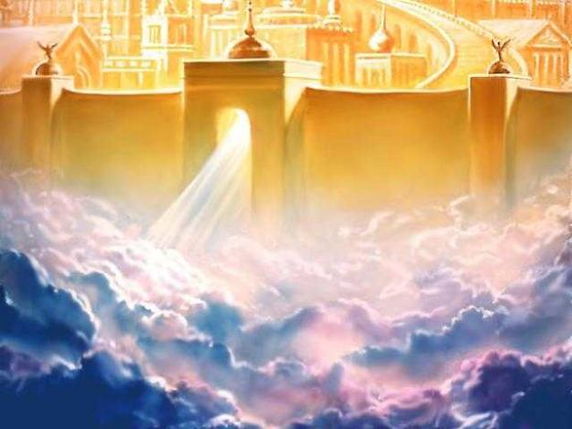
ZION = heaven
锡安=天堂
Revelation 14:1 “Then I looked, and there before me was the Lamb, standing on Mount Zion, and with him 144,000 who had his name and his Father’s name written on their foreheads.”
启14:1 “我又观看，见羔羊站在锡安山，同他又有十四万四千人，都有他的名，和他父的名，写在额上。”

Slide 20
ZION = the holy Christian Church, the communion of saints
锡安=圣基督教会，圣徒的集合体
Hebrews 12:22-23 “But you have come to Mount Zion, to the heavenly Jerusalem, the city of the living God. You have come to thousands upon thousands of angels in joyful assembly, to the church of the firstborn, whose names are written in heaven. You have come to God, the judge of all men, to the spirits of righteous men made perfect.”
来12:22-23 “你们乃是来到锡安山，永生神的城邑，就是天上的耶路撒冷。那里有千万的天使，有名录在天上诸长子之会所共聚的总会，有审判众人的神，和被成全之义人的灵魂。”

Slide 21
PSALM 2:7-9
诗2:7-9
⁷ I will proclaim the decree of the LORD: He said to me, “You are my Son; today I have become your Father.
⁸ Ask of me, and I will make the nations your inheritance, the ends of the earth your possession.
⁹ You will rule them with an iron scepter; you will dash them to pieces like pottery.”
7受膏者说，我要传圣旨。耶和华曾对我说，你是我的儿子，我今日生你。
8你求我，我就将列国赐你为基业，将地极赐你为田产。
9你必用铁杖打破他们。你必将他们如同窑匠的瓦器摔碎。

Slide 22
诗2:7-9 PSALM 2:7-9
⁷ I will proclaim the decree of the LORD: He said to me, “You are my Son; today I have become your Father.
⁸ Ask of me, and I will make the nations your inheritance, the ends of the earth your possession.
⁹ You will rule them with an iron scepter; you will dash them to pieces like pottery.”
7受膏者说，我要传圣旨。耶和华曾对我说，你是我的儿子，我今日生你。
8你求我，我就将列国赐你为基业，将地极赐你为田产。
9你必用铁杖打破他们。你必将他们如同窑匠的瓦器摔碎。
Acts 13:32-33 “We tell you the good news: What God promised our fathers he has fulfilled for us, their children, by raising up Jesus. As it is written in the second Psalm: “ ‘You are my Son; today I have become your Father.’”
徒13:32-33 “我们也报好信息给你们，就是那应许祖宗的话，神已经向我们这作儿女的应验，叫耶稣复活了。正如诗篇第二篇上记着说，你是我的儿子，我今日生你。”

Slide 23
诗2:7-9 PSALM 2:7-9
⁷ I will proclaim the decree of the LORD: He said to me, “You are my Son; today I have become your Father.
⁸ Ask of me, and I will make the nations your inheritance, the ends of the earth your possession.
⁹ You will rule them with an iron scepter; you will dash them to pieces like pottery.”
7受膏者说，我要传圣旨。耶和华曾对我说，你是我的儿子，我今日生你。
8你求我，我就将列国赐你为基业，将地极赐你为田产。
9你必用铁杖打破他们。你必将他们如同窑匠的瓦器摔碎。
Hebrews 1:5 For to which of the angels did God ever say, “You are my Son; today I have become your Father”? Or again, “I will be his Father, and he will be my Son”?
来1:5 “所有的天使，神从来对那一个说，你是我的儿子，我今日生你。又指着那一个说，我要作他的父，他要作我的子。”

Slide 24
诗2:7-9 PSALM 2:7-9
⁷ I will proclaim the decree of the LORD: He said to me, “You are my Son; today I have become your Father.
⁸ Ask of me, and I will make the nations your inheritance, the ends of the earth your possession.
⁹ You will rule them with an iron scepter; you will dash them to pieces like pottery.”
7受膏者说，我要传圣旨。耶和华曾对我说，你是我的儿子，我今日生你。
8你求我，我就将列国赐你为基业，将地极赐你为田产。
9你必用铁杖打破他们。你必将他们如同窑匠的瓦器摔碎。
Hebrews 5:5 “So Christ also did not take upon himself the glory of becoming a high priest. But God said to him, “You are my Son; today I have become your Father.”
来5:5 “如此，基督也不是自取荣耀作大祭司，乃是在乎向他说，‘你是我的儿子，我今日生你’的那一位。”

Slide 25
诗2:7-9 PSALM 2:7-9
⁷ I will proclaim the decree of the LORD: He said to me, “You are my Son; today I have become your Father.
⁸ Ask of me, and I will make the nations your inheritance, the ends of the earth your possession.
⁹ You will rule them with an iron scepter; you will dash them to pieces like pottery.”
7受膏者说，我要传圣旨。耶和华曾对我说，你是我的儿子，我今日生你。
8你求我，我就将列国赐你为基业，将地极赐你为田产。
9你必用铁杖打破他们。你必将他们如同窑匠的瓦器摔碎。
The day that Jesus was born? 耶稣出生的那日？
The day that Jesus was baptized? 耶稣受洗的那日？
The eternal day in which the Lord lives? 主永远活着的那日？

Slide 26
诗2:7-9 PSALM 2:7-9
⁷ I will proclaim the decree of the LORD: He said to me, “You are my Son; today I have become your Father.
⁸ Ask of me, and I will make the nations your inheritance, the ends of the earth your possession.
⁹ You will rule them with an iron scepter; you will dash them to pieces like pottery.”
7受膏者说，我要传圣旨。耶和华曾对我说，你是我的儿子，我今日生你。
8你求我，我就将列国赐你为基业，将地极赐你为田产。
9你必用铁杖打破他们。你必将他们如同窑匠的瓦器摔碎。
“He is before all things, and in him all things hold together. And he is the head of the body, the church; he is the beginning and the firstborn from among the dead, so that in everything he might have the supremacy.” (Colossians 1:17–18)
“他在万有之先，万有也靠他而立。他也是教会全体之首。他是元始，是从死里首先复生的，使他可以在凡事上居首位。”（西1:17-18）

Slide 27
诗2:7-9 PSALM 2:7-9
“He will rule them with an iron scepter; he will dash them to pieces like pottery’— just as I have received authority from my Father.” (Revelation 2:27)
“他必用铁杖辖管他们，将他们如同窑户的瓦器打得粉碎。像我从我父领受的权柄一样。”（启2:27）
“She gave birth to a son, a male child, who “will rule all the nations with an iron scepter.” And her child was snatched up to God and to his throne.” (Revelation 12:5)
“妇人生了一个男孩子，是将来要用铁杖辖管万国的。她的孩子被提到神宝座那里去了。”（启12:5）
⁷ I will proclaim the decree of the LORD: He said to me, “You are my Son; today I have become your Father.
⁸ Ask of me, and I will make the nations your inheritance, the ends of the earth your possession.
⁹ You will rule them with an iron scepter; you will dash them to pieces like pottery.”
7受膏者说，我要传圣旨。耶和华曾对我说，你是我的儿子，我今日生你。
8你求我，我就将列国赐你为基业，将地极赐你为田产。
9你必用铁杖打破他们。你必将他们如同窑匠的瓦器摔碎。

Slide 28
诗2:7-9 PSALM 2:7-9
⁷ I will proclaim the decree of the LORD: He said to me, “You are my Son; today I have become your Father.
⁸ Ask of me, and I will make the nations your inheritance, the ends of the earth your possession.
⁹ You will rule them with an iron scepter; you will dash them to pieces like pottery.”
7受膏者说，我要传圣旨。耶和华曾对我说，你是我的儿子，我今日生你。
8你求我，我就将列国赐你为基业，将地极赐你为田产。
9你必用铁杖打破他们。你必将他们如同窑匠的瓦器摔碎。
“有利剑从他口中出来，可以击杀列国。他必用铁杖辖管他们。并要踹全能神烈怒的酒榨。” (启 19:15)
“Out of his mouth comes a sharp sword with which to strike down the nations. “He will rule them with an iron scepter.” He treads the winepress of the fury of the wrath of God Almighty.” (Revelation 19:15)

Slide 29
PSALM 2:10-12
诗2:10-12
¹⁰ Therefore, you kings, be wise; be warned, you rulers of the earth.
¹¹ Serve the LORD with fear and rejoice with trembling.
¹² Kiss the Son, lest he be angry and you be destroyed in your way, for his wrath can flare up in a moment. Blessed are all who take refuge in him.
10现在你们君王应当省悟。你们世上的审判官该受管教。
11当存畏惧事奉耶和华，又当存战兢而快乐。
12当以嘴亲子，恐怕他发怒，你们便在道中灭亡，因为他的怒气快要发作。凡投靠他的，都是有福的。

Slide 30
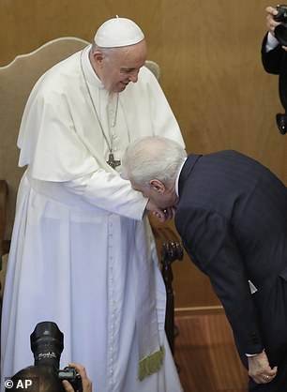
PSALM 2:10-12
诗2:10-12
¹⁰ Therefore, you kings, be wise; be warned, you rulers of the earth.
¹¹ Serve the LORD with fear and rejoice with trembling.
¹² Kiss the Son, lest he be angry and you be destroyed in your way, for his wrath can flare up in a moment. Blessed are all who take refuge in him.
10现在你们君王应当省悟。你们世上的审判官该受管教。
11当存畏惧事奉耶和华，又当存战兢而快乐。
12当以嘴亲子，恐怕他发怒，你们便在道中灭亡，因为他的怒气快要发作。凡投靠他的，都是有福的。

Slide 31
11) What do we learn about the Messiah?
我们知道关于弥赛亚的什么信息？
It is futile to try to rebel against him. Serve him willingly.
敌挡他是徒劳的。甘心乐意事奉他。
No one can overthrow the Messiah. He will rule over all.
没人能够推翻弥赛亚。他要在万事上掌权。

Slide 32
PSALM 110
诗110

Slide 33
PSALM 110 Title
诗110 标题
Of David. A psalm.
大卫的诗
Mark 12:36 “David himself, speaking by the Holy Spirit, declared: ‘The Lord said to my Lord: Sit at my right hand until I put your enemies under your feet.”
可12:36
“大卫被圣灵感动说，主对我主说，你坐在我的右边，等我使你仇敌作你的脚凳。”
“The Spirit of the LORD spoke through me; his word was on my tongue.” (2 Samuel 23:2)
“耶和华的灵借着我说，他的话在我口中。”（撒下23:2）

Slide 34
诗110:1 PSALM 110:1
¹ The LORD says to my Lord: “Sit at my right hand until I make your enemies a footstool for your feet.”
1耶和华对我主说，你坐在我的右边，等我使你仇敌作你的脚凳。

Slide 35
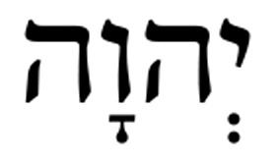
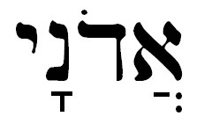
诗110:1 PSALM 110:1
¹ The LORD says to my Lord: “Sit at my right hand until I make your enemies a footstool for your feet.”
Jehovah
Adonai
“lord”, master, king
“主”，主人，王
1耶和华对我主说，你坐在我的右边，等我使你仇敌作你的脚凳。

Slide 36
Who is “my Lord”? “我主”是谁？
PSALM 110:1 The LORD says to my Lord: “Sit at my right hand until I make your enemies a footstool for your feet.” 诗110:1 耶和华对我主说，你坐在我的右边，等我使你仇敌作你的脚凳。 | Matthew 22:41-46 While the Pharisees were gathered together, Jesus asked them, “What do you think about the Christ? Whose son is he?” “The son of David,” they replied. He said to them, “How is it then that David, speaking by the Spirit, calls him ‘Lord’? For he says, “ ‘The Lord said to my Lord: “Sit at my right hand until I put your enemies under your feet.” ’ If then David calls him ‘Lord,’ how can he be his son?” No one could say a word in reply, and from that day on no one dared to ask him any more questions. The large crowd listened to him with delight.” 太22:41-46 法利赛人聚集的时候，耶稣问他们说，论到基督，你们的意见如何？他是谁的子孙呢？他们回答说，是大卫的子孙。耶稣说，这样，大卫被圣灵感动，怎么还称他为主。说，主对我主说，你坐在我的右边，等我把你仇敌，放在你的脚下。大卫既称他为主，他怎么又是大卫的子孙呢？他们没有一个人能回答一言。从那日以后，也没有人敢再问他什么。

Slide 37
徒2:29-36 Acts 2:29-36
“Fellow Israelites, I can tell you confidently that the patriarch David died and was buried, and his tomb is here to this day. But he was a prophet and knew that God had promised him on oath that he would place one of his descendants on his throne. Seeing what was to come, he spoke of the resurrection of the Messiah, that he was not abandoned to the realm of the dead, nor did his body see decay. God has raised this Jesus to life, and we are all witnesses of it. Exalted to the right hand of God, he has received from the Father the promised Holy Spirit and has poured out what you now see and hear. For David did not ascend to heaven, and yet he said, “ ‘The Lord said to my Lord: “Sit at my right hand until I make your enemies a footstool for your feet.” ’ “Therefore let all Israel be assured of this: God has made this Jesus, whom you crucified, both Lord and Messiah.”
“弟兄们，先祖大卫的事，我可以明明地对你们说，他死了，也葬埋了，并且他的坟墓，直到今日还在我们这里。大卫既是先知，又晓得神曾向他起誓，要从他的后裔中，立一位坐在他的宝座上。就预先看明这事，讲论基督复活说，他的灵魂，不撇在阴间，他的肉身，也不见朽坏。这耶稣，神已经叫他复活了，我们都为这事作见证。他既被神的右手高举，又从父受了所应许的圣灵，就把你们所看见所听见的，浇灌下来。大卫并没有升到天上，但自己说，主对我主说，你坐在我的右边，
等我使你仇敌作你的脚凳。故此，以色列全家当确实的知道，你们钉在十字架上的这位耶稣，神已经立他为主为基督了。”

Slide 38
Psalm 110:1
“The LORD says to my Lord: “Sit at my right hand until I make your enemies a footstool for your feet.”
诗110:1
耶和华对我主说，你坐在我的右边，等我使你仇敌作你的脚凳。
“my Lord” = the Messiah
“我主”=弥赛亚

Slide 39
诗110:1 PSALM 110:1
¹ The LORD says to my Lord: “Sit at my right hand until I make your enemies a footstool for your feet.”
耶和华对我主说，你坐在我的右边，等我使你仇敌作你的脚凳。
Ephesians 1:20–21 (NET) This power he exercised in Christ when he raised him from the dead and seated him at his right hand in the heavenly realms far above every rule and authority and power and dominion and every name that is named, not only in this age but also in the one to come.
弗1:20-21 就是照他在基督身上，所运行的大能大力，使他从死里复活，叫他在天上坐在自己的右边，远超过一切执政的，掌权的，有能的，主治的，和一切有名的。不但是今世的，连来世的也都超过了。

Slide 40
“Sit at my right hand … ”
“坐在我的右边…”
Mark 14:62 (NIV) “I am,” said Jesus. “And you will see the Son of Man sitting at the right hand of the Mighty One and coming on the clouds of heaven.”
可14:62“耶稣说，我是。你们必看见人子，坐在那权能者的右边，驾着天上的云降临。”
Mark 16:19 (NIV) “After the Lord Jesus had spoken to them, he was taken up into heaven and he sat at the right hand of God.”
可16:19 “主耶稣和他们说完了话，后来被接到天上，坐在神的右边。”
Luke 22:69 (NIV) “But from now on, the Son of Man will be seated at the right hand of the mighty God.”
路22:69 “从今以后，人子要坐在神权能的右边。”

Slide 41
“Sit at my right hand … ”
“坐在我的右边…”
Romans 8:34 (NIV) “Christ Jesus who died—more than that, who was raised to life—is at the right hand of God and is also interceding for us. ”
罗8:34 “谁能定他们的罪呢？有基督耶稣已经死了，而且从死里复活，现今在神的右边，也替我们祈求。”
Colossians 3:1 (NIV) “Christ is seated at the right hand of God.”
西3:1 “所以你们若真与基督一同复活，就当求在上面的事。那里有基督坐在神的右边。”

Slide 42
PSALM 110:1
诗110:1
¹ The LORD says to my Lord: “Sit at my right hand until I make your enemies a footstool for your feet.”
1耶和华对我主说，你坐在我的右边，等我使你仇敌作你的脚凳。

Slide 43
“使你仇敌作你的脚凳…” “your enemies a footstool … ”
1 Corinthians 15:20–28 “But Christ has indeed been raised from the dead, the firstfruits of those who have fallen asleep. …Then the end will come, when he hands over the kingdom to God the Father after he has destroyed all dominion, authority and power. For he must reign until he has put all his enemies under his feet. The last enemy to be destroyed is death. For he “has put everything under his feet.” Now when it says that “everything” has been put under him, it is clear that this does not include God himself, who put everything under Christ. When he has done this, then the Son himself will be made subject to him who put everything under him, so that God may be all in all.”
林前15:20-28 “但基督已经从死里复活，成为睡了之人初熟的果子。死既是因一人而来，死人复活也是因一人而来。在亚当里众人都死了。照样，在基督里众人也都要复活。但各人是按着自己的次序复活。初熟的果子是基督。以后在他来的时候，是那些属基督的。再后末期到了，那时，基督既将一切执政的，掌权的，有能的，都毁灭了，就把国交与父神。因为基督必要作王，等神把一切仇敌，都放在他的脚下。尽末了所毁灭的仇敌，就是死。因为经上说，神叫万物都服在他的脚下。既说万物都服了他，明显那叫万物服他的不在其内了。万物既服了他，那时，子也要自己服那叫万物服他的，叫神在万物之上，为万物之主。”

Slide 44
PSALM 110:2
诗110:2
² The LORD will extend your mighty scepter from Zion, saying, “Rule in the midst of your enemies!”
2耶和华必使你从锡安伸出能力的杖来。你要在你仇敌中掌权。

Slide 45
PSALM 110:3
诗110:3
³ Your troops will be willing on your day of battle. Arrayed in holy splendor, your young men will come to you like dew from the morning’s womb.
3当你掌权的日子，你的民要以圣洁的妆饰为衣，甘心牺牲自己。你的民多如清晨的甘露。

Slide 46
PSALM 110:3
诗110:3
³ Your troops will be willing on your day of battle. Arrayed in holy splendor, your young men will come to you like dew from the morning’s womb.
3当你掌权的日子，你的民要以圣洁的妆饰为衣，甘心牺牲自己。你的民多如清晨的甘露。

Slide 47
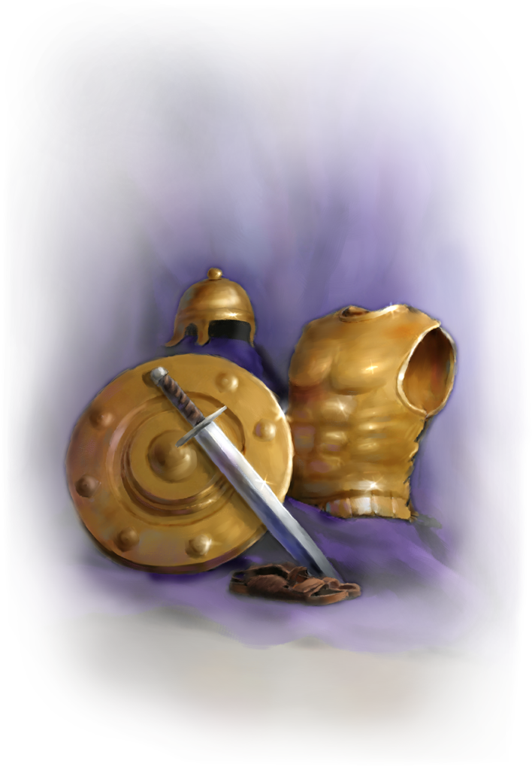
PSALM 110:3
诗110:3
³ Your troops will be willing on your day of battle. Arrayed in holy splendor, your young men will come to you like dew from the morning’s womb.
3当你掌权的日子，你的民要以圣洁的妆饰为衣，甘心牺牲自己。你的民多如清晨的甘露。

Slide 48
PSALM 110:3
诗110:3
³ Your troops will be willing on your day of battle. Arrayed in holy splendor, your young men will come to you like dew from the morning’s womb.
3当你掌权的日子，你的民要以圣洁的妆饰为衣，甘心牺牲自己。你的民多如清晨的甘露。

Slide 49
PSALM 110:4
诗110:4
4The LORD has sworn and will not change his mind: “You are a priest forever, in the order of Melchizedek.”
4耶和华起了誓，决不后悔，说，你是照着麦基洗德的等次，永远为祭司。

Slide 50
PSALM 110:4
诗110:4
⁴ The LORD has sworn and will not change his mind: “You are a priest forever, in the order of Melchizedek.”
4耶和华起了誓，决不后悔，说，你是照着麦基洗德的等次，永远为祭司。

Slide 51
PSALM 110:4
诗110:4
⁴ The LORD has sworn and will not change his mind: “You are a priest forever, in the order of Melchizedek.”
4耶和华起了誓，决不后悔，说，你是照着麦基洗德的等次，永远为祭司。
Then Melchizedek king of Salem brought out bread and wine. He was priest of God Most High, and he blessed Abram, saying, “Blessed be Abram by God Most High, Creator of heaven and earth. And praise be to God Most High, who delivered your enemies into your hand.” Then Abram gave him a tenth of everything. (Genesis 14:17–20)
又有撒冷王麦基洗德带着饼和酒出来迎接。他是至高神的祭司。他为亚伯兰祝福，说，愿天地的主，至高的神赐福与亚伯兰。至高的神把敌人交在你手里，是应当称颂的。亚伯兰就把所得的拿出十分之一来，给麦基洗德。（创14:17-20）

Slide 52
PSALM 110:5-6
诗110:5-6
⁵ The Lord is at your right hand; he will crush kings on the day of his wrath. ⁶ He will judge the nations, heaping up the dead and crushing the rulers of the whole earth.
5在你右边的主，当他发怒的日子，必打伤列王。6他要在列邦中刑罚恶人，尸首就遍满各处。他要在许多国中打破仇敌的头。

Slide 53
PSALM 110:7
诗110:7
⁷ He will drink from a brook along the way, and so he will lift his head high.
7他要喝路旁的河水，因此必抬起头来。

Slide 54
24) What do we learn about the Messiah?
我们学到关于弥赛亚的什么信息？
We learn that the Messiah will rule victorious at God’s right hand after crushing all opposition.
我们学到，打破一切的仇敌之后，弥赛亚会得胜并坐在神的右边。
We learn that the Messiah will be both a King and a Priest. He will be one of a kind.
我们学到，弥赛亚既是君王又是祭司。他是独一无二的。
We learn that the Messiah will execute judgment on all his enemies.
我们学到，弥赛亚会审判他所有的仇敌。

