Slide 1

Welcome to Bible Class
欢迎参加圣经课程
The Messiah in the Old Testament
旧约中的弥赛亚

Slide 2

Part 3
第三部分
THE MESSIAH IN THE PSALMS
诗篇中的弥赛亚
Lesson 9 = The Messiah Does God’s Will (Psalm 40)
第九课=弥赛亚行神的旨意（诗40）
Lesson 10 = The Messiah is Crucified (Psalm 22)
第十课=弥赛亚被钉十字架（诗22）
Lesson 11 = The Messiah is the Risen Lord (Psalm 16)
第十一课=弥赛亚是复活的主（诗16）
Lesson 12 = The Messiah is the King of Glory (Ps 2 & 110)
第十二课=弥赛亚是荣耀的君王（诗2及诗110）

Slide 3
Job
PSALMS
Proverbs
Song of Songs
Ezra
Nehemiah
Esther
Ruth
1 Chronicles
2 Chronicles
Lamentations
Ecclesiastes
约伯记
诗篇
箴言
雅歌
以斯拉记
尼西米记
以斯贴记
路得记
历代志上
历代志下
耶利米哀歌
传道书
“Everything must be fulfilled that is written about me in the Law of Moses, the Prophets and the Psalms.” (Luke 24:44–45)
“摩西的律法，先知的书，和诗篇上所记的，凡指着我的话，都必须应验。”（路24:44-45）
“Writings”
圣卷

Slide 4
Job 19:25-27 = My Redeemer lives
伯19:25-27=我的救赎主活着
Psalm 2 = The Messiah as the Son of God
诗2=弥赛亚是神的儿子
Psalm 8 = The Messiah is humbled, then crowned with glory
诗8=弥赛亚降卑，然后受荣耀的冠冕
Psalm 16 = The Messiah’s resurrection
诗16=弥赛亚的复活
Psalm 22 = The Messiah is Crucified
诗22=弥赛亚被钉十字架
Psalm 34:20 = The Messiah’s Bones will not be Broken
诗34:20=弥赛亚的骨头不被折断
Psalm 40 = The Messiah came to do God’s will
诗40=弥赛亚来是为了行神的旨意

Slide 5
Psalm 41:9 = The Messiah is betrayed by a friend
诗41:9=弥赛亚被朋友出卖
Psalm 45:2-7 = The Messiah as eternal king
诗45:2-7=弥赛亚是永远的君王
Psalm 68:18 = The triumph of Messiah over his foes
诗68:18=弥赛亚胜过仇敌
Psalm 69 = The Messiah is hated and betrayed
诗69=弥赛亚遭憎恨被出卖
Psalm 72 = The Messiah as righteous ruler
诗72=弥赛亚是公义的君王
Psalm 109 = The Messiah is mocked
诗109=弥赛亚受嘲讽
Psalm 110 = The Messiah is exalted over his enemies
诗110=弥赛亚被高举超过仇敌
Psalm 118 = The Messiah is the rejected cornerstone
诗118=弥赛亚是被弃的房角石

Slide 6
“The messianic psalms are the greatest single block of predictive matter concerning the Savior to be found anywhere in the Old Testament.”
“弥赛亚诗篇是旧约当中关于救主的最伟大的一块预言内容。”
J. Barton Payne, Encyclopedia of Biblical Prophecy
潘巴顿，《圣经预言百科全书》

Slide 7

Messianic Prophecy
弥赛亚预言
Direct and Indirect
直接的和间接的

Slide 8
DIRECT MESSIANIC PROPHECY
直接的弥赛亚预言
When the prophecy has only one possible fulfillment in Christ.
这类预言唯有基督才能应验
Prophecy ➙ Christ
预言 ➙ 基督
Example: the virgin birth in Isaiah 7:14 These prophecies can be referring to no one other than Jesus.
例如：赛7:14当中的童女生子。这些预言所指的只能是耶稣。

Slide 9
INDIRECT MESSIANIC PROPHECY
间接的弥赛亚预言
When the passage may be about two future events – an early partial or incomplete fulfillment (an event or person) and the ultimate, final, greater fulfillment in Christ.
这是指经文所指可能有两次将来的事件——其中一次是（事件或人）部分的不完全的应验，然后是基督终极的、完全的、更伟大的应验。
Prophecy ➙ Type ➙ Christ
预言➙ 类型 ➙ 基督
Example: David will have a son who will build God’s house (2 Samuel 7:1-16). Solomon is the intermediate fulfillment (Prophet ➙ Solomon ➙ Christ)
例如：大卫将有一个儿子要建造神的殿（撒下7:1-16）。所罗门是中级应验(先知 ➙ 所罗门 ➙ 基督)

Slide 10
THE MESSIAH IN PSALM 40
诗40中的弥赛亚
Psalm 40:6-8
诗40:6-8

Slide 11
Psalm 40:6-8
⁶ Sacrifice and offering you did not desire, but my ears you have pierced; burnt offerings and sin offerings you did not require. ⁷ Then I said, “Here I am, I have come— it is written about me in the scroll. ⁸ I desire to do your will, O my God; your law is within my heart.”
诗40:6-8
⁶祭物和礼物，你不喜悦。你已经开通我的耳朵。燔祭和赎罪祭，非你所要。 ⁷那时我说，看哪，我来了。我的事在经卷上已经记载了。 ⁸我的神阿，我乐意照你的旨意行。你的律法在我心里。”

Slide 12
Hebrews 10:5-10
“Therefore, when Christ came into the world, he said: “Sacrifice and offering you did not desire, but a body you prepared for me; ⁶ with burnt offerings and sin offerings you were not pleased. ⁷ Then I said, ‘Here I am—it is written about me in the scroll— I have come to do your will, O God.’ ” ⁸ First he said, “Sacrifices and offerings, burnt offerings and sin offerings you did not desire, nor were you pleased with them” (although the law required them to be made). ⁹ Then he said, “Here I am, I have come to do your will.” He sets aside the first to establish the second. ¹⁰ And by that will, we have been made holy through the sacrifice of the body of Jesus Christ once for all.”
来10:5-10
“所以基督到世上来的时候，就说，神阿祭物和礼物是你不愿意的，你曾给我预备了身体。燔祭和赎罪祭是你不喜欢的。那时我说，神阿，我来了为要照你的旨意行。我的事在经卷上已经记载了。以上说，祭物和礼物，燔祭和赎罪祭，是你不愿意的，也是你不喜欢的，（这都是按着律法献的）。后又说我来了为要照你的旨意行。可见他是除去在先的，为要立定在后的。我们凭这旨意，靠耶稣基督只一次献上他的身体，就得以成圣。”

Slide 13
Psalm 40
“For the director of music. Of David. A psalm.”
诗40
“（大卫的诗，交与伶长）”

Slide 14
Psalm 40:6-8
⁶ Sacrifice and offering you did not desire, but my ears you have pierced; burnt offerings and sin offerings you did not require. ⁷ Then I said, “Here I am, I have come— it is written about me in the scroll. ⁸ I desire to do your will, O my God; your law is within my heart.”
诗40:6-8
⁶祭物和礼物，你不喜悦。你已经开通我的耳朵。燔祭和赎罪祭，非你所要。 ⁷那时我说，看哪，我来了。我的事在经卷上已经记载了。 ⁸我的神阿，我乐意照你的旨意行。你的律法在我心里。”

Slide 15
1 Samuel 15:22
“But Samuel replied: “Does the LORD delight in burnt offerings and sacrifices as much as in obeying the voice of the LORD? To obey is better than sacrifice, and to heed is better than the fat of rams.”
撒上15:22
“撒母耳说，耶和华喜悦燔祭和平安祭，岂如喜悦人听从他的话呢？听命胜于献祭。顺从胜于公羊的脂油。”

Slide 16
Jeremiah 7:22-23
“For when I brought your forefathers out of Egypt and spoke to them, I did not just give them commands about burnt offerings and sacrifices, but I gave them this command: Obey me, and I will be your God and you will be my people. Walk in all the ways I command you, that it may go well with you.”
耶7:22-23
“因为我将你们列祖从埃及地领出来的那日，燔祭平安祭的事我并没有提说，也没有吩咐他们。我只吩咐他们这一件说，你们当听从我的话，我就作你们的神，你们也作我的子民。你们行我所吩咐的一切道，就可以得福。”

Slide 17
Psalm 51:16-17
“You do not delight in sacrifice, or I would bring it; you do not take pleasure in burnt offerings. The sacrifices of God are a broken spirit; a broken and contrite heart, O God, you will not despise.”
诗51:16-17
“你本不喜爱祭物。若喜爱，我就献上。燔祭你也不喜悦。神所要的祭，就是忧伤的灵。神阿，忧伤痛悔的心，你必不轻看。”

Slide 18
Isaiah 1:10-17 “Hear the word of the LORD, you rulers of Sodom; listen to the law of our God, you people of Gomorrah! “The multitude of your sacrifices— what are they to me?” says the LORD. “I have more than enough of burnt offerings, of rams and the fat of fattened animals; I have no pleasure in the blood of bulls and lambs and goats. When you come to appear before me, who has asked this of you, this trampling of my courts? Stop bringing meaningless offerings! Your incense is detestable to me. New Moons, Sabbaths and convocations— I cannot bear your evil assemblies. Your New Moon festivals and your appointed feasts my soul hates. They have become a burden to me; I am weary of bearing them. When you spread out your hands in prayer, I will hide my eyes from you; even if you offer many prayers, I will not listen. Your hands are full of blood; wash and make yourselves clean. Take your evil deeds out of my sight! Stop doing wrong, learn to do right! Seek justice, encourage the oppressed. Defend the cause of the fatherless, plead the case of the widow.”
赛1:10-17
你们这所多玛的官长阿，要听耶和华的话。你们这蛾摩拉的百姓阿，要侧耳听我们神的训诲。耶和华说，你们所献的许多祭物，与我何益呢？公绵羊的燔祭，和肥畜的脂油，我已经够了。公牛的血，羊羔的血，公山羊的血，我都不喜悦。你们来朝见我，谁向你们讨这些，使你们践踏我的院宇呢？你们不要再献虚浮的供物。香品是我所憎恶的。月朔，和安息日，并宣召的大会，也是我所憎恶的。作罪孽，又守严肃会，我也不能容忍。你们的月朔，和节期，我心里恨恶，我都以为麻烦。我担当，便不耐烦。你们举手祷告，我必遮眼不看。就是你们多多地祈祷，我也不听。你们的手都满了杀人的血。你们要洗濯，自洁。从我眼前除掉你们的恶行。要止住作恶，学习行善。寻求公平，解救受欺压的，给孤儿伸冤，为寡妇辨屈。

Slide 19
Romans 12:1
“Therefore, I urge you, brothers, in view of God’s mercy, to offer your bodies as living sacrifices, holy and pleasing to God—this is your spiritual act of worship.”
罗12:1
“所以弟兄们，我以神的慈悲劝你们，将身体献上，当作活祭，是圣洁的，是神所喜悦的。你们如此事奉，乃是理所当然的。”

Slide 20
Psalm 40:6-8
⁶ Sacrifice and offering you did not desire, but my ears you have pierced; burnt offerings and sin offerings you did not require. ⁷ Then I said, “Here I am, I have come— it is written about me in the scroll. ⁸ I desire to do your will, O my God; your law is within my heart.”
诗40:6-8
祭物和礼物，你不喜悦。你已经开通我的耳朵。燔祭和赎罪祭，非你所要。那时我说，看哪，我来了。我的事在经卷上已经记载了。我的神阿，我乐意照你的旨意行。你的律法在我心里。
Literally = “dug”
“刺穿”直译就是“挖”
“you pierced my ears” (the understanding of the NIV)
“你刺穿了我的耳朵”（新国际版译本的理解）
“you opened my ears (to hear)” (the understanding of most other translations)
“你开通了我的耳朵”（其他大多数译本的理解）

Slide 21
“my ears you have pierced”
“你已经刺穿我的耳朵”
“then his master must take him before the judges. He shall take him to the door or the doorpost and pierce his ear with an awl. Then he will be his servant for life.” (Exodus 21:6)
“他的主人就要带他到审判官那里（审判官或作神下同），又要带他到门前，靠近门框，用锥子穿他的耳朵，他就永远服事主人。”（出21:6）
“then take an awl and push it through his ear lobe into the door, and he will become your servant for life. Do the same for your maidservant.” (Deuteronomy 15:17)
“你就要拿锥子将他的耳朵在门上刺透，他便永为你的奴仆了。你待婢女也要这样。”（申15:17）

Slide 22
“my ears you have pierced” (NIV)
“你已经刺穿我的耳朵”（新国际版）
Psalm 40:6 (EHV) “Sacrifice and offering you did not desire. Ears you have opened for me.”
诗40:6（福音遗产版本） “祭物和礼物，你不喜悦。你已经开通我的耳朵。燔祭和赎罪祭，非你所要。”

Slide 23
Psalm 40:6 诗40:6 | Hebrews 10:5-6 来10:5-6
Sacrifice and offering you did not desire, but my ears you have pierced; burnt offerings and sin offerings you did not require. 祭物和礼物，你不喜悦。你已经开通我的耳朵。燔祭和赎罪祭，非你所要。 | “Sacrifice and offering you did not desire, but a body you prepared for me; with burnt offerings and sin offerings you were not pleased. 所以基督到世上来的时候，就说，神阿祭物和礼物是你不愿意的，你曾给我预备了身体。燔祭和赎罪祭是你不喜欢的。

Slide 24
Psalm 40:6-8
⁶ Sacrifice and offering you did not desire, but my ears you have pierced; burnt offerings and sin offerings you did not require. ⁷ Then I said, “Here I am, I have come— it is written about me in the scroll. ⁸ I desire to do your will, O my God; your law is within my heart.”
诗40:6-8
祭物和礼物，你不喜悦。你已经开通我的耳朵。燔祭和赎罪祭，非你所要。那时我说，看哪，我来了。我的事在经卷上已经记载了。我的神阿，我乐意照你的旨意行。你的律法在我心里。
“If you believed Moses, you would believe me, for he wrote about me.” (John 5:46)
“你们如果信摩西，也必信我。因为他书上有指着我写的话。”（约5:46）

Slide 25
Psalm 40:6-8
⁶ Sacrifice and offering you did not desire, but my ears you have pierced; burnt offerings and sin offerings you did not require. ⁷ Then I said, “Here I am, I have come— it is written about me in the scroll. ⁸ I desire to do your will, O my God; your law is within my heart.”
诗40:6-8
祭物和礼物，你不喜悦。你已经开通我的耳朵。燔祭和赎罪祭，非你所要。 那时我说，看哪，我来了。我的事在经卷上已经记载了。 我的神阿，我乐意照你的旨意行。你的律法在我心里。”
“My food,” said Jesus, “is to do the will of him who sent me and to finish his work.” (John 4:34)
“耶稣说，我的食物，就是遵行差我来者的旨意，作成他的工。”（约4:34）

Slide 26
“For I have come down from heaven not to do my will but to do the will of him who sent me, that I shall lose none of all that he has given me, but raise them up at the last day. (John 6:38-39)
“因为我从天上降下来，不是要按自己的意思行，乃是要按那差我来者的意思行。差我来者的意思，就是他所赐给我的，叫我一个也不失落，在末日却叫他复活。”（约6:38-39）

Slide 27
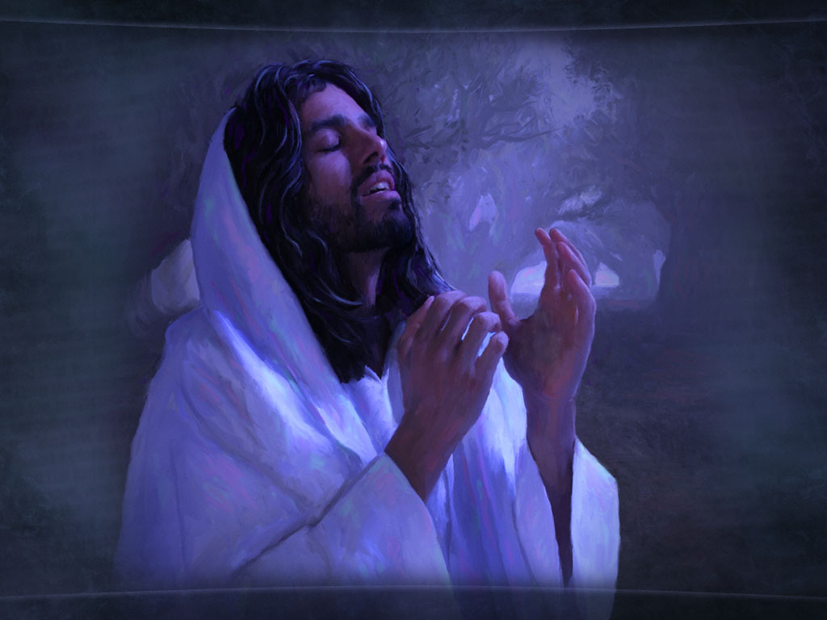
“Father, if you are willing, take this cup from me; yet not my will, but yours be done.” (Luke 22:42)
“父阿，你若愿意，就把这杯撤去。然而不要成就我的意思，只要成就你的意思。”（路22:42）

Slide 28
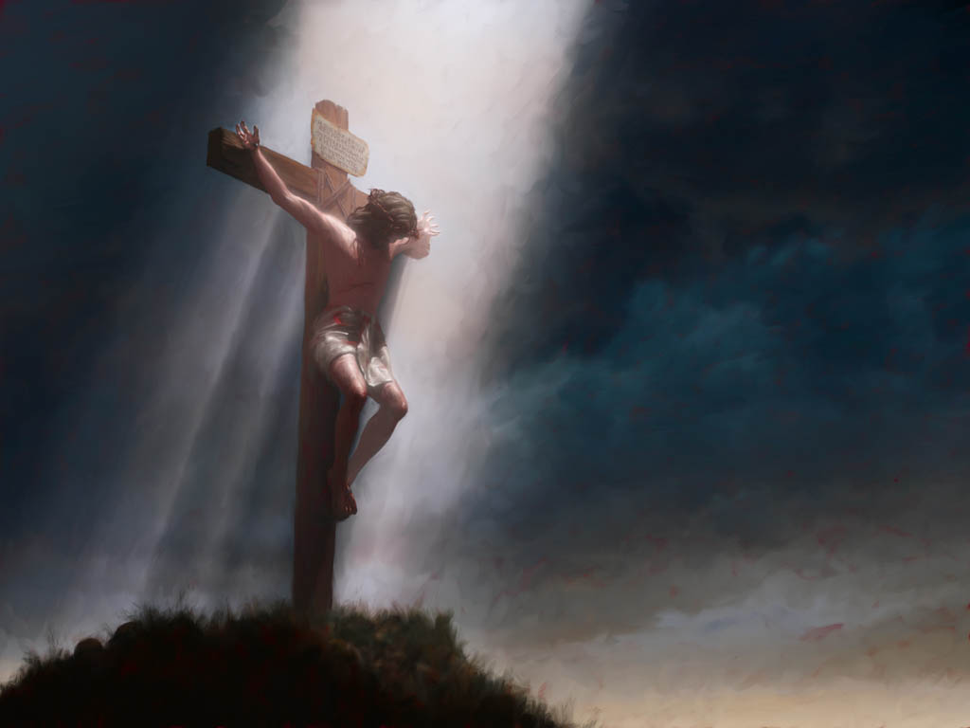
“he humbled himself and became obedient to death— even death on a cross!” (Philippians 2:7–8)
“自己卑微，存心顺服，以至于死，且死在十字架上。”（腓2:7-8）

Slide 29
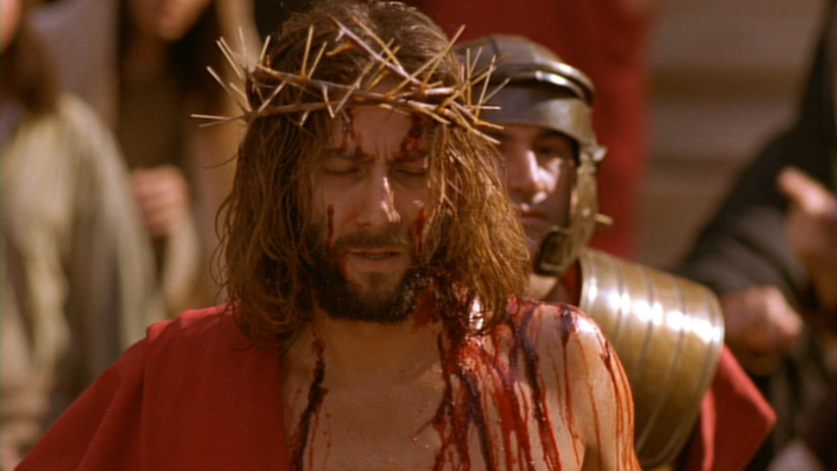
“Although he was a son, he learned obedience from what he suffered and, once made perfect, he became the source of eternal salvation for all who obey him.” (Hebrews 5:8-9)
“他虽然为儿子，还是因所受的苦难学了顺从。他既得以完全，就为凡顺从他的人，成了永远得救的根源。”（来5:8-9）

Slide 30
Psalm 40:6-8
⁶ Sacrifice and offering you did not desire, but my ears you have pierced; burnt offerings and sin offerings you did not require. ⁷ Then I said, “Here I am, I have come— it is written about me in the scroll. ⁸ I desire to do your will, O my God; your law is within my heart.”
诗40:6-8
⁶祭物和礼物，你不喜悦。你已经开通我的耳朵。燔祭和赎罪祭，非你所要。 ⁷那时我说，看哪，我来了。我的事在经卷上已经记载了。 ⁸我的神阿，我乐意照你的旨意行。你的律法在我心里。”
“These commandments that I give you today are to be upon your hearts.” (Deuteronomy 6:6)
“我今日所吩咐你的话都要记在心上”（申6:6）

Slide 31
Psalm 40:6-8
⁶ Sacrifice and offering you did not desire, but my ears you have pierced; burnt offerings and sin offerings you did not require. ⁷ Then I said, “Here I am, I have come— it is written about me in the scroll. ⁸ I desire to do your will, O my God; your law is within my heart.”
诗40:6-8
⁶祭物和礼物，你不喜悦。你已经开通我的耳朵。燔祭和赎罪祭，非你所要。 ⁷那时我说，看哪，我来了。我的事在经卷上已经记载了。 ⁸我的神阿，我乐意照你的旨意行。你的律法在我心里。”
“Let love and faithfulness never leave you; bind them around your neck, write them on the tablet of your heart.” (Proverbs 3:3)
“不可使慈爱诚实离开你。要系在你颈项上，刻在你心版上。”（箴3:3）

Slide 32
Psalm 40:6-8
⁶ Sacrifice and offering you did not desire, but my ears you have pierced; burnt offerings and sin offerings you did not require. ⁷ Then I said, “Here I am, I have come— it is written about me in the scroll. ⁸ I desire to do your will, O my God; your law is within my heart.”
诗40:6-8
⁶祭物和礼物，你不喜悦。你已经开通我的耳朵。燔祭和赎罪祭，非你所要。 ⁷那时我说，看哪，我来了。我的事在经卷上已经记载了。 ⁸我的神阿，我乐意照你的旨意行。你的律法在我心里。”
“This is the covenant I will make with them after that time, says the Lord. I will put my laws in their hearts, and I will write them on their minds.” (Hebrews 10:16)
“主说，那些日子以后，我与他们所立的约乃是这样。我要将我的律法写在他们心上，又要放在他们的里面。”（来10:16）

Slide 33
Psalm 40:12
“For troubles without number surround me; my sins have overtaken me, and I cannot see. They are more than the hairs of my head, and my heart fails within me.”
诗40:12
因有无数的祸患围困我。我的罪孽追上了我，使我不能昂首。这罪孽比我的头发还多。我就心寒胆战
“God made him who had no sin to be sin for us, so that in him we might become the righteousness of God.” (2 Corinthians 5:21)
“神使那无罪的，替我们成为罪。好叫我们在他里面成为神的义。”（林后5:21）

Slide 34
“Surely he took up our infirmities and carried our sorrows, yet we considered him stricken by God, smitten by him, and afflicted.” (Isaiah 53:4)
“他诚然担当我们的忧患，背负我们的痛苦。我们却以为他受责罚，被神击打苦待了。”（赛53:4）
“Christ redeemed us from the curse of the law by becoming a curse for us, for it is written: “Cursed is everyone who is hung on a tree.” (Galatians 3:13)
“基督既为我们受了咒诅，就赎出我们脱离律法的咒诅。因为经上记着，凡挂在木头上都是被咒诅的。”（加3:13）

Slide 35
8) What do we now know about the Messiah?
现在我们知道关于弥赛亚的什么信息？
We learn that the Messiah will come to carry out the will of God through a life of perfect obedience.
我们知道，弥赛亚通过一生完全的顺服，来完成神的旨意。
We learn that the Messiah will come just as was prophesied about him.
我们知道，弥赛亚的来临一如预言当中所说的。
We learn that the Messiah will come to take our sins and die for us.
我们知道，弥赛亚来是为了担负我们的罪，为我们而死。

