Slide 1
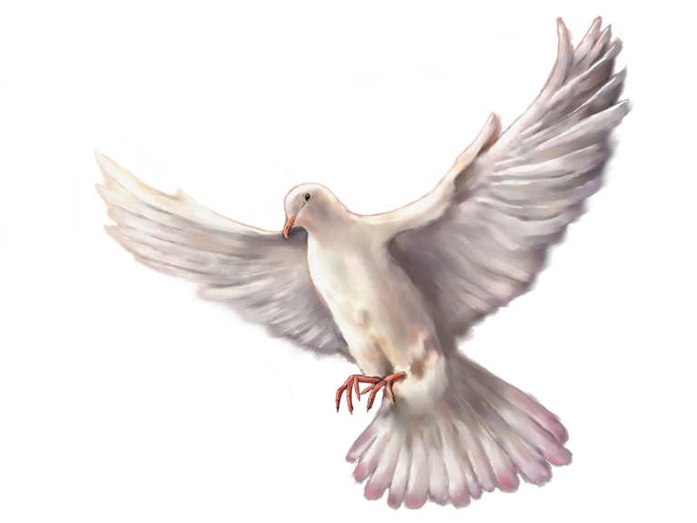
给万民施洗 BAPTISM FOR ALL NATIONS
关于施洗的查经
A Bible Study of Baptism

Slide 2
开始祷告 Opening Prayer

Slide 3
学习提纲 Outline of Our Study
1.洗礼这词的意义
The Meaning Of The Word “Baptism”
2. 约翰洗礼的事工和施洗的仪式
Ceremonial Washings and the Ministry of John the Baptist
3.耶稣的洗礼
The Baptism of Jesus
4. 基督设立的洗礼研究所
The Baptism Instituted by Christ
早期基督徒的洗礼实践
The Practice of Baptism among Early Christians

Slide 4
“洗礼”或“施洗”的定义 A definition of “baptism” or “baptize”
洗或应用水
To wash or apply water

Slide 5
旧约中的洗洗涤和洗礼
Washings and Baptisms in the Old Testament

Slide 6
旧约中的洗礼和洗礼
Washings and Baptisms in the Old Testament
卫生的洗涤（为了身体健康）
Sanitary washings (for good health)
2. 礼仪的洗涤（表示精神纯洁）
Ceremonial Washings (to signify spiritual purity)

Slide 7
卫生的洗涤
Sanitary Washings 以色列社区的健康和疾病预防
good health and the prevention of disease in the Israelite community
洗手 Hand washing
洗脚 Foot washing
洗身体 Body washing

Slide 8
出埃及 Exodus 30:17-21
¹⁷ 耶和华晓谕摩西说： ¹⁸ “你要用铜做洗濯盆和盆座，以便洗濯。要将盆放在会幕和坛的中间，在盆里盛水。 ¹⁹ 亚伦和他的儿子要在这盆里洗手洗脚。 ²⁰ 他们进会幕，或是就近坛前供职给耶和华献火祭的时候，必用水洗濯，免得死亡。 ²¹ 他们洗手洗脚，就免得死亡。这要做亚伦和他后裔世世代代永远的定例。”
Exodus 30:17-21
“Aaron and his sons are to wash their hands and feet with water from it. Whenever they enter the Tent of Meeting, they shall wash with water so that they will not die. Also, when they approach the altar to minister by presenting an offering made to the LORD by fire, they shall wash their hands and feet so that they will not die. This is to be a lasting ordinance for Aaron and his descendants for the generations to come.”

Slide 9
马太福音 15:2
“你的门徒为什么犯古人的遗传呢？因为吃饭的时候，他们不洗手。
Matthew 15:2
“Why do your disciples break the tradition of the elders? They don’t wash their hands before they eat!”
马可福音 7:3-4
（原来法利赛人和犹太人都拘守古人的遗传，若不仔细洗手就不吃饭； 4 从市上来，若不洗浴也不吃饭；还有好些别的规矩，他们历代拘守，就是洗杯、罐、铜器等物。）
Mark 7:3-4
“The Pharisees and all the Jews do not eat unless they give their hands a ceremonial washing, holding to the tradition of the elders. When they come from the marketplace they do not eat unless they wash.”

Slide 10
创世记 18:4
容我拿点水来，你们洗洗脚，在树下歇息歇息。
Genesis 18:4
“Let a little water be brought, and then you may all wash your feet and rest under this tree.”
路加福音 7:44
于是转过来向着那女人，便对西门说：“你看见这女人吗？我进了你的家，你没有给我水洗脚，但这女人用眼泪湿了我的脚，用头发擦干；
Luke 7:44
“Then he turned toward the woman and said to Simon, “Do you see this woman? I came into your house. You did not give me any water for my feet, but she wet my feet with her tears and wiped them with her hair.”

Slide 11
约翰福音 13:5
随后把水倒在盆里，就洗门徒的脚，并用自己所束的手巾擦干。
John 13:5
“After that, he poured water into a basin and began to wash his disciples’ feet, drying them with the towel that was wrapped around him.”

Slide 12
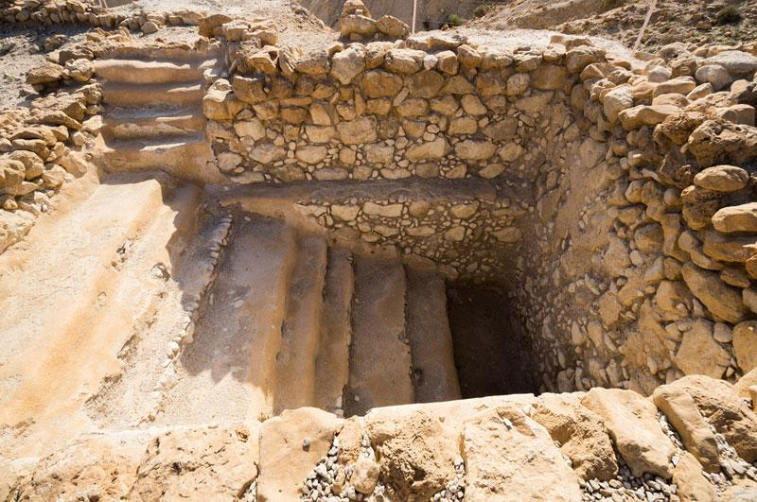
库姆兰的仪式浴 Ritual bath at Qumran

Slide 13
道德清洁（高尚）和净化洗涤
Moral Cleanliness and Purification Washings

Slide 14
箴言 20:9
谁能说：“我洁净了我的心，我脱净了我的罪”？
Proverbs 20:9
“Who can say, “I have kept my heart pure; I am clean and without sin”?

Slide 15
撒迦利亚书13:1
“那日，必给大卫家和耶路撒冷的居民开一个泉源，洗除罪恶与污秽。”
Zechariah 13:1 “On that day a fountain will be opened to the house of David and the inhabitants of Jerusalem, to cleanse them from sin and impurity.”
以西结书 36:25
我必用清水洒在你们身上，你们就洁净了。我要洁净你们，使你们脱离一切的污秽，弃掉一切的偶像。
Ezekiel 36:25 “I will sprinkle clean water on you, and you will be clean; I will cleanse you from all your impurities and from all your idols.”
诗篇 24:3-4
谁能登耶和华的山？谁能站在他的圣所？
就是手洁心清，不向虚妄，起誓不怀诡诈的人。
Psalm 24:3–4 “Who may ascend the hill of the LORD? Who may stand in his holy place? He who has clean hands and a pure heart, who does not lift up his soul to an idol or swear by what is false.”

Slide 16
诗篇 51:2,7
求你将我的罪孽洗除净尽，并洁除我的罪
求你用牛膝草洁净我，我就干净；求你洗涤我，我就比雪更白。
Psalm 51:2,7 “Wash away all my iniquity and cleanse me from my sin. Cleanse me with hyssop, and I will be clean; wash me, and I will be whiter than snow.”
以赛亚书 1:16
“你们要洗濯，自洁，从我眼前除掉你们的恶行。要止住作恶，
Isaiah 1:16 “Wash and make yourselves clean. Take your evil deeds out of my sight! Stop doing wrong”
以赛亚书 64:6
我们都像不洁净的人，所有的义都像污秽的衣服；我们都像叶子渐渐枯干，我们的罪孽好像风把我们吹去
Isaiah 64:6 “All of us have become like one who is unclean, and all our righteous acts are like filthy rags…”

Slide 17
创世记 35:2
”雅各就对他家中的人并一切与他同在的人说：“你们要除掉你们中间的外邦神，也要自洁，更换衣裳。
Genesis 35:2 “So Jacob said to his household and to all who were with him, “Get rid of the foreign gods you have with you, and purify yourselves and change your clothes.”
利未记 16:16, 30
他因以色列人诸般的污秽、过犯，就是他们一切的罪愆，当这样在圣所行赎罪之礼，并因会幕在他们污秽之中，也要照样而行。
因在这日要为你们赎罪，使你们洁净。你们要在耶和华面前得以洁净，脱尽一切的罪愆。
Leviticus 16:16, 30 “In this way he will make atonement for the Most Holy Place because of the uncleanness and rebellion of the Israelites, whatever their sins have been. He is to do the same for the Tent of Meeting, which is among them in the midst of their uncleanness. because on this day atonement will be made for you, to cleanse you. Then, before the LORD, you will be clean from all your sins.”

Slide 18
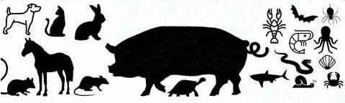
不干净的食物
Unclean foods

Slide 19
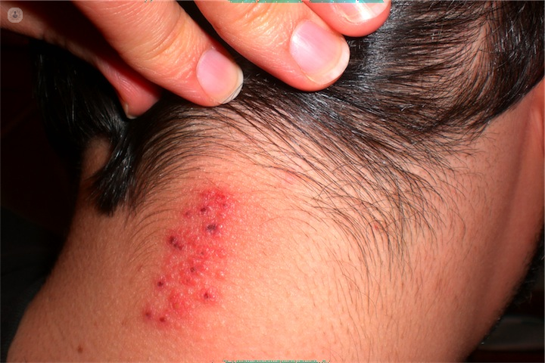
皮肤病
Skin diseases

Slide 20
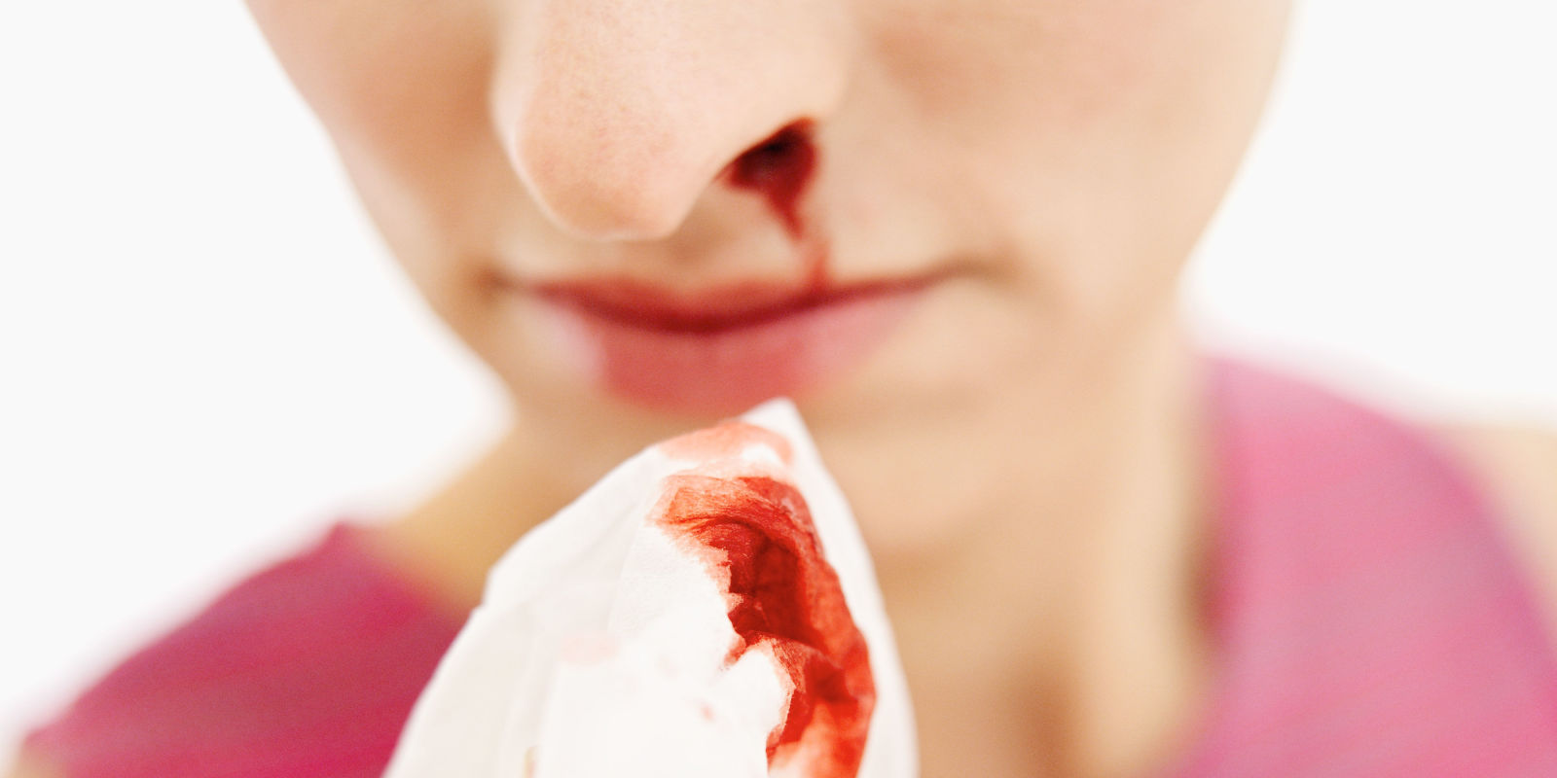
身体分泌物
Bodily discharges

Slide 21
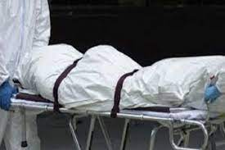
与尸体接触
Contact with a dead body

Slide 22
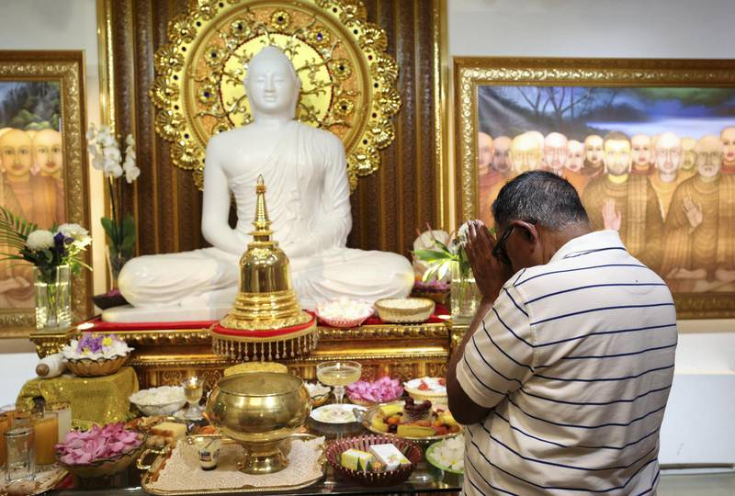
祭拜
Idolatry
以西结书 36:25
我必用清水洒在你们身上，你们就洁净了。我要洁净你们，使你们脱离一切的污秽，弃掉一切的偶像。
Ezekiel 36:25
“I will sprinkle clean water on you, and you will be clean; I will cleanse you from all your impurities and from all your idols.”

Slide 23
利未记 15:5-11
凡摸那床的，必不洁净到晚上，并要洗衣服，用水洗澡。 那坐患漏症人所坐之物的，必不洁净到晚上，并要洗衣服，用水洗澡。 那摸患漏症人身体的，必不洁净到晚上，并要洗衣服，用水洗澡。 若患漏症人吐在洁净的人身上，那人必不洁净到晚上，并要洗衣服，用水洗澡。 患漏症人所骑的鞍子也为不洁净。 凡摸了他身下之物的，必不洁净到晚上；拿了那物的，必不洁净到晚上，并要洗衣服，用水洗澡。 患漏症的人没有用水涮手，无论摸了谁，谁必不洁净到晚上，并要洗衣服，用水洗澡。
Leviticus 15:5–11 “Anyone who touches his bed must wash his clothes and bathe with water, and he will be unclean till evening. Whoever sits on anything that the man with a discharge sat on must wash his clothes and bathe with water, and he will be unclean till evening. Whoever touches the man who has a discharge must wash his clothes and bathe with water, and he will be unclean till evening. If the man with the discharge spits on someone who is clean, that person must wash his clothes and bathe with water, and he will be unclean till evening. Everything the man sits on when riding will be unclean, and whoever touches any of the things that were under him will be unclean till evening; whoever picks up those things must wash his clothes and bathe with water, and he will be unclean till evening. Anyone the man with a discharge touches without rinsing his hands with water must wash his clothes and bathe with water, and he will be unclean till evening.”

Slide 24
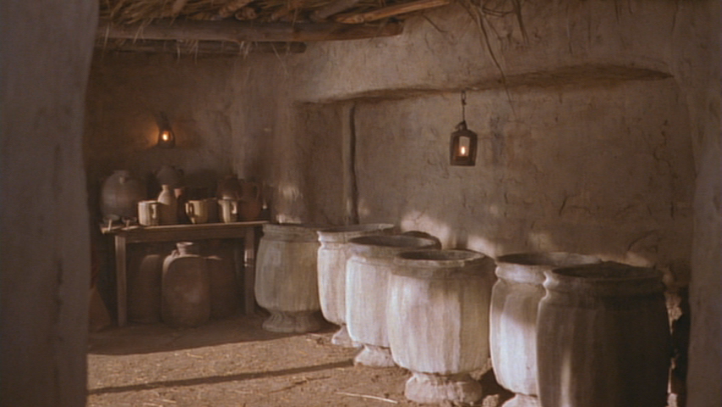
约翰福音 2:6
照犹太人洁净的规矩，有六口石缸摆在那里，每口可以盛两三桶水。
John 2:6
“Nearby stood six stone water jars, the kind used by the Jews for ceremonial washing, each holding from twenty to thirty gallons.”

Slide 25
约翰福音 3:25
约翰的门徒和一个犹太人辩论洁净的礼，
John 3:25
“An argument developed between some of John’s disciples and a certain Jew over the matter of ceremonial washing.”
约翰福音 11:55
犹太人的逾越节近了，有许多人从乡下上耶路撒冷去，要在节前洁净自己。
John 11:55
“When it was almost time for the Jewish Passover, many went up from the country to Jerusalem for their ceremonial cleansing before the Passover.”

Slide 26
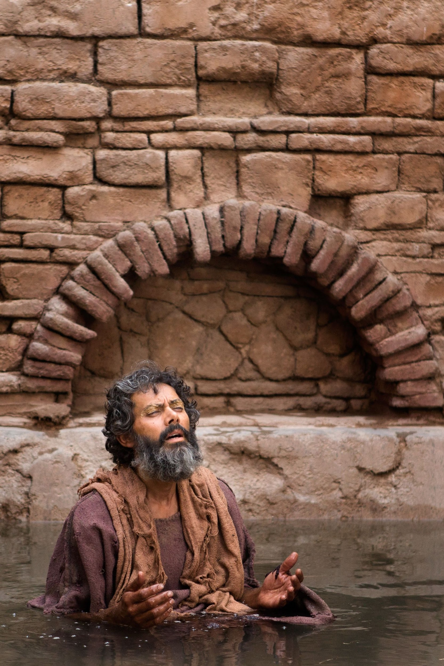
交流洗礼
Conversion Baptism

Slide 27
希伯来书 9:10
这些事，连那饮食和诸般洗濯的规矩，都不过是属肉体的条例，命定到振兴的时候为止。
Hebrews 9:10
“various ceremonial washings … are external regulations applying until the time of the new order”
约翰一书 1:7
我们若在光明中行，如同神在光明中，就彼此相交，他儿子耶稣的血也洗净我们一切的罪。,
1 John 1:7
“The blood of Jesus, his Son, purifies us from all sin.”

Slide 28
有什么问题吗？
Questions?

Slide 29
约翰的洗礼和新约圣礼
The Baptisms of John and the New Testament Sacrament

Slide 30
约翰的洗涤部
The Ministry of John the Baptist
马太 3:5-6, 11 Matthew 3:5-6, 11
马克1：1-11 Mark 1:1-11
路克 3：1-18 Luke 3:1-18
约翰 1:19-28；32-34 John 1:19-28; 32-34

Slide 31
路加福音 3:2
亚那和该亚法做大祭司。那时，撒迦利亚的儿子约翰在旷野里，神的话临到他。
Luke 3:2
“during the high priesthood of Annas and Caiaphas, the word of God came to John son of Zechariah in the desert.”

Slide 32
马太福音 21:25-26
约翰的洗礼是从哪里来的？是从天上来的，是从人间来的呢？”他们彼此商议说：“我们若说从天上来，他必对我们说：‘这样，你们为什么不信他呢？’ 若说从人间来，我们又怕百姓，因为他们都以约翰为先知。”
Matthew 21:25-26
“John’s baptism—where did it come from? Was it from heaven, or from men?” They discussed it among themselves and said, “If we say, ‘From heaven,’ he will ask, ‘Then why didn’t you believe him?’ But if we say, ‘From men’—we are afraid of the people, for they all hold that John was a prophet.”

Slide 33
约翰的洗礼与旧约的洗礼的不同处
John’s baptism was different from the OT Ceremonial Washings
1) 约翰的洗礼是一次/一生的.
John’s baptism was once/lifetime.
2) 约翰的洗礼是由约翰本人完成的.
John’s baptism was only done by John himself.
3) 约翰的洗礼将在他死后结束.
John’s baptism would end after his death.
4) 约翰的洗礼是为了罪得以赦免.
John’s baptism was for the forgiveness of sins.

Slide 34
约翰洗礼事部的目的是什么？
What was the PURPOSE of John’s baptism ministry?
约翰福音 1:31
我先前不认识他，如今我来用水施洗，为要叫他显明给以色列人。”
John 1:31
“The reason I came baptizing with water was that he might be revealed to Israel.”

Slide 35
如何描述约翰的洗礼部？
How is John’s baptism ministry described?
路加福音 3:3
他就来到约旦河一带地方，宣讲悔改的洗礼，使罪得赦。
Luke 3:3
“He went into all the country around the Jordan, preaching a baptism of repentance for the forgiveness of sins.”

Slide 36
这次悔改的目的是什么？
What was the PURPOSE of this repentance?
路加福音 1:16-17
他要使许多以色列人回转，归于主他们的神。 他必有以利亚的心志能力，行在主的前面，叫为父的心转向儿女，叫悖逆的人转从义人的智慧，又为主预备合用的百姓。”
Luke 1:16-17
(The angel’s words to Zechariah) “Many of the people of Israel will he bring back to the Lord their God. And he will go on before the Lord, in the spirit and power of Elijah, to turn the hearts of the fathers to their children and the disobedient to the wisdom of the righteous— to make ready a people prepared for the Lord.”

Slide 37
路加福音 1:76-77
孩子啊，你要称为至高者的先知，因为你要行在主的前面，预备他的道路， 叫他的百姓因罪得赦就知道救恩。
Luke 1:76-77
And you, my child, will be called a prophet of the Most High; for you will go on before the Lord to prepare the way for him, to give his people the knowledge of salvation through the forgiveness of their sins.”

Slide 38
约翰的洗礼带来了什么祝福（保佑）？
What BLESSING did John’s baptism give?
路加福音 3:3
他就来到约旦河一带地方，宣讲悔改的洗礼，使罪得赦。
Luke 3:3
“He went into all the country around the Jordan, preaching a baptism of repentance for the forgiveness of sins.”
路加福音 24:46-47
又对他们说：“照经上所写的，基督必受害，第三日从死里复活， 47 并且人要奉他的名传悔改、赦罪的道，从耶路撒冷起直传到万邦。
Luke 24:46–47
He told them, “This is what is written: The Christ will suffer and rise from the dead on the third day, ⁴⁷ and repentance and (literally, eis, for, to) forgiveness of sins will be preached in his name to all nations.

Slide 39
约翰的洗礼和耶稣设立的基督教的洗礼
The baptism of John the Baptist
and the Christian baptism Jesus’ instituted
John’s Baptism | Christian Baptism
马可福音 1:4 照这话，约翰来了，在旷野施洗，传悔改的洗礼，使罪得赦。 Mark 1:4 And so John came, baptizing in the desert region and preaching a baptism of repentance for the forgiveness of sins. | 使徒行传 2:38 彼得说：“你们各人要悔改，奉耶稣基督的名受洗，叫你们的罪得赦，就必领受所赐的圣灵。 Acts 2:38 Peter replied, “Repent and be baptized, every one of you, in the name of Jesus Christ for the forgiveness of your sins. And you will receive the gift of the Holy Spirit.

Slide 40
耶稣指的是什么？
What was Jesus referring to?
约翰福音 3:5
耶稣说：“我实实在在地告诉你：人若不是从水和圣灵生的，就不能进神的国。
John 3:5
Jesus answered, “I tell you the truth, no one can enter the kingdom of God unless he is born of water and the Spirit.”

Slide 41
一个特殊案例：
使徒行传 19： 1-7
A Special Case
Acts 19:1-7

Slide 42
使徒行传 19:1-7
亚波罗在哥林多的时候，保罗经过了上边一带地方，就来到以弗所。在那里遇见几个门徒， 问他们说：“你们信的时候受了圣灵没有？”他们回答说：“没有，也未曾听见有圣灵赐下来。” 保罗说：“这样，你们受的是什么洗呢？”他们说：“是约翰的洗。” 保罗说：“约翰所行的是悔改的洗，告诉百姓当信那在他以后要来的，就是耶稣。” 他们听见这话，就奉主耶稣的名受洗。 保罗按手在他们头上，圣灵便降在他们身上，他们就说方言，又说预言[a]。一共约有十二个人。
Acts 19:1-7
While Apollos was at Corinth, Paul took the road through the interior and arrived at Ephesus. There he found some disciples ² and asked them, “Did you receive the Holy Spirit when you believed?” They answered, “No, we have not even heard that there is a Holy Spirit.” ³ So Paul asked, “Then what baptism did you receive?” “John’s baptism,” they replied. ⁴ Paul said, “John’s baptism was a baptism of repentance. He told the people to believe in the one coming after him, that is, in Jesus.” ⁵ On hearing this, they were baptized into the name of the Lord Jesus. ⁶ When Paul placed his hands on them, the Holy Spirit came on them, and they spoke in tongues and prophesied. ⁷ There were about twelve men in all.

Slide 43
有哪些问题？ What are the problems?
这十二个人 These 12 men…
接受了约翰的洗礼，但 had received John’s baptism, but …
他们从未听说过圣灵，并且 they had never heard of the Holy Spirit, and
他们没有接受圣灵. they had not received the Holy Spirit.
所以保罗为他们重新施洗. So Paul re-baptized them.
那么约翰的洗礼难道不是真正的洗礼吗？So was John’s baptism not a true baptism?

Slide 44
一个可能的解决方案：
他们还没有真正接受约翰的洗礼
A possible solution:
They had not really received John’s baptism
“约翰所行的是悔改的洗，告诉百姓当信那在他以后要来的，就是耶稣。”
“John’s baptism was a baptism of repentance. He told the people to believe. . . . “

Slide 45
家庭作业 Homework

