Slide 1
Predicting Video Game Sales
Grace Campbell

Slide 2
Goal and Approach
GOAL: Inform video game creators on the video games--and on which platforms--they should invest their time and money.
HOW: Use video game sales data from 2000-2016 to predict North American sales of a game based on the platform on which the video game is released.

Slide 3
The Data
The dataset I have used contains information about the sales of video games from 1980 to 2016.
The data includes the name of each video game, the platform on which it was released, the year of release, the genre of video game, the publisher, and the number of sales in North America, Europe, Japan, other countries, and globally (all in millions).
I want to use this data to find out how the platform on which a video game is released will affect its sales in North America.

Slide 4
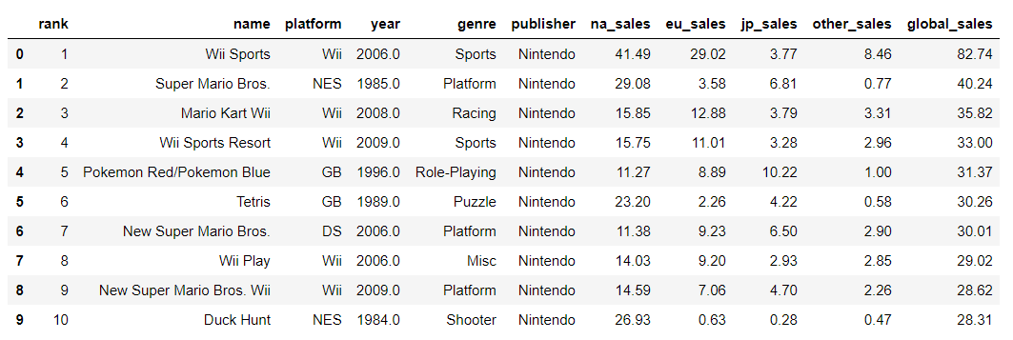
Quick look at the dataset

Slide 5

Processing the data
To the left you can see all of the platforms which were included in this dataset.
I grouped similar platforms into one category in order to better capture relationships. For example, I grouped all handheld game platforms together because I wanted a broader look at the sales of games on handheld platforms, not just the sales of games on, for example, the Sony PSP or Nintendo DS specifically.
Here are the 6 categories I created and used for my model:
Handheld
PlayStation Console
Xbox Console
Wii
PC
Other (Extinct) Console

