Slide 1
Report on alignment and ID of abundant sequences
Grace Coppinger

Slide 2
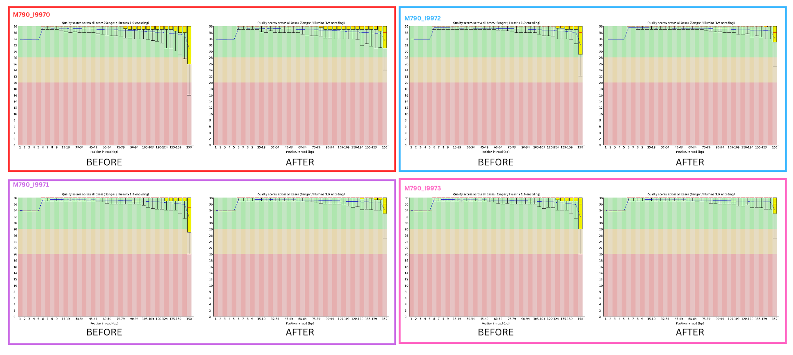
Trimming report

Slide 3
HiSat2 report
Tick pool 1
98.14% overall alignment rate
Tick pool 2
92.97% overall alignment rate
Tick pool 3
93.48% overall alignment rate
Tick pool 4
93.73% overall alignment rate

Slide 4
The problem…
Status | Arcadia-gff | rRNA-gff
Assigned | 325145 | 7283082
Unassigned_Unmapped | 132899 | 132899
Unassigned_Read_Type | 0 | 0
Unassigned_Singleton | 0 | 0
Unassigned_MappingQuality | 0 | 0
Unassigned_Chimera | 0 | 0
Unassigned_FragmentLength | 0 | 0
Unassigned_Duplicate | 0 | 0
Unassigned_MultiMapping | 0 | 0
Unassigned_Secondary | 0 | 0
Unassigned_NonSplit | 0 | 0
Unassigned_NoFeatures | 7857622 | 899685
Unassigned_Overlapping_Length | 0 | 0
Unassigned_Ambiguity | 0 | 0
Example from tick pool 3

Slide 5
What is in these transcriptomes?

Slide 6
What type of rRNA

Slide 7
Top 10 scaffolds for rRNA

Slide 8
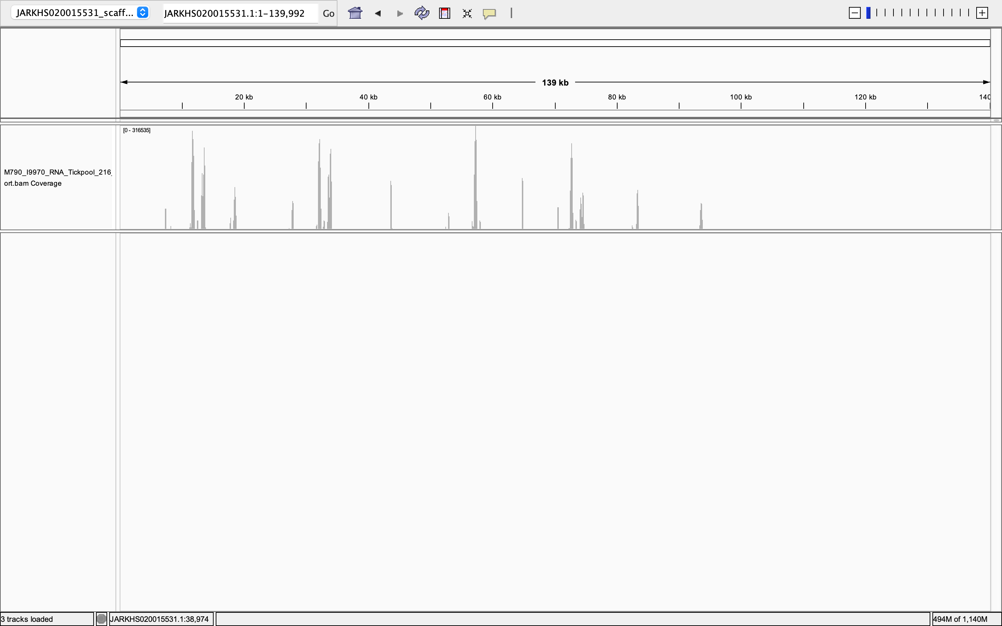
What is the read coverage of scaffold JARKHS020015531.1

Slide 9
Pointers for the future - rRNA comprises the majority of the transcriptome (89%). - Assembly means there are complete/incomplete rRNA genes. - Need a complete genome annotation. Can access all my scripts/ work at https://github.com/GraceCoppinger/Lonestar_Metatranscriptome

