Slide 1
GLOBAL DEBT ANALYSIS: SECTORAL TRENDS, COUNTRY RISKS & REGIONAL INSIGHTS
GRACE GODWIN OKECHUKWU

Slide 2
BUSINESS PROBLEM
As global economies evolve, understanding debt composition and trajectory is vital. Rising debt levels impact fiscal health, financial risk, and development planning. This analysis helps:
Identify critical debt trends by sector and region
Assessing regional vulnerabilities to fiscal shocks.
Comparing public vs. private sector debt trends.
Exploring correlations between different debt types.
Support data-driven decisions for sustainable fiscal policies

Slide 3
BUSINESS OBJECTIVES
Understand Global Debt Patterns: Explore how government, household, corporate, and private debt levels have evolved globally from 1950 to 2022.
Highlight Countries with Significant Shifts in Debt Levels : Identify economies that have experienced notable changes in debt structure, either surges or declines, over the past three decades.
Compare Debt Structures in Developed vs. Developing Economies : Contrast borrowing patterns and debt concentrations across developed and developing countries to understand structural imbalances and fiscal exposure.
Assess Sector-Specific Debt Surges
Guide Policy and Financial Strategy: Deliver actionable insights that can inform government policy, fiscal planning, and global financial risk assessments.

Slide 4
Methodology USED ON POWER QUERY
Used power query editor.
Placed the appropriate data type on each of the columns.
Cleaned and unpivoted yearly columns in Power Query
Merged all sector tables using append method
Created calculated columns for income group and development status
Used DAX to compute average and maximum values
Built interactive dashboards in Power BI

Slide 5
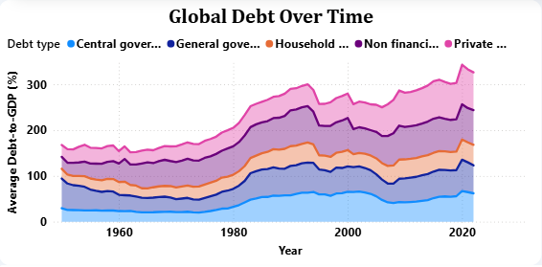
BUSINESS QUESTION: How has global debt evolved over time by sector?
Debt accumulation has significantly accelerated across all sectors, particularly after major global events (2008 financial crisis and COVID-19). The non-financial corporate and private debt sectors recorded the sharpest increases post-2008.
Recommendation: Strengthen private sector oversight and crisis-buffering fiscal policies to mitigate future debt shocks.

Slide 6
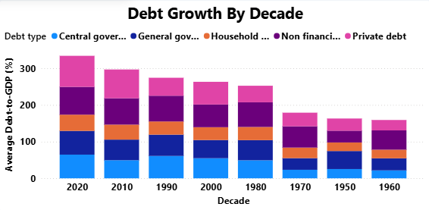
BUSINESS QUESTION: Which decades saw the highest debt growth rates across sectors?
The 2010s and early 2020s recorded the steepest growth in global debt, largely fueled by expansionary stimulus packages, low interest rate environments, and emergency fiscal responses to the COVID-19 pandemic. the highest average Debt-to-GDP (%) levels were observed in Private Debt: 84.77%, Non-Financial Corporate Debt: 75.80%
Recommendation: Reassess post-crisis fiscal stimulus strategies to ensure long-term debt sustainability

Slide 7
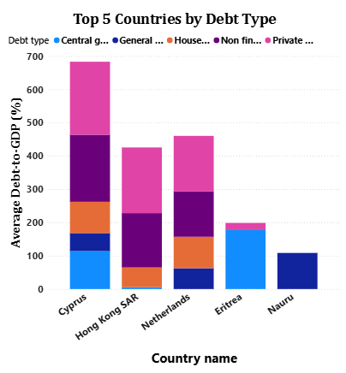
Business Questions : Which countries currently have the highest levels of each debt type?
Countries such as Cyprus (219.59% of GDP), Hong Kong (197.39% of GDP), and Netherlands (167.06% of GDP) consistently rank among the top, and highest in private debt.
Recommendation: Promote fiscal consolidation plans in high-debt economies while monitoring sector-specific debt risks.

Slide 8
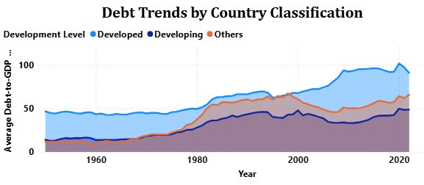
Business Questions: How do debt levels in developed vs. developing countries compare over time?
Developed countries hold significantly higher Private and Corporate Debt, averaging between 40-110% of GDP(1950-2022), driven by mature financial markets and strong credit systems.
Developing countries, by contrast, carry higher proportions of Government Debt, often used to finance infrastructure, services, and crisis recovery, averaging exceeding 40% of GDP.
Recommendation:
Developed countries: Strengthen private debt oversight.
Developing countries: Expand responsible private credit access.

Slide 9
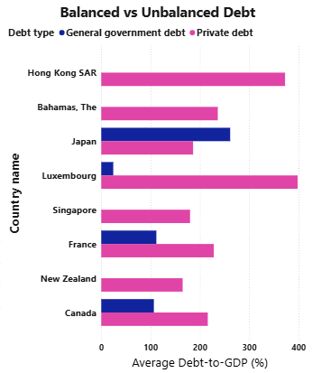
Business Questions: Which countries have balanced vs. imbalanced debt profiles?
Imbalanced Profiles: Hong Kong SAR, Japan, Singapore, and Luxembourg show heavy reliance on either private or government debt, with levels exceeding 200–300% of GDP.
Balanced Profiles: France, Canada, New Zealand, and Bahamas maintain a more even spread across debt sectors, reflecting greater stability and resilience.
Recommendation: Imbalanced economies should rebalance borrowing across sectors and strengthen regulations in overexposed areas to reduce systemic vulnerabilities.

Slide 10
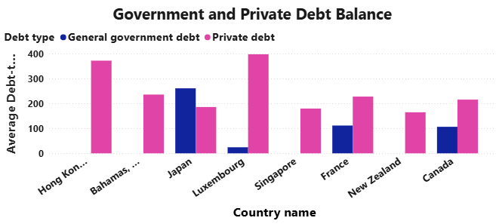
Business Questions : Are there notable trade-offs between government and private debt levels in some countries?
In many countries (e.g., Eastern Europe, parts of Latin America), a reduction in government borrowing is accompanied by rising private debt, suggesting a debt shift rather than actual reduction. Average Debt-to-GDP ratios show that: Government sectors average 60–65%, Private sectors (Corporate + Household) average 120%.
This indicates that debt burdens are not disappearing, they’re just changing hands.
Recommendation: Adopt holistic debt governance that captures both public and private debt trends and integrates them into national debt sustainability frameworks.

Slide 11
Recommendations : Data-Backed Strategies For Global Debt
Promote Balanced Debt Portfolios: Encourage equitable debt growth between government and private sectors.
Strengthen Crisis Resilience: Create buffers and emergency frameworks for economic shocks.
Debt Transparency: Enhance public access to debt data and increase IMF/World Bank engagement.
Targeted Policy Reforms: Customize policies by income level, sector exposure, and region.
Private Sector Monitoring: Regulate private debt in high-risk economies.
Focus on Growth-Driven Borrowing: Especially in low-income countries, debt should fund productivity, not just spending.

Slide 12
LIMITATIONS : Any constraints in the dataset
Incomplete Country Coverage: Some countries had missing or inconsistent data across debt types or years.
No Regional Classification: Dataset lacked predefined regional tags, requiring manual classification.
Estimated or Rounded Values: Some data points may be interpolated or estimated, especially in earlier decades.
No Economic Context Included: The dataset focuses solely on debt ratios — no GDP growth, inflation, or interest rate indicators included.
Appended Structure Assumption: Merging multiple debt types into one column may oversimplify sector-specific nuances.
Lack of Real-Time Updates: Data ends in 2022, and recent fiscal trends post-COVID recovery are not reflected.

