Slide 1
Air Pollution Gases Analysis
By: Grace Hsu, Loveleen Bangar, Fatema Nourzaie

Slide 2
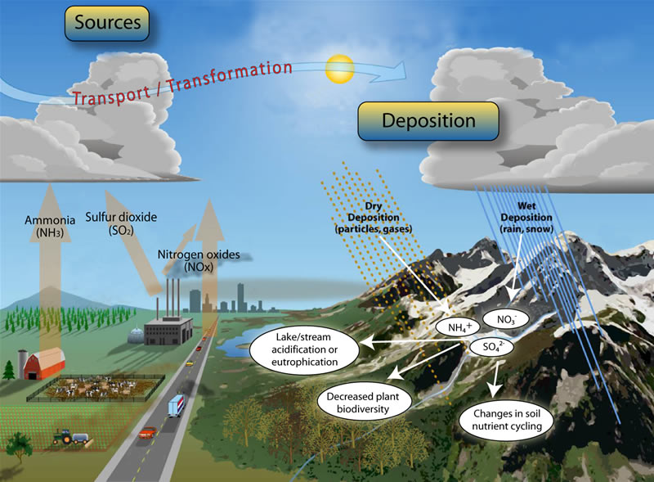

Slide 3
Types of Air Quality Measurements
PM2.5 and PM10
Concentration of microscopic particles less than 2.5/10 microns in diameter
Ex. particulates from burning wood, oil, motor exhausts, dust particles, etc
Ozone (O₃) in Earth’s lower atmosphere
Formed from pollutants emitted by cars, power plants, etc
Nitric Oxide (NO₂)
Produced during air combustion at high temperatures (ie. Motor vehicles)
Sulfur Dioxide (SO₂)
An irritant produced from industrial processing of sulfur-containing materials
Carbon Monoxide (CO)
Produced by incomplete combustion of carbon-containing fuels
Affects the amount of oxygen carried around in the body
Black Carbon (BC)
Formed from incomplete combustion of biomass and fossil fuels

Slide 4
Project Objectives:
Analyze how different gases surround the various countries
Analyze different gases effect on each state in US
Worldwide data contribution for air pollution analysis

Slide 5
Data Limitations
Bulk of data points from limited regions: United States, Europe, India, and China
Not every location measured every gas parameter
API was only able to grab the most recent date’s collected gas values

Slide 6
Website Design
Demo

Slide 7
Gas Analysis in US:
Ozone(O3)
States near coasts show high ozone value
As per analysis, top three states showing high value are: CA, NY, TX
In 2019 average ozone level is 53 µg/m³, while in 2018 it was 46 µg/m³
Particulate matter (PM2.5) analysis
Most effected states are CA, Montana, Washington
Highest value recorded in CA
West cost is more effected by this gas

Slide 8
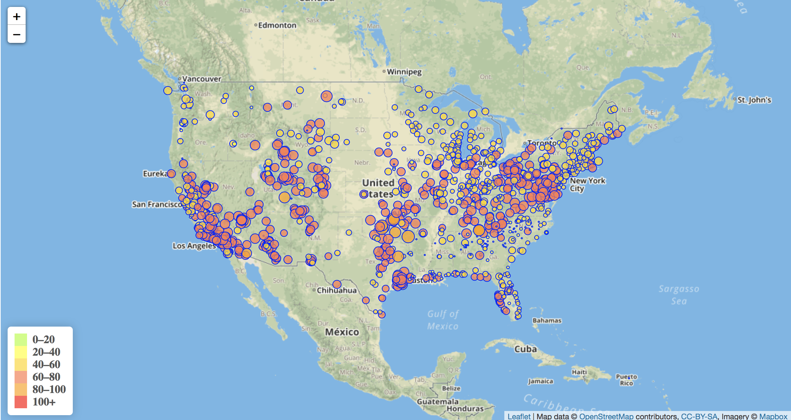
Ozone (O3) on US map:

Slide 9
Particulate matter (PM10) analysis
Most effected state CA
Sulfur dioxide (SO2) analysis
Most effected states are Ohio, Indiana, Alabama
East is most effected by this gas
Nitrogen Oxide(NO2) analysis
Most effected city is Wisconsin, Colorado
Central part of US is most effected by this gas

Slide 10
Carbon Monoxide(CO) analysis
Most effected state Virginia, Washington
East coast shows high value
Black Carbon (BC) analysis
Most effected states is Indiana, CA
Overall in year 2019 records, gases values are increasing more as compare on years 2018, 2017

Slide 11
Data contribution
Top 5 countries where most of the data recorded:
US
China
India
France
Spain

Slide 12
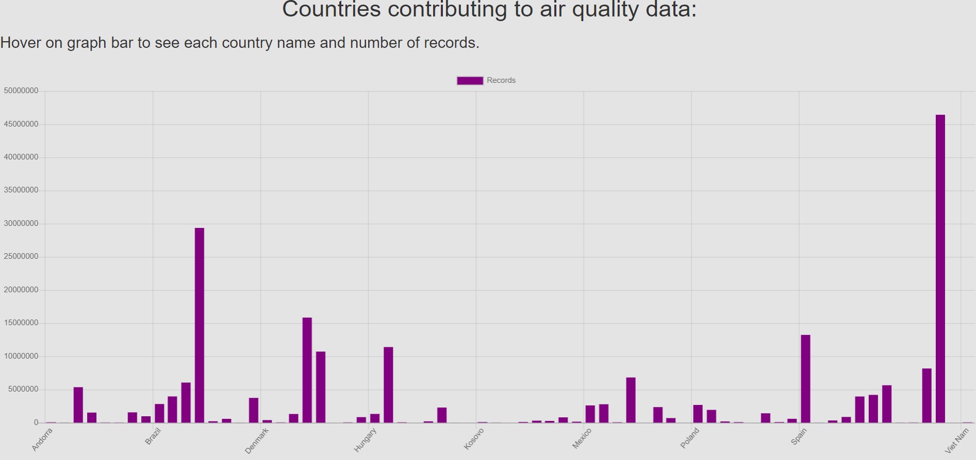

Slide 13
Appendix:
Data obtained from openaq.org
JS graphing library used: chart.js
Challenges:
Use json data with mongodb

Slide 14
Future Directions
Obtain data from previous years to track over time how the air quality measurements have changed.
Map with real time data

