Slide 1
Air Pollution Gases Analysis
By: Grace, Loveleen, Fatema

Slide 2
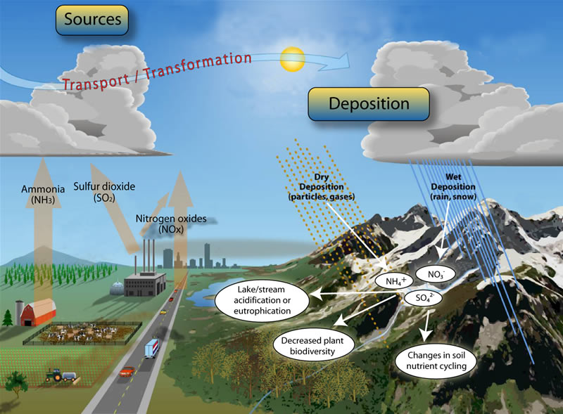

Slide 3
Project Objectives:
Analyze how different gases effecting different countries
Analyze different gases effect on each state in US

Slide 4
Analysis gases:
Ozone (O3)

Slide 5
Data Limitations
Bulk of data points from limited regions: United States, Europe, India, and China
Not every location measured every gas parameter
API was only able to grab the most recent date’s collected gas values

Slide 6
Types of Air Quality Measurements
PM2.5 and PM10
Concentration of microscopic particles less than 2.5/10 microns in diameter
Ex. particulates from burning wood, oil, motor exhausts, dust particles, etc
Ozone (O₃) in Earth’s lower atmosphere
Formed from pollutants emitted by cars, power plants, etc
Nitric Oxide (NO₂)
Produced during air combustion at high temperatures (ie. Motor vehicles)
Sulfur Dioxide (SO₂)
An irritant produced from industrial processing of sulfur-containing materials
Carbon Monoxide (CO)
Produced by incomplete combustion of carbon-containing fuels
Affects the amount of oxygen carried around in the body
Black Carbon (BC)
Formed from incomplete combustion of biomass and fossil fuels

Slide 7
Website Design
Demo

Slide 8
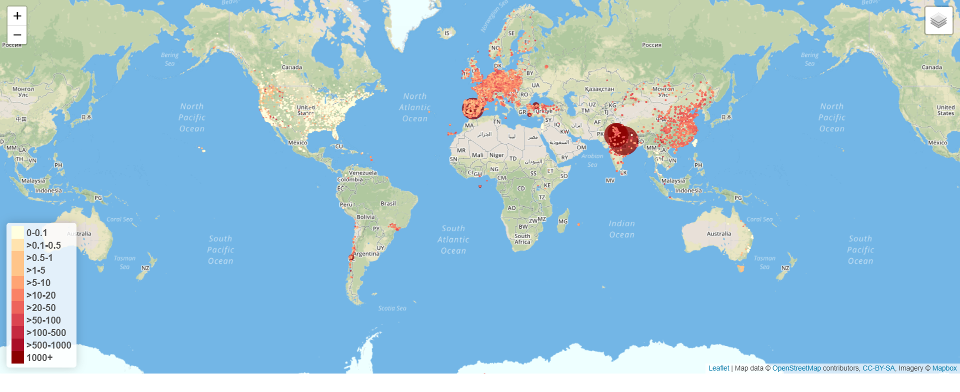
Leaflet Visualization of Multiple Air Gas Parameters

Slide 9
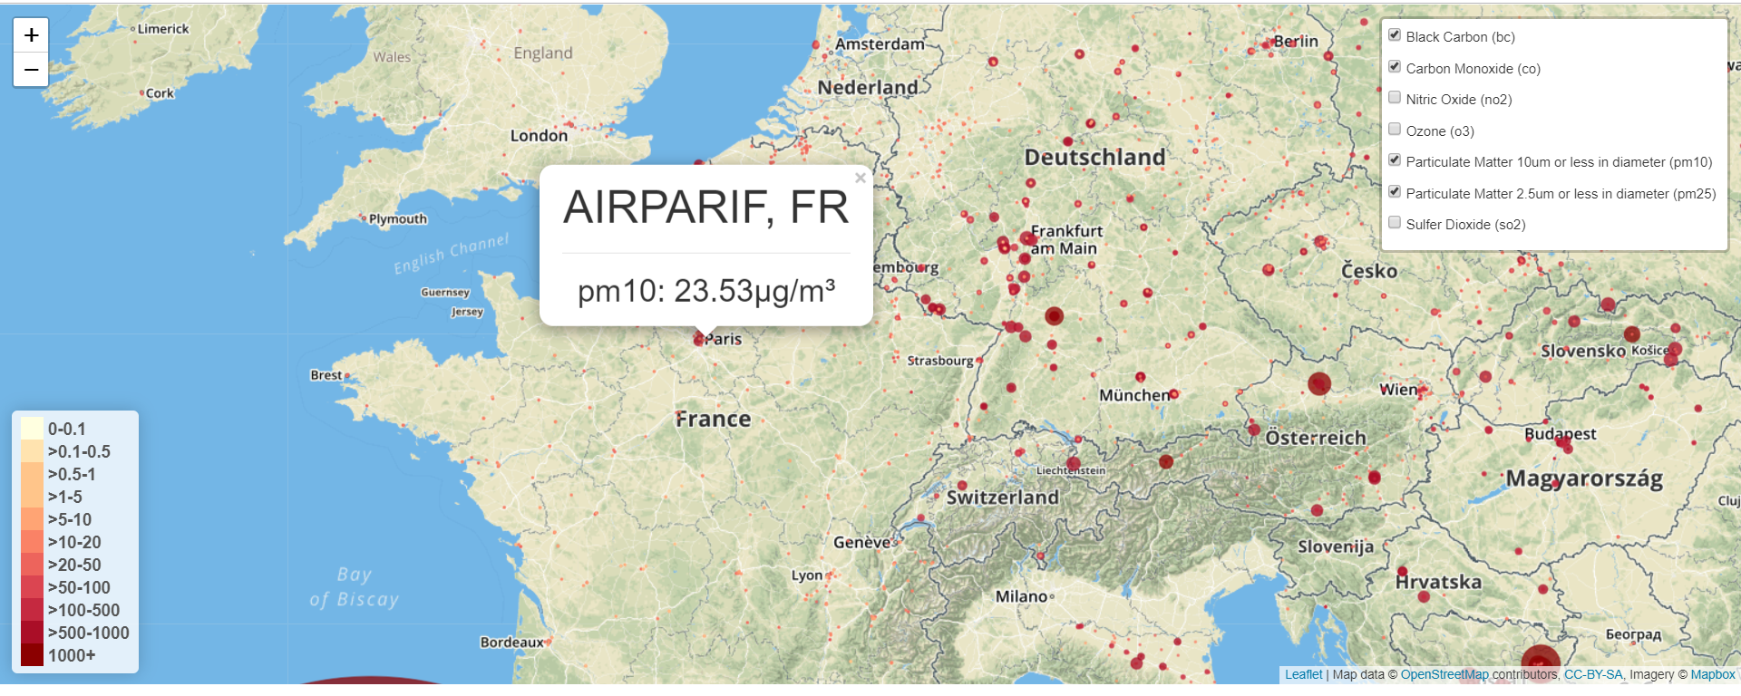
Leaflet Visualization of Multiple Air Gas Parameters

Slide 10
Future Directions
Obtain data from previous years to track over time how the air quality measurements have changed.

