Slide 1
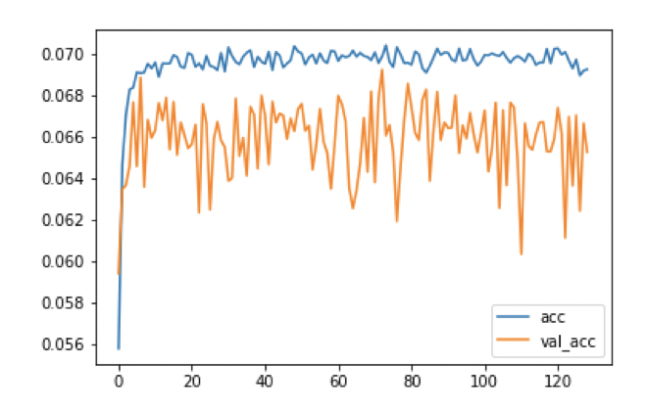
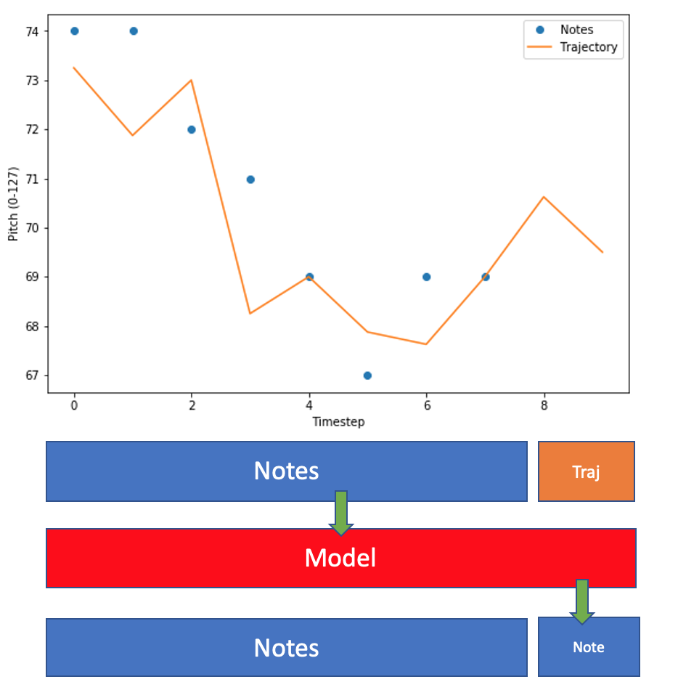
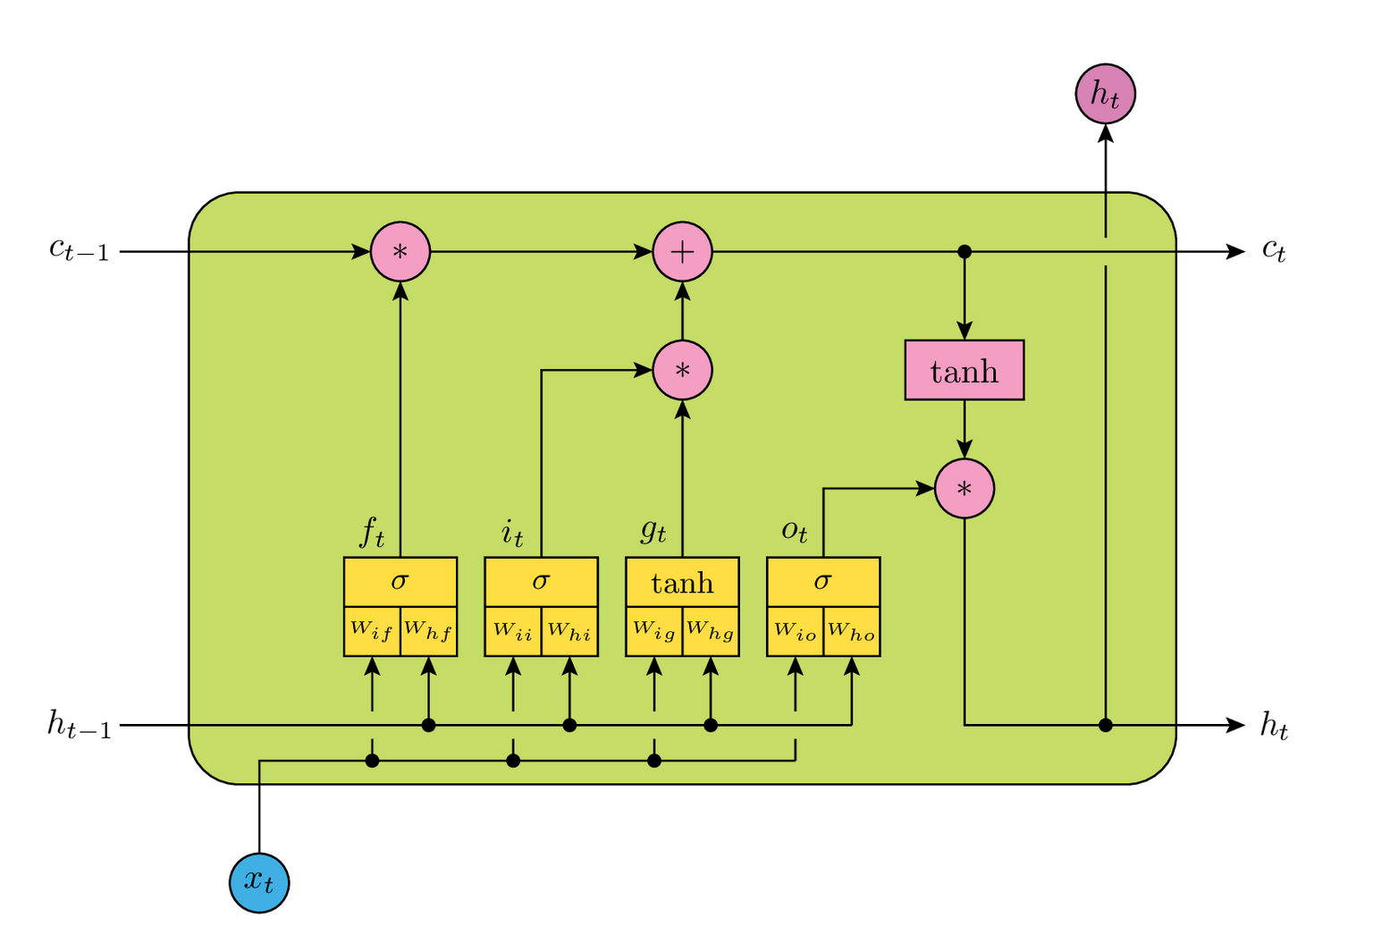
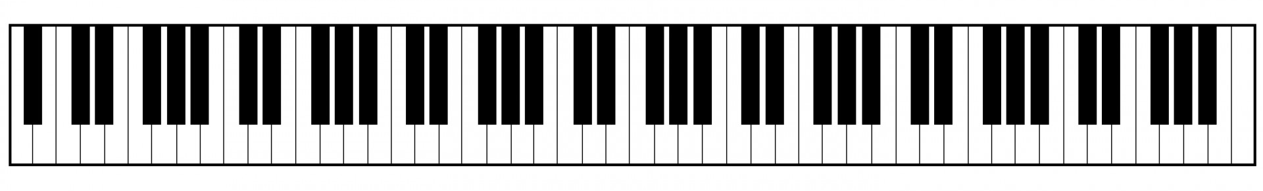

Listen to Your Data: Turning Chemical Dynamics Simulations into Music
Austin Atsango¹ (atsango), Soren Holm¹ (sorenh), and K. Grace Johnson¹ (kgjohn)
¹ Department of Chemistry, Stanford University
Abstract
Models
Discussion
Our goal is to translate simulation data into a musical form in order to present a different way to interact with data. Specifically, the goals are 1) to generate music, i.e. melodies that are indistinguishable from those composed by humans, and 2) to have those melodies reflect trends in the underlying data.
We take two approaches: 1) We use a supervised model (either softmax regression or an LSTM RNN trained on composed melodies) to predict the next note in a song, biased by the trajectory values. 2) We cluster snippets of a trajectory using a Gaussian Mixture Model (GMM) with the EM algorithm to discover motifs within a trajectory, then match these motifs to similar ones from a composed melody.
We evaluate the success of these approaches with a survey designed to assess the two goals of the project.
Predictive models
We explored training predictive models with several architectures and on several subsets of the music data. We found the best training and validation accuracy using a subset of the full dataset: the pieces composed by Clementi.
Of all models tested, the LSTM RNN was most successful at generating music that reflected trends in a given dynamics trajectory. Softmax regression produced samples with the same note repeated, which were neither musical nor reflective of trajectory data. The GMM approach had roughly the same success as the LSTM, but cannot truly be considered music generation, as it sampled snippets from composed pieces. To more fully analyze the success of the models in achieving both goals outlined, we would need a survey with a much larger sample size both in number participants and number of audio clips.
Convolution over each musical piece
One-hot encoding
Supervised: predict next note based on previous 50 notes
Music generation from trajectory:
Softmax Regression
LSTM RNN
GMM
use a Gaussian Mixture Model with the EM algorithm to cluster snippets of all trajectories based on distance and gradient
Match snippets to motifs in a given musical piece
Future Work
Datasets
Future efforts include curating a larger dataset with distinctive melodies and exploring other generative models such as GANs or GRUs. The control of the Turing test shows that reducing a piece to simply pitch and time removes much of the musicality. We would also want to extend the model to train not just on pitch, but also on rhythm, chords, and other expressive information, then explore methods of interpreting the trajectory data with these additional features.
Music
MIDI data format
312 classical piano pieces
93 piano pieces from Final Fantasy video game
Simplified using music21 and mido packages in Python to represent as pitch (with value 0 to 127) vs time
Architecture:
LSTM with 256 hidden units
LSTM with 38 hidden units
Dense layer with softmax activation
Population of trajectory snippets for EM with 16 GMM means
Results
Most piano pieces have melodies in pitch range 50-90
Goal 1: Turing test
Goal 2: matching generated music to trajectory
References
Chemical dynamics
[1] Weir, H., Williams, M., Parrish, R., and Martinez, T.J. Nonadiabatic dynamics of photoexcited cis-Stilbene using ab initio multiple spawning. In prep. (2019).
[2] Classical piano midi page. Retrieved from http://www.piano-midi.de/
[3] Skli, Sigurur. How to Generate Music Using a LSTM
Neural Network in Keras. Data Science, 7 Dec. 2017. Retrieved from towardsdatascience.com
[4] Holzner, A. LSTM Cells in Pytorch. Retrieved from https://medium.com/@andre.holzner/lstm-cells-in-pytorch-fab924a78b1c
Quantum dynamics simulations of stilbene decaying from excited to ground state
200 trajectories of potential energy vs. time (femtoseconds)
Potential energy normalized to 50-90 pitch range
(Z)-Stilbene
Survey results with 40 participants showing % responding the sample was composed by a human.
Percentage of participants matching correct trajectory

