Slide 1
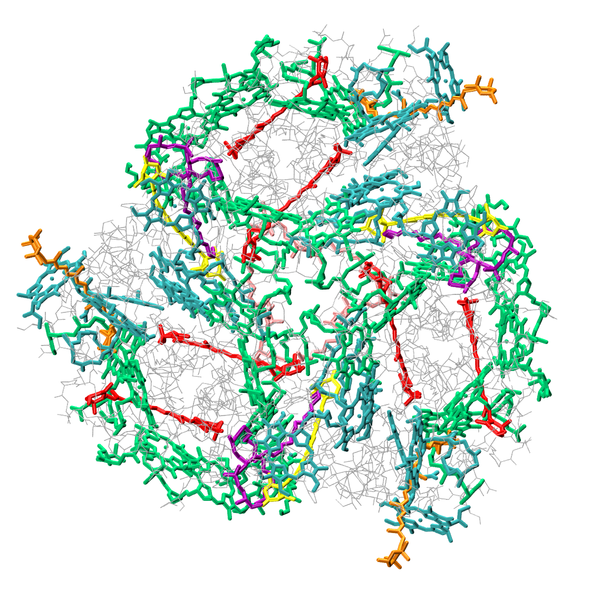
Excited State Studies of Carotenoid Photoactive Proteins: Light Harvesting Complex II and Orange Carotenoid Protein
K. Grace Johnson, Deniz Tuna and Todd J. Martínez
Department of Chemistry and The PULSE Institute, Stanford University, Stanford, California 94305, United States; SLAC National Accelerator Laboratory, Menlo Park, California 94025, United States
Introduction
LHC II
OCP
The light harvesting protein complex of photosystem II (LHCII) in photosynthetic plants serves as a photosynthetic antenna: carotenoid and chlorophyll chromophores within the protein complex absorb photons and transmit the resulting excitation energy to photosystem II. The exact mechanism of excitation energy transfer is still highly debated.¹ Due to the size of the system (54 chromophores and 10,000+ atoms) and the range of timescales over which transfer processes occur, a computational study of full system dynamics has yet to be undertaken. Here we describe an ab initio exciton method^{2,3,4} to study the dynamics of the excitation energy transfer.
Orange Carotenoid Protein (OCP) is a photoactive protein found in cyanobacteria. Photoactivated OCP dissipates excess light energy absorbed by the light-harvesting complex into heat to prevent damage to the photosynthetic apparatus,⁵ a phenomenon which has been termed “nonphotochemical quenching.” Here, we present our first results on setting up the protein system for subsequent multiple-spawning dynamics simulations with a QM/MM setup.
¹ C. Curutchet, B. Mennucci,, Chem. Rev. 2017, 117, 294-343.
² X. Li, et al., J. Chem. Theory Comput. 2017, 13, 3493-3504.
³ A. Sisto, D. R. Glowacki, T. J. Martínez,, Acct. Chem. Res. 2014, 47, 2858-2866.
⁴ A. Sisto, et al., Phys. Chem. Chem. Phys. 2017, 19, 14924-14936.
⁵ D. Kirilovsky, C. A. Kerfeld, Nat. Plants 2016, 2, 1‒7.
⁶ H. Hashimoto, et al., J. Royal Soc. Interface 2018, 15, 20180026
Chromophores in each of three monomers:
8 chlorophyll a
6 chlorophyll b
2 lutein
1 neoxanthin
1 violaxanthin
Sub-system studies: lutein
Full system studies: Construct Exciton Hamiltonian from independent calculations (TDDFT) of chromophore excited states

