Slide 1
Health Information System
By Grace Muli
Date: 27th April 2025

Slide 2
Introduction
The goal was to build a lightweight, functional Health Information System for doctors to manage clients and health programs, with a focus on simplicity, modularity, and clean design.
Tasks solved:
Client registration
Program management
Client enrollments into multiple health programs
Search for clients
View a client’s detailed profile
Expose client profiles via a RESTful API for integration

Slide 3
Approach
Flask (Python) was chosen because:
It's lightweight, fast, and simple for building APIs and websites.
It allows clear separation of backend logic, database interaction, and frontend templates.
SQLite was selected because:
It is serverless and perfect for small to medium-sized applications.
No complicated setup, ideal for rapid development.
HTML + CSS for frontend:
Custom templates to create dynamic and responsive pages.
Added a sidebar and improved CSS for better user experience.
Deployment:
Used Render.com for free hosting, showing understanding of real-world deployments.
REST API for exposing client profiles:
Designed the client profiles to be available both via Web UI (HTML pages) and API (JSON endpoints)
This ensures easy future integration with external systems (e.g., mobile apps or other health systems).

Slide 4
System Design
Backend: Separated the code into multiple files for maintainability:
routes.py - handles URLs and logic
forms.py - form handling
utils.py - helper functions (e.g., formatting names)
models.py – for the database models
Frontend:
HTML templates extending base.html
CSS for design and sidebar layout
Database:
Models: Client, Program, and Enrollment tables for many-to-many relationships.

Slide 5
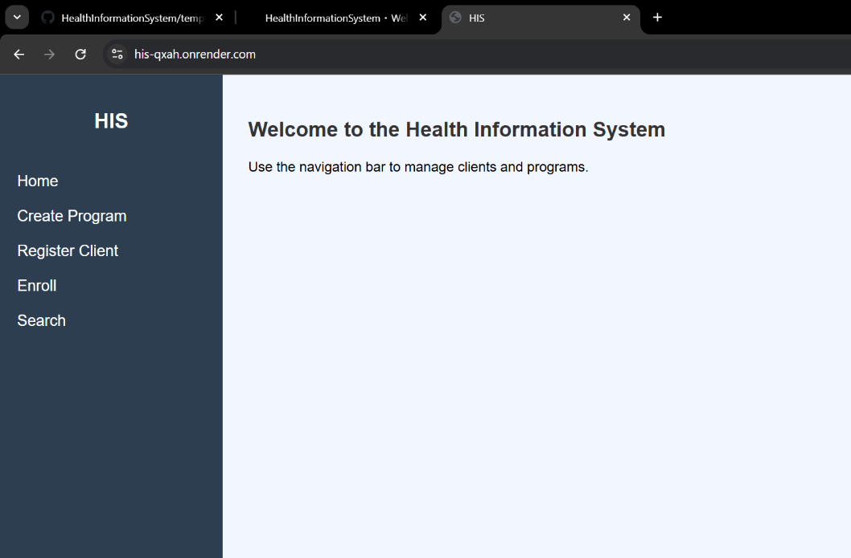
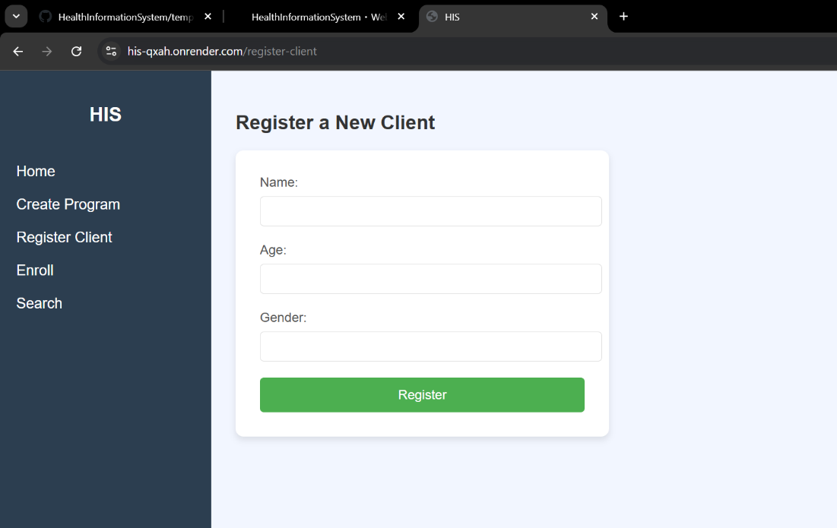
Solution demonstration
Homepage:
Register a client:

Slide 6
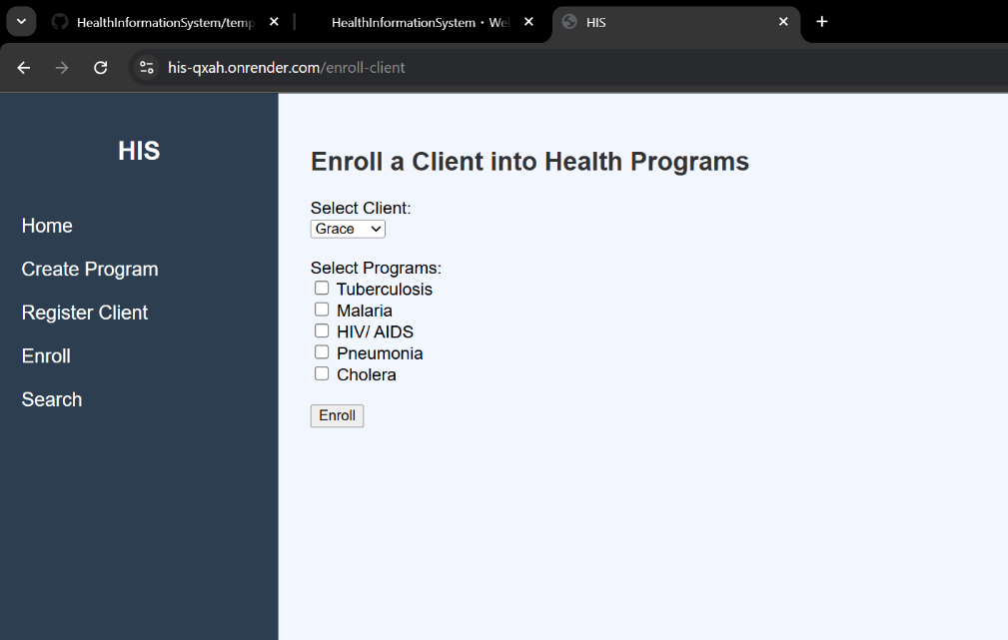
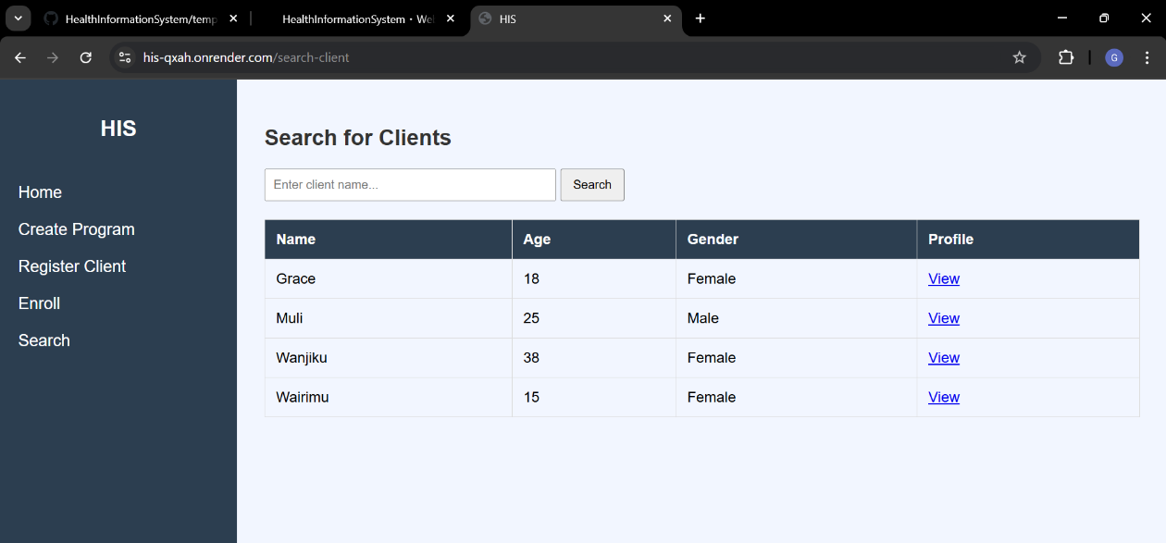
Solution demonstration
Search:
Enroll client:

Slide 7
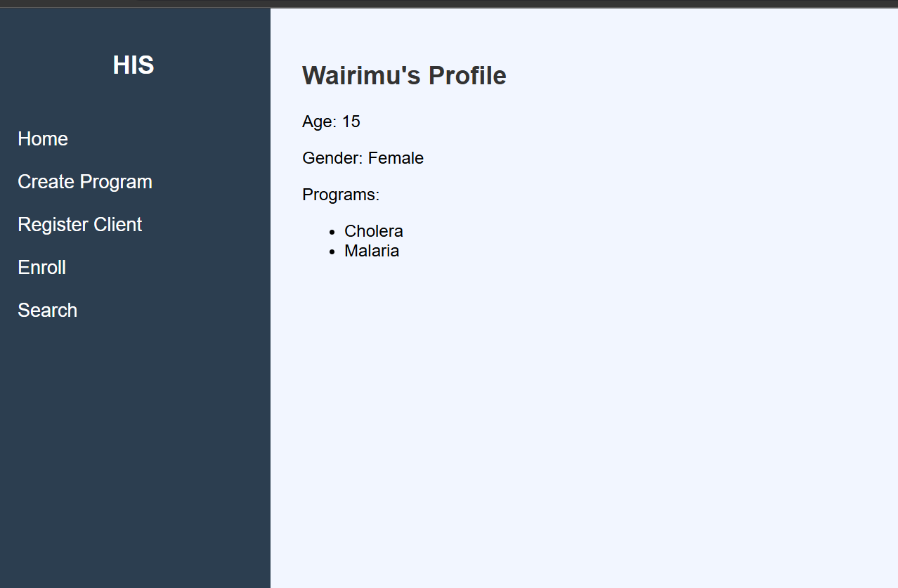
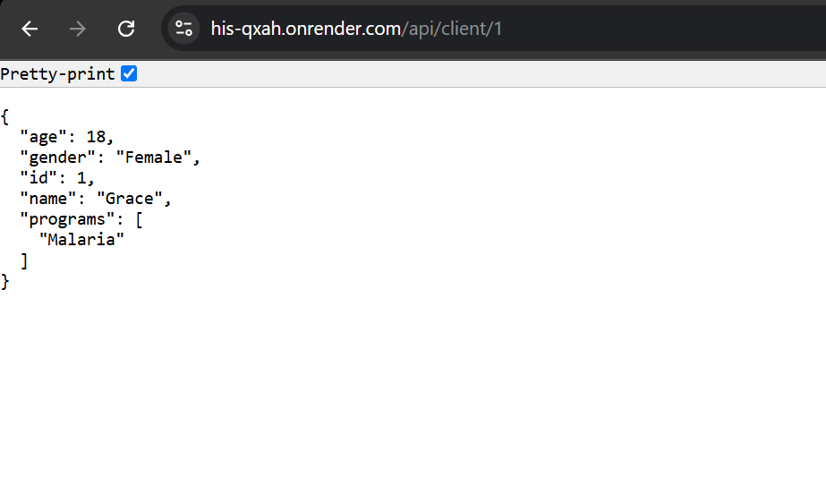
Solution demonstration
Client profile:
Api Json output

Slide 8
Deployment
The system was deployed live using Render at: https://his-qxah.onrender.com

Slide 9
Thank You!
You can find the full project on GitHub: https://github.com/GraceMuli/HealthInformationSystem

