Slide 1
LOW - RISK AIRCRAFT TO PURCHASE
Best Makes to go for:

Slide 2
Summary
This project aims to analyze data and recommend the low-risk aircrafts that a company that is looking into venturing in the aviation business can opt for.
The company also seeks to venture into both private and commercial aircrafts
After Analyzing the dataset we see that the for private venture Boeing 747-123 would be the most preferred while for commercial we would go with Cessna 421B followed by Boeing 727-22C

Slide 3
Outline
01
03
Business problem
Methods
02
04
Data
Results & Conclusion
You can describe business problem
Describe the methods used.Can include data preparation and analysis
Describe relavant characteristics of data
Results of your analysis and recommendations,project limitation and/or future improvement ideas

Slide 4
Business Problem
Our Company is expanding and wants to venture in purchasing and operating aircrafts for commercial and private enterprises, but do not know the potential risks of aircrafts. we are tasked to determine which aircraft are the lowest risk for the company to start this new business endeavor. We then translate finds into actionable insights that the head of the new aviation division can help decide which aircraft to purchase

Slide 5
Data
The data is an aviation dataset from the National Transportation safety board that includes aviation accidents from 1962 to 2023 about civil aviation accidents and selected incidents in the United states and international waters. Every accidents / incident has:
The Injury Severity category it falls into i.e (Minor, Fatal,Non-fatal,serious or incidents)
The level of damage to the aircraft i.e (Destroyed, substantial or minor)
The total number of fatalities, of serious injuries and of uninjured
Purpose of flight whether its personal, business among others but for our scenario we will focus on the two

Slide 6
Methods
I Chose specific columns that are important for my analysis which include Injury severity, Aircraft damage, Make, Model and Purpose of flight.
Our dataset has real incidents and accidents so in our data cleaning for missing values it didn’t seem sensible to fill with the most common values so I dropped the rows with minimal NA values e.g. Make and Model column which has less than 0.00071% and 0.00055 respectively. For the other columns I filled with placed ‘Unknown’ or ‘UNK depending on the placeholder for that column
For my analysis I did a low risk test of each feature and then finally all factors together that would bring about a low risk aircraft

Slide 7
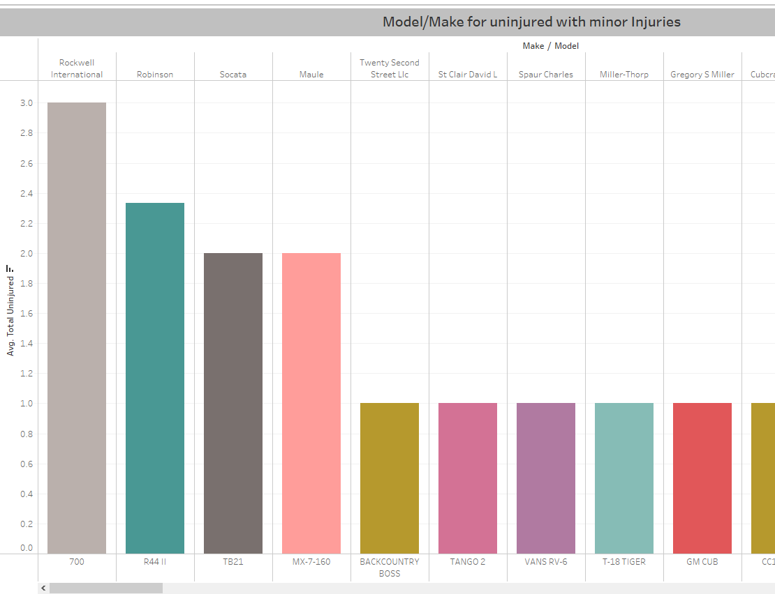
Results
I grouped the results based on whether it is private or public category 1.For personal/Private Enterprises with greater No of uninjured and with Minor Injury severity
a)private
Rockwell 700 and Robinson 411 had greater no of uninjured with minor injury severity

Slide 8
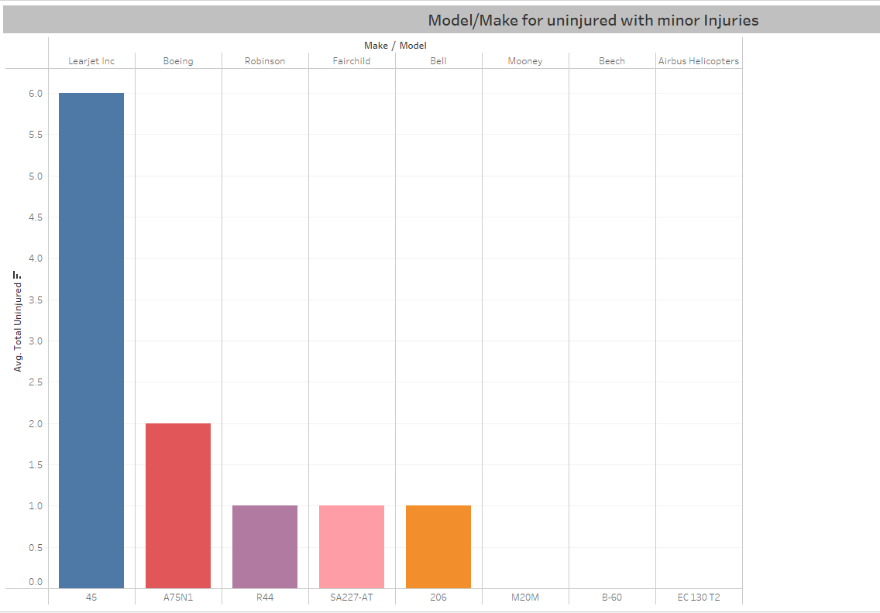
Results
b)Commercial
Learjet 45 followed by Boeing A75NI

Slide 9
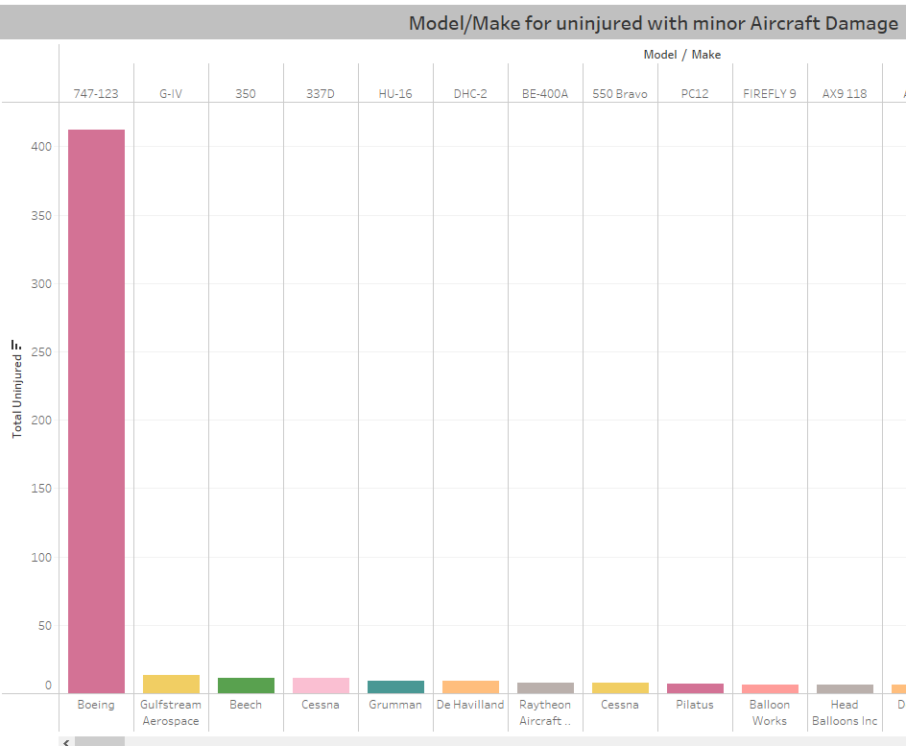
Results
2. For personal/private enterprises with greater no of injured for minor Aircraft Damage
a)private
Boeing 747-123 had greater no of total uninjured with minor damages to the aircraft

Slide 10
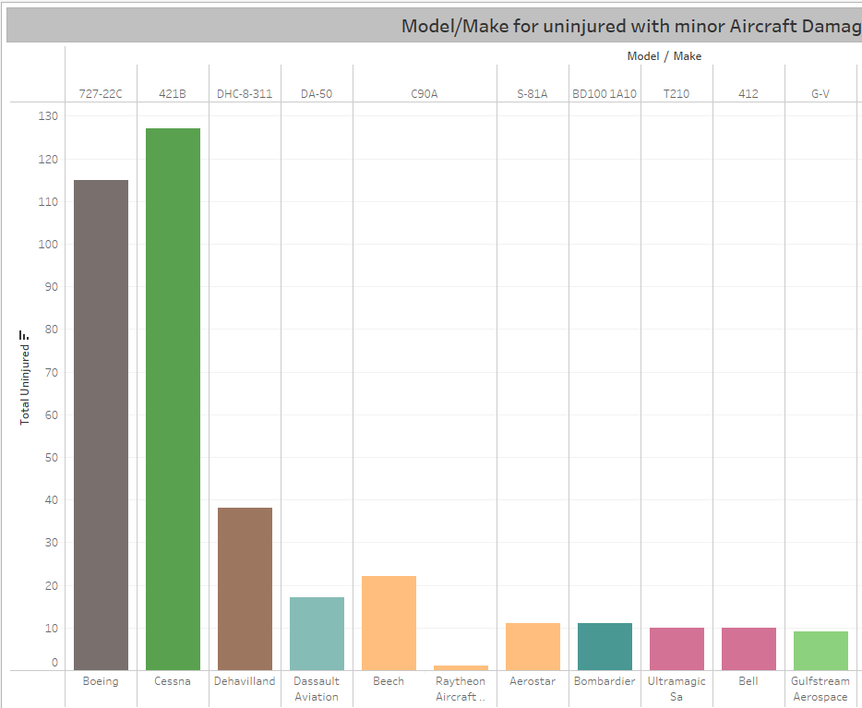
Results
b)Commercial
Cessna 421B followed by Boeing 727-22C

Slide 11
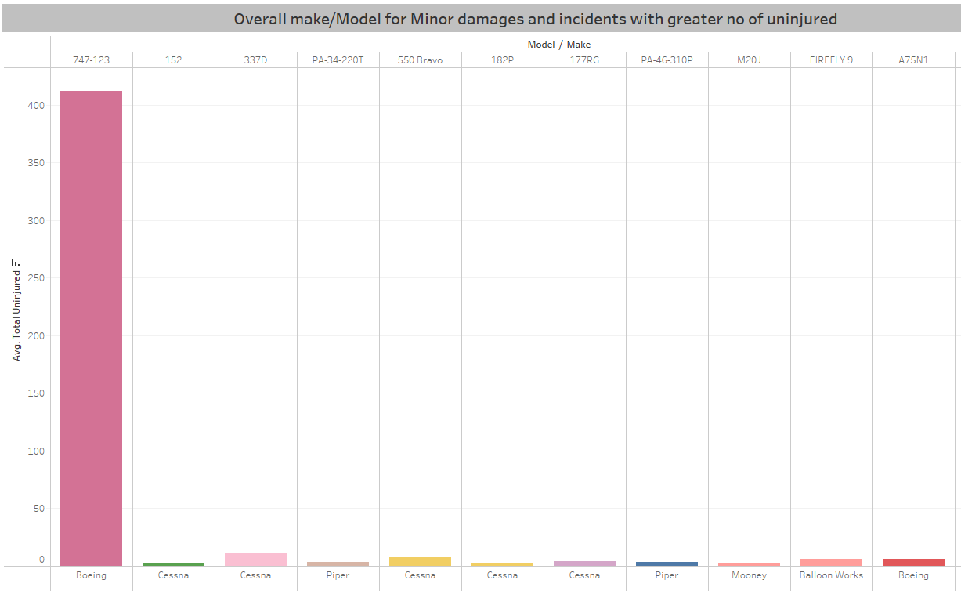
Results
3. Overall low risk Aircrafts with greater no of uninjured, has Incidents and minor Aircraft Damage
a)private
Boeing 747-123 followed by Cessna 337D then Cessna 550 Bravo

Slide 12
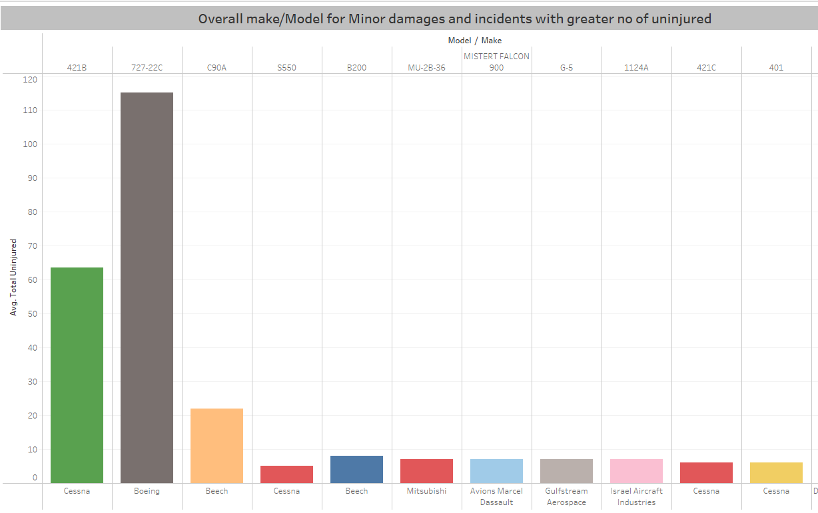
Results
b)Commercial
Cessna 421B followed by Boeing 727-22C

Slide 13
CONCLUSIONS
01
03
This analysis led to the following recommendations on the best aircraft to purchase:
Overall Low Risk
For private enterprise the low risk is Boeing 747-123 overall while commercial is Cessna 421B followed by Boeing 727-22C
Makes to Consider
Overall makes to consider are Cessna, Boeing , Piper, and Beech
02
Low Risk on Minor Injury
If priority is based on minor injury severity than aircraft damage then Rockwell 700 and Robinson 411 are preferrable for private venture and Learjet 45 followed by Boeing A75NI for commercial

Slide 14
THANKS!
Email: gracemwendemicheni@gmail.com
Github: https://github.com/GraceMwende
Linkedin: https://www.linkedin.com/in/gracemwende/

