Slide 1
Real-Time Ensemble Estimation Model

Slide 2
Preliminaries
Gaussian Process Regression
For a new query point x*
The posterior probability distribution of y*:

Slide 3
Real-time Ensemble Estimation Model
Partition and Training based on KD-Tree with Spatial Features and Weather Features.
We set the threshold as k and select the (d_tree-k)th layer as the divided layer.
Notes:
鲁棒性好
相邻相似性

Slide 4
The second layer: frequency analysis
Notes:
加数据实证分析
时间周期性
126

Slide 5

Ensemble and Estimation
We train each subset based on the GPR method and use the average kernel value of most relative samples as the weight of ensemble
$$w_{i}=mean(top(K\left(x_{∗}, X^{i}\right))$$
Notes:
Top:降噪
结合KD－tree，鲁棒性，集成学习加速训练
复杂性分析

Slide 6
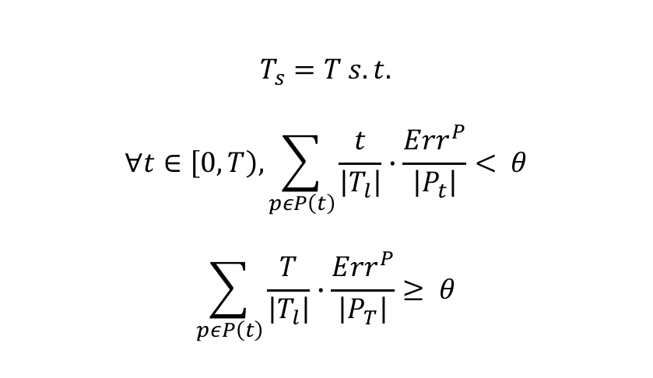
Two-Layer Self-Adaptivity Framework
The data in T_l time window is used for training hyper-parameters and constructing KD-Tree;
We update the training set and re-train the model after T_s time slices. T_s is determined by the equation:
$$T_{s}=T s.t.$$
$$∀t∈\left[0, T\right), \sum_{pεP\left(t\right)}{\frac{t}{\left|T_{l}\right|}∙\frac{Err^{P}}{\left|P_{t}\right|}}< θ$$
$$\sum_{pεP\left(t\right)}{\frac{T}{\left|T_{l}\right|}∙\frac{Err^{P}}{\left|P_{T}\right|}}≥ θ$$
Notes:
框架动机：自适应的目的，选择这个自适应框架的原因
在百分比法的基础上加了时间因素
（找找相关自适应论文）
为什么引入自适应性？
为什么要用这种框架？

Slide 7
Two-Layer Self-Adaptivity Framework
During the T_s time window, for a new sample [x_new, y_new]
When the time reaches T_s after training, we slide the training time window and remove stale samples from KD-tree
The new samples X_add is added to the KD-Tree:

