Slide 1
组会报告
Wangyun

Slide 2
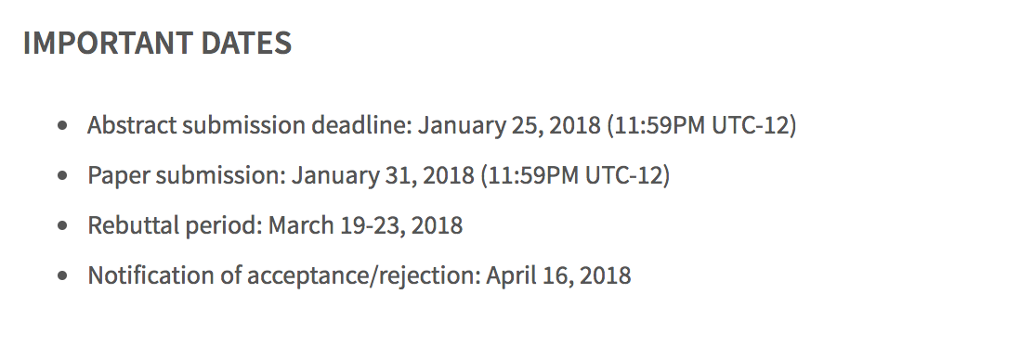
Submission Site: http://ijcai2018.confmaster.net
papers will be subject to double blind pee

Slide 3
Paper length and format
Submitted technical papers must be no longer than seven pages in total: six pages for the main text of the paper (including all figures but excluding references), and one additional page for references. Note that the references page can only include references.
For accepted papers, up to two additional pages may be purchased at an additional cost per page, but note that at the time of submissions, papers should adhere to the guidelines above: 6 pages for main text plus one page for references.
IJCAI-ECAI-18 will not accept any supplementary materials other than those specified in the paragraph ‘RESUBMISSIONS OF SUBSTANTIALLY IMPROVED AAAI-18 Submissions’ below.(不接受任何补充材料出了 AAAI resubmission提到的那些问题)

Slide 4
RESUBMISSIONS OF SUBSTANTIALLY IMPROVED AAAI-18 Submissions
Authors of declined AAAI-18 submissions may submit substantially improved versions to IJCAI-ECAI-18
the resubmission can be accompanied by all three of the following, as a single file:
a cover letter that explains how the revised submission addresses the comments of the AAAI-18 reviewers,
the AAAI-18 paper,
the full AAAI-18 reviews.

Slide 5
六页布局
1.5页 abstract + introduction + related work
2.5页 问题定义＋模型
2页 实验
GNE:
1.5页abstract + introduction + related work
3.5页 模型部分
2页 实验 （实验的图可以再调小一点）

Slide 6
需要增加的内容
1. 大数据集实验结果
2. 调参策略
Reviewer_2:
3. 添加算法框
4. 要求增加比较时间的实验

