Slide 1
Binary Classification with a Bank Churn Dataset
Kaggle Competitions - Playground Series - Season 4, Episode 1
https://github.com/Gracee2024/5622-final

Slide 2
Content
Dataset Description
Exploratory Data Analysis
Feature Engineering
Modeling, Results and Analysis

Slide 3
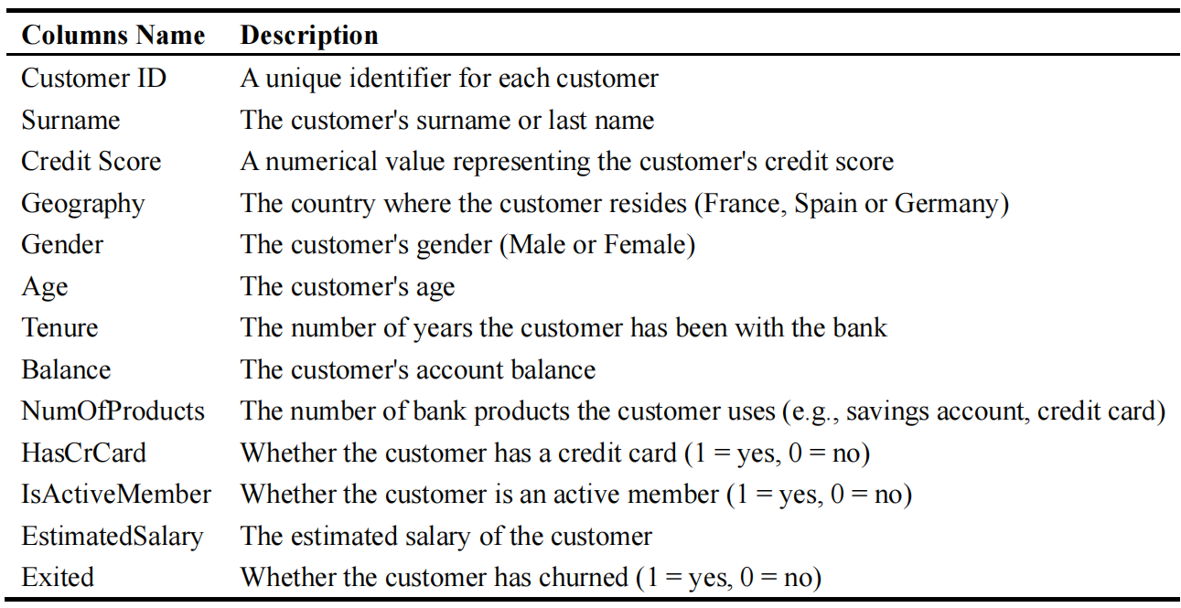
Dataset Description
The bank customer churn dataset contains information on bank customers who either left the bank or continue to be a customer. The dataset includes the following attributes:
Table 1 Dataset Description
[1] Data Source: Reade, W., & Chow, A. (2024). Binary Classification with a Bank Churn Dataset. Kaggle. Retrieved from https://kaggle.com/competitions/playground-series-s4e1

Slide 4
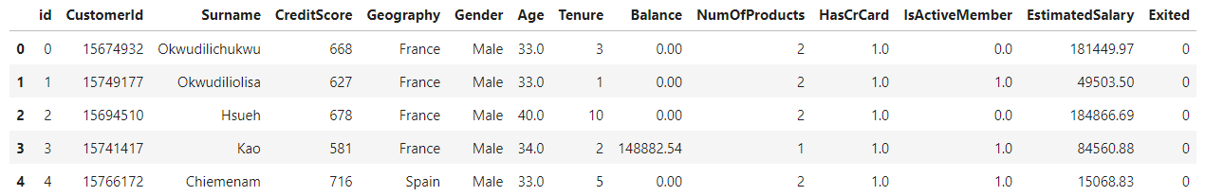
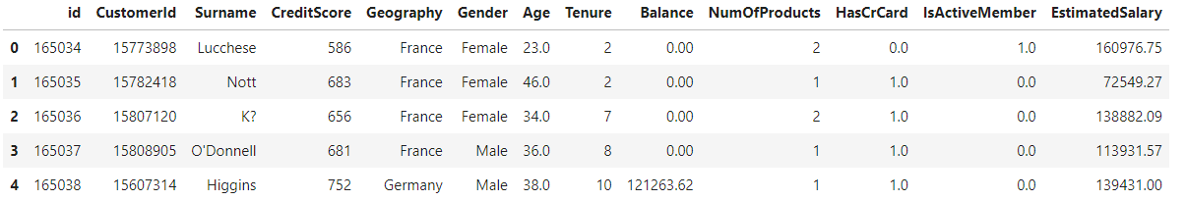
Dataset Description
Training data
Test data (without target)

Slide 5
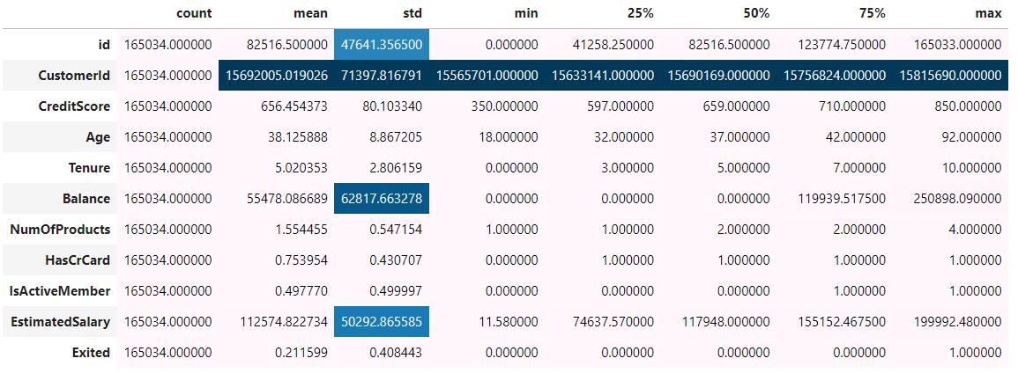
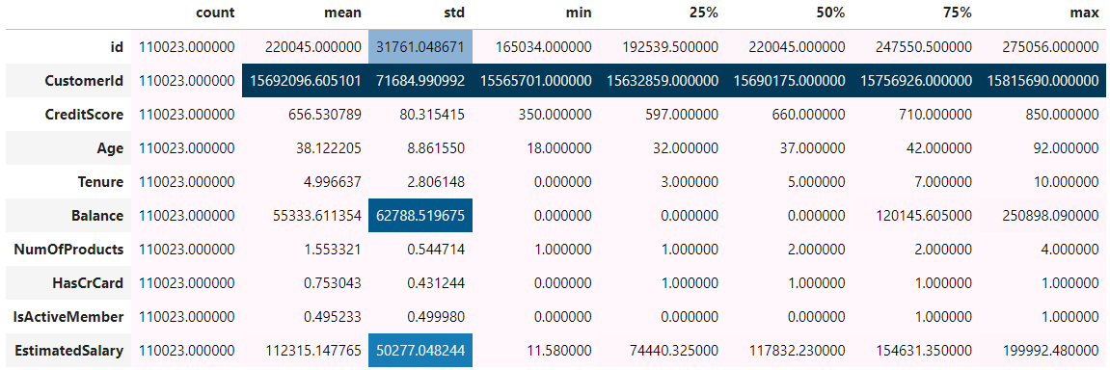
Descriptive Analysis
Training data
The distribution of the training data and the test data remains essentially consistent.
Test data (without target)

Slide 6
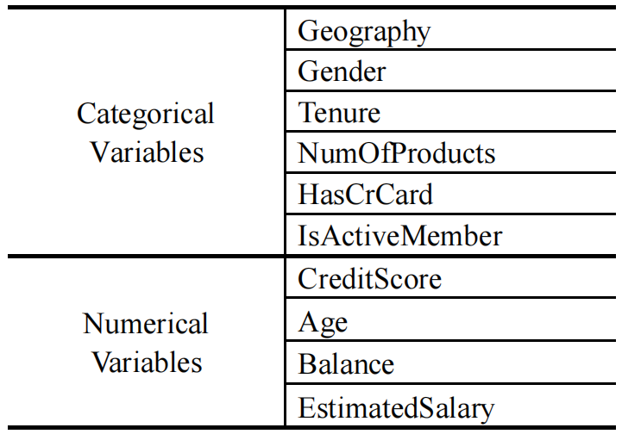
Descriptive Analysis
Table 2 Variable Type

Slide 7
Content
Dataset Description
Exploratory Data Analysis
Feature Engineering
Modeling, Results and Analysis

Slide 8
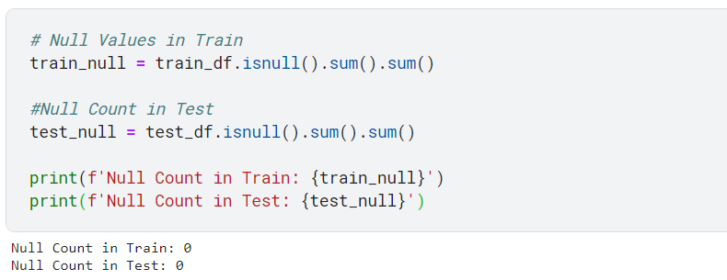
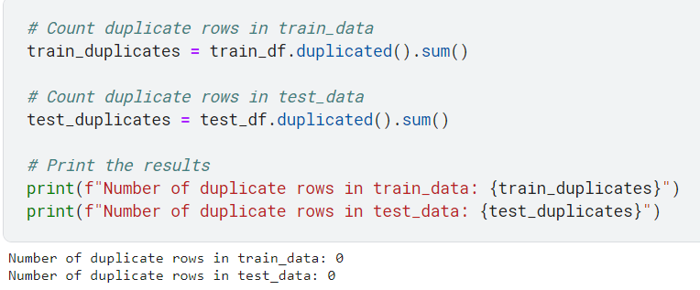
Null & Duplicate Values
Null values
As we can see there have no null values in the both train and test data.
Duplicates Values
As we can see there have no duplicate values in the both train and test data.

Slide 9
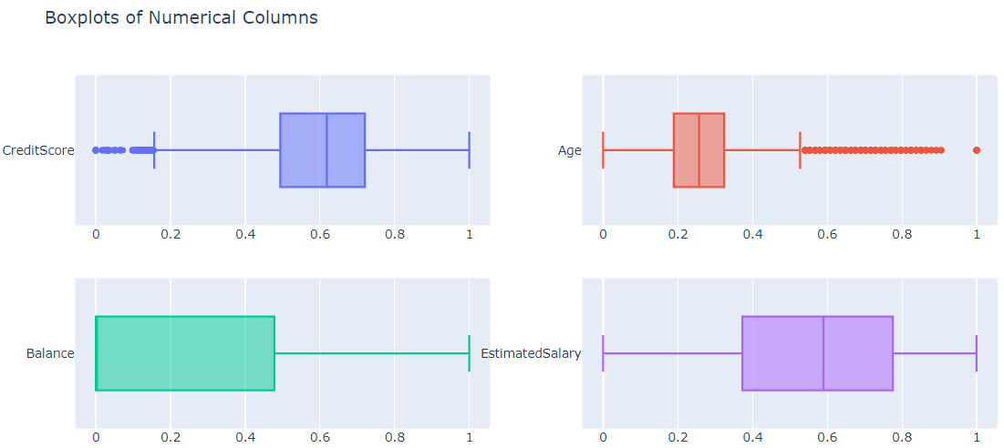
Detect Outliers
Despite the presence of numerous points that deviate from the quantiles in the graph, these data are consistent with reality and are not considered outliers.

Slide 10
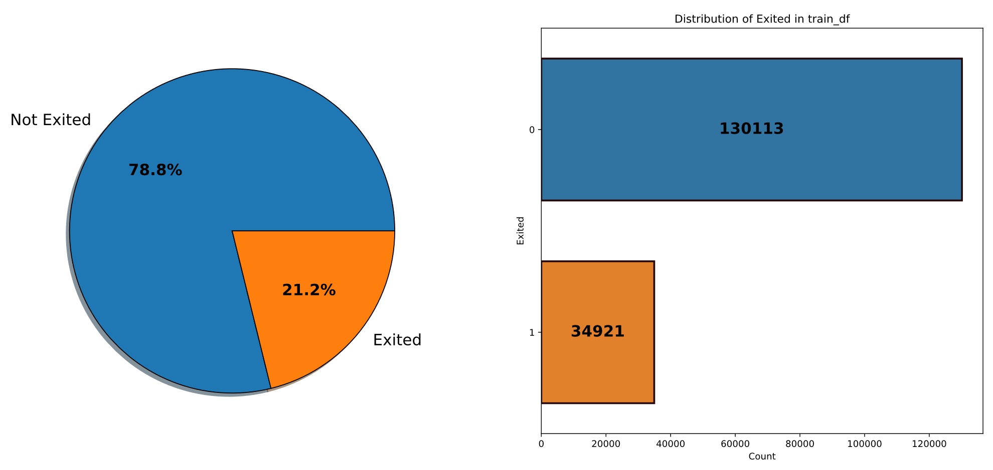
Target Distribution
The distribution of categories for this variable is imbalanced, indicating a potential issue

Slide 11
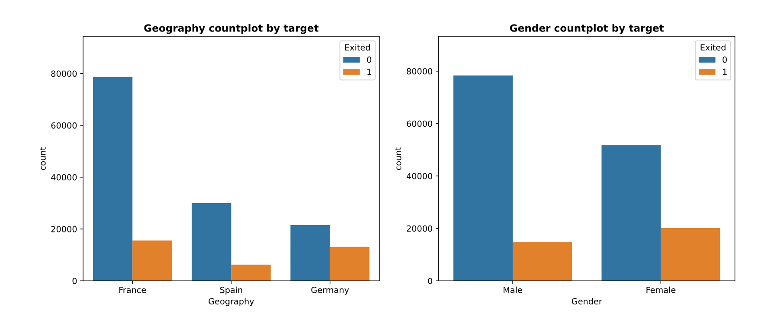
Categorical Value Analysis
The distribution of the `Geography` and `Gender` attributes among churned users are inconsistent with those of non-churned users.

Slide 12
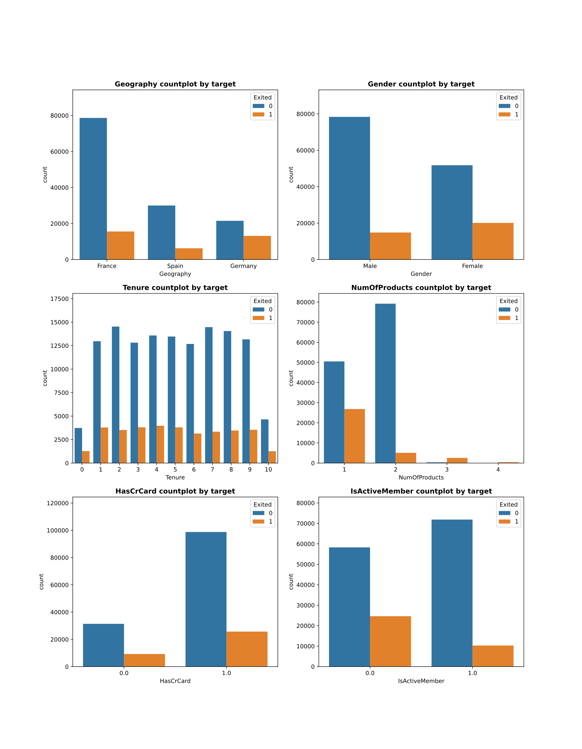
Categorical Value Analysis
The distribution of the `Tenure` attribute among churned users is essentially consistent with that of non-churned users, while the `NumOfProducts` attribute among churned users is inconsistent with that of non-churned users.

Slide 13
Categorical Value Analysis
The distribution of the `hascrcard` attribute among churned users is largely consistent with that of non-churned users, whereas the distribution of the `isActivate` attribute among churned users is inconsistent with that of non-churned users.

Slide 14
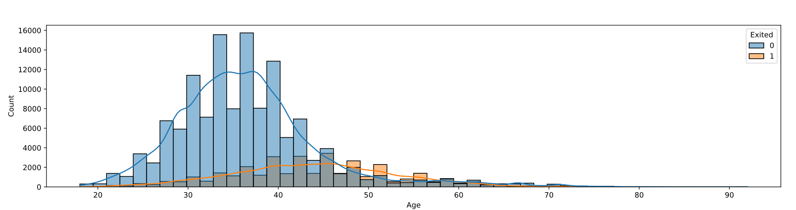
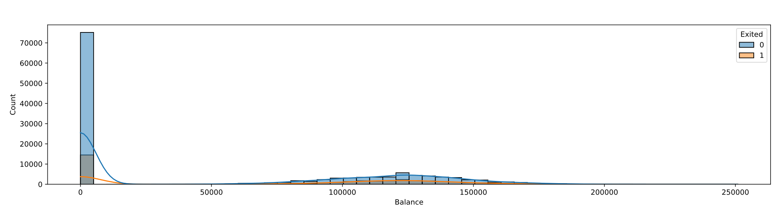
Numerical Value Analysis
The distribution of `age` and `Balance` attributes among churned users is differ from those of non-churned users.

Slide 15
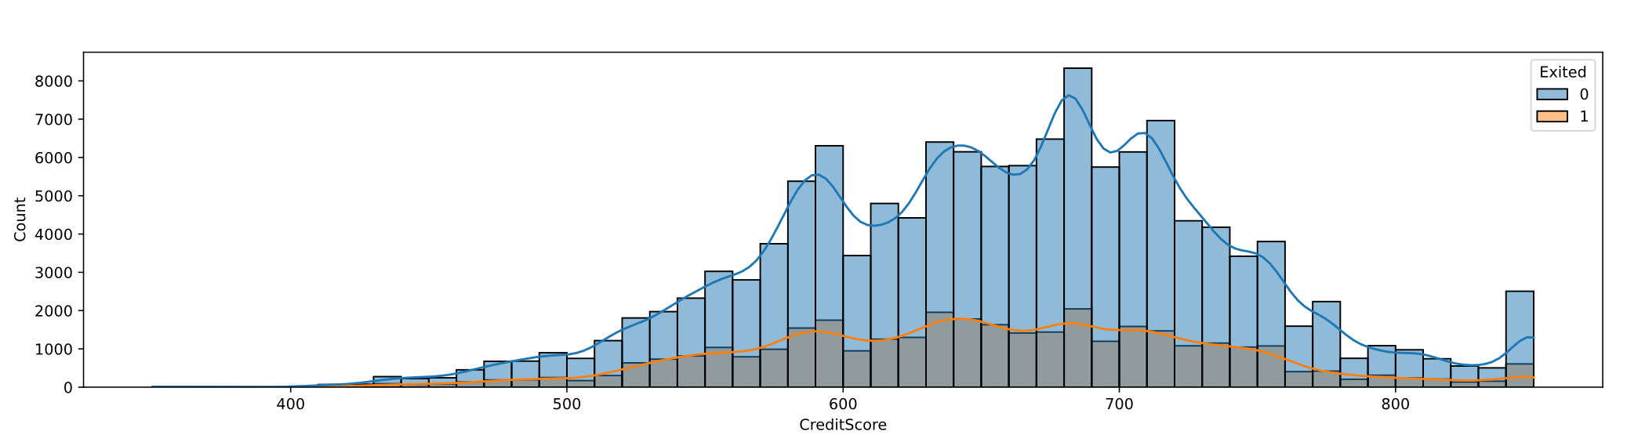
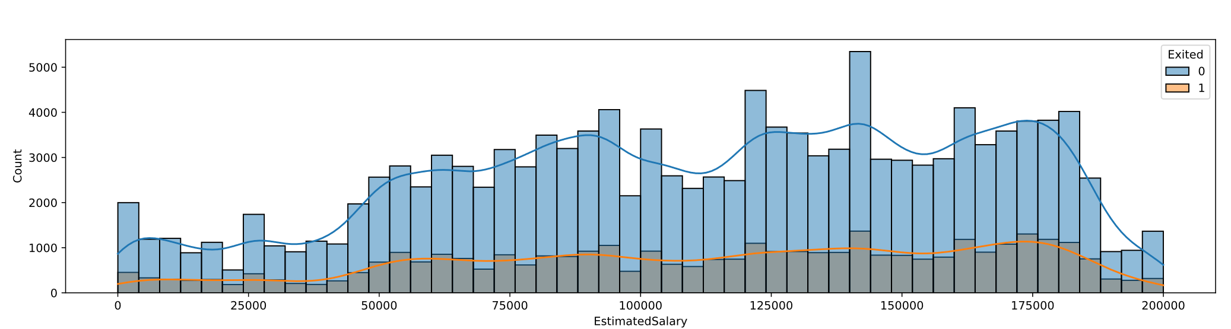
Numerical Value Analysis
The distribution of `CreditScore` and `EstimateSalary` attributes among churned users is consistent with that those of non-churned users.

Slide 16
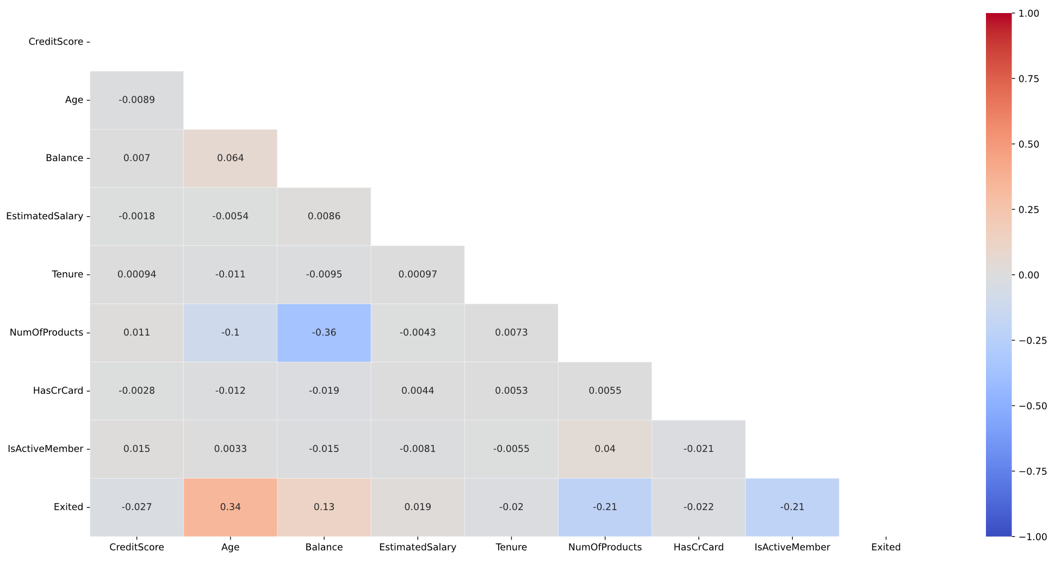
Correlation Matrix
The variables `Age`, `Balance`, `NumOfProducts`, and `IsActiveMember` exhibit a significant linear relationship with Exited.

Slide 17
Content
Dataset Description
Exploratory Data Analysis
Feature Engineering
Modeling, Results and Analysis

Slide 18
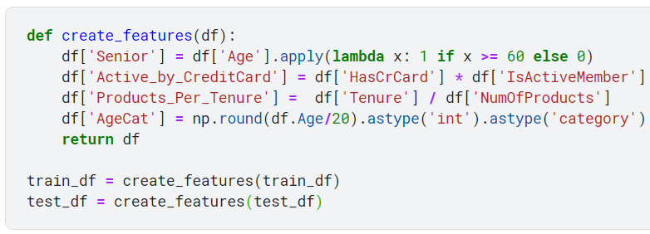
Create Features
The create_features function enhances a given DataFrame by creating new features based on existing ones. Here's a concise summary of the code:
Senior: Adds a binary column indicating whether a person is a senior (age 60 or above).
Active_by_CreditCard: Multiplies the binary columns 'HasCrCard' and 'IsActiveMember' to create a new feature.
Products_Per_Tenure: Calculates the ratio of 'Tenure' to 'NumOfProducts' and creates a new column.
AgeCat: Divides ages by 20, rounds the result, and converts it to a categorical variable.
The function then returns the modified DataFrame with these additional features.

Slide 19
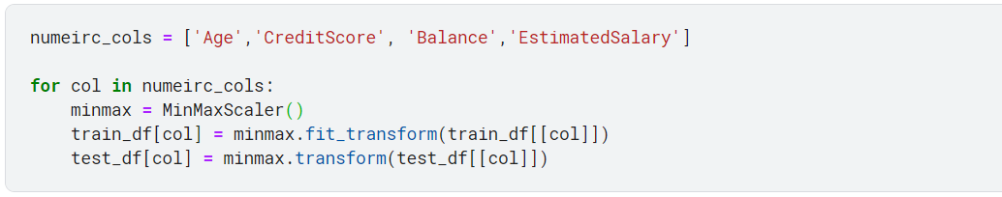
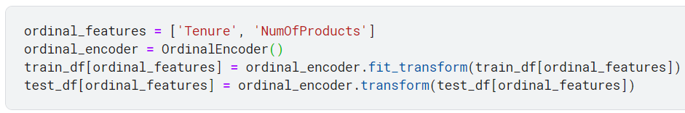
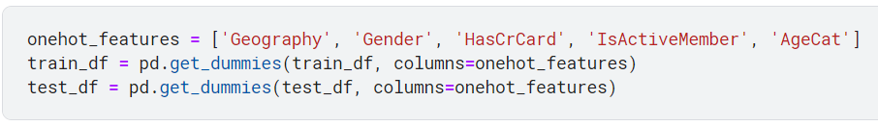
Feature Transformation
Min-Max Standardization
Scaling the numerical variables to the range [0, 1].
Ordinal Encoding
Convert categorical features into quantitative features.
One-hot Encoding
One-hot encoding

Slide 20
Content
Dataset Description
Exploratory Data Analysis
Feature Engineering
Modeling, Results and Analysis

Slide 21
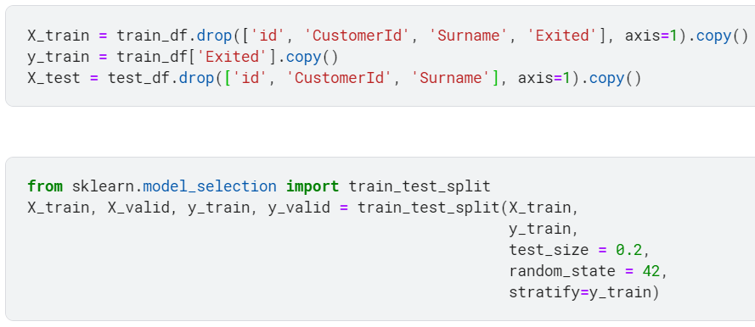
Train-Valid-Test Split
(Ensure that the distribution of the target variable in the valid set is consistent with that in the training set)
Test ratio = 0.2, stratify=y_train

Slide 22
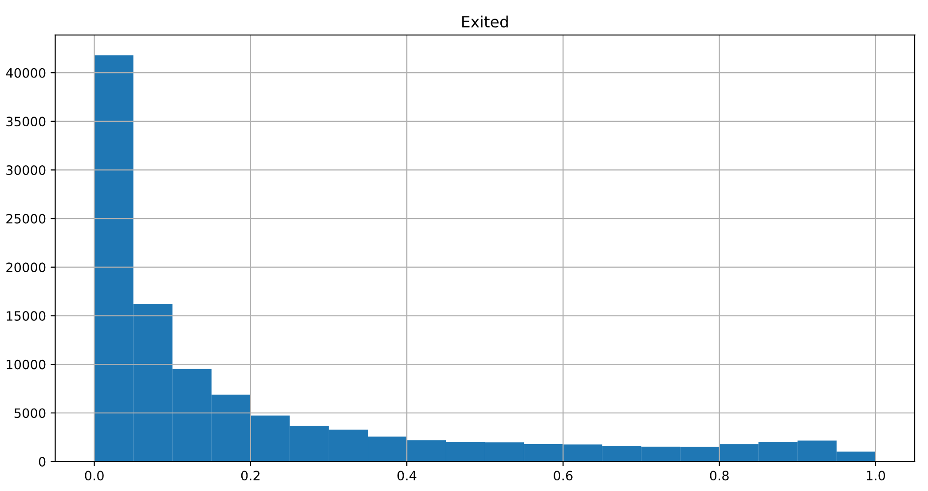
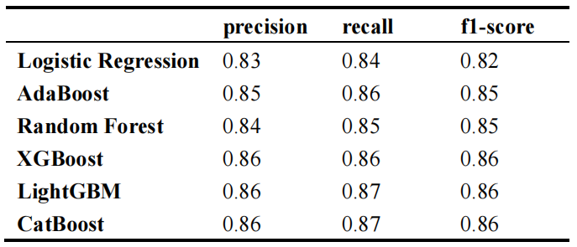
Results
Table 3 Results with different models
XGBoost
LightGBM
CatBoost
Voter
Result
The performance of XGBoost, LightGBM, and CatBoost algorithms is quite similar. To further enhance the robustness of our models and reduce their variance, we utilized a voting method.

Slide 23
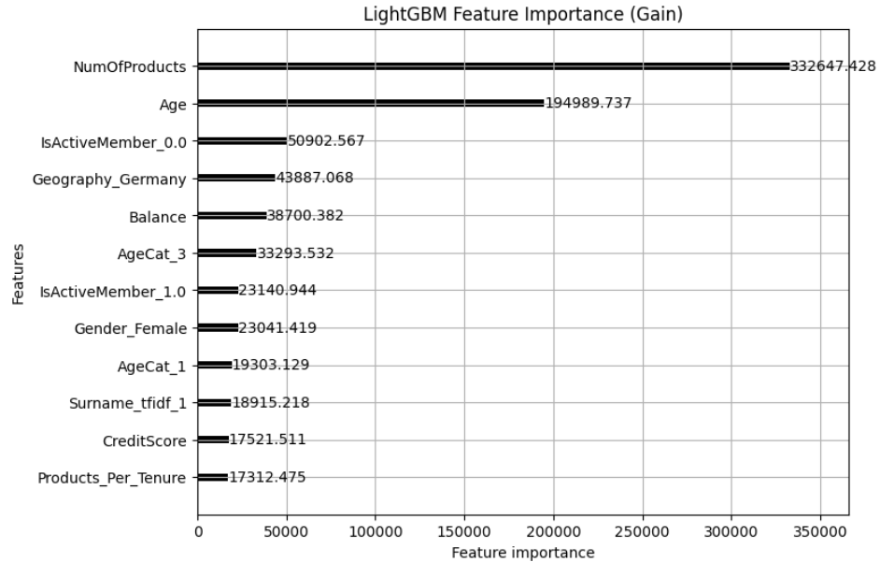
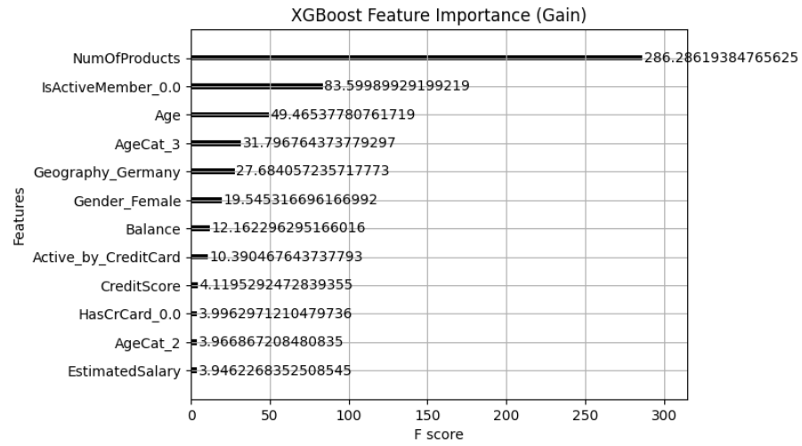
Feature Importance
Regarding feature importance rankings from LightGBM and XGBoost, as previously mentioned, the attribute of `NumOfProducts` is the most critical variable, followed by `Age` and so on.

Slide 24
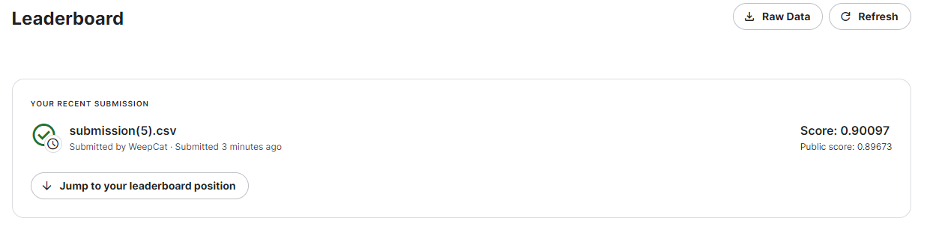
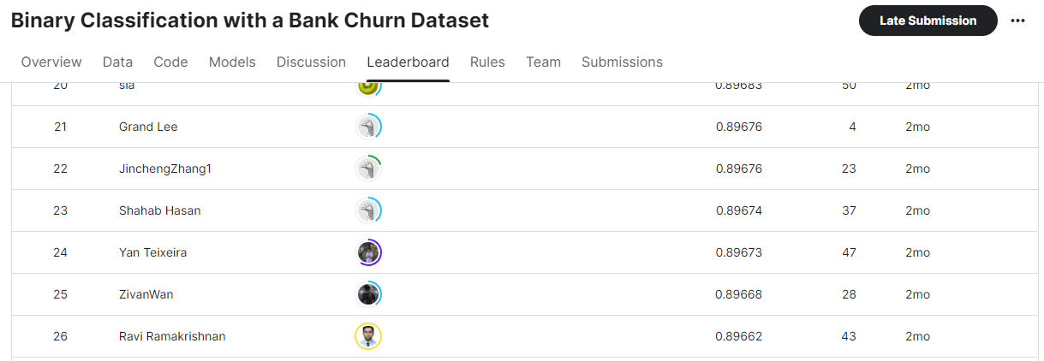
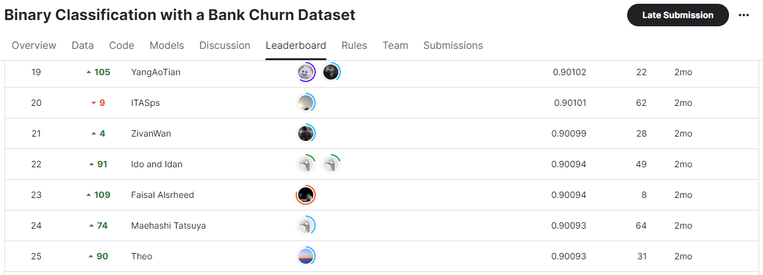
Result
Public
Private

Slide 25
Discussion & Conclusion
Gains: We applied several classification algorithms learned from the course, such as Logistic Regression, AdaBoost, and Random Forest, to real-world tasks. I also studied three common Boosting methods used in data mining competitions: XGBoost, LightGBM, and CatBoost, and mastered some basic feature engineering techniques, including one-hot encoding and scaling.
Additionally, I experimented with applying SVM and KNN to our tasks. However, as the number of features and the volume of samples increased, the efficiency of these two algorithms plummeted, leading us to ultimately exclude them from consideration. At the same time, we attempted to use target encoding for feature construction, but the results indicated that this approach exacerbated model overfitting.
Suggestions: Last but not least, it's worth considering the TF-IDF method for handling textual features in the data, which could potentially enhance model performance further. More parameter optimization techniques can be applied to XGBoost, LightGBM, and CatBoost.

