Slide 1

Credit Card Fraud Detection
— Anonymized Credit Card Transactions Labeled as Fraudulent or Genuine
Link: GitHub repo link

Slide 2
Content
Background
Dataset Description
Exploratory Data Analysis
Model Building and Training
Conclusions

Slide 3
Background
Definition: Financial fraud involves the use of deceitful practices to illegally obtain money or assets
Examples:
  Credit card fraud
  Identity theft
  Insurance scams
  Investment scams
Importance of Financial Fraud Detection
  Preventing Economic Losses: Globally, billions of dollars are lost annually due to financial fraud.
  Enhancing Trust: Effective fraud detection systems increase user confidence in financial services.
  Legal Compliance: Financial institutions have a legal obligation to prevent fraudulent activities.
  Technological Advancements: Advanced data analytics, machine learning, and artificial intelligence can improve accuracy in detecting fraudulent behavior.
The task involves developing and implementing advanced algorithms to detect fraudulent activities in bank transactions.

Slide 4
Content
Background
Dataset Description
Exploratory Data Analysis
Model Building and Training
Conclusions

Slide 5
Dataset Description
The dataset contains transactions made by credit cards in September 2013 by European cardholders. This dataset presents transactions that occurred in two days, where we have 492 frauds out of 284,807 transactions. The dataset is highly unbalanced, the positive class (frauds) account for 0.172% of all transactions.
creditcard.csv
Time: Number of seconds elapsed between this transaction and the first transaction in the dataset
V1-V28: Features after dimensionality reduction to protect user identities and sensitive features
Amount: Transaction amount
Class: Target Class (1 for fraudulent transactions, 0 genuine)
Data Source By: https://www.kaggle.com/datasets/mlg-ulb/creditcardfraud

Slide 6
Content
Background
Dataset Description
Exploratory Data Analysis
Model Building and Training
Conclusions

Slide 7
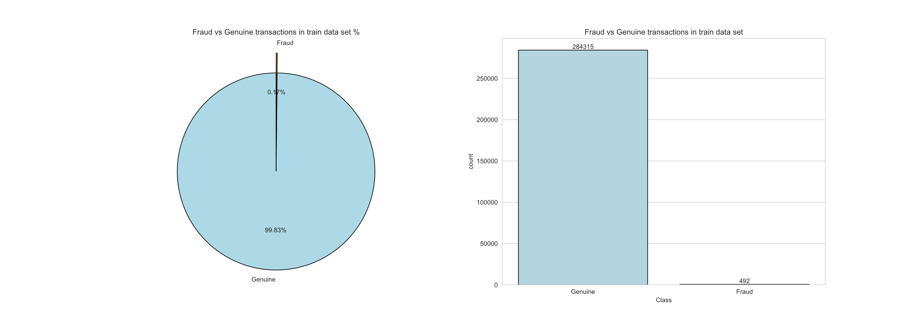
DATA IMBALANCE
We have 99.8% (284,807) of Genuine transactions and only 0.172% (492) of fraud transactions!
This means that a blind guess (bet on Genuine) would give us accuracy of 99,8%.

Slide 8
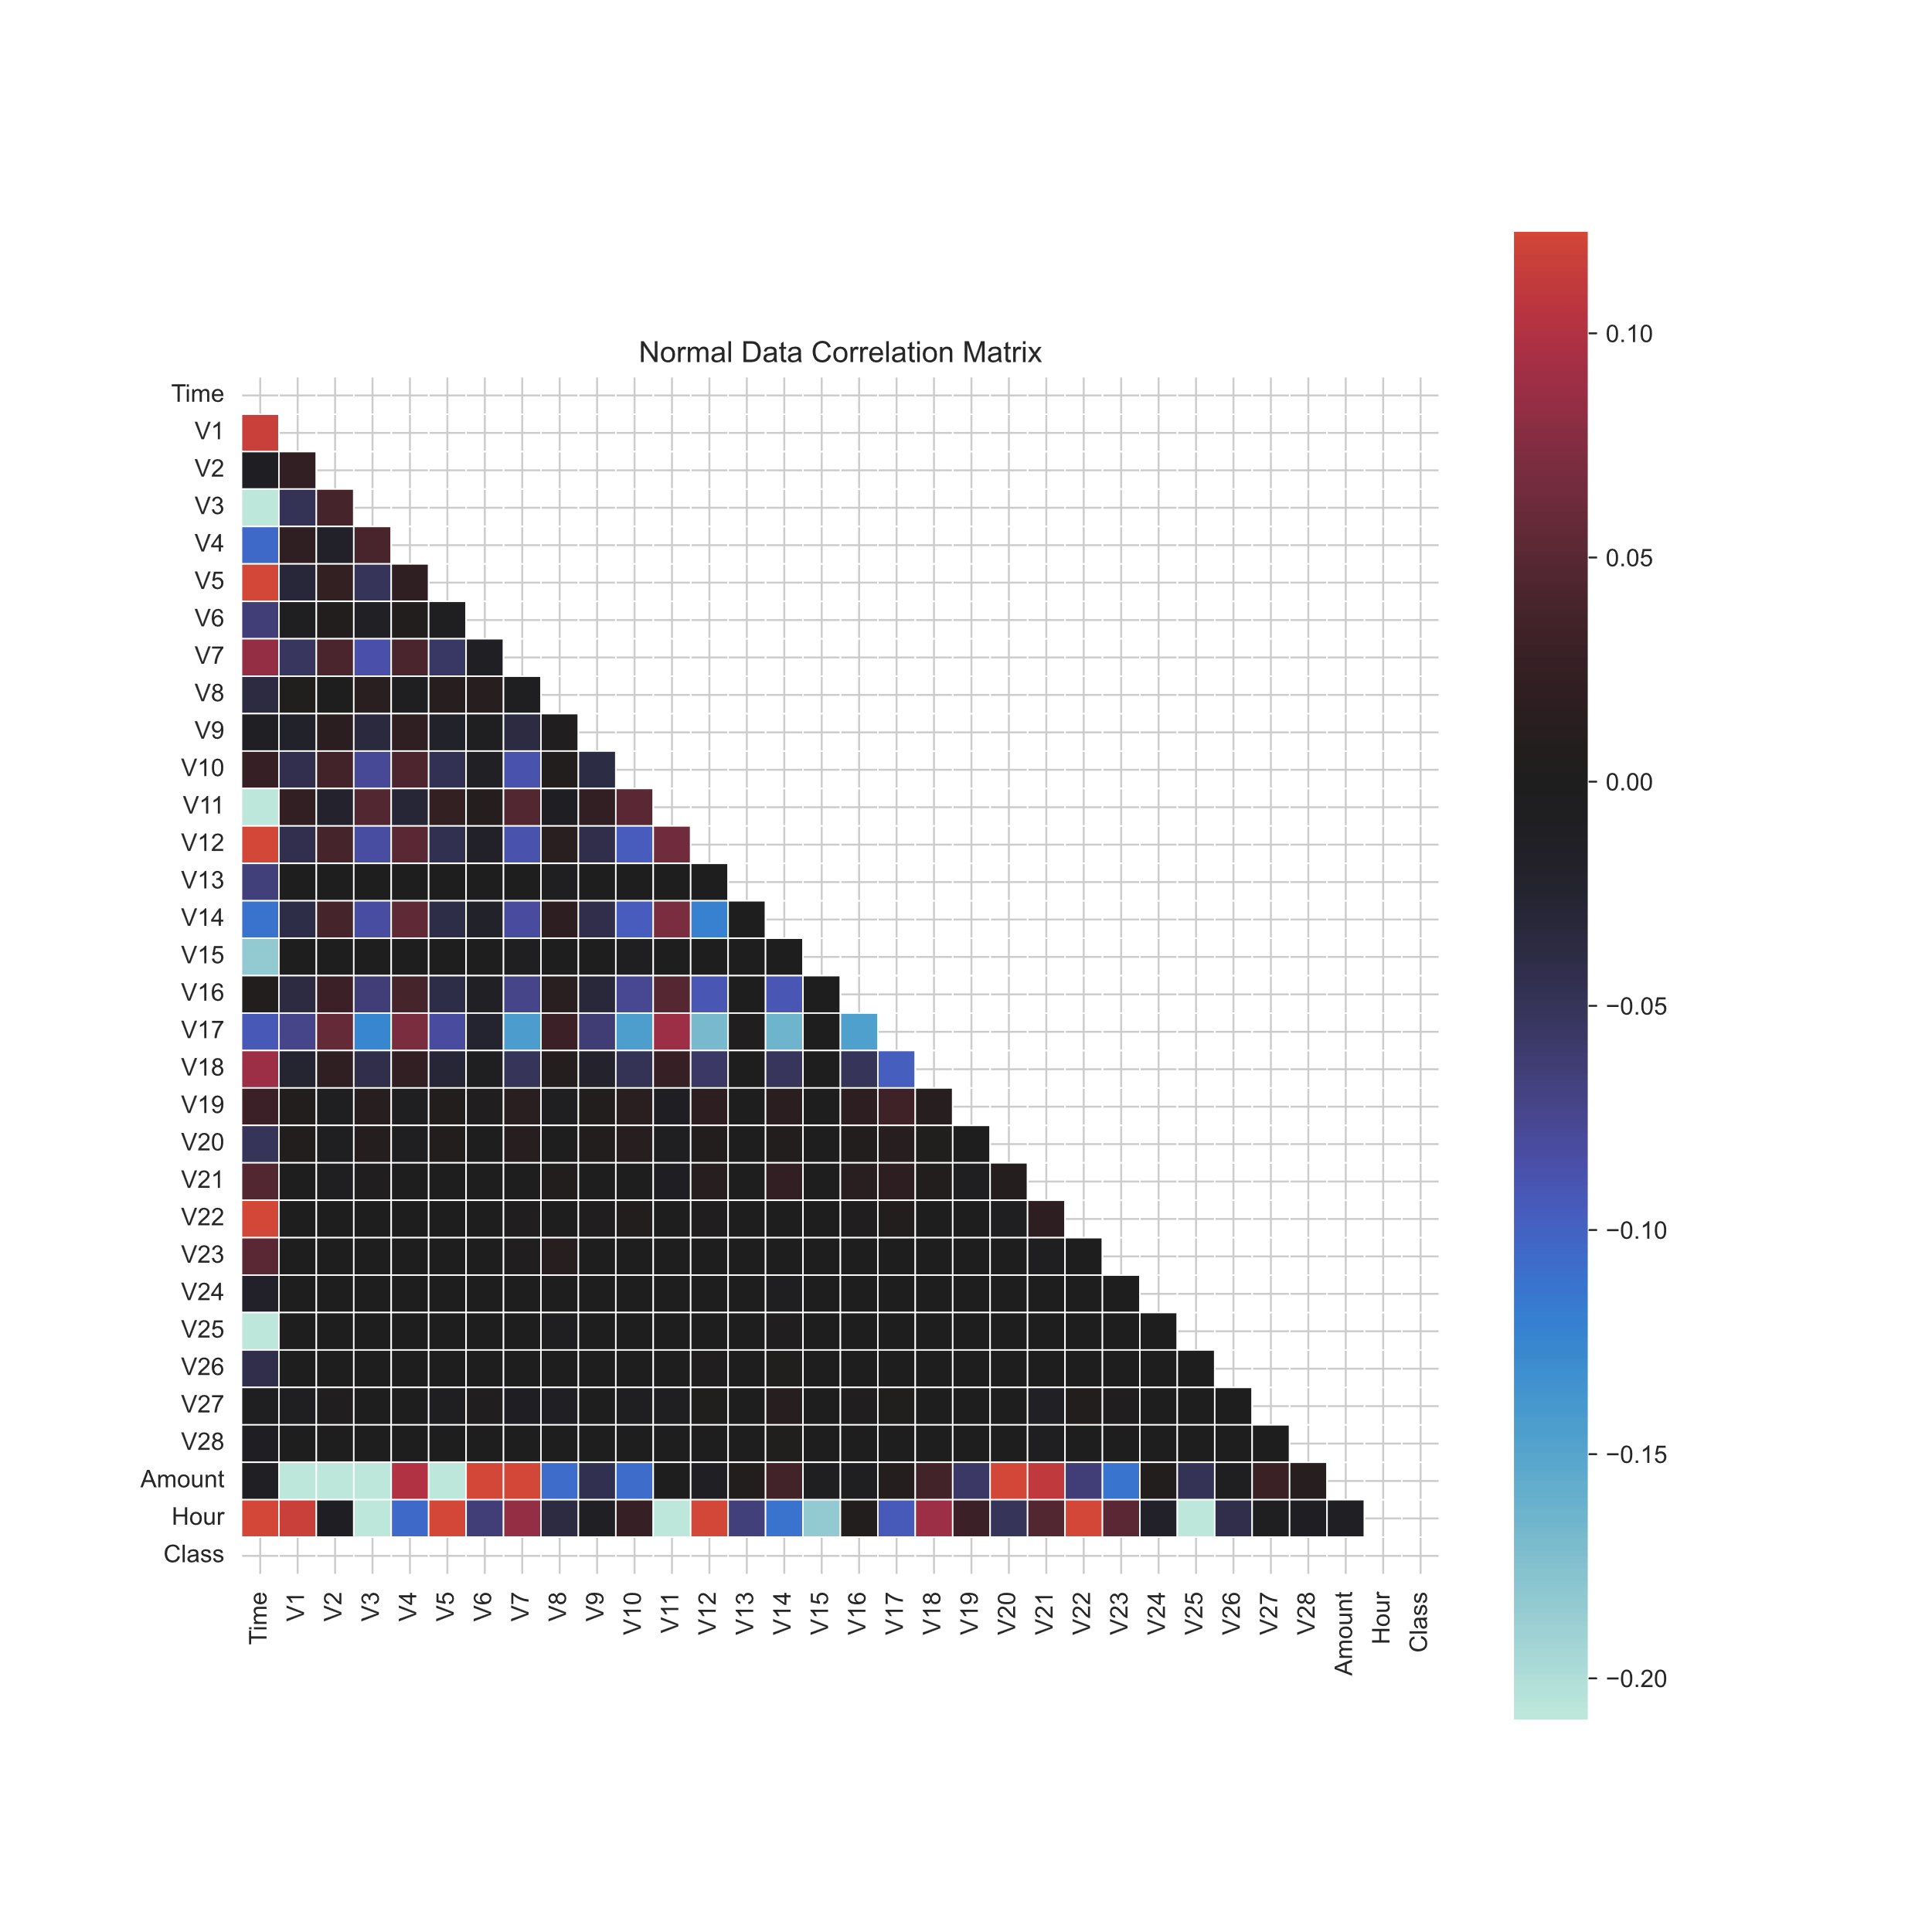
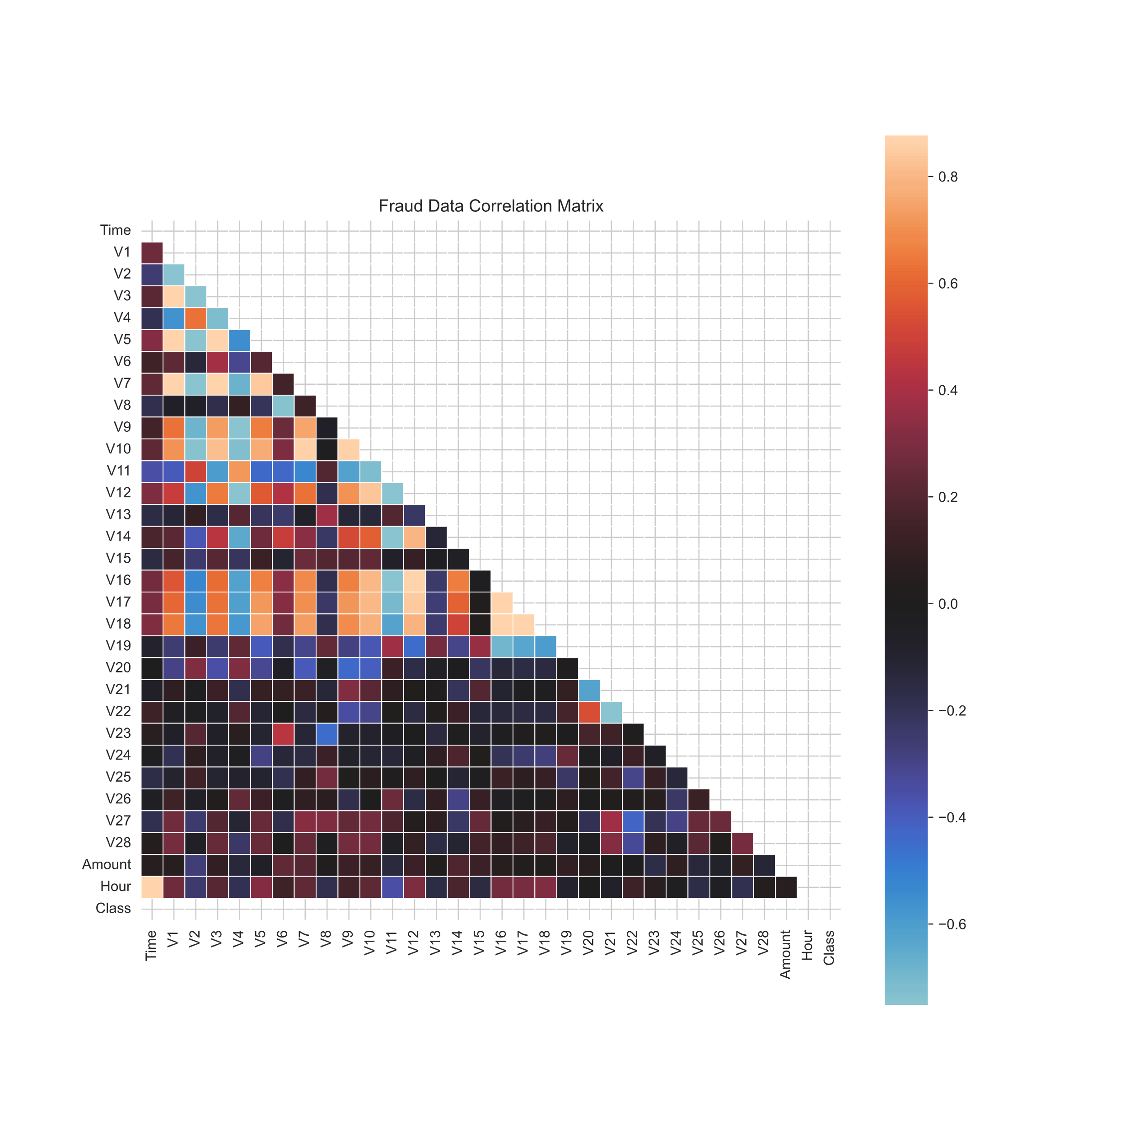
NORMAL VS FRAUD
Specifically, variables V1, V2, V3, V4, V5, V6, V7, V9, V10, V11, V12, V14, V16, V17, and V18, as well as V19, exhibit a certain regularity in the samples of fraudulent credit card transactions.

Slide 9
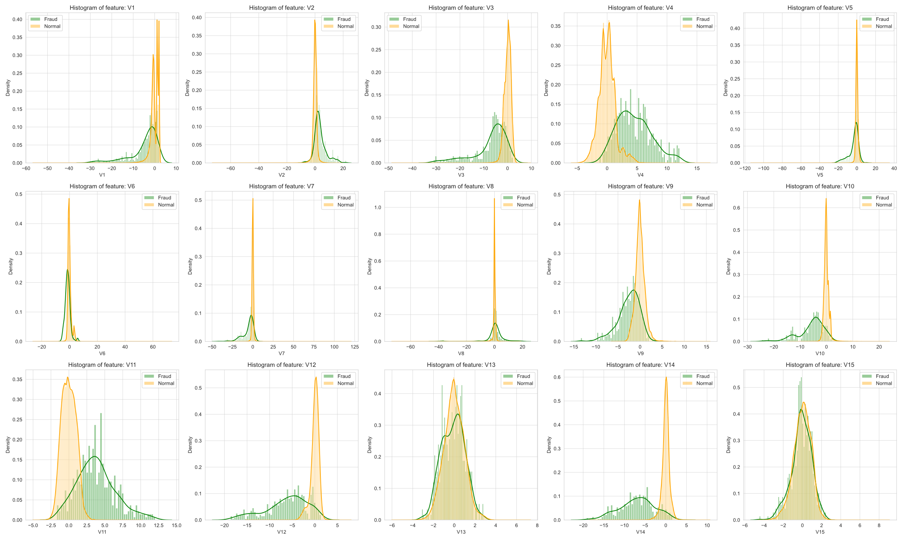
NORMAL VS FRAUD
We therefore exclude the variables V8, V13, V15, these features do not effectively distinguish between the fraud and normal categories.

Slide 10
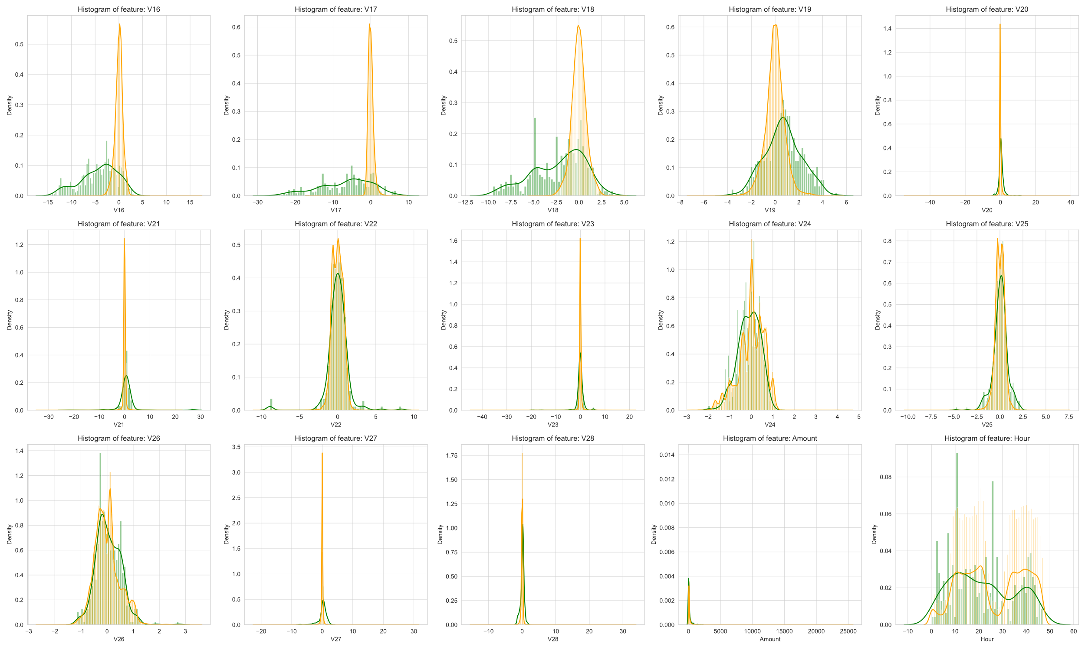
NORMAL VS FRAUD
We therefore exclude the variables V20, V21, V22, V23, V24, V25, V26, V27, and V28, these features do not effectively distinguish between the fraud and normal categories.

Slide 11
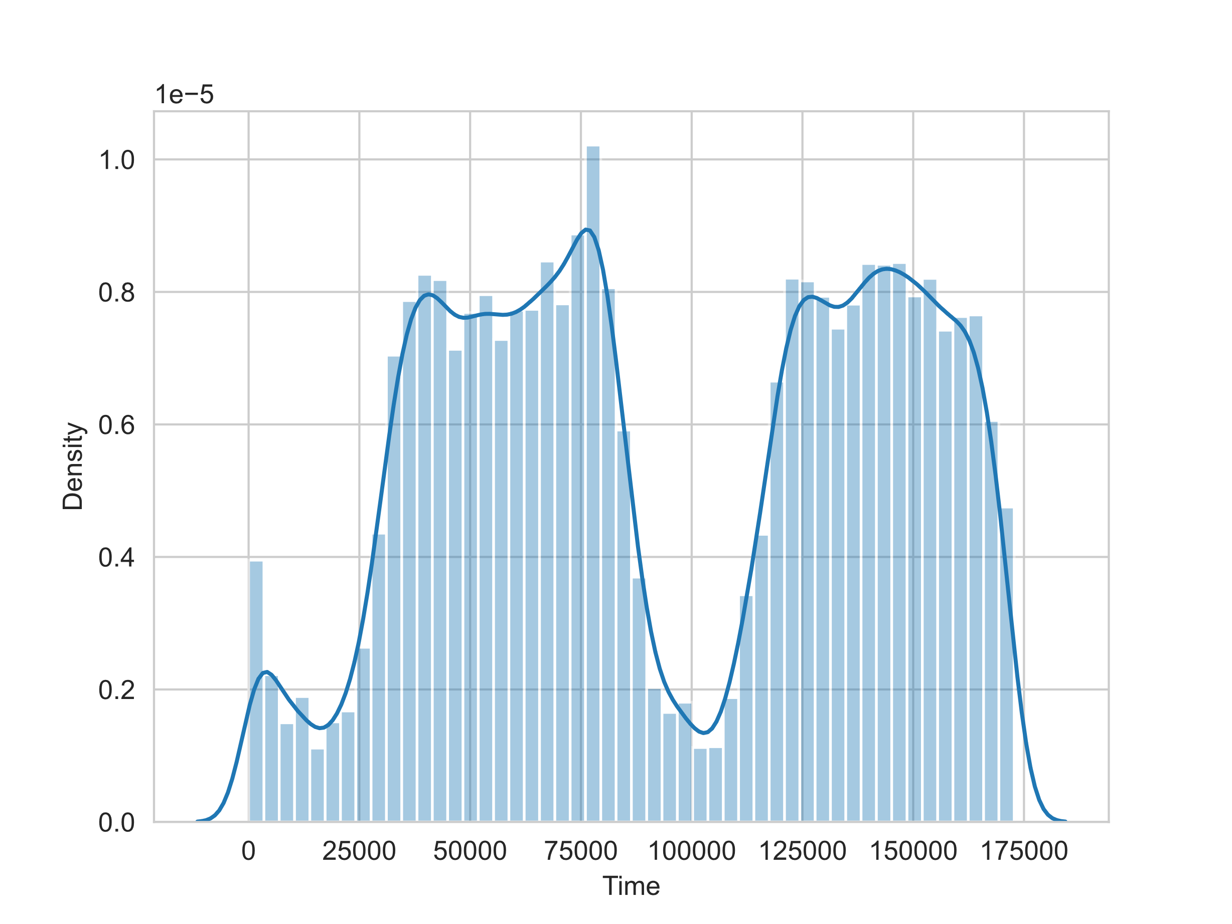
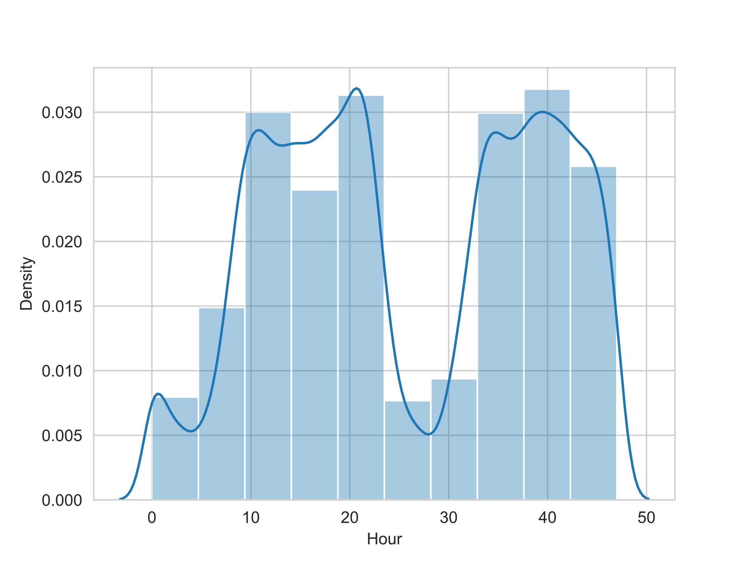
FEATURE ENGINEERING

Slide 12
Content
Background
Dataset Description
Exploratory Data Analysis
Model Building and Training
Conclusions

Slide 13
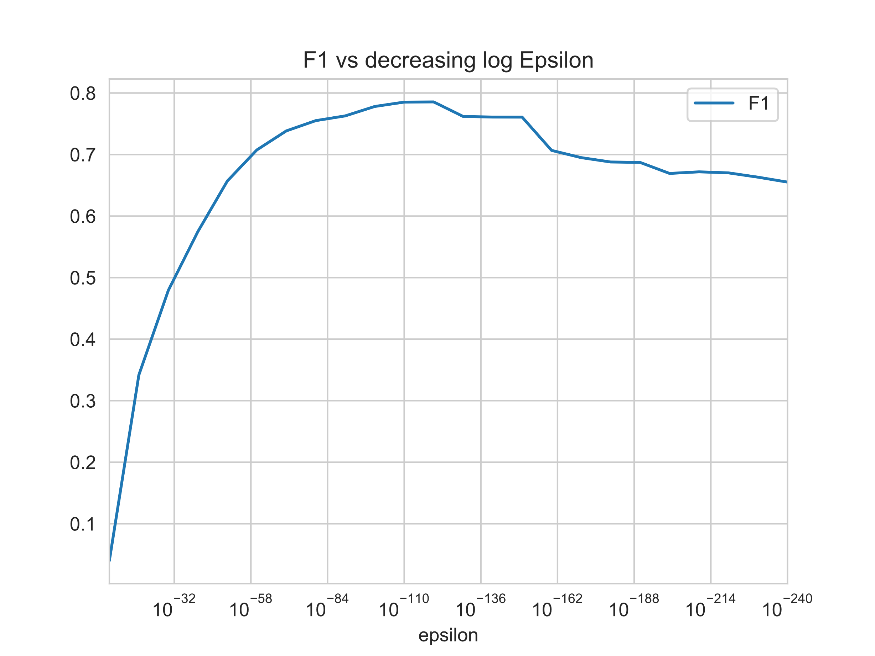
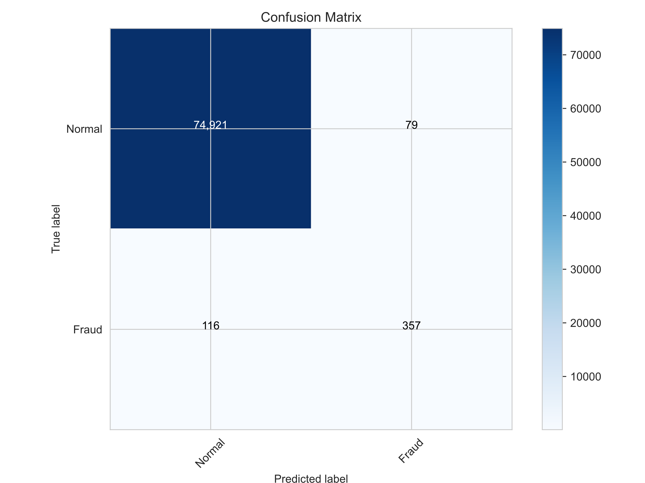
MULTI-VARIATE GAUSSIAN PROB DISTRIBUTION
In the training phase, a multivariate Gaussian distribution is fitted to the data distribution of normal transactions. During the testing phase, the probability of the data points is predicted using the obtained Gaussian distribution, and if the probability falls below a threshold, the data point is considered anomalous

Slide 14
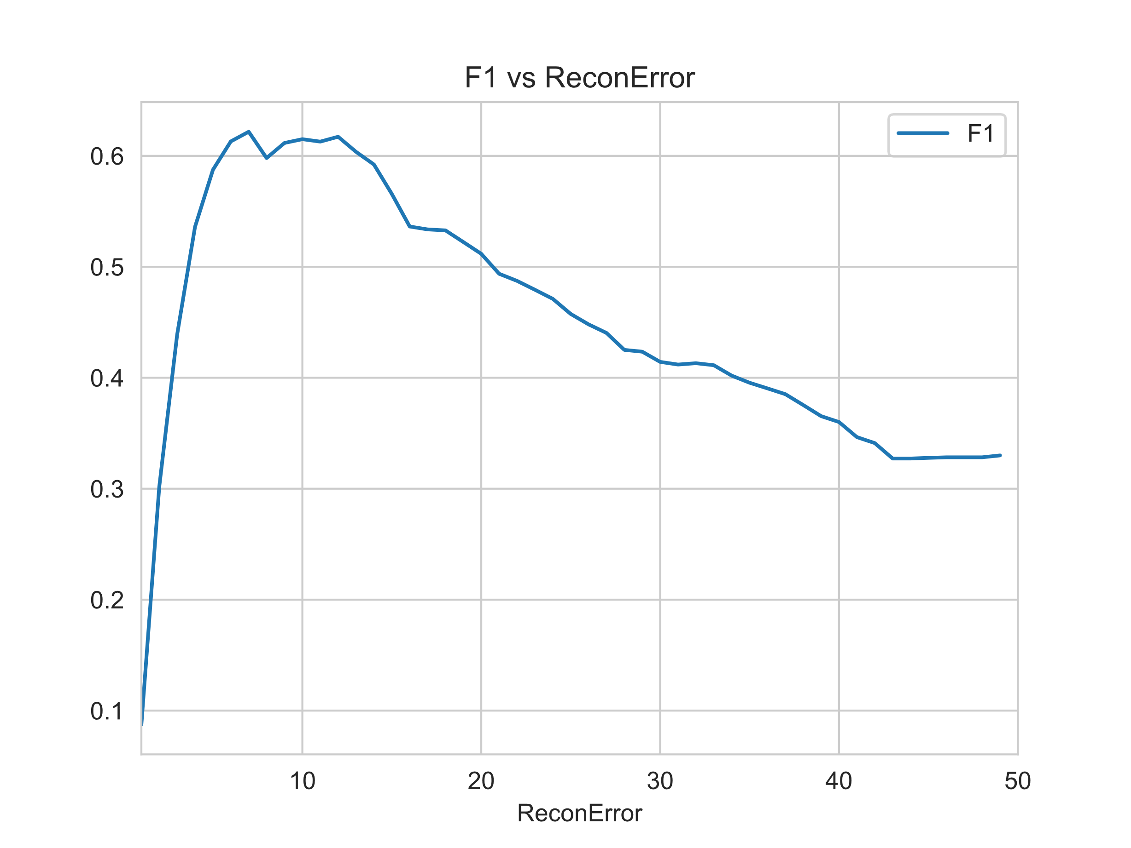
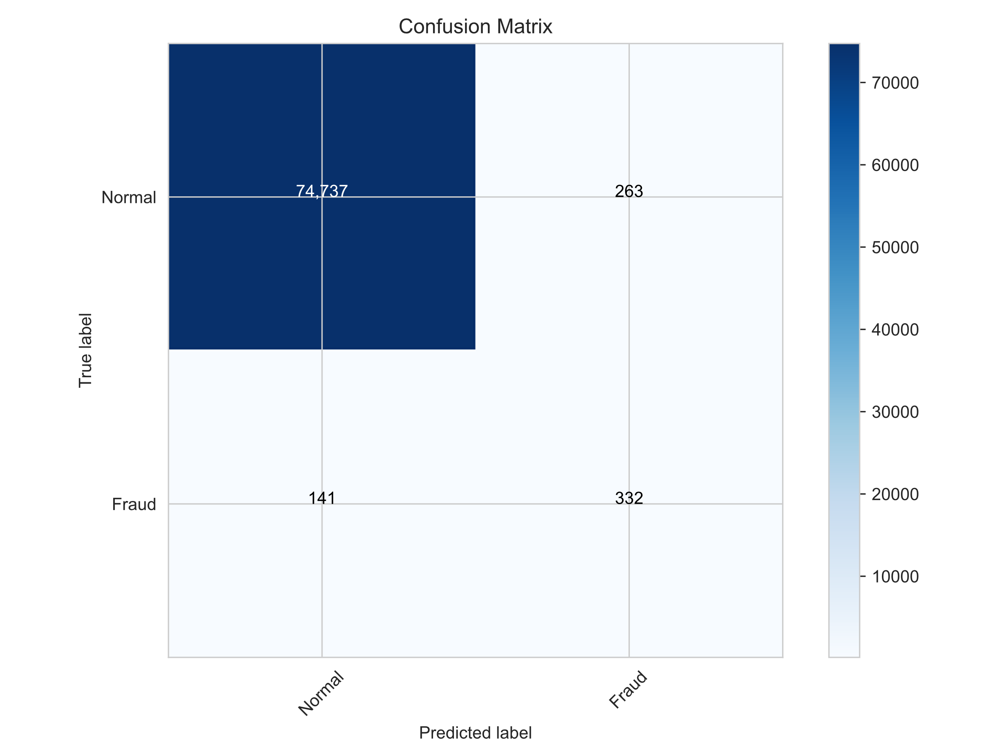
AUTOENCODER
In the training phase, a normal autoencoder is trained using only normal data to obtain the average reconstruction error for normal data. During the testing phase, if the reconstruction error for a data point exceeds a predefined threshold, the data point is considered anomalous

Slide 15
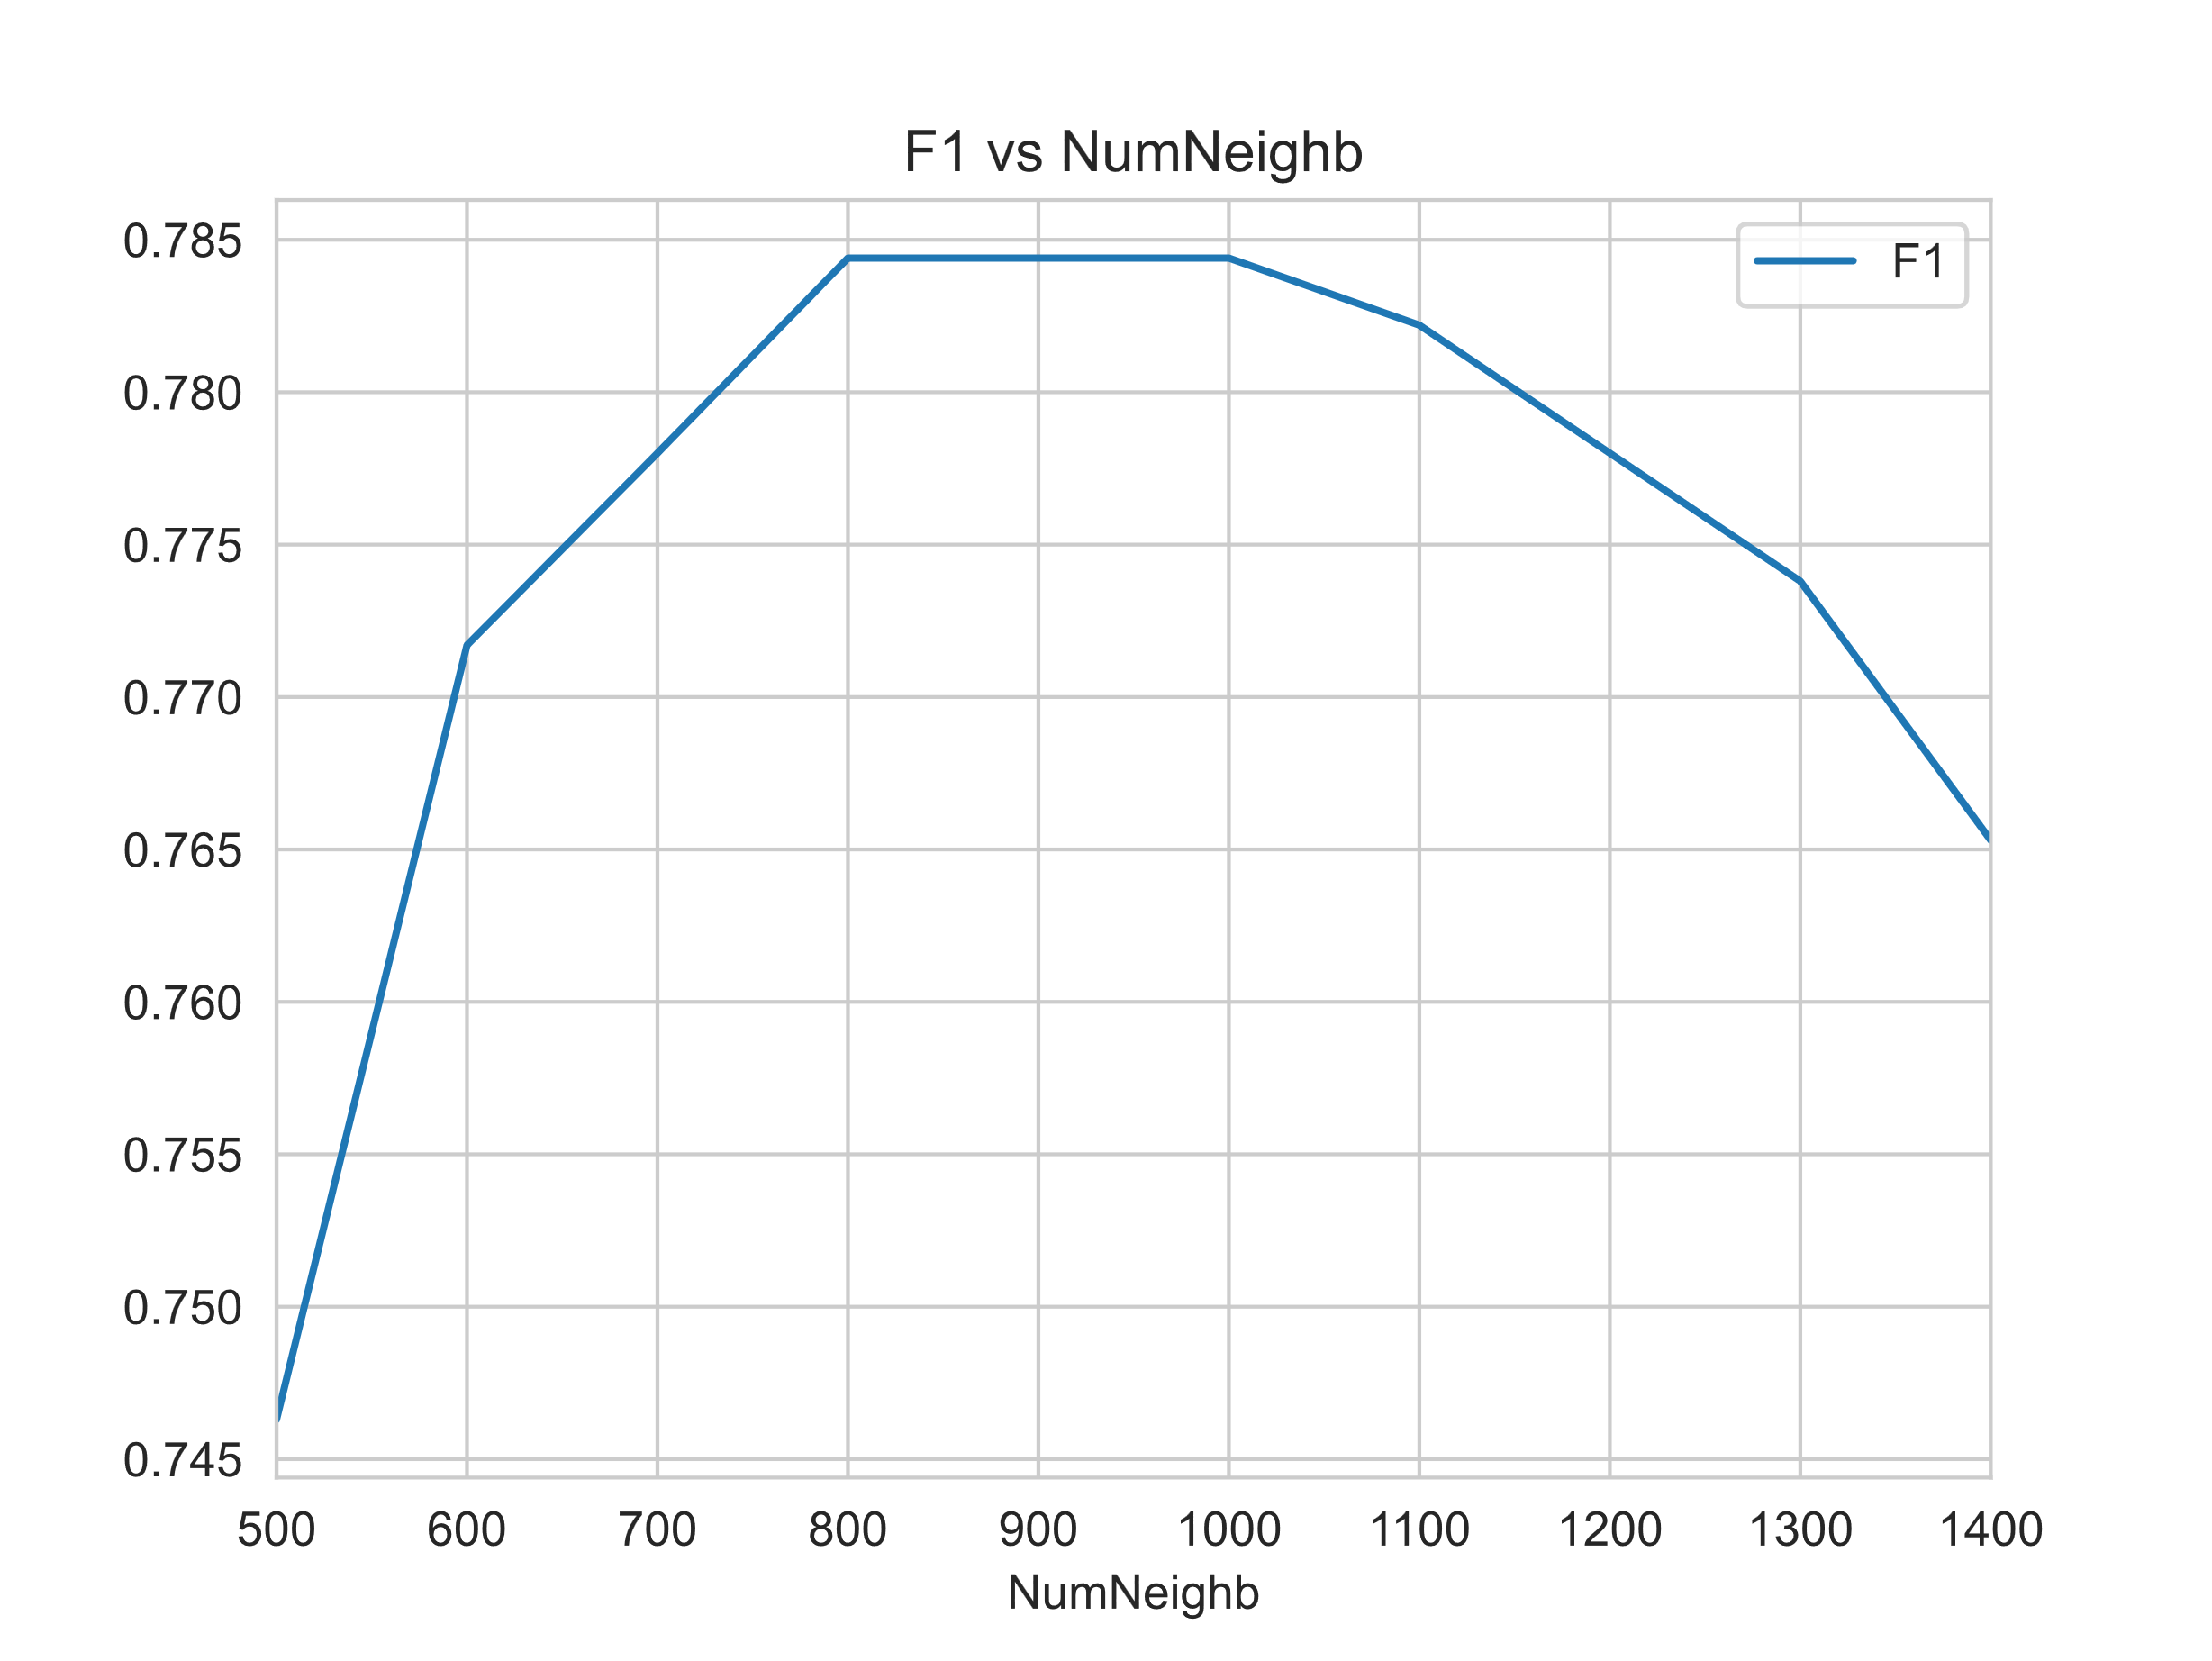

LOCAL OUTLIER FACTOR
In the training phase, we use the Local Outlier Factor (LOF) algorithm to compute the local outlier factor for each data point. In the testing phase, we determine whether a data point is an anomaly based on a predefined threshold. If the LOF value of a data point exceeds this threshold, it is considered an anomaly.

Slide 16
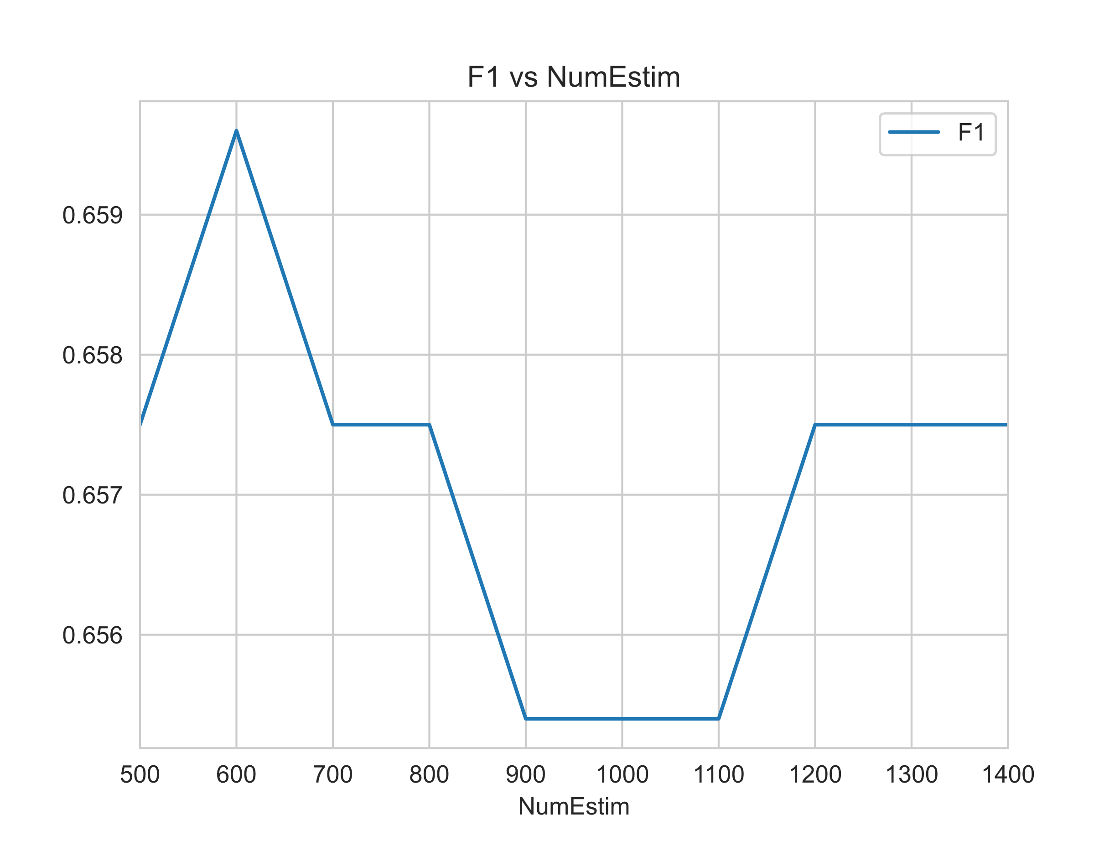

ISOLATION FOREST
In the training phase, the Isolation Forest builds multiple decision trees by randomly selecting features and subsets of those features. In the testing phase, for each new data point, we calculate its average path length across all the decision trees. If a data point has a shorter average path length, it is likely to be an anomaly.

Slide 17
Content
Background
Dataset Description
Exploratory Data Analysis
Model Building and Training
Conclusions

Slide 18
Conclusions
When it comes to model evaluation metrics, recall and precision serve different purposes depending on the application. For instance, in news text classification, we might prioritize high accuracy, meaning that the predicted categories for news articles should be highly accurate. However, in scenarios like credit card fraud detection, where the goal is to capture as many fraudulent transactions as possible (even at the cost of some false alarms), recall becomes the primary concern.
In binary classification, setting the threshold for predicting a sample's class is not fixed but rather depends on business objectives. Different thresholds will affect both recall and precision, so the choice depends on which metric is more important for the specific application. For credit card fraud, for instance, a higher recall is often preferred, meaning that we aim to flag potentially fraudulent transactions as much as possible.
Feature engineering plays a crucial role, especially with engineered features like V1 through V28, which can significantly impact model performance. Ultimately, the quality and relevance of the data are paramount for building effective models..

